Slide 1
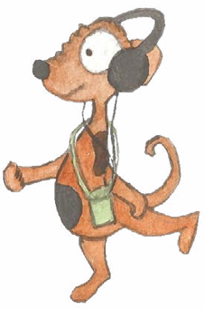

Tenses
1. Past and present (simple) 2. Progressive form of verbs: present and past 3. Perfect form of verbs

Slide 2
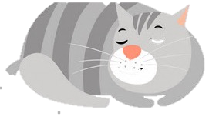
Verbs
Verbs indicate that someone or something is
doing, feeling or being.
verbs
verbs
Basanti loves her cat.
Basanti’s cat sleeps all day long.
I sympathise.
I absolutely adore my budgie.
Usually verbs have the name of a person or thing or a pronoun in front of them.
Can you spot these?

Slide 3
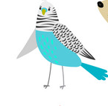
Verbs have a tense.
They can tell us when the action happened.
Basanti’s cat caught a mouse.
In the past
or in the present.
My budgie sings all day long.
Write a sentence in the present tense.
Example
Now rewrite it in the past tense.
I play football every Saturday.
I played football every Saturday.

Slide 4
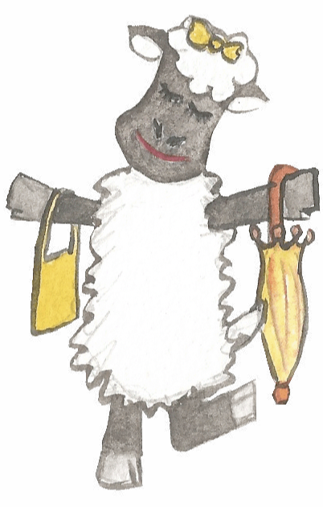
Verbs have a tense.
They can tell us when the action happened.
Past tense | Present tense
The sheep walked.
The sheep walks.
She carried a bag.
She carries a bag.
I ate an ice-cream.
I eat an ice-cream.
You did not have to smile.
You do not have to smile.

Slide 5
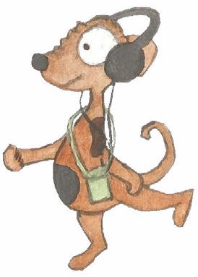
For regular verbs we add ed to show that an action is
in the past and complete.
walked
jumped
scored
danced
skated
listened
balanced
Irregular verbs take different forms when showing past tense; we learn them through hearing them used.
ran
won
did
threw

Slide 6
ANSWERS
Past tense
Simple past | Simple present
It rains and rains.
Basanti carries the cat.
We do not want to go.
We are lost!
Change these verbs into simple past tense.

Slide 7
ANSWERS
Past tense
Simple past | Simple present
It rained and rained.
It rains and rains.
Basanti carried the cat.
Basanti carries the cat.
We did not want to go.
We do not want to go.
We were lost!
We are lost!
Change these verbs into simple past tense.

Slide 8
ANSWERS
Present tense
Simple past | Simple present
My budgie squawked.
Basanti grabbed her cat.
We found the cage.
I was relieved.
Turn these verbs into simple present tense.

Slide 9
ANSWERS
Present tense
Simple past | Simple present
My budgie squawked.
My budgie squawks.
Basanti grabbed her cat.
Basanti grabs her cat.
We found the cage.
We find the cage.
I was relieved.
I am relieved.
Turn these verbs into simple present tense.

