Slide 1

Compare numbers with 1 decimal place.
0
1
2
3
4
5
6
7
8
9
10
1.2
2.1
Which is more, 1.2 or 2.1? What whole number lies between?
We can place both numbers on the number line to check.
2.1 > 1.2
The whole number between them is 2.

Slide 2
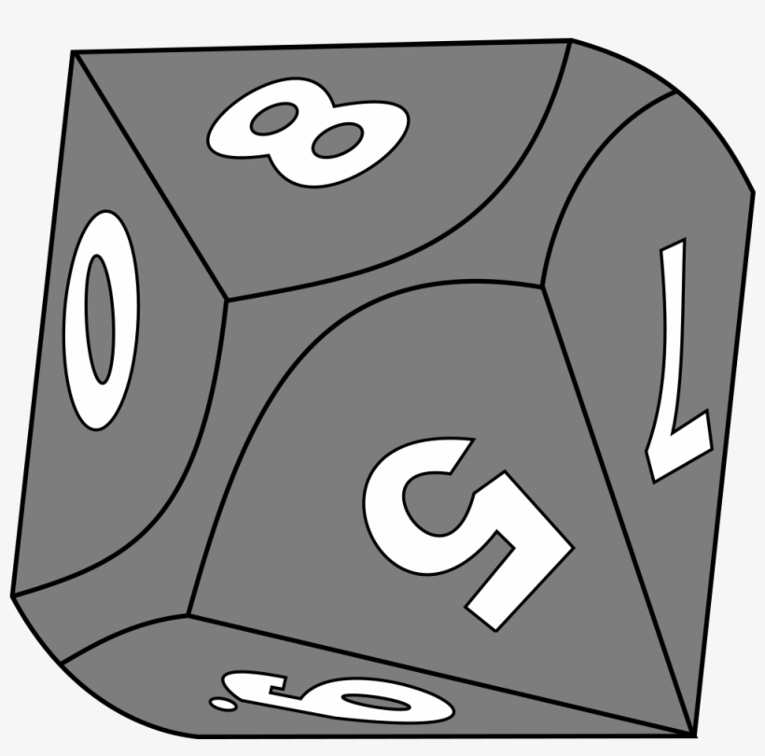
Compare numbers with 1 decimal place.
0
1
2
3
4
5
6
7
8
9
10
6.5
8.2
Let’s play
Higher or Lower.
□.□ > □.□
8.□ > □.□
8.□ > 6.□
8.□ > 6.5
8.2 > 6.5
Imagine rolling a 0-9 dice four times, writing each digit into this grid.
Once it’s placed you can’t move it!
First roll is an 8.
Second a 6.
Next a 5.
Lastly a 2.
Is our number sentence 8.2 > 6.5 correct?
We can check on the number line.

