Slide 1



Understand, measure and calculate perimeters.
Choose a book. If you were to measure the distance around the sides of this book, how long do you think that distance would be?
The Magic Frog
By A.A.Jumper
We call the distance around the sides of a 2-D shape its perimeter.
Let’s look at how we can measure perimeter...

Slide 2
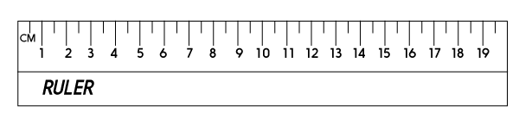
Understand, measure and calculate perimeters.
The most accurate way to measure each side is with a ruler.
Top = 12cm
The Magic Frog
Left = 10cm
Right = 10cm
By A.A.Jumper
12cm + 10cm + 12cm + 10cm = ?
44cm
Bottom = 12cm
Add the 4 lengths to find the perimeter…

Slide 3

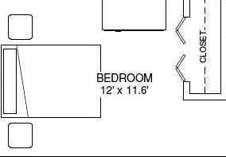
Understand, measure and calculate perimeters.
If you were to find the perimeter of your bedroom, what do you think that might be?
Would you use millimetres, centimetres or metres?

