Slide 1

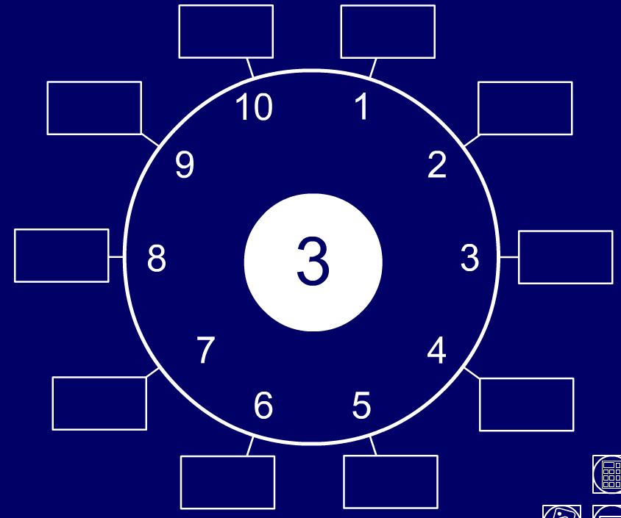
Use tables facts and place value to multiply multiples of 10 and 100 by 1-digit numbers.
300
30
Let’s count around the number dial in 3s…
30
3
270
60
27
6
Now let’s try 30s…
30
3
240
90
24
9
What was the same? What was different?
210
120
21
12
180
150
18
15
How many times bigger are the 30s?

Slide 2
Use tables facts and place value to multiply multiples of 10 and 100 by 1-digit numbers.
600
60
Let’s count around the number dial in 6s…
60
6
540
120
54
12
Now let’s try 60s…
60
6
480
180
48
18
How many times bigger are the 60s?
420
240
42
24
If you know the
6 times table, you can use place value to create the 60s!
360
300
36
30

Slide 3
Use tables facts and place value to multiply multiples of 10 and 100 by 1-digit numbers.
800
80
Let’s count around the number dial in 8s…
80
8
720
160
72
16
Now let’s try 80s…
8
640
80
240
64
24
How many times bigger are the 80s?
560
320
56
32
480
400
If you know the
8 times table, you can use place value to create the 80s!
48
40

Slide 4
Use tables facts and place value to multiply multiples of 10 and 100 by 1-digit numbers.
0
900
1800
2700
3600
4500
5400
6300
7200
8100
9000
9900
10,800
90
180
270
360
450
540
630
720
810
900
990
1080
9
18
27
36
45
54
63
72
81
90
99
108
Let’s count in 9s on the counting stick.
Now let’s try it in 90s.
Now let’s try it in 900s!
If you know the 9 times table you can use place value to find the 90s and 900s.

Slide 5
Use tables facts and place value to multiply multiples of 10 and 100 by 1-digit numbers.
We can see this happening on a place value grid…
2 × 9 = 18...
1000s | 100s | 10s | 1s
1
1
8
1
8
0
8
0
0
2 × 90 = 180
2 x 9 x 10
2 × 900 = 1800
2 x 9 x 100
When we multiply by 10 or 100, the digits move to the left and we use 0s to hold the ‘empty’ place.

