Slide 1

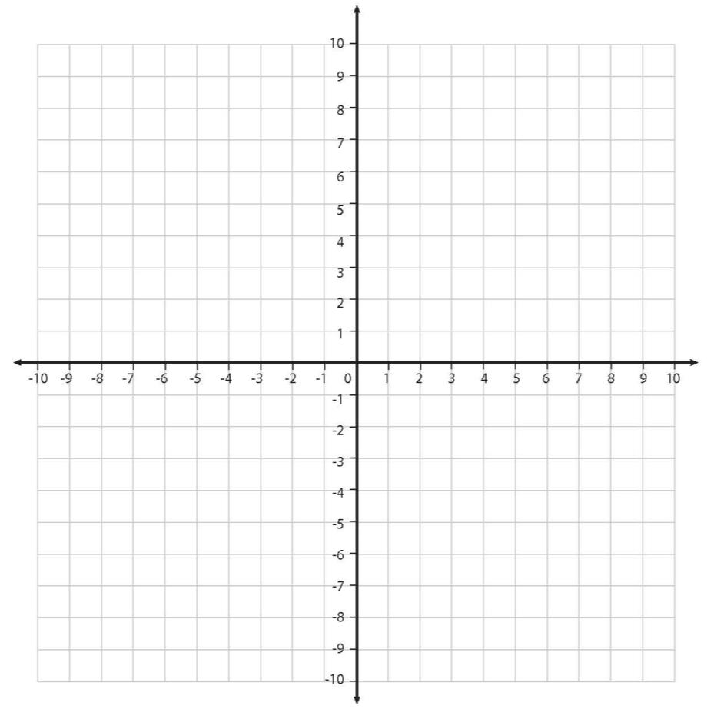



Describe new co-ordinates after a reflection.
y
Sketch this parallelogram and write the co-ordinates of its vertices.
(-9,6)
(-3,6)
(3,6)
(9,6)
The new shape must be the same distance away from the y-axis as the first one, but ‘flipped’ over.
(-7,2)
(-1,2)
(1,2)
(7,2)
x
If we reflect this parallelogram across the y-axis, where will the new shape be?
Sketch it…
What are the co-ordinates of the new shape?

Slide 2

Describe new co-ordinates after a reflection.
y
Now reflect this new shape in the x-axis.
(-9,6)
(-3,6)
(3,6)
(9,6)
original shape
What do you notice about the shape itself compared with the original one?
What about its position?
Is this different from a translation?
(-7,2)
(-1,2)
(1,2)
(7,2)
x
(-7,-2)
(-1,-2)
What are the co-ordinates of the new shape?
(-9,-6)
(-3,-6)

Slide 3
Describe new co-ordinates after a reflection.
y
IT’S BACK WHERE IT STARTED!
(-9,6)
(-3,6)
(3,6)
(9,6)
original shape
(-7,2)
(-1,2)
(1,2)
(7,2)
x
Now reflect the new shape in the y-axis; again record the new co-ordinates.
(-7,-2)
(-1,-2)
(1,-2)
(7,-2)
(-9,-6)
(-3,-6)
(3,-6)
(9,-6)
What would happen if it was now reflected again in the x-axis?

