Slide 1
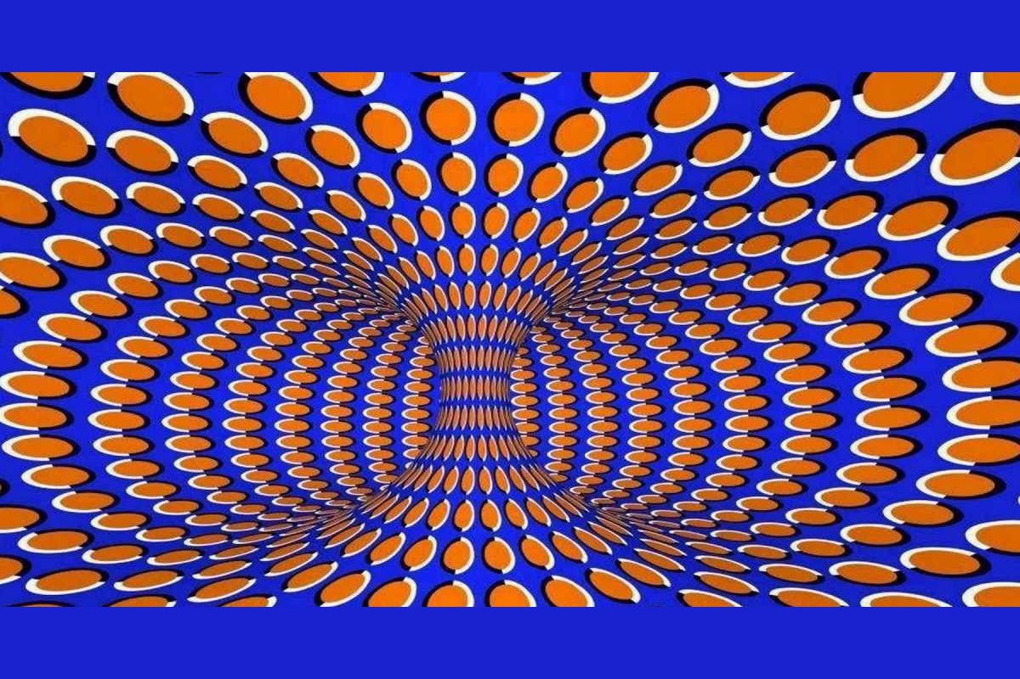
Dream Machine
British Science Week 2022
Notes:
Imagine isn’t moving but your brain tricks you into thinking it is.

Slide 2
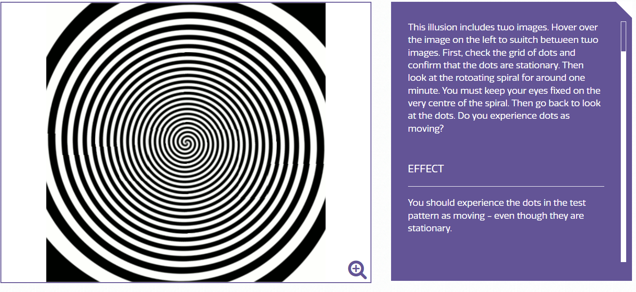
Waterfall Illusion - The Illusions Index
Notes:
Waterfall Illusion - The Illusions Index
Ask the chn to follow instructions for the illustion. Can they guess what we are learning about? Do they know what an illusion is? Do they have any idea about how an illusion works?

Slide 3
What is an illusion?
Something that is false or unreal but seems to be true or real.

Slide 4
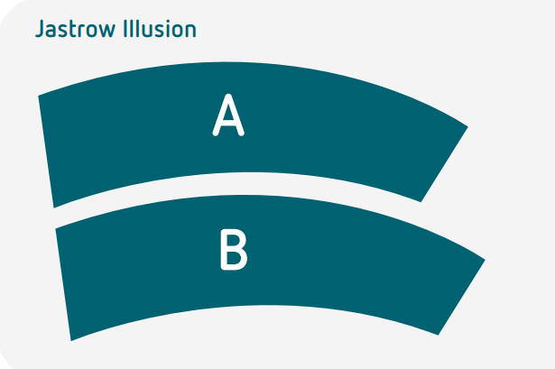
The Jastrow Illusion
Which shape is longer, A or B?
Notes:
Ask the children how they know? How could we test it to see? Hopefully some children will think about perhaps measuring – prompt children towards cutting the shapes out and seeing if they are the same size when placed on top of each other.

Slide 5
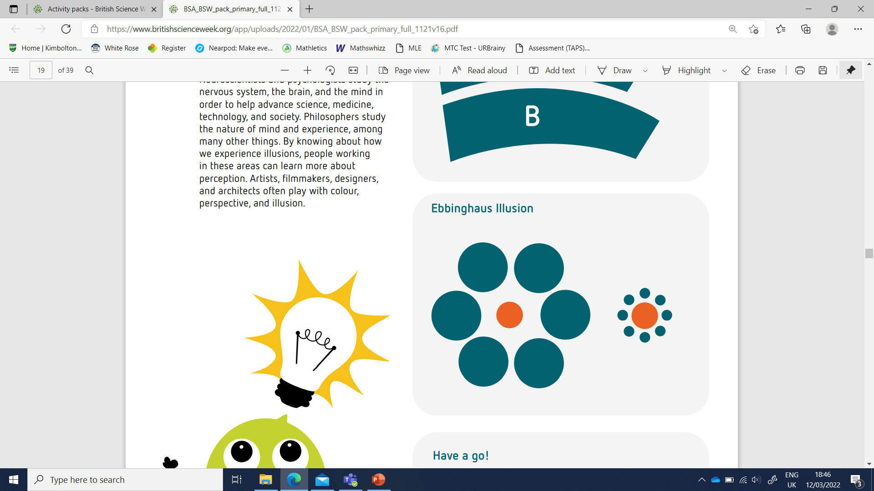
The Ebbinghaus Illusion
Which orange circle is bigger?
Notes:
Ask the children how they know? How could we test it to see? Hopefully some children will think about perhaps measuring – prompt children towards cutting the shapes out and seeing if they are the same size when placed on top of each other again.

Slide 6
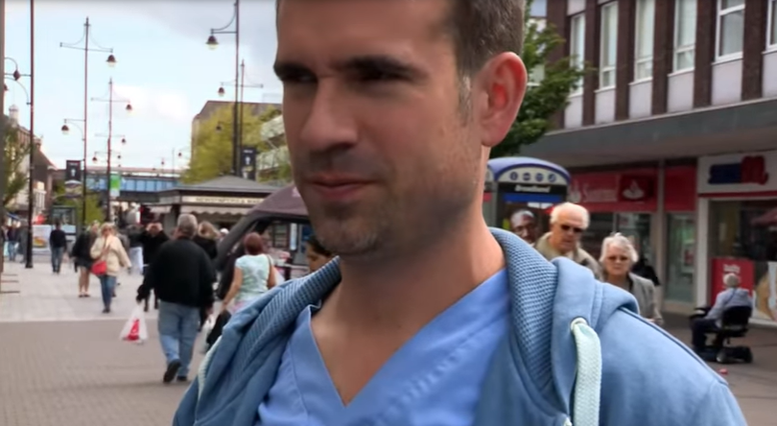
https://youtu.be/v_-hUqlIt18
Notes:
The Ebbinghaus Illusion from Operation Ouch

Slide 7

Did they trick you?
Your brain is very busy trying to understand all the information from your senses, so to cope, it makes some assumptions (guesses) based on your memory and experience.
Usually, these assumptions allow us to see the world more-or-less as it is, but sometimes they lead to illusions.

Slide 8
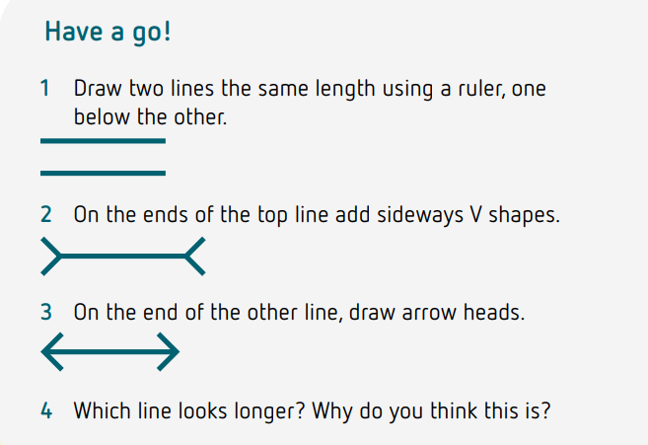
Let’s Make Our Own Muller-Lyer Illusion!

Slide 9
Make your own Ebbinghaus Illusion!
Find three round objects e.g. different sized coins, rubbers, counters etc.
Use the same coin as your middle circle.
Then, surround one with the smaller circle objects.
Surround the other with the bigger circle objects.
Colour your middle circles the same colour.
Colour your outer circles a different colour.

Slide 10

Discussion questions:
Why do you think our brains make guesses about what we see?
Do you think everyone sees the world the same way you do?
How do you think this might relate to other ways you come across the world?

Slide 11

What jobs link to illusions?
Neuroscientists and psychologists study the brain and the mind to help advance science, medicine, technology, and society.
Philosophers study the nature of mind and experience, among many other things. By knowing about how we experience illusions, people working in these areas can learn more about perception.
Artists, filmmakers, designers, and architects often play with colour, perspective, and illusion.
Notes:
illusionsindex.org – more illusions if you want to.

