Slide 1

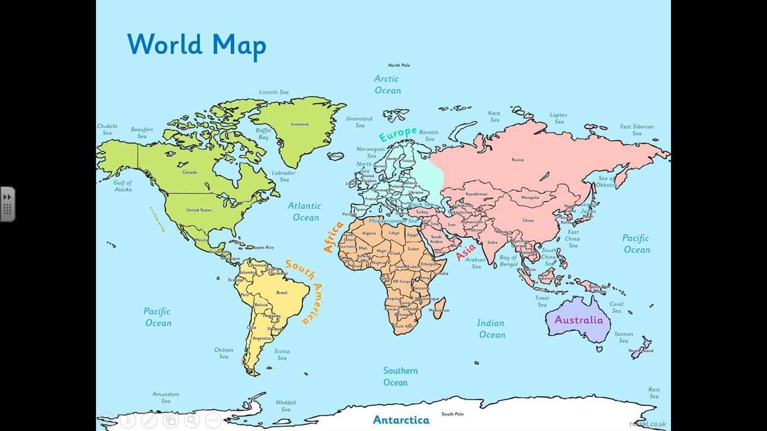
L.O: To identify the location of hot and cold countries.
Miss Bleakley’s comments

Slide 2
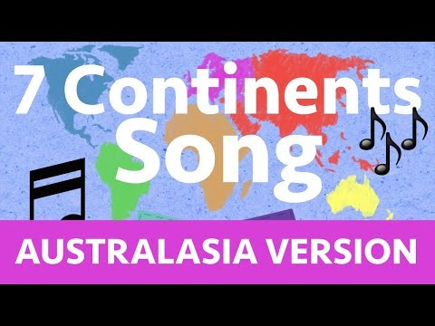
Miss Bleakley’s comments
Starter:
What is a continent? Can you name any continents? There are 7!
https://www.youtube.com/watch?v=35V2dm7JIwE

Slide 3
Miss Bleakley’s comments
Equator
The equator is an imaginary line that splits the earth into northern/southern hemisphere.
Notes:
Can you point to the continents? Can you find the oceans?

Slide 4
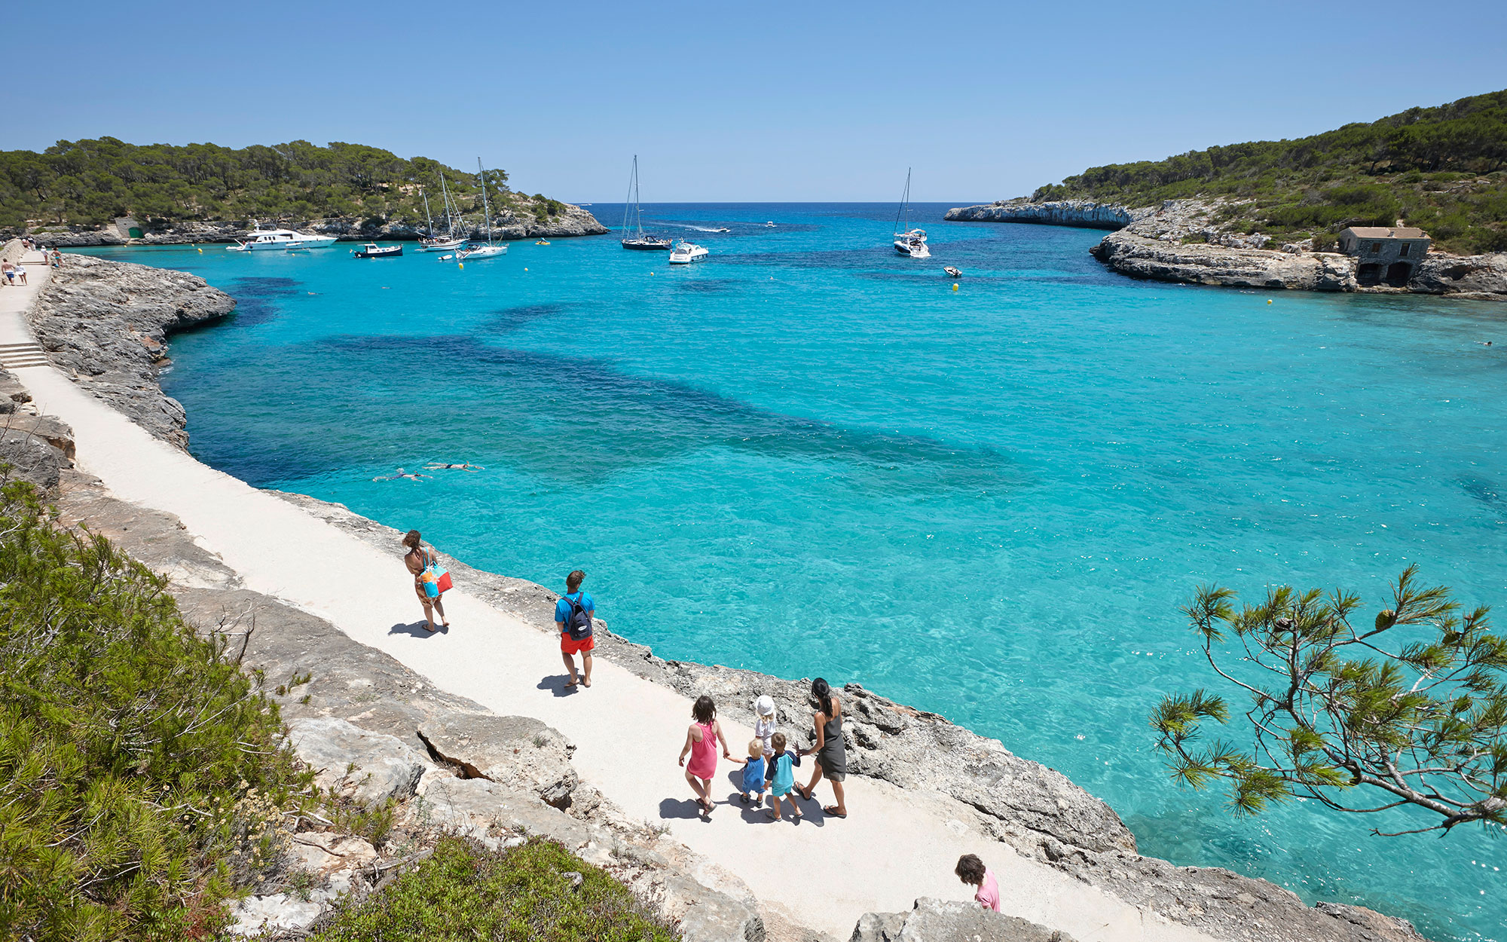
Do you think this is a hot or cold country?
Spain

Slide 5
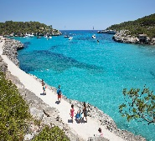
Miss Bleakley’s comments
Spain
Equator
Notes:
Can you point to the continents? Can you find the oceans?

Slide 6
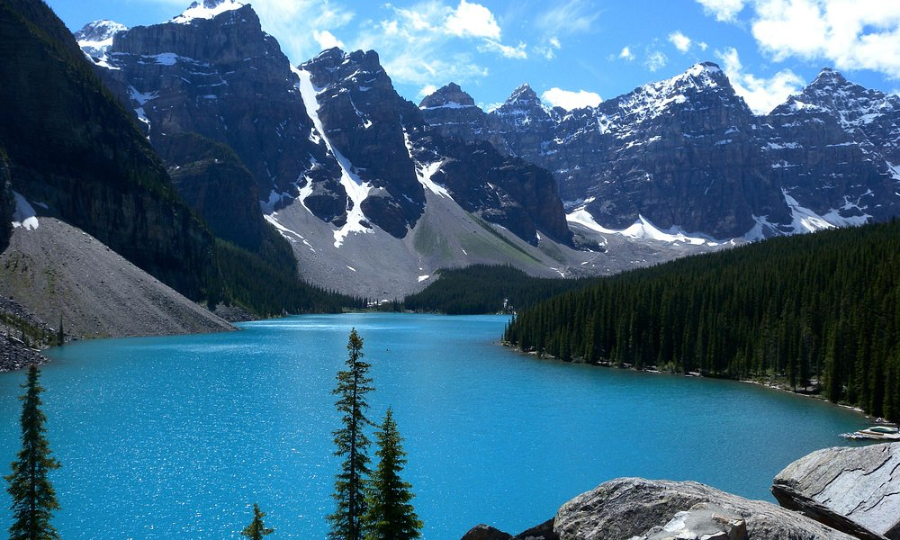
Do you think this is a hot or cold country?
Canada

Slide 7


Equator
Notes:
Can you point to the continents? Can you find the oceans?

Slide 8
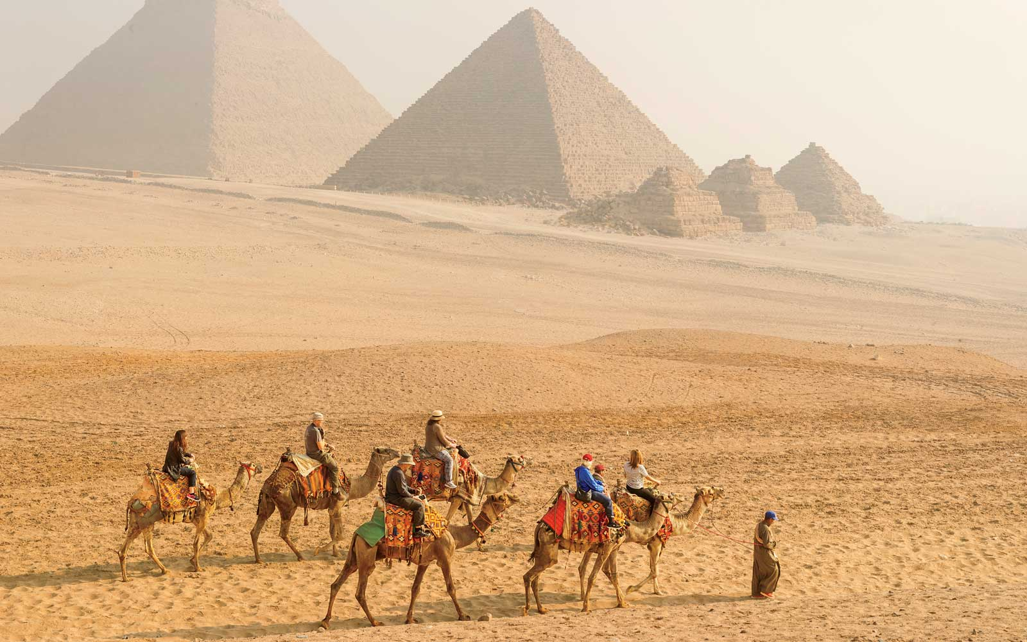
Do you think this is a hot or cold country?
Egypt

Slide 9
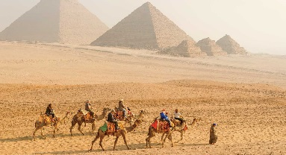
Miss Bleakley’s comments
Equator
Notes:
Can you point to the continents? Can you find the oceans?

Slide 10
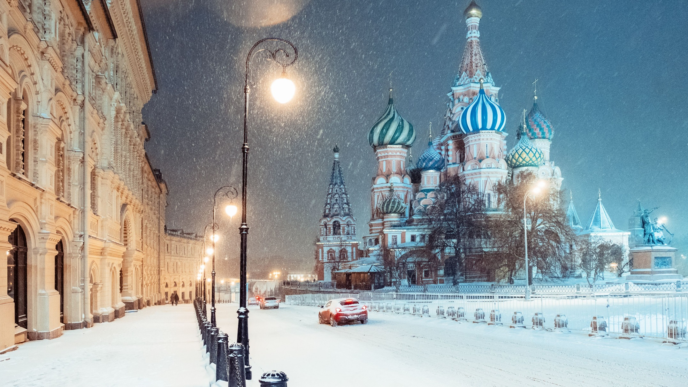
Do you think this is a hot or cold country?
Russia

Slide 11
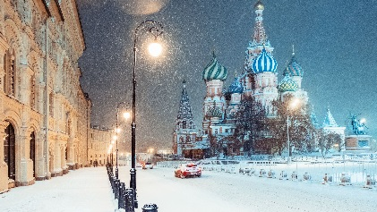
Miss Bleakley’s comments
Equator
Notes:
Can you point to the continents? Can you find the oceans?

Slide 12
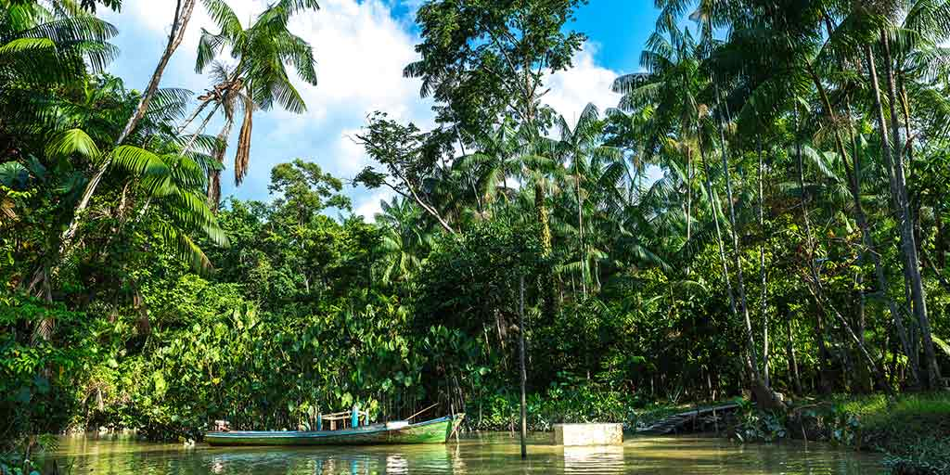
Do you think this is a hot or cold country?
Brazil

Slide 13
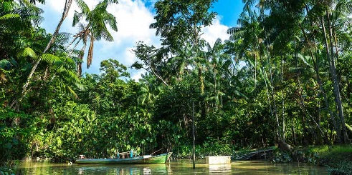
Miss Bleakley’s comments
Equator
What do you notice about the countries weather near the equator?
Notes:
What do you notice about the countries weather near the equator?

Slide 14
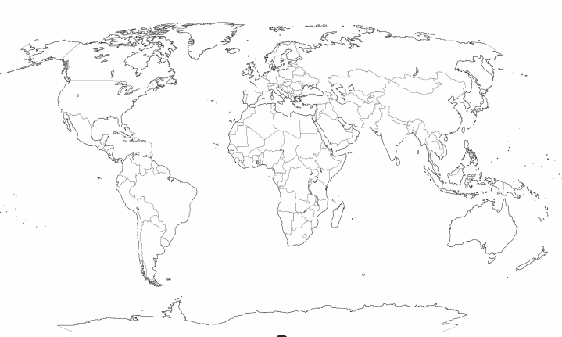
Task:
Asia
Africa
North America
South America
Antarctica
Europe
Australia
Something easier: label the continents on the map and draw the equator.
Task: Draw the equator on the map, label the continents and label and colour a hot and cold country.
Something harder: Draw the equator on the map, label the continents and label/ colour a hot and cold country. Then choose a hot and a cold country to compare. Are there any similarities and differences?

Slide 15
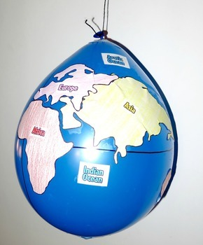
Optional Extra Task:
Using the balloons you are going to make your own globe.
1) Cut out the continents and stick on the balloon using glue.
2) Using the tape put an equator around your globe- make sure it is in the right place.
3) Find a hot and cold country on your globe and label it.
QUESTION????
What climate do the countries near the equator have? Hot or cold?

