Slide 1
Talk to the person next to you-
When you are feeling poorly who are the people who help us?

Slide 2
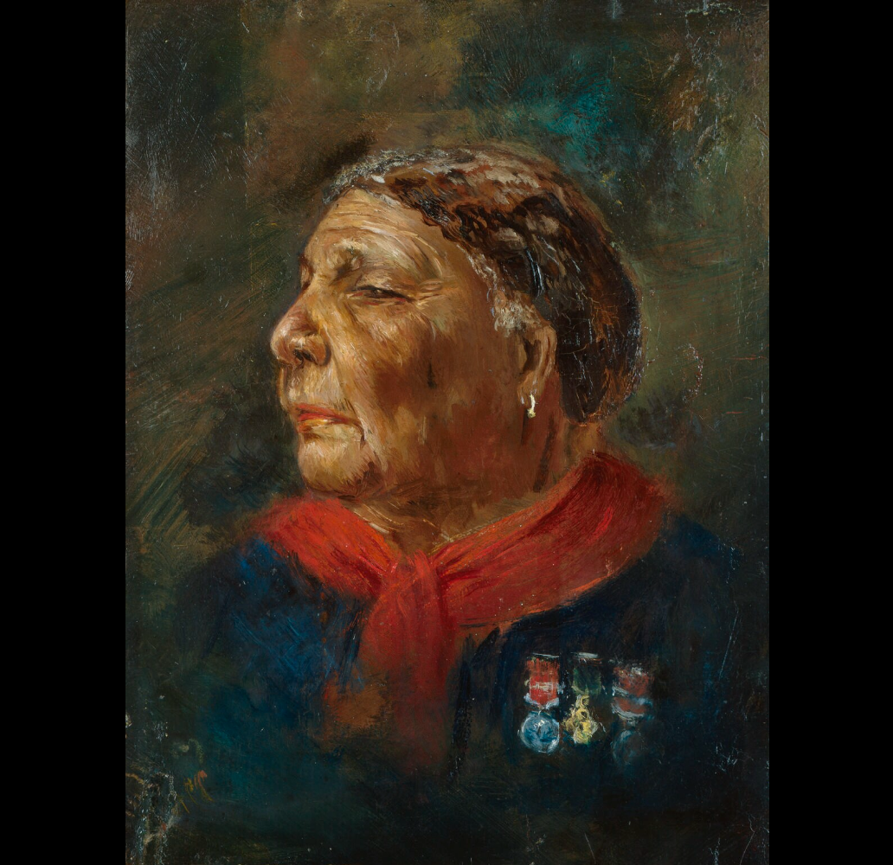
This is a portrait of a famous person. What do you notice? Describe her face how old do you think she is? What expression does she show? What is she wearing? Why does she have medals? What do you think her job is?
Notes:
This is a portrait of a famous person.
What do you notice? Describe her face, how old do you think she is? What expression does she show? What is she wearing? Why does she have medals? What do you think her job is?

Slide 3
This is Mary Seacole.
She was a nurse during the Crimean war in 1984.

Slide 4
Year 1 LO: To explain and sequence the life of Mary Seacole. Must: Understand who Mary Seacole is. Should: Contribute to sequencing Mary Seacole’s life. Could: Use an image to infer and extend their knowledge.

Slide 5

Today our learning objective we are going to learn all about Mary Seacole and sequence her life.
We are going to watch a video on Mary Seacole’s life so watch carefully.
Who was Mary Seacole? - BBC Bitesize

Slide 6
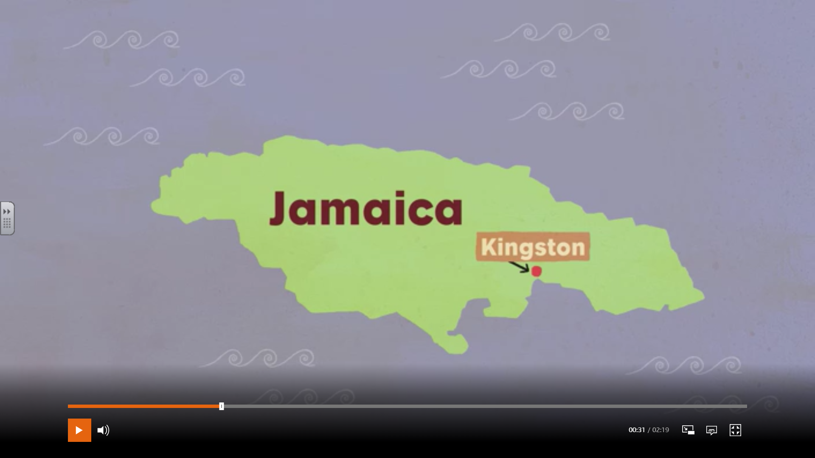
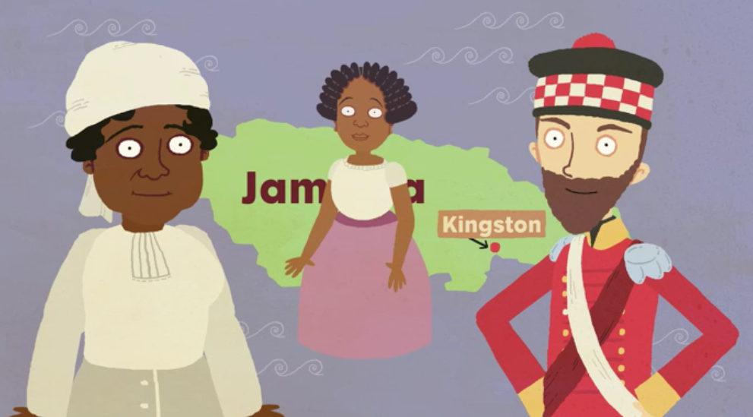
Mary was born in 1805 in Kingston, Jamaica.
Her father was a Scottish soldier and her mum was a Jamaican ‘doctress’.
A doctress is a healer who uses African and Caribbean herbal remedies.

Slide 7
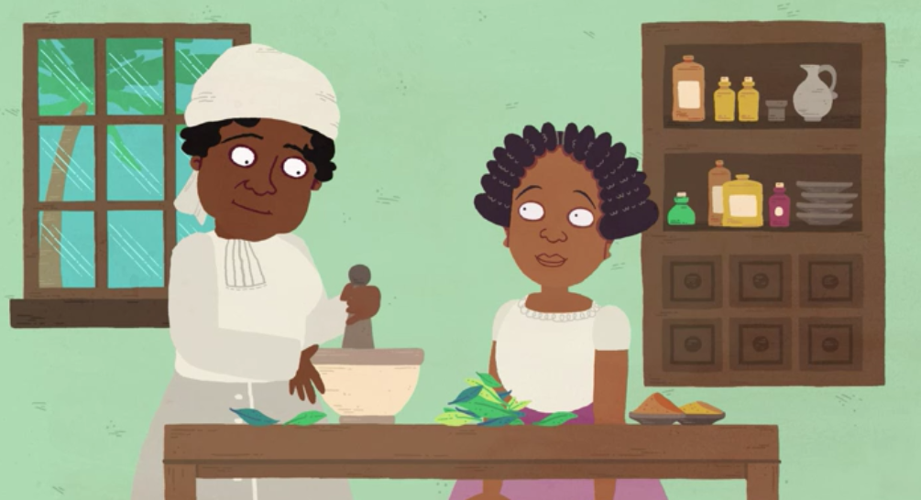
Mary learned nursing skills from her mother, who ran a boarding house for injured soldiers.

Slide 8
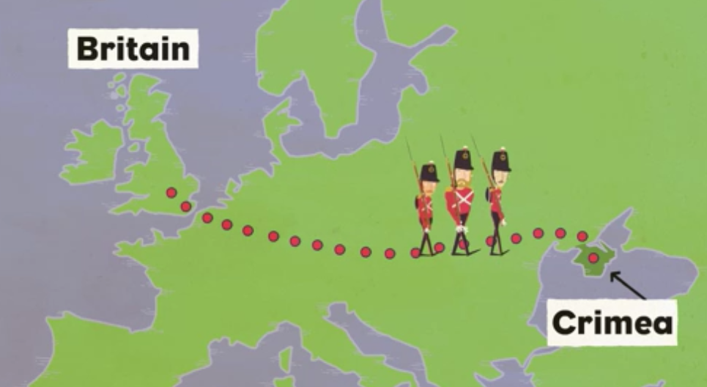
In 1853 the Crimean War began. The soldiers who went to the war died from an illness called Cholera. Mary wanted to help the British soldiers as she knew about the illness from helping her mum.

Slide 9
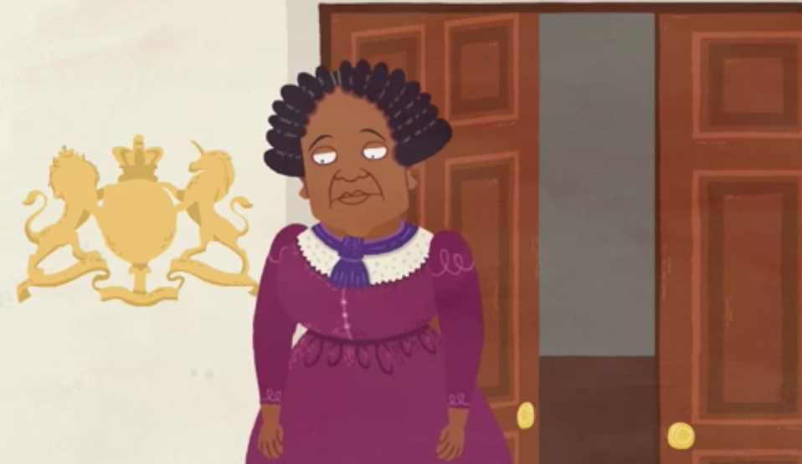
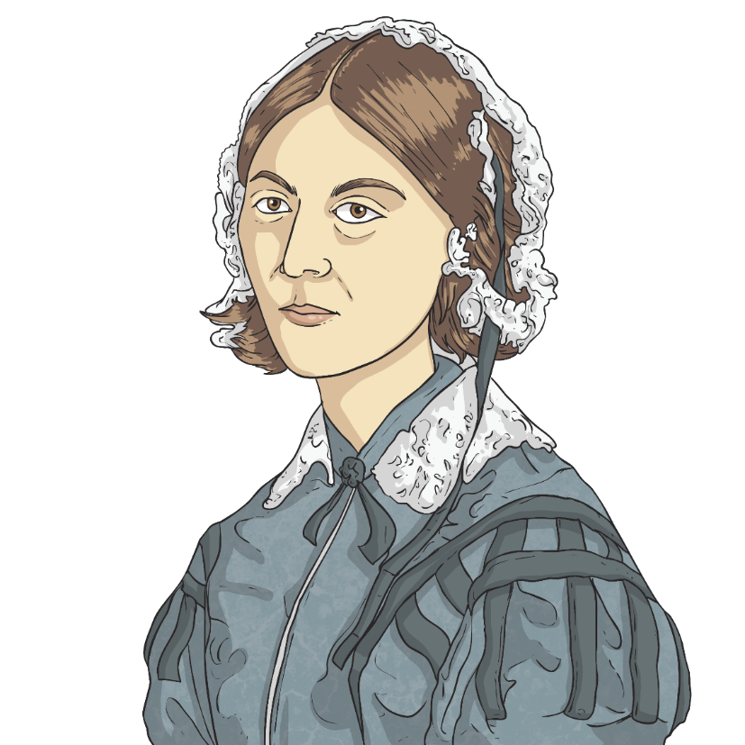
Mary went to London to visit the war office.
A lady called Florence Nightingale was looking for nurses to go to the Crimean War.
Although Mary had very good references and knew a lot about medicine she was turned away for the colour of her skin.

Slide 10
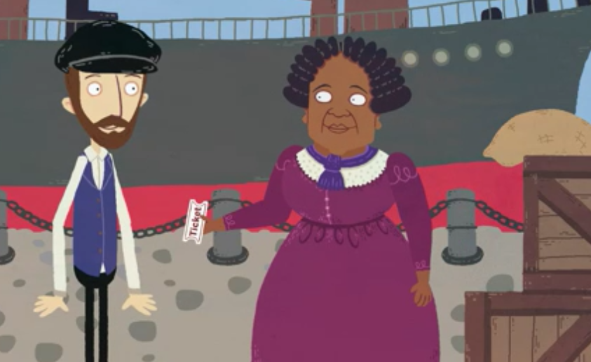
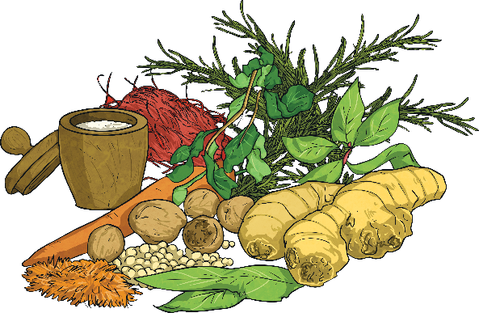
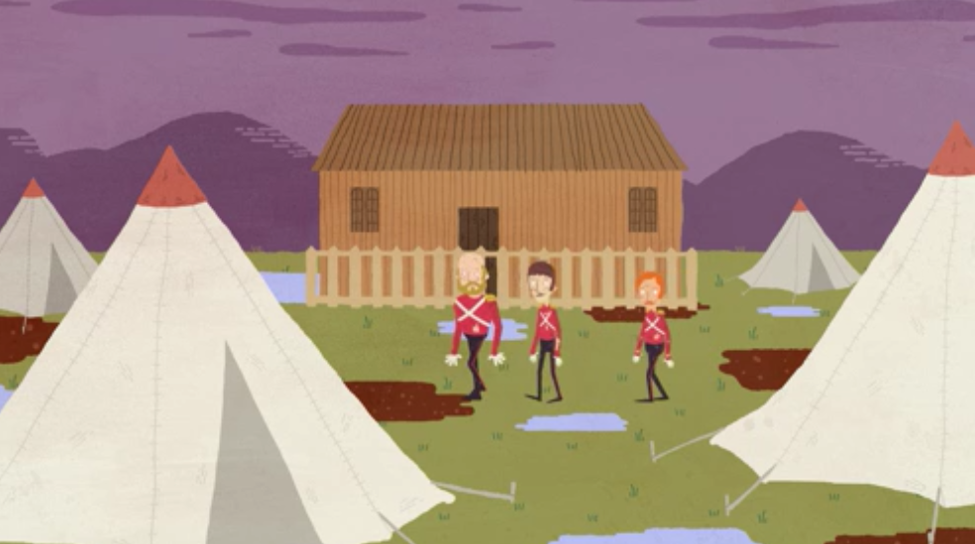
Mary cared so much she paid for herself to get to the Crimea.
She set up her own hospital which she called the ‘British Hotel’ near the battlefield.
She used the herbal remedies she learnt form her mum.

Slide 11
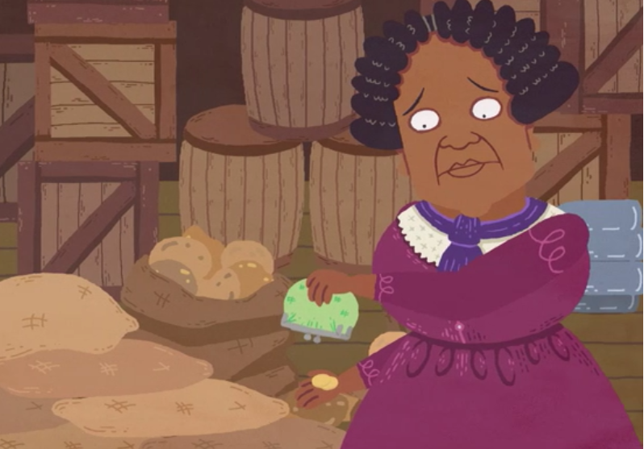
After the war Mary returned to Britain she had no money or home.
The British people heard of her good work and raised money to help her, she also received medals for her work.

Slide 12
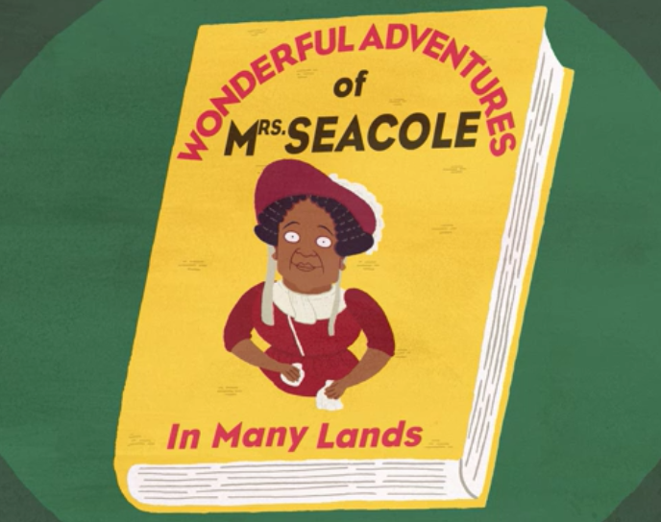
In 1857 Mary published an autobiography
(a book you write about your life)
‘The Wonderful Adventures of Mrs Seacole in Many Lands’.
It is the first book written by a black woman in Britain.

Slide 13
Task : Our task today is to sequence Mary Seacole’s life.
In pairs can you put the pictures in order on the timeline and add more information.
Remember, a fact has to be true, not made up!
When you have finished write a fact in your book about Mary Seacole that you have found out today.

Slide 14
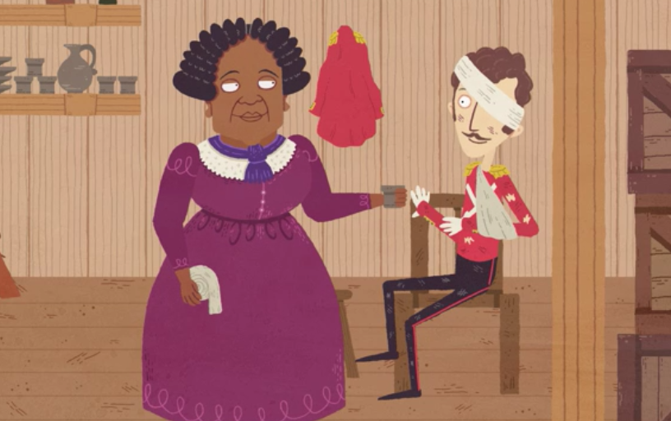
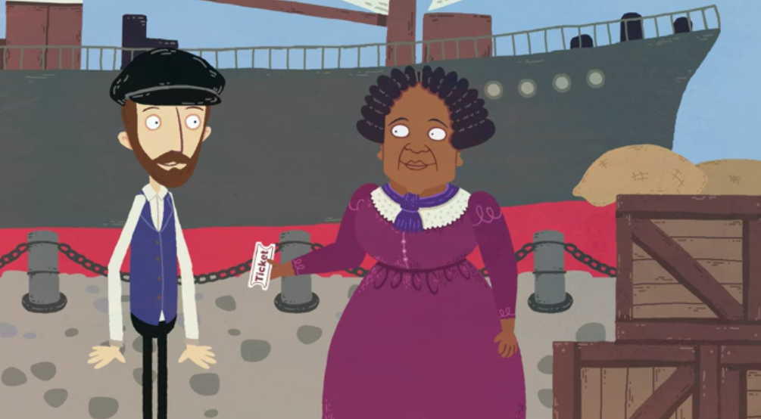
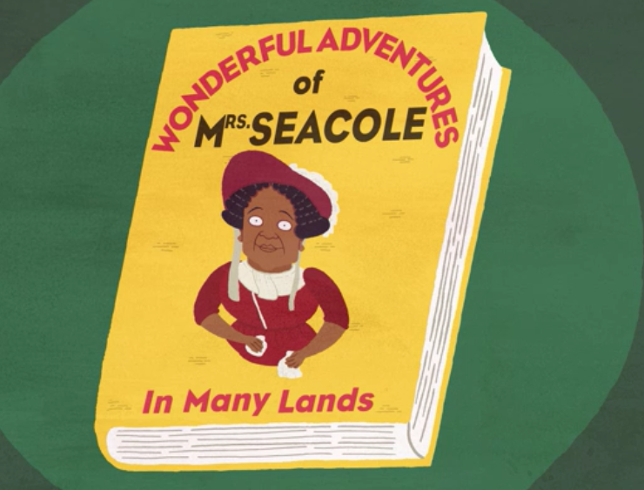
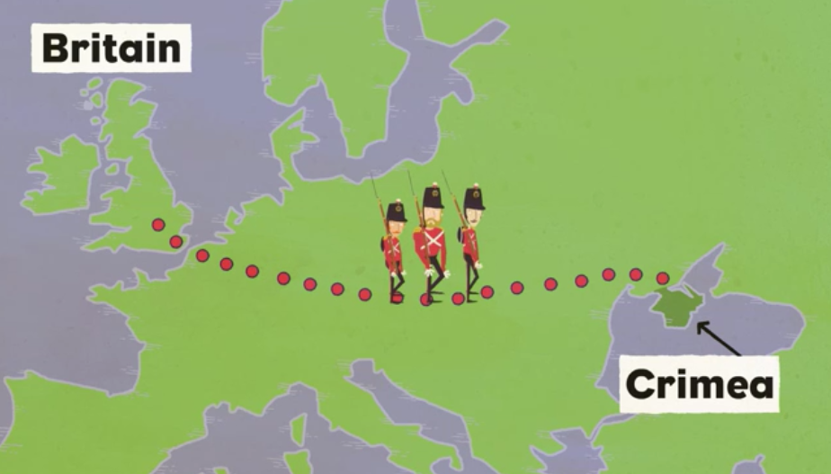
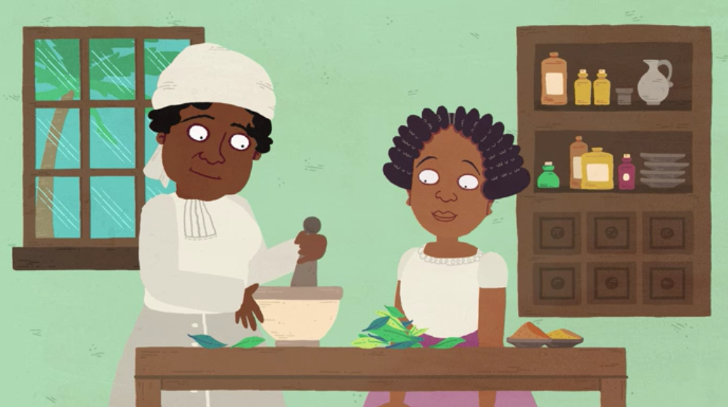
Plenary: I have done my own time line of Mary’s life am I correct?

