Slide 1

LO: to add by counting on.
Must: add using groups of objects to count on.
Should: count in ones on a number line to add
Could: know that addition is commutative.

Slide 2
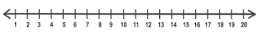
Warm up!
In pairs, take turns to count on from any number. Person A starts on a number and person B continues counting in ones. Take turns to start.

Slide 3
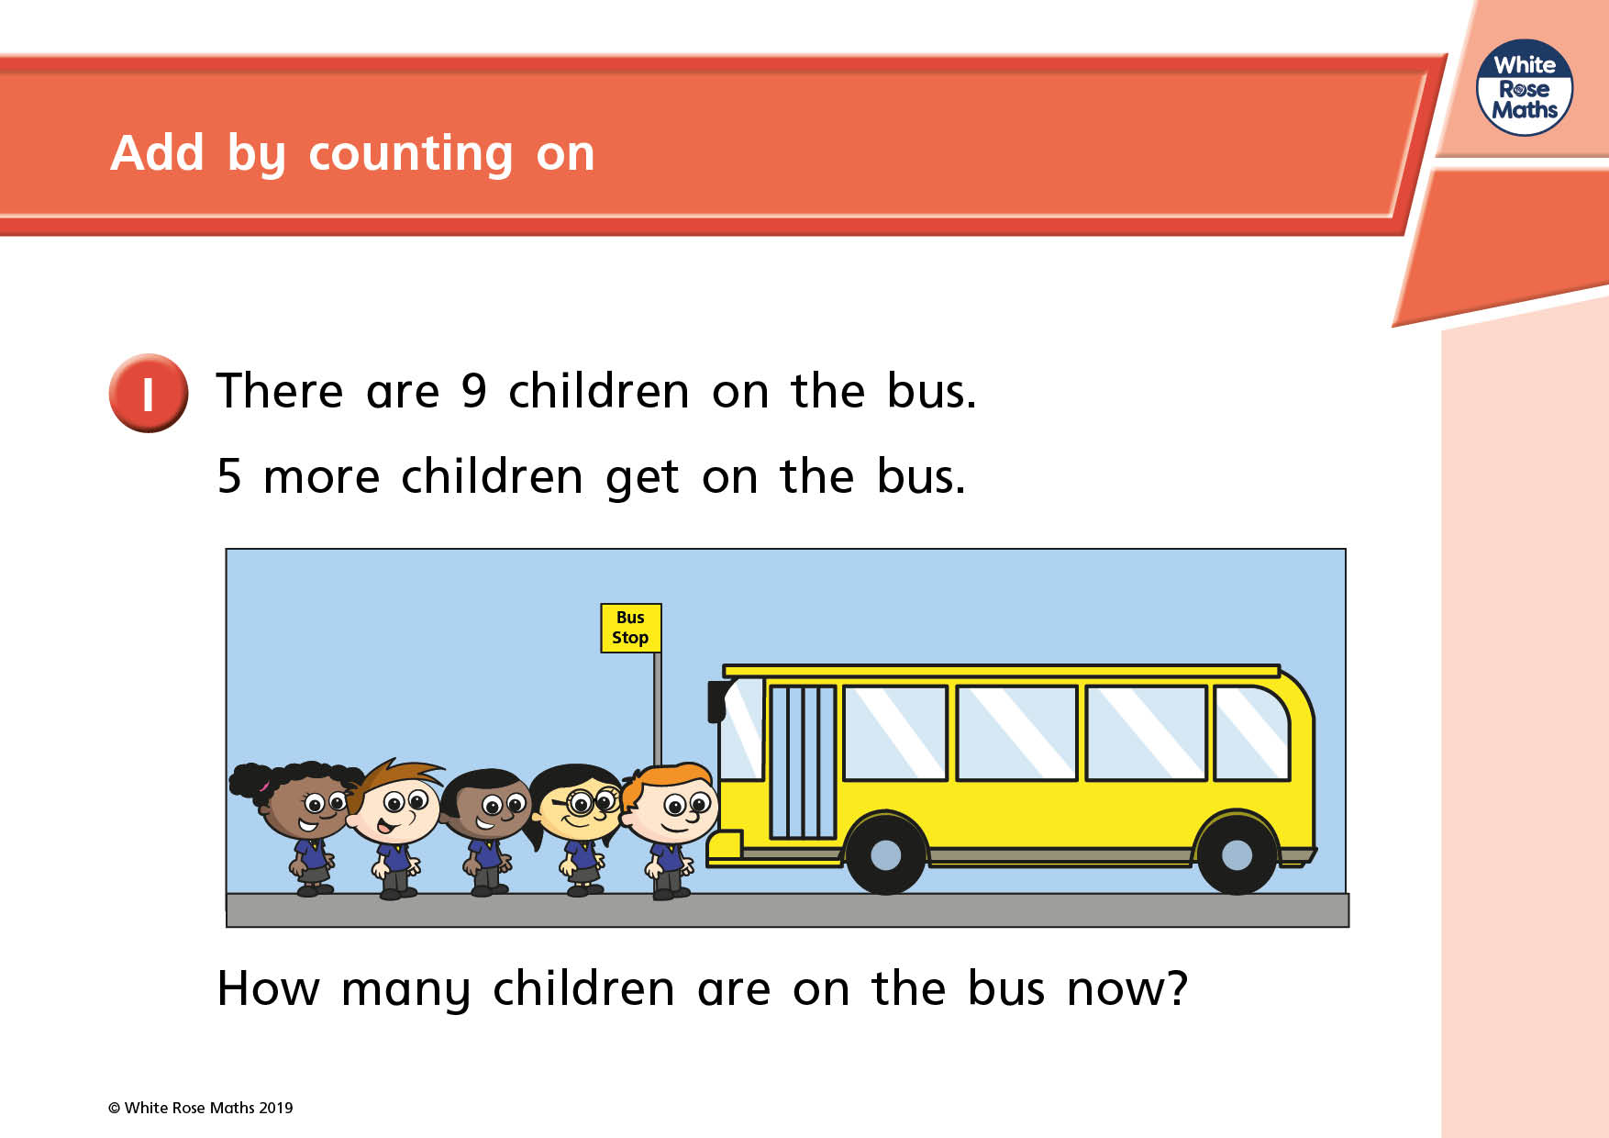
How could we solve this question? What methods could we use?

Slide 4
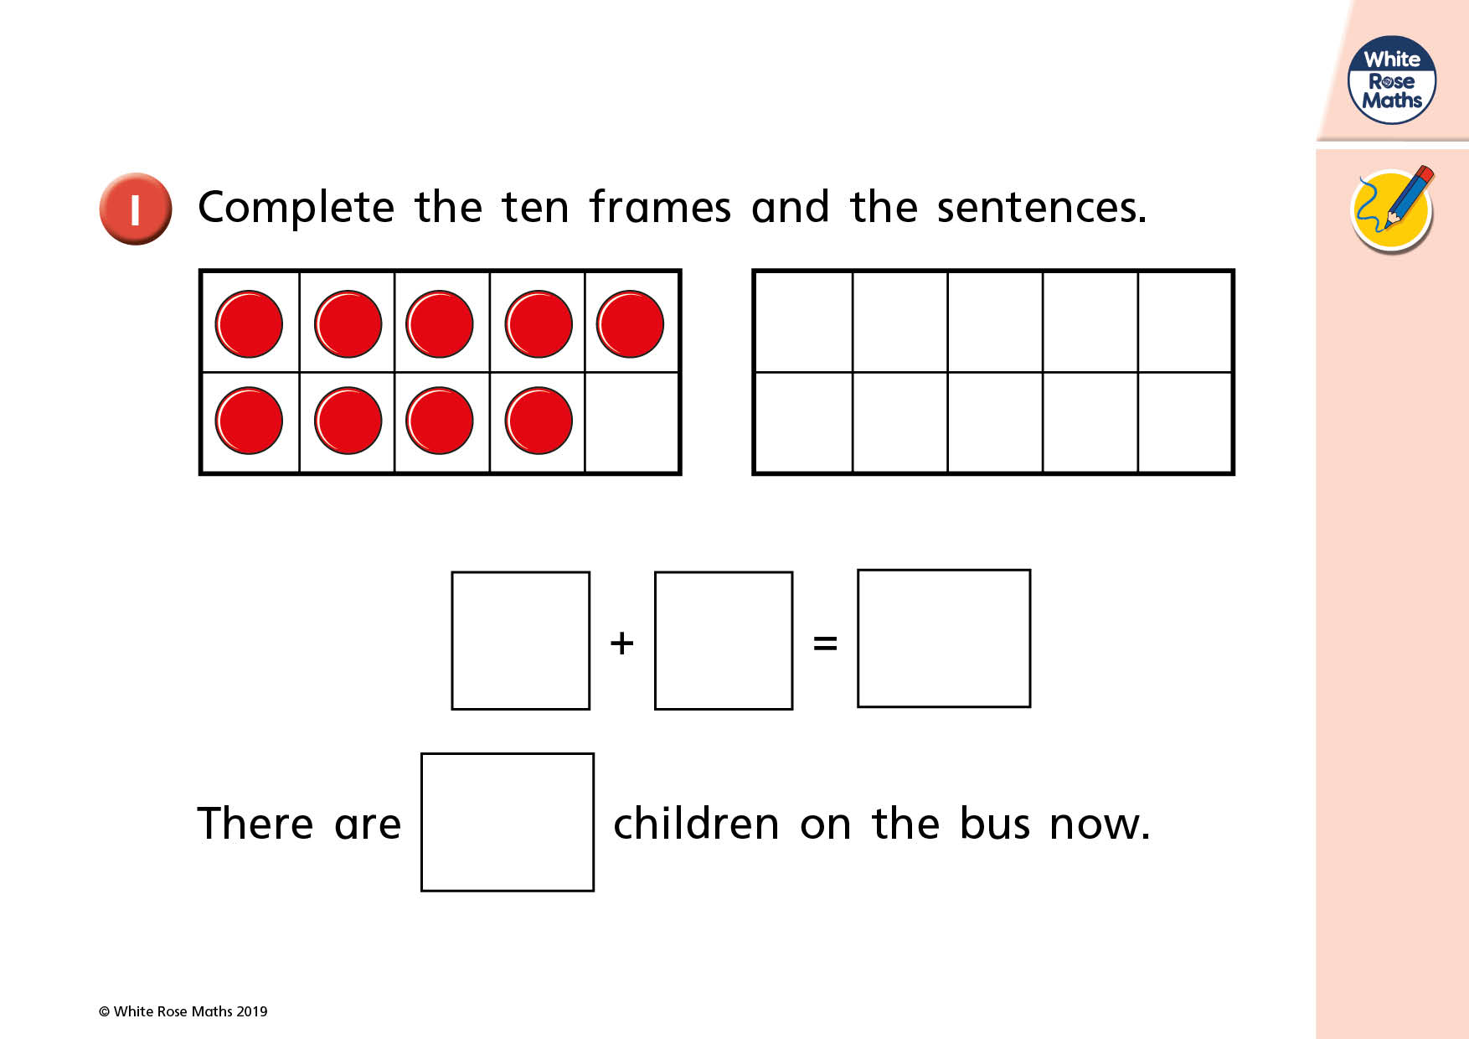

Slide 5
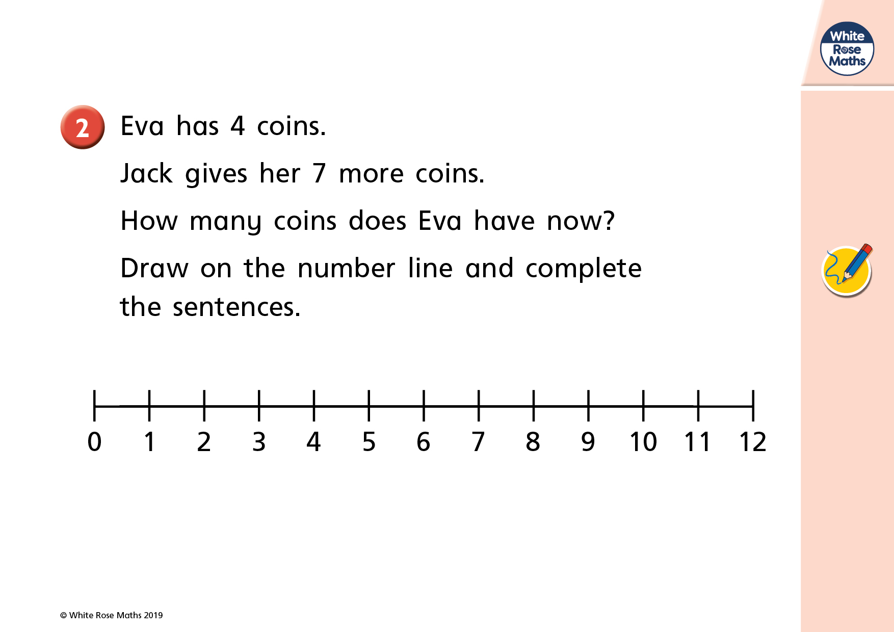
What happens to a number when we add to it? Which way will we move along the number line?

Slide 6
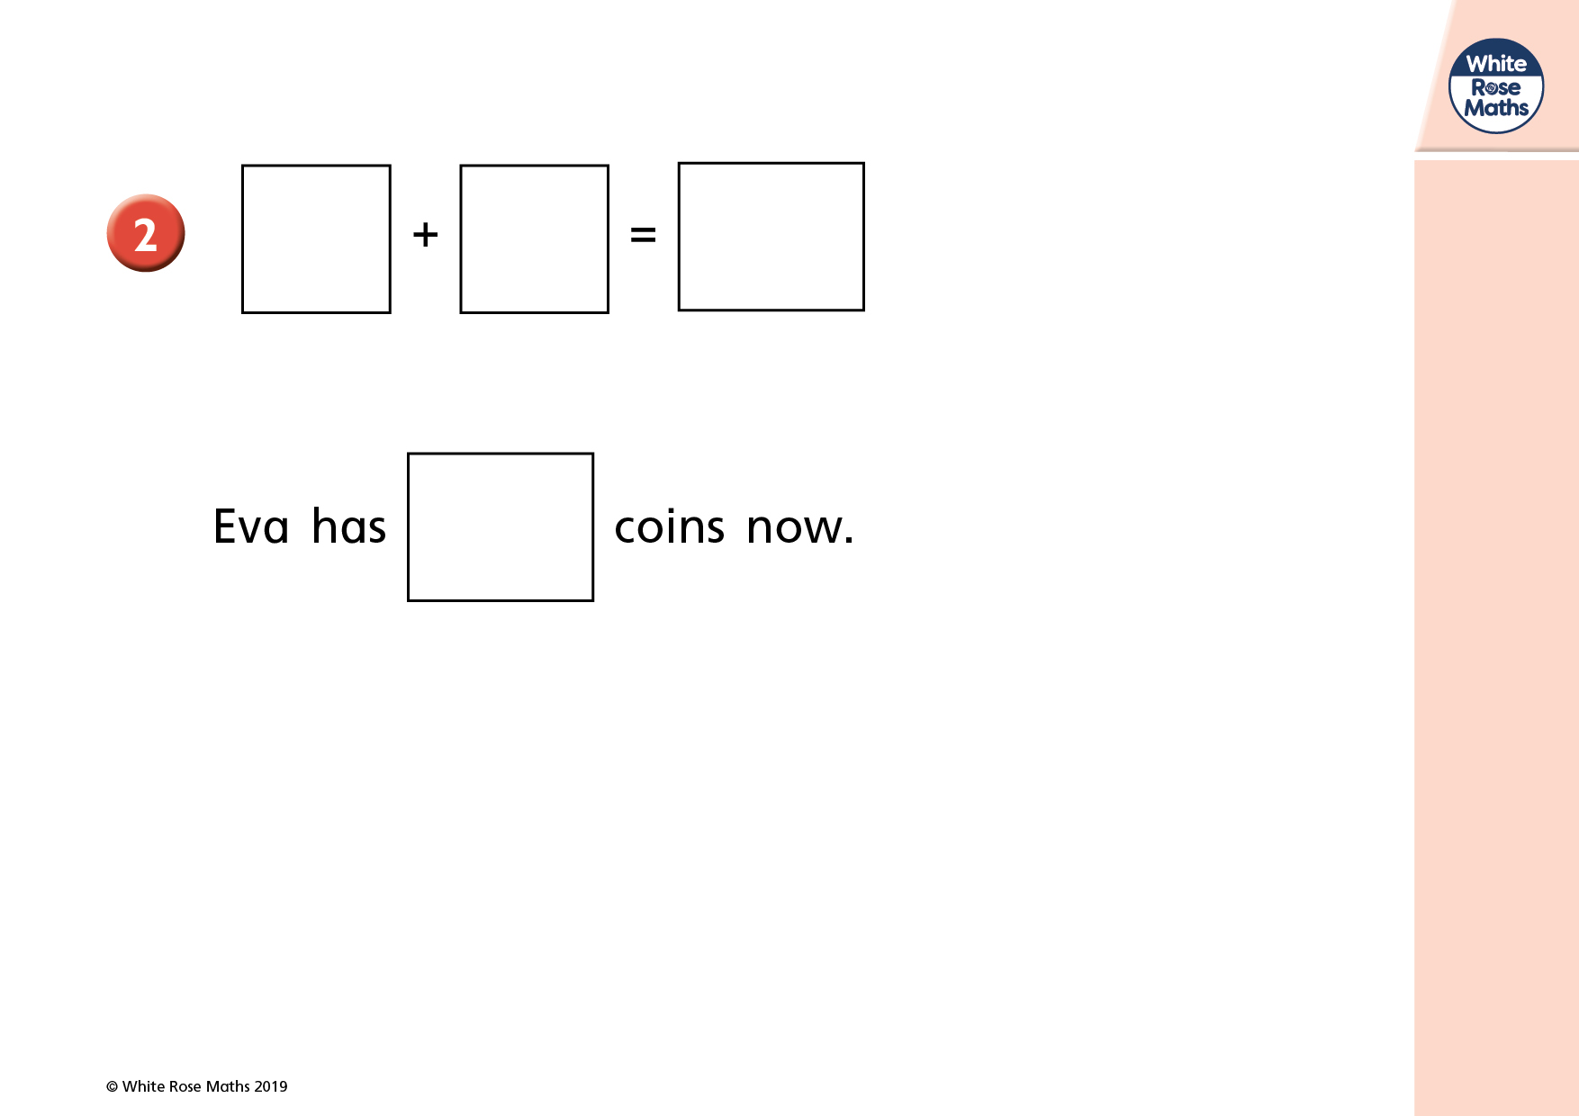

Slide 7
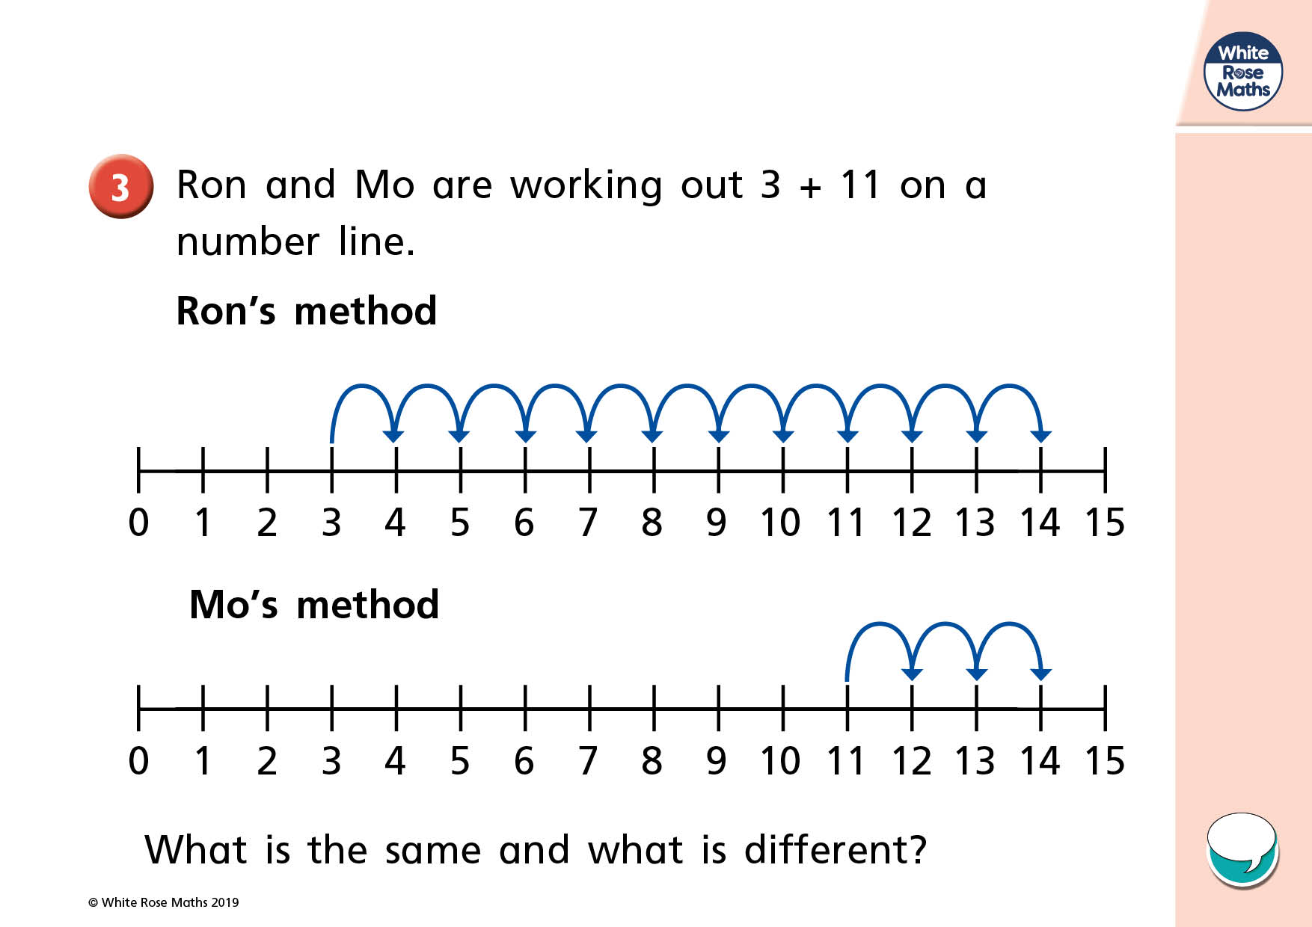
What is the best number to start on? Why?

Slide 8
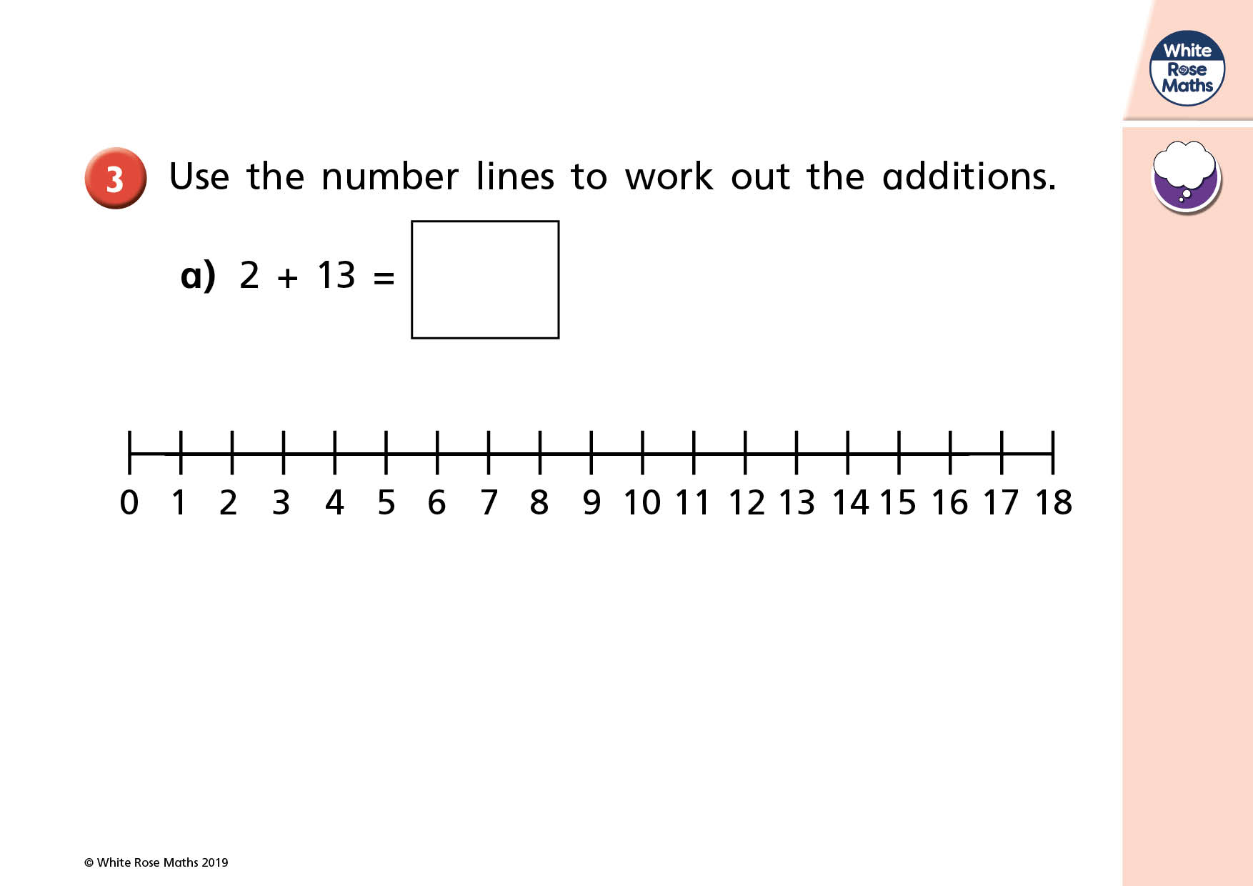
What number should we start on?

Slide 9
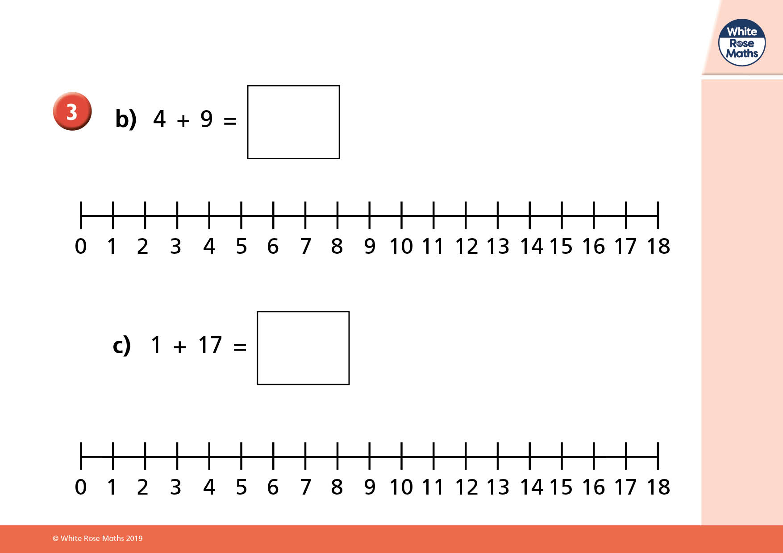
Try these on your own number line!

Slide 10
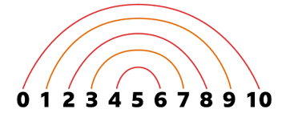
Plenary
Recap number bonds to 10

