Slide 1
Reception LO: to listen to and explore environmental sounds.
Must: listen to environmental sounds.
Should: make sensible suggestions of what the sounds might be.
Could: make your own sounds using the instruments.
Year 1 LO: to identify features of a diary.
Must: listen to and read a diary entry
Should: discuss the features of a diary.
Could: identify diary features.

Slide 2
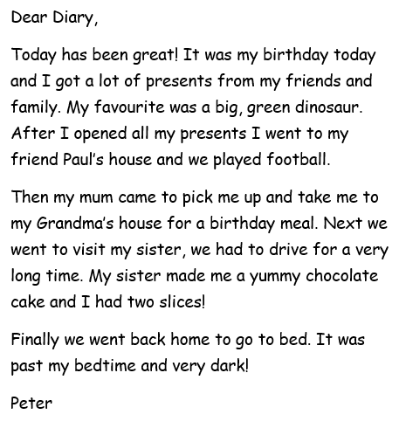
What are the features of a diary?

Slide 3
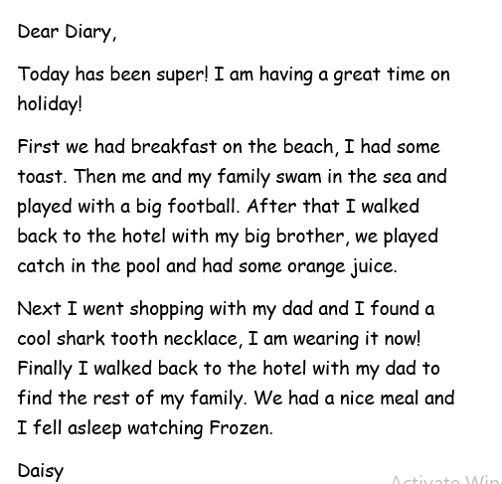

Slide 4
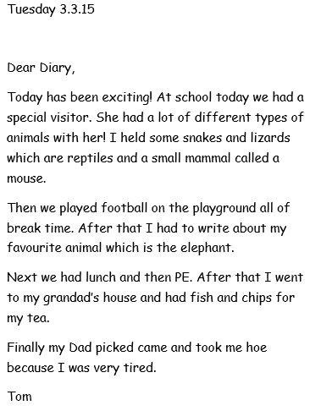

Slide 5
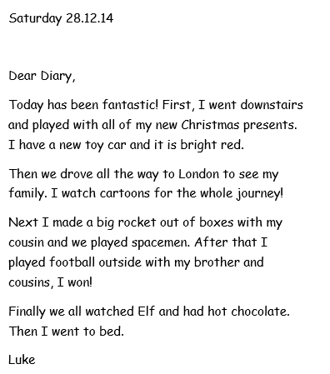

Slide 6
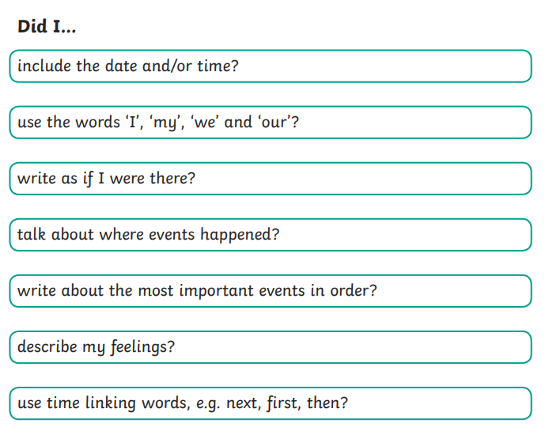
A diary should…
Did you spot all the features in the diary entries you have read?

Slide 7
Your Task:
Work in small groups/ pairs to explore some diary entries. Can you annotate or highlight the features?

Slide 8
Plenary
What are the main features of a diary?

