Slide 1
Reception LO: to listen carefully to rhyming words.
Must: listen carefully.
Should: identify pairs of rhyming words.
Could: continue a rhyming string.
Year 1 LO: to sequence the events in the story.
Must: identify the key events in the story.
Should: sequence the key events.
Could: consider how the characters were feeling at different points in the story.

Slide 2
What are the main events in the story?
Notes:
Discuss with a partner.

Slide 3
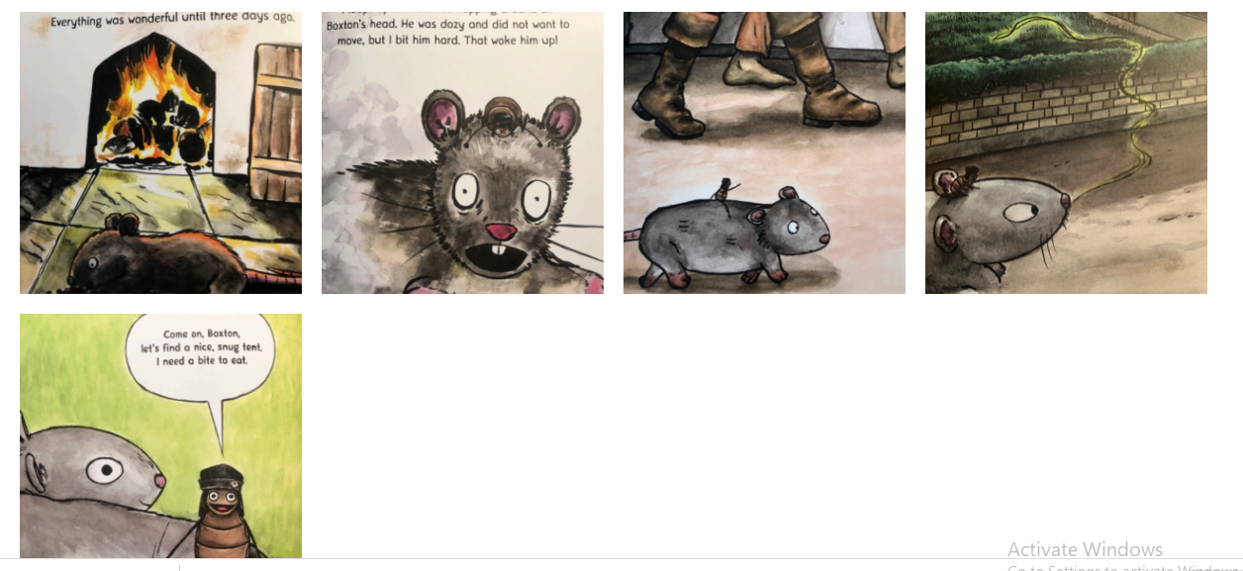
Sequence the events

Slide 4
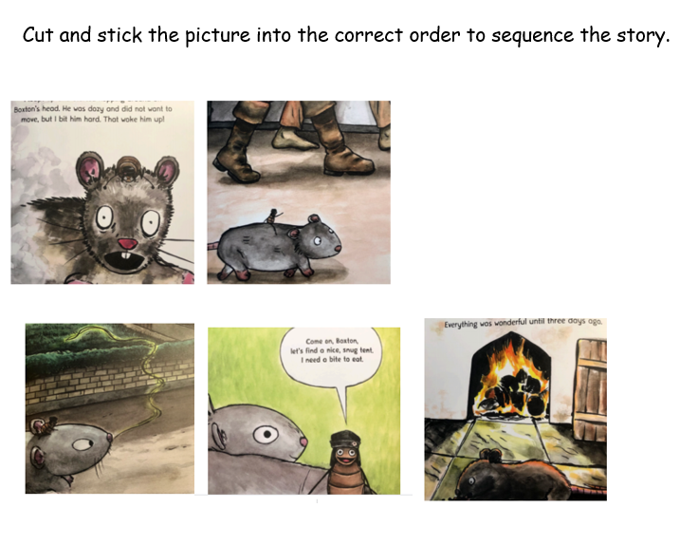
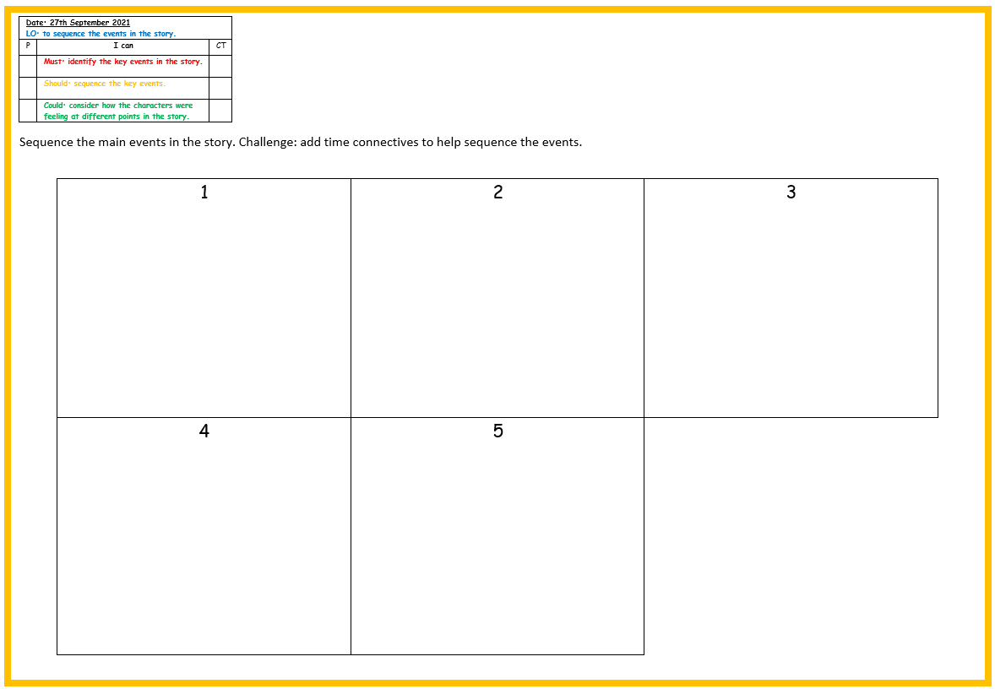
Your task
Challenge: Can you add time connectives between each event? Eg first, then, next, finally.

Slide 5
Plenary
Hot seat each of the main characters. How are they feeling at different points in the story.

