Slide 1


Year 2 – Autumn Block 4 – Multiplication and Division – Recognise Equal Groups
About This Resource:
This PowerPoint has been designed to support your teaching of this small step. It includes a starter activity and an example of each question from the Varied Fluency and Reasoning and Problem Solving resources also provided in this pack. You can choose to work through all examples provided or a selection of them depending on the needs of your class.
National Curriculum Objectives:
Mathematics Year 2: (2C8) Solve problems involving multiplication and division, using materials, arrays, repeated addition, mental methods, and multiplication and division facts, including problems in contexts
More Year 2 Multiplication and Division resources.
Did you like this resource? Don’t forget to review it on our website.
© Classroom Secrets Limited 2018

Slide 2
Year 2 – Autumn Block 4 – Multiplication and Division
Step 1: Recognise Equal Groups
© Classroom Secrets Limited 2018

Slide 3
Introduction
Tick the groups that are equal.
      A.
      B.
      C.
© Classroom Secrets Limited 2018

Slide 4
Introduction
Tick the groups that are equal.
      A.
      B.
      C.
✓
✓
© Classroom Secrets Limited 2018

Slide 5
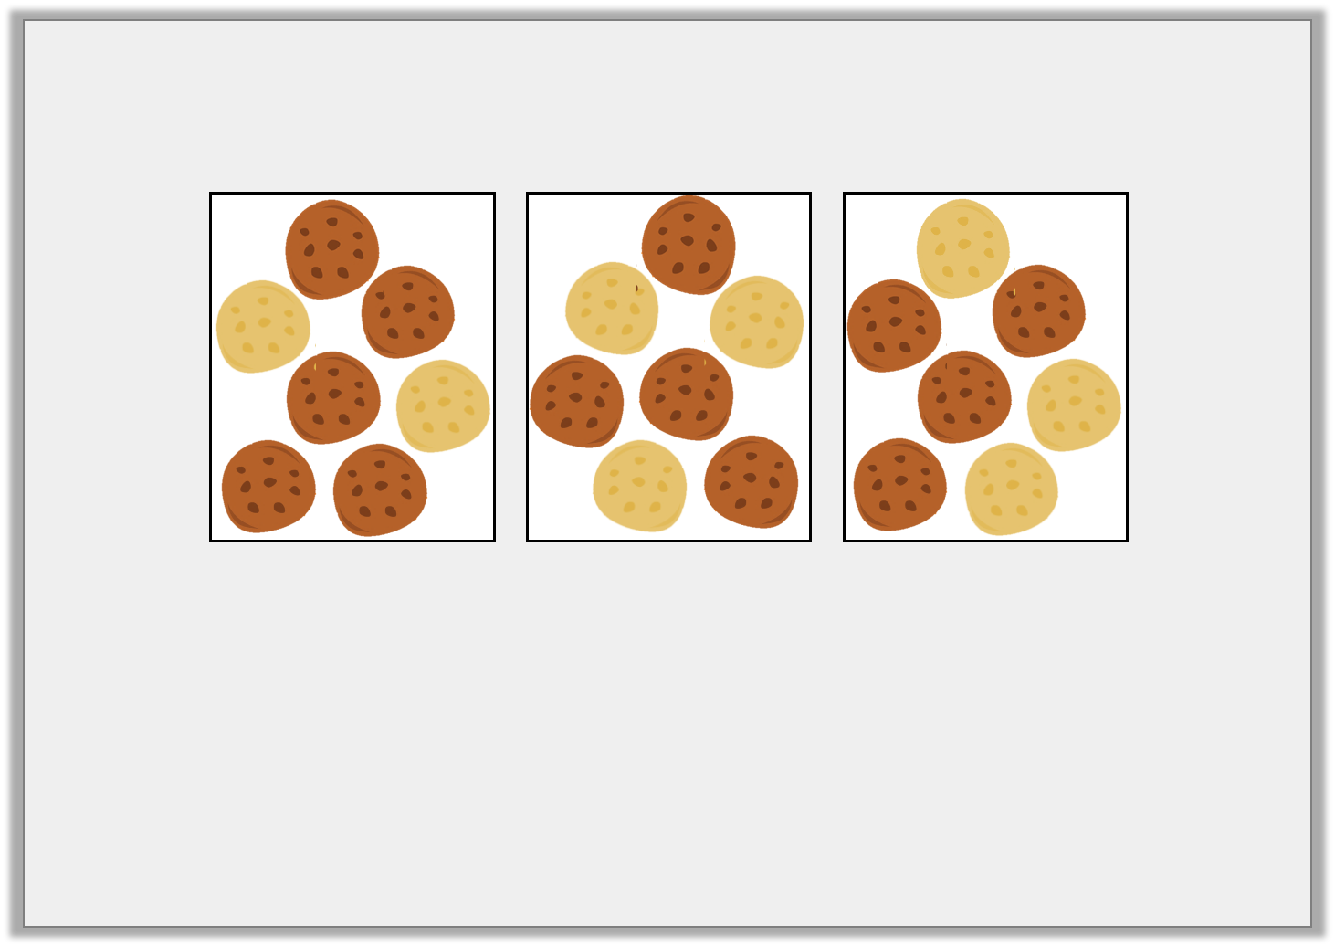
Varied Fluency 1
Which sentence matches the groups below?
A. There are 7 equal groups with 3 in each group.
B. There are 3 equal groups with 7 in each group.
C. There are 24 equal groups with 1 in each group.
© Classroom Secrets Limited 2018

Slide 6
Varied Fluency 1
Which sentence matches the groups below?
A. There are 7 equal groups with 3 in each group.
B. There are 3 equal groups with 7 in each group.
C. There are 24 equal groups with 1 in each group.
© Classroom Secrets Limited 2018

Slide 7
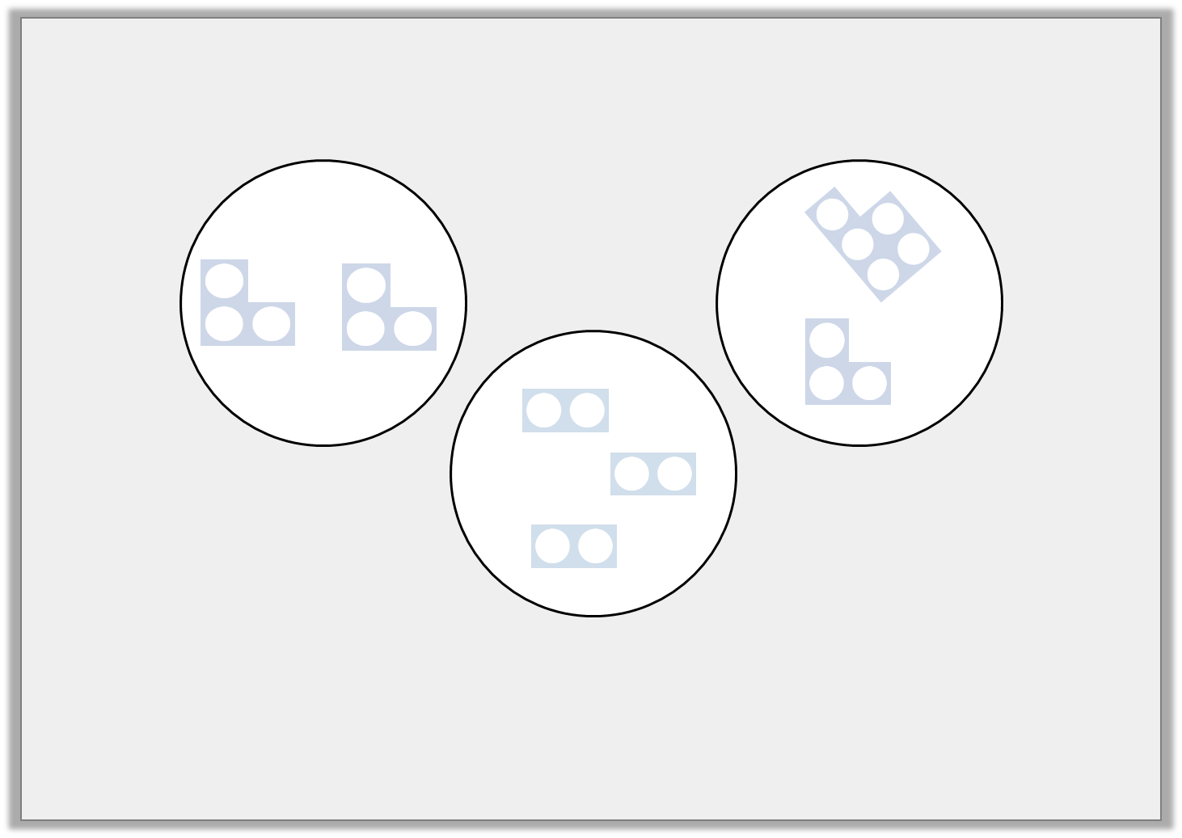
Varied Fluency 2
Which groups are equal? Which group is unequal?
A
C
B
© Classroom Secrets Limited 2018

Slide 8
Varied Fluency 2
Which groups are equal? Which group is unequal?
A is equal, B is equal, C is unequal
A
C
B
© Classroom Secrets Limited 2018

Slide 9
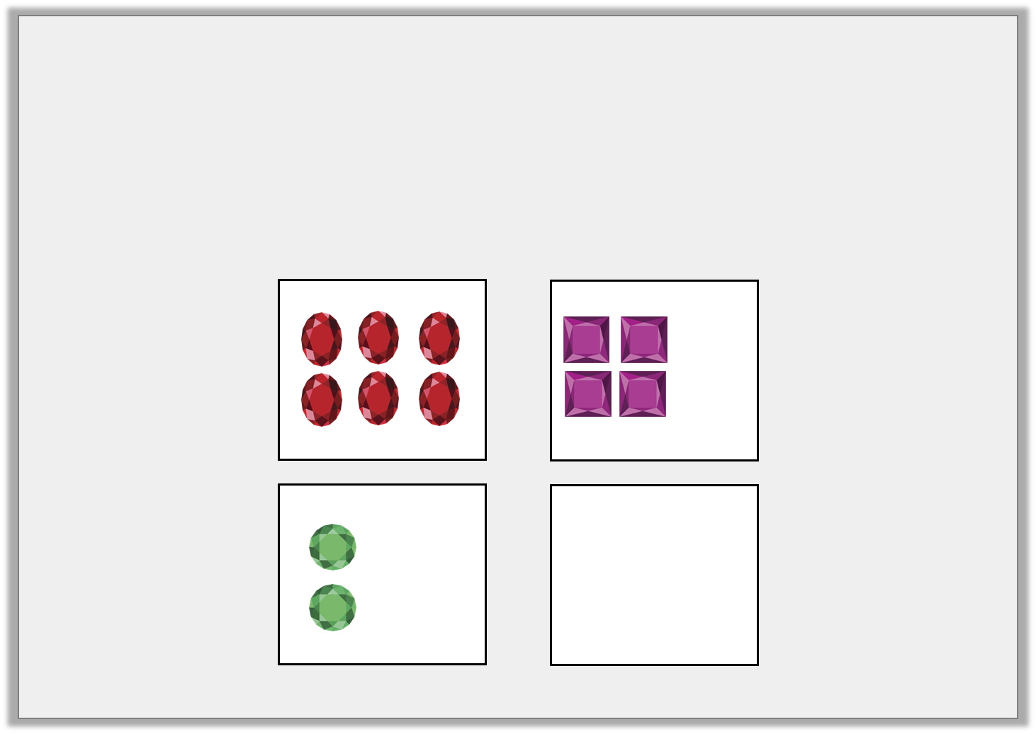
Varied Fluency 3
Complete the groups to match the following sentence.
There are 4 equal groups with 6 in each group.
© Classroom Secrets Limited 2018

Slide 10
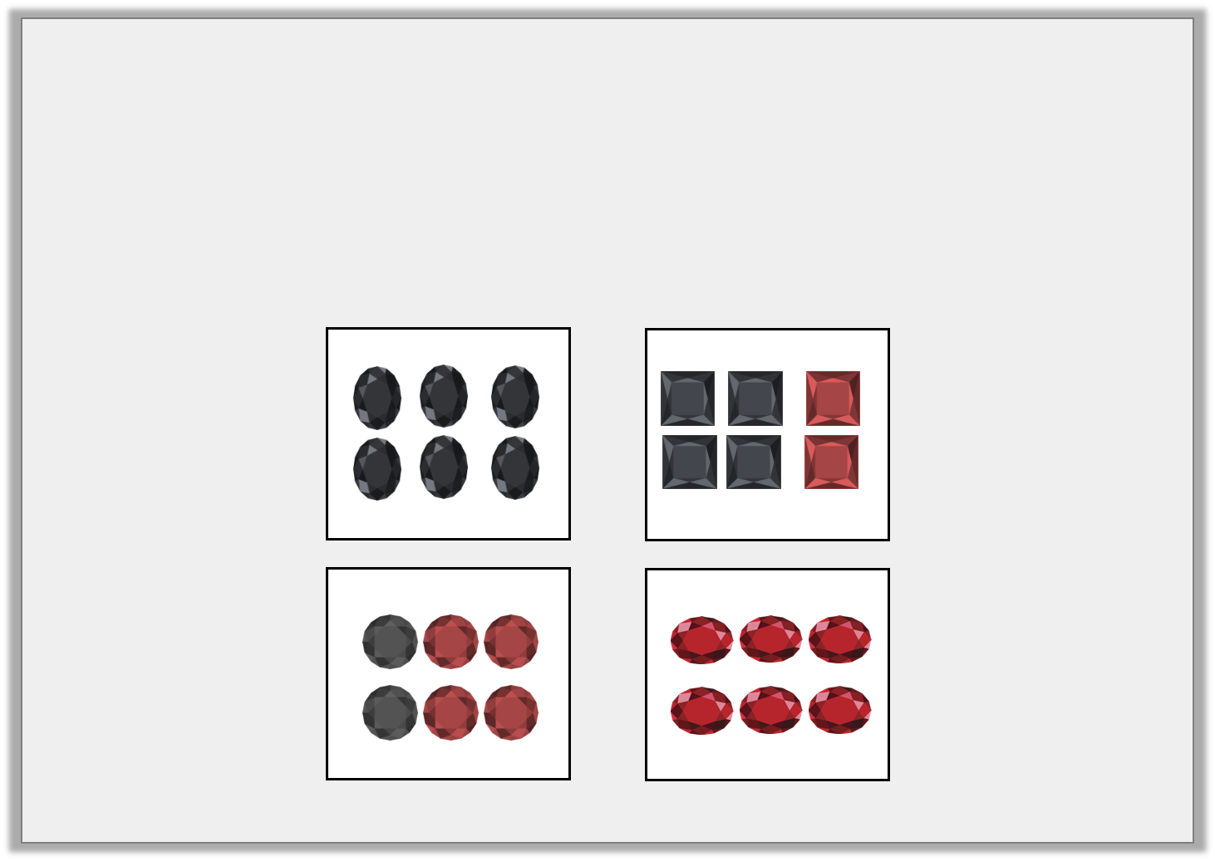
Varied Fluency 3
Complete the groups to match the following sentence.
There are 4 equal groups with 6 in each group.
© Classroom Secrets Limited 2018

Slide 11
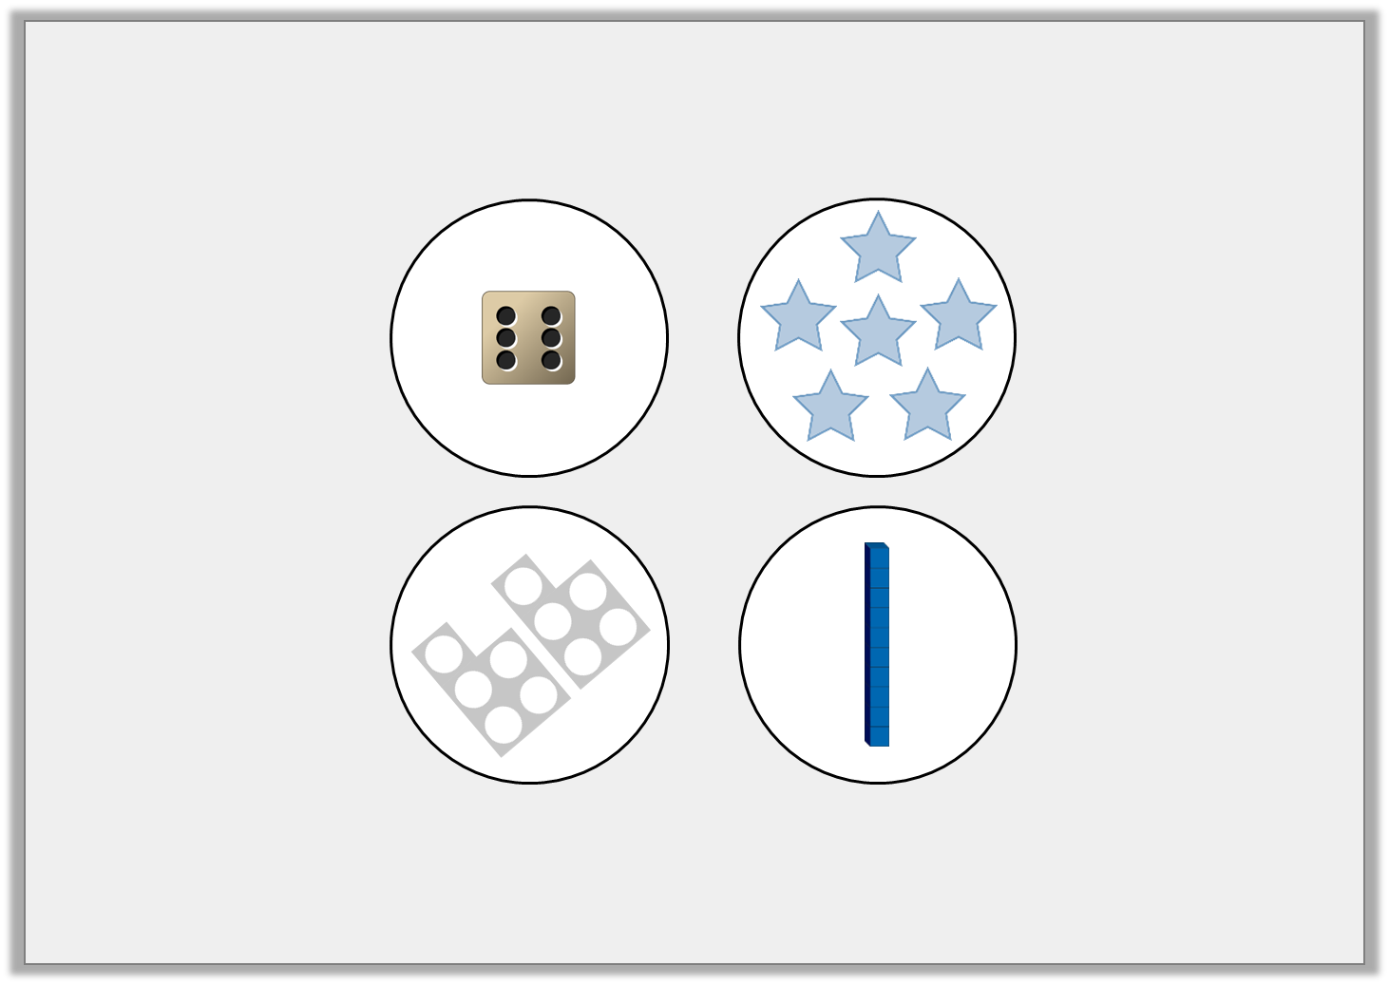
Reasoning 1
Which groups are equal? Explain your reasoning.
A and B are equal as…
C and D are equal as…
B
A
C
D
© Classroom Secrets Limited 2018

Slide 12
Reasoning 1
Which groups are equal? Explain your reasoning.
A and B are equal as they both have 6.
C and D are equal as they both have 10.
B
A
C
D
© Classroom Secrets Limited 2018

Slide 13
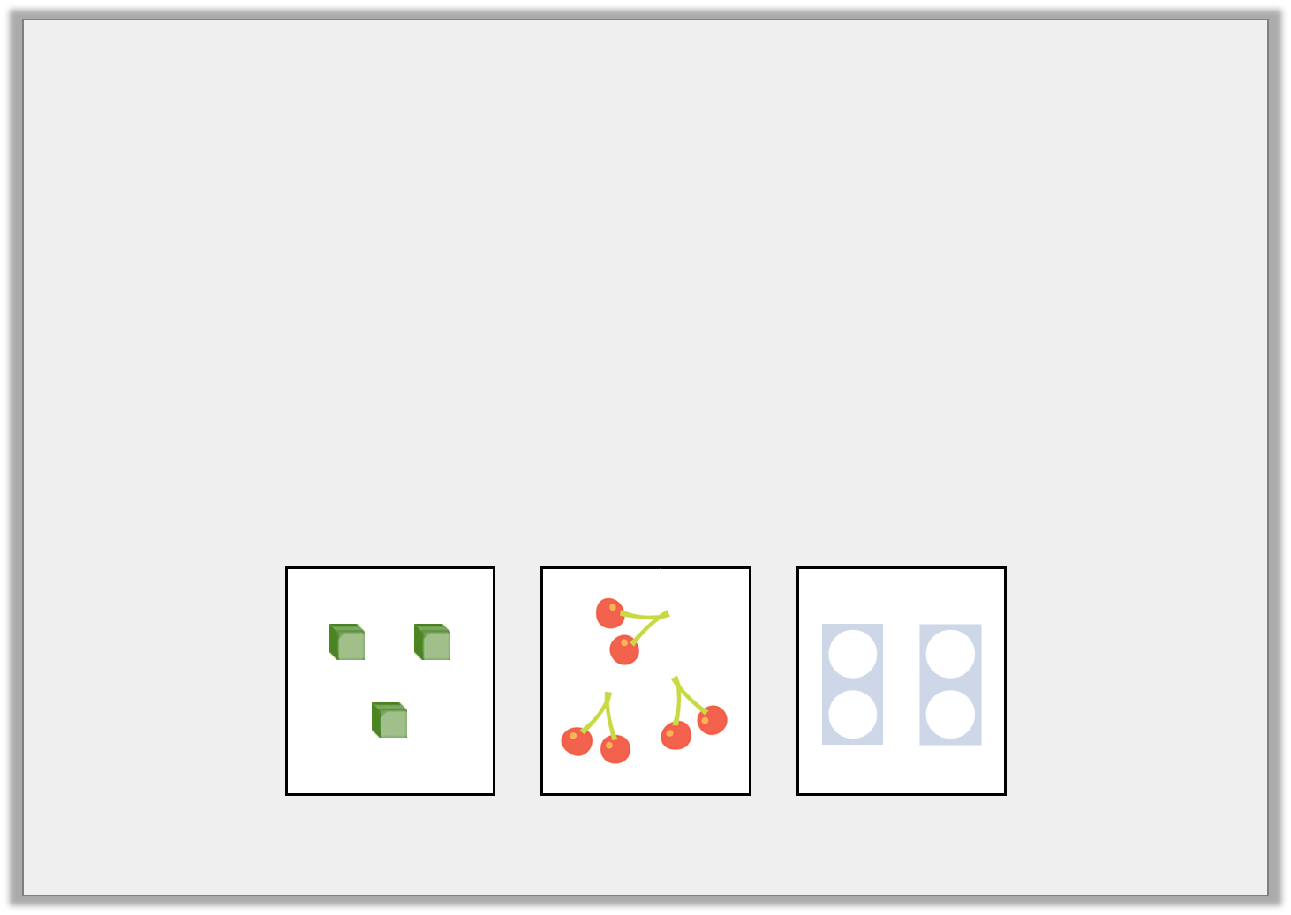
Problem Solving 1
Which image is each child describing?
I have 2 equal groups of 2.
Oli
I have 3 equal groups of 1.
Nell
I have 3 equal groups of 2.
Will
A
B
C
© Classroom Secrets Limited 2018

Slide 14
Problem Solving 1
Which image is each child describing?
I have 2 equal groups of 2.
C
Oli
I have 3 equal groups of 1.
A
Nell
I have 3 equal groups of 2.
B
Will
A
B
C
© Classroom Secrets Limited 2018

Slide 15
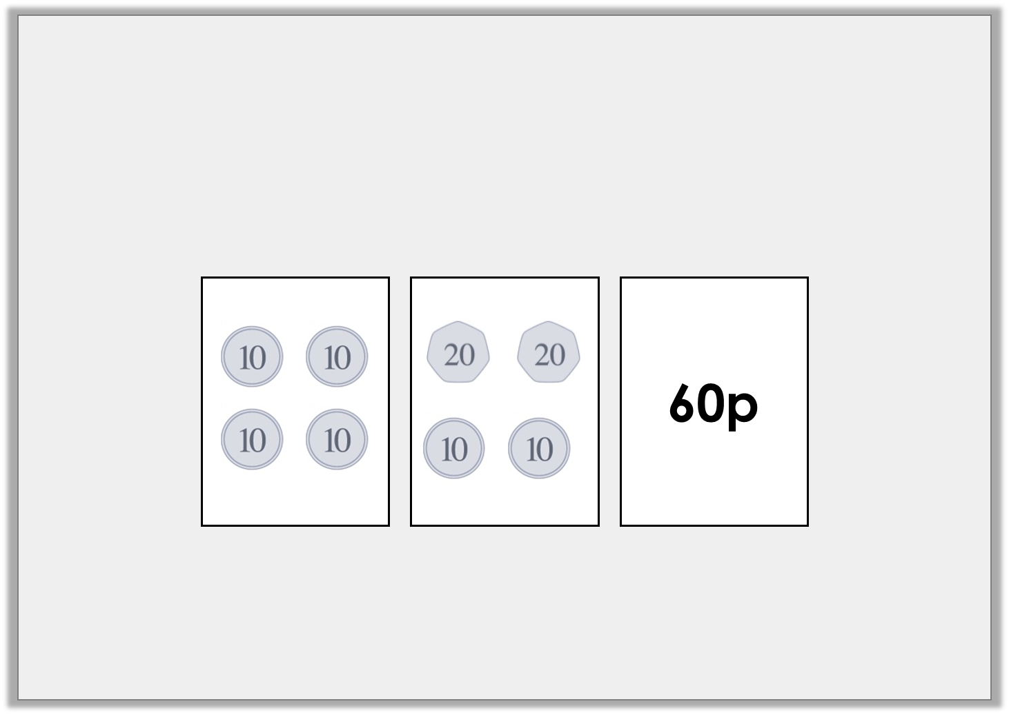
Reasoning 2
Fred is counting his pocket money.
He is making equal groups that each have the same amount of money.
Which group is not equal to the others?
© Classroom Secrets Limited 2018

Slide 16
Reasoning 2
Fred is counting his pocket money.
He is making equal groups that each have the same amount of money.
Which group is not equal to the others?
The first group is not equal to the others as it only has…
© Classroom Secrets Limited 2018

Slide 17
Reasoning 2
Fred is counting his pocket money.
He is making equal groups that each have the same amount of money.
Which group is not equal to the others?
The first group is not equal to the others as it only has 40p, not 60p.
© Classroom Secrets Limited 2018

