Slide 1
LO: to explore key features of traditional tales.
Must: give some examples of traditional tales.
Should: discuss characters and settings of traditional tales.
Could: explain some key features found in traditional tales.
Starter:
What stories do you like?
Can you remember any stories your grown ups have told you?
What is your favourite book?

Slide 2
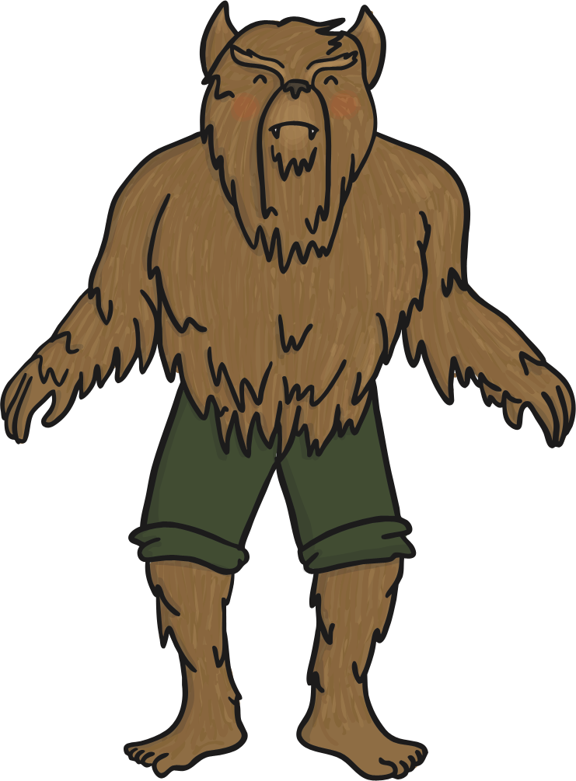
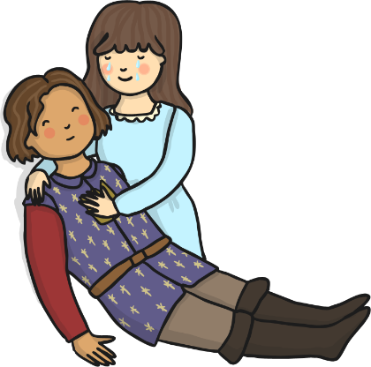
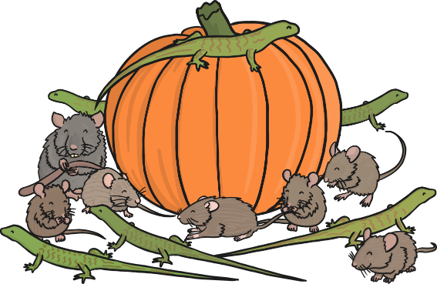
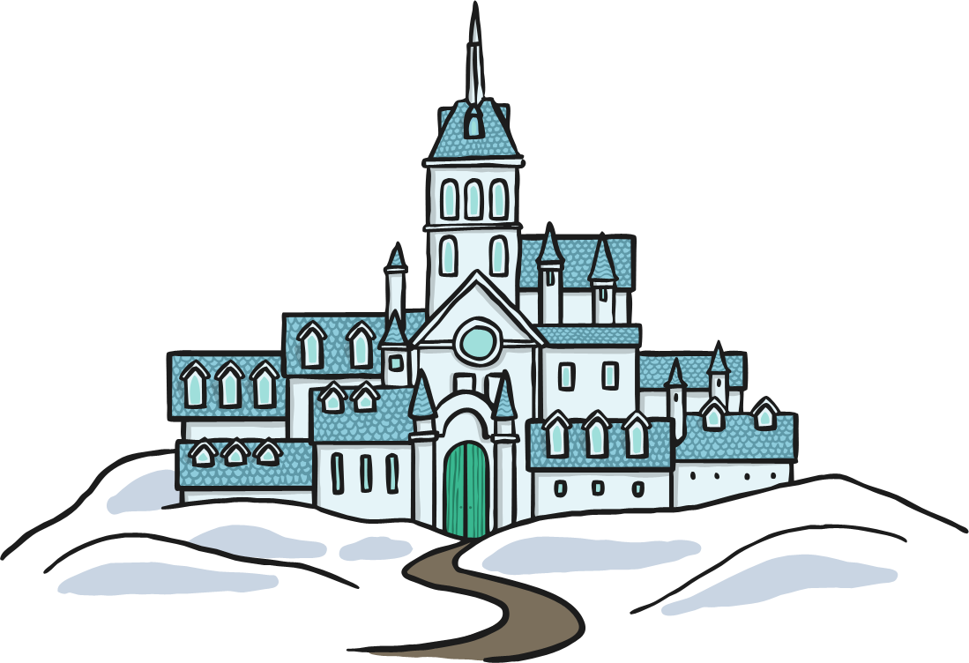
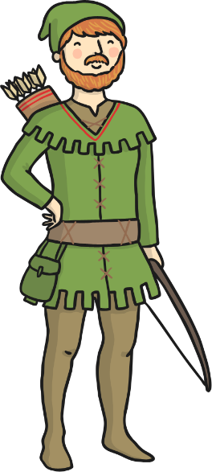
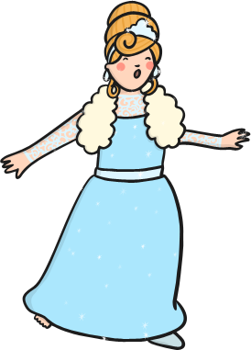
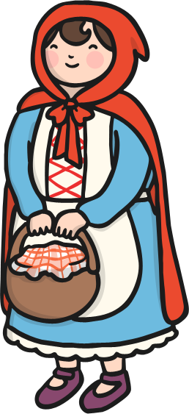
What is a traditional tale?
What does traditional mean?
Traditional tales are stories that have been told and retold for many years. Therefore, they become a story that many people know. There are often lots of different versions of the same story.
Traditional tales are also known as fairy stories or fairy tales.

Slide 3
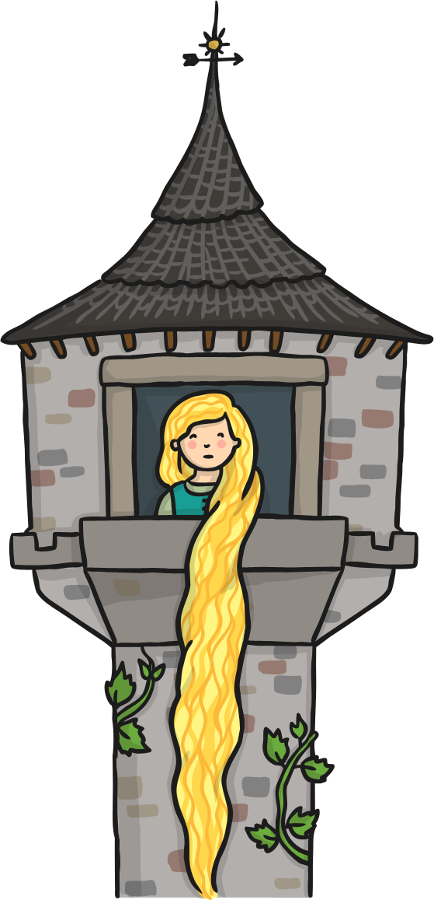
What settings are mostly traditional tales/ fairy tales?
Setting means the place they are in.
Magical kingdom
A land far, far away
A cottage
Woods
Forest
Castle
A tower

Slide 4
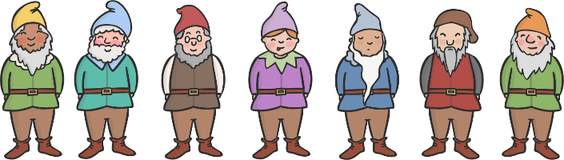
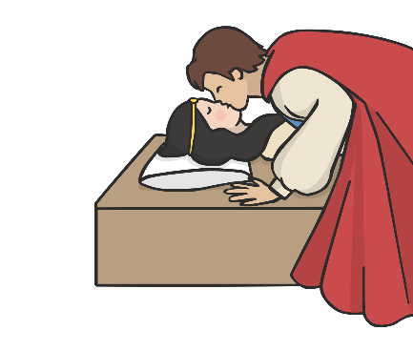
Name the story!
It’s a tale about a beautiful princess and her evil stepmother the Queen…
She went to live with 7 dwarves in a cottage…
She was poisoned by an apple but was woken up by a kiss from a handsome prince…
Snow White and the Seven Dwarfs!

Slide 5
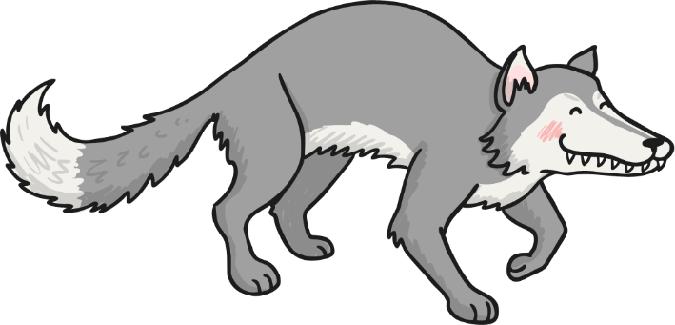
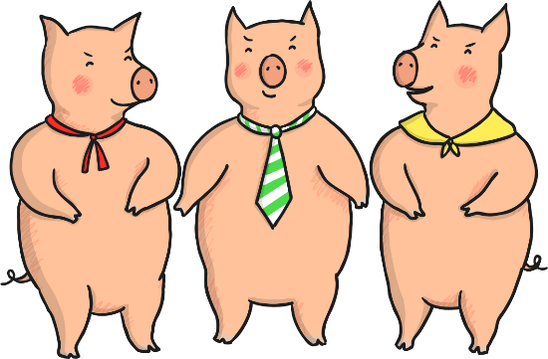
Name the story!
It’s a tale about 3 characters who were sent away to build houses of their own…
The first two found out that houses built with straw and sticks could be blown down…
The wolf huffed and he puffed but he couldn’t blow the brick house down…
The Three Little Pigs!

Slide 6
What is a character?
A character is someone who is in the story.

Slide 7
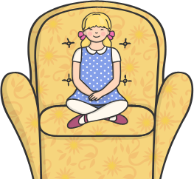
Name that character!
She’s a girl with blonde (golden) hair…
She likes to eat porridge…
She sits in other people’s chairs until she finds the one that’s just right.
She even gets caught sleeping in a bear’s bed!
Goldilocks!

Slide 8
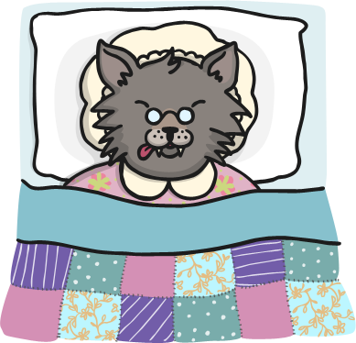
Name that character!
It’s an animal…
He’s got sharp teeth…
He’s got big eyes…
He likes to eat grandmas and little girls…
The Big Bad Wolf!
(from Little Red Riding Hood)

Slide 9
Some other key features include:
Start with ‘Once upon a time’ or ‘In a land far away’ etc.
Good vs evil
Power of three eg Three Little Pigs, Billy Goats Gruff, Goldilock and the Three Bears etc.
Magic
Love
A happy ending

Slide 10

Your Task:
In your groups I would like you to explore the traditional tales.
Do you know what the traditional tale is?
Do you like the story?
Do you like the characters?
What do you notice about the setting and the character?

