Slide 1

What comes next? 11, 12, 13, ___
1 ten and 7 ones = ____
Can you count from 15 to 20?
14
17
15, 16, 17, 18, 19, 20

Slide 2
L.O to add by counting on.
11.01.21

Slide 3


Counting on
10 +
What number is this?
14
8 +
What number is this?
13

Slide 4


Have a think
There were 8 ants out for a walk.
Then 4 more joined in.
How many ants were out for a walk?
8 + 4 = 12

Slide 5
Counting on from 10
There were 9 ants out for a walk.
Then 5 more joined in.
How many ants were out for a walk?
1
2
3
4
5
6
7
8
9
10
11
12
13
14
15
16
17
18
19
20

Slide 6
Let’s have a go at questions 1 and 2 on the worksheet together.

Slide 7
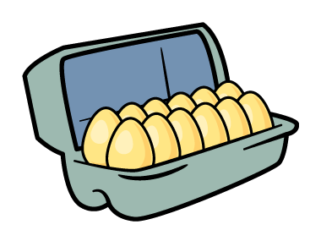
Counting on
Eva found 12 eggs.
Her mum bought 6 more.
How many eggs do they have now?
1
2
3
4
5
6
6
7
8
9
10
11
12
13
14
15
16
17
18
19
20

Slide 8


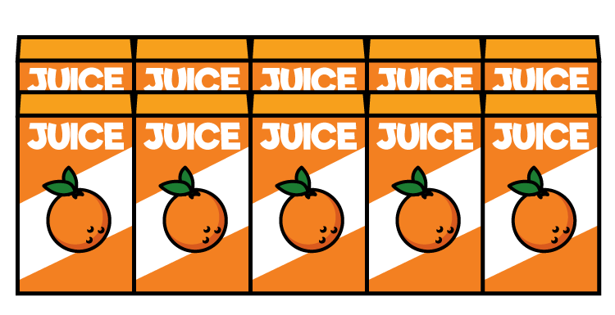
Have a think
Counting on
The shop had 4 juice boxes.
They ordered 12 more.
How many juice boxes do they have now?
3
4
5
6
7
8
9
10
11
12
13
14
15
16
17
18

Slide 9
Have a think
Counting on
The shop had 4 juice boxes.
They ordered 12 more.
How many juice boxes do they have now?
1
2
3
4
3
4
5
6
7
8
9
10
11
12
13
14
15
16
17
18

Slide 10
Task:
Carry on with the questions on your sheet.
Remember you start with the biggest number first and carry on counting.

