Slide 1

Year 1 LO: to find and make number bonds to 20.
Must: recall number bonds to 10.
Should: use number bonds to 10 to find number bonds to 20.
Could: work systematically to find all possible answers.

Slide 2
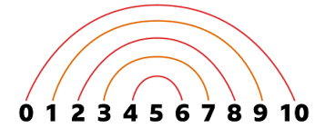
Recap number bonds to 10

Slide 3
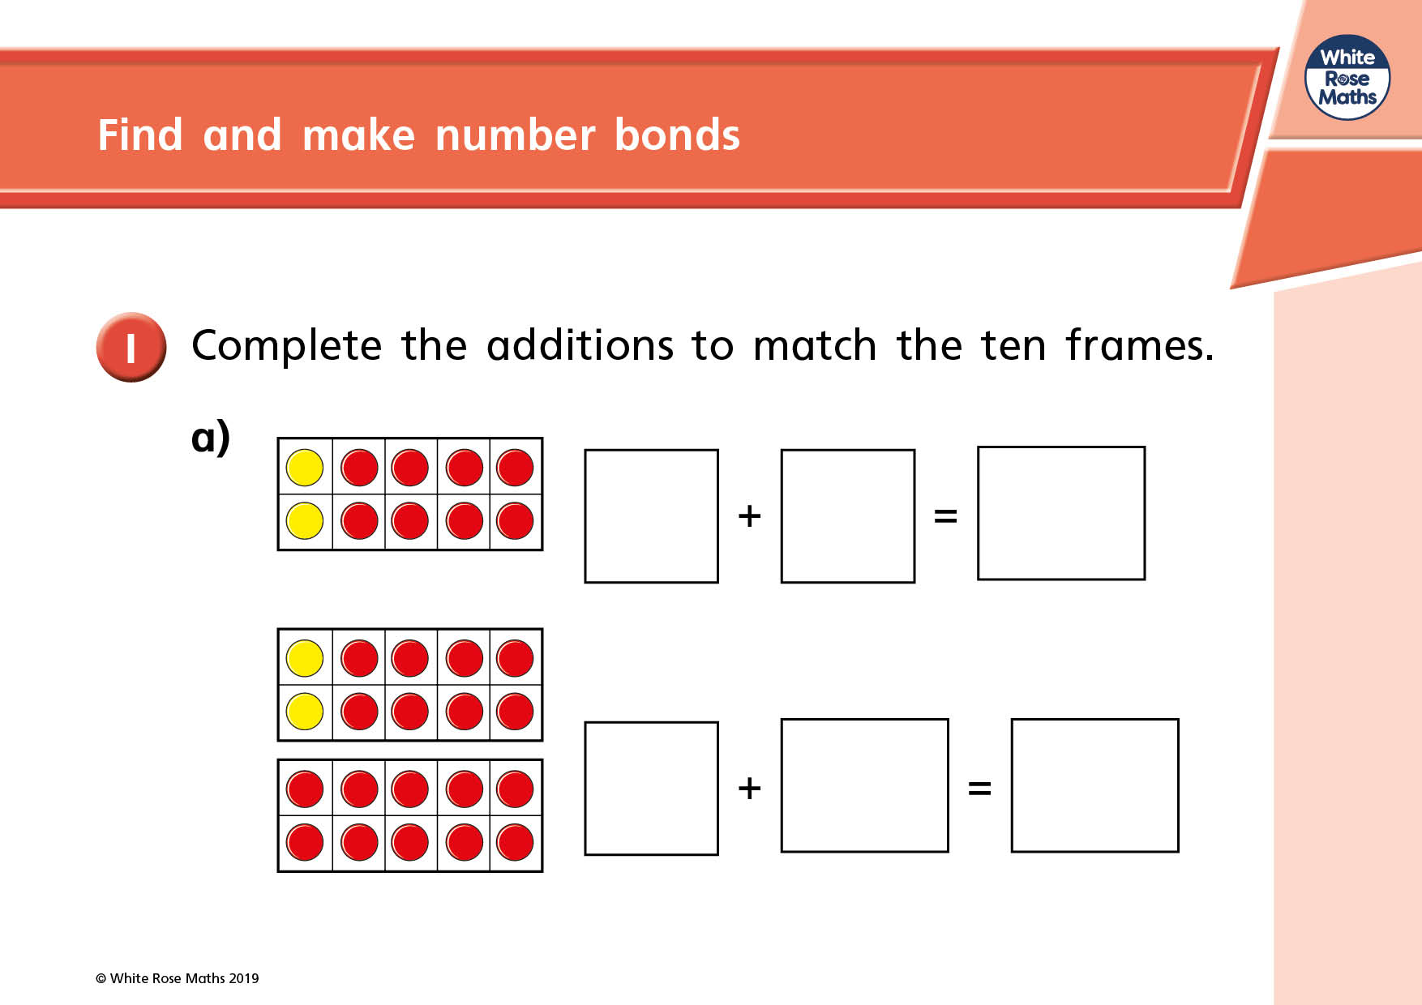

Slide 4
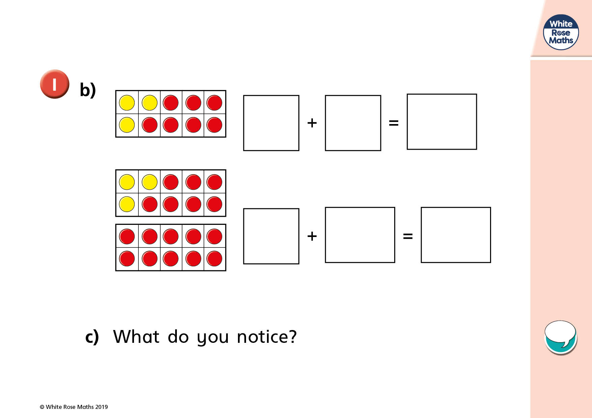

Slide 5
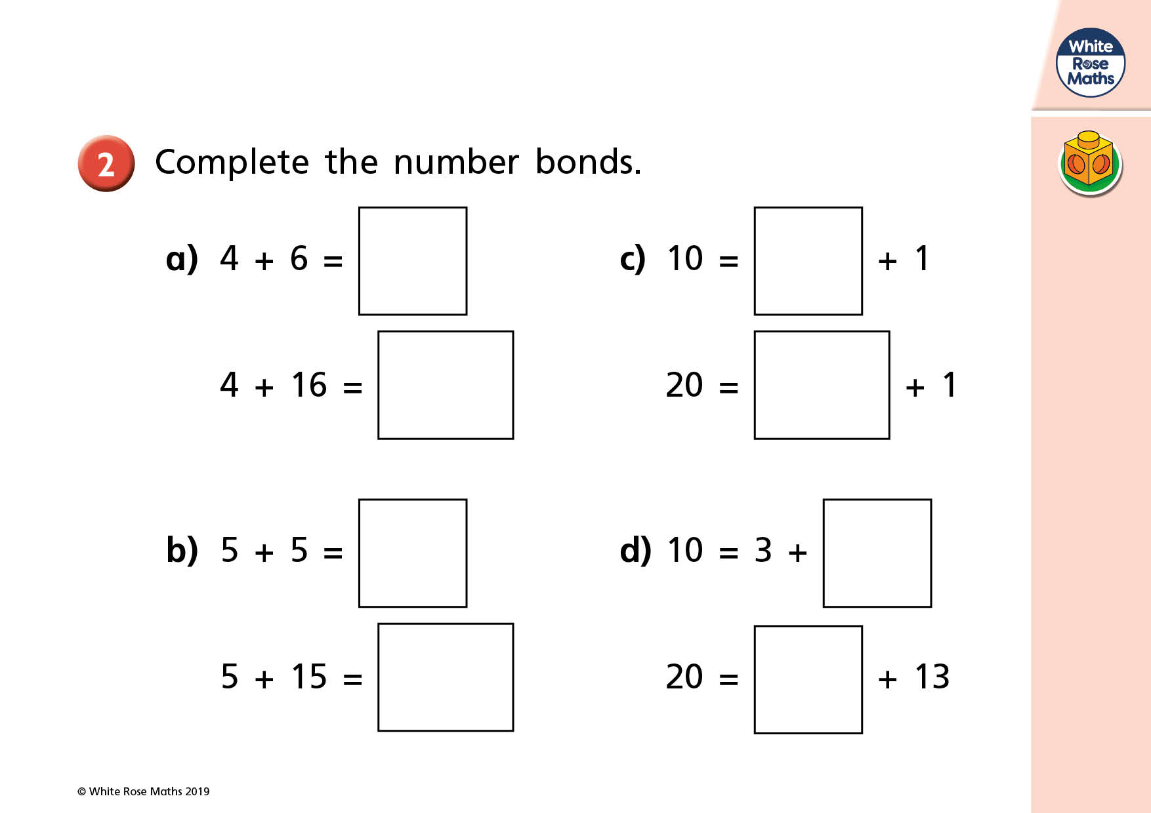

Slide 6
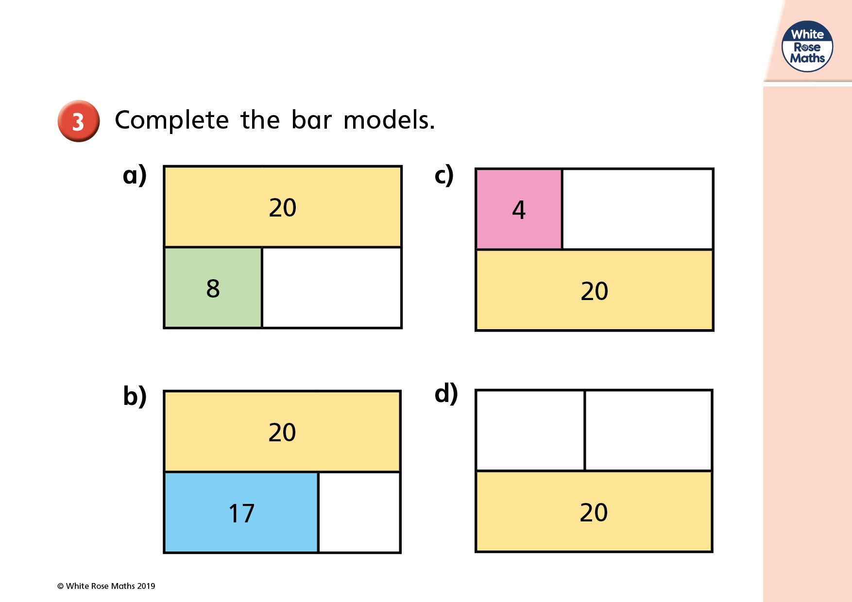

Slide 7
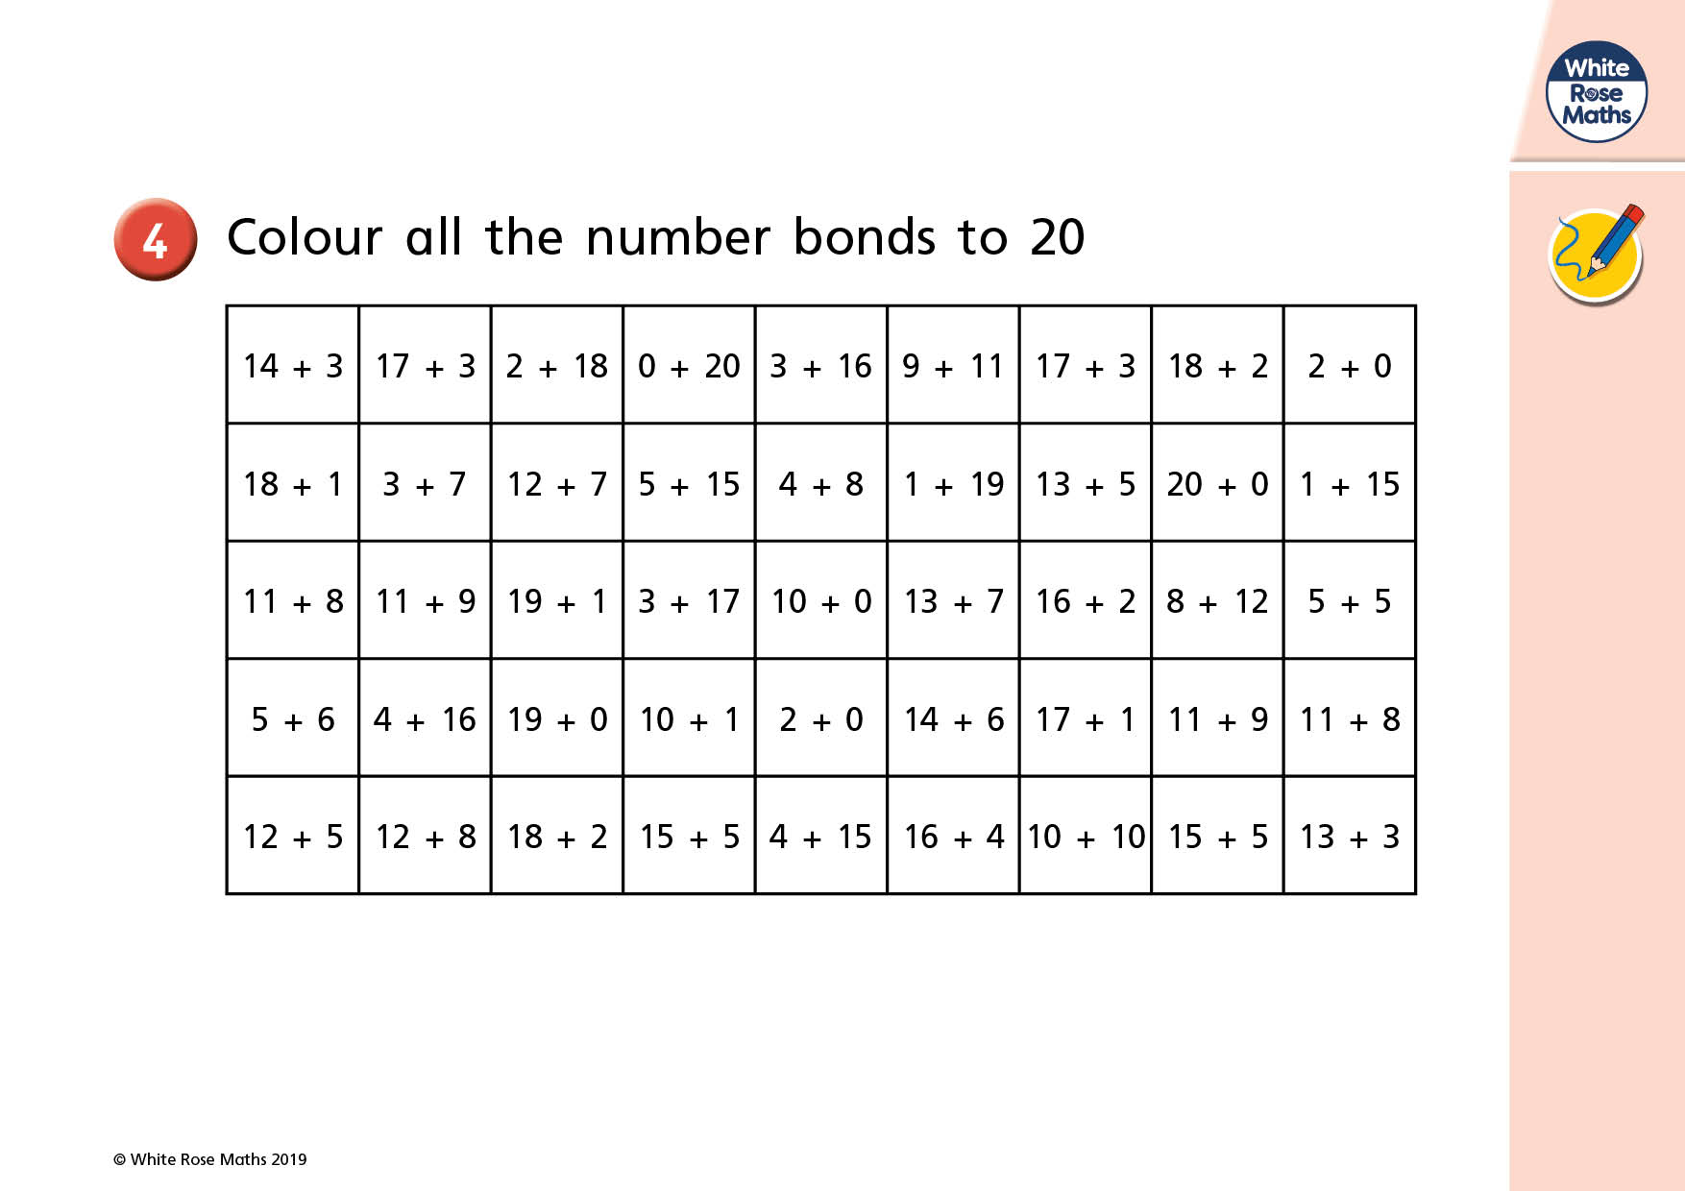

Slide 8
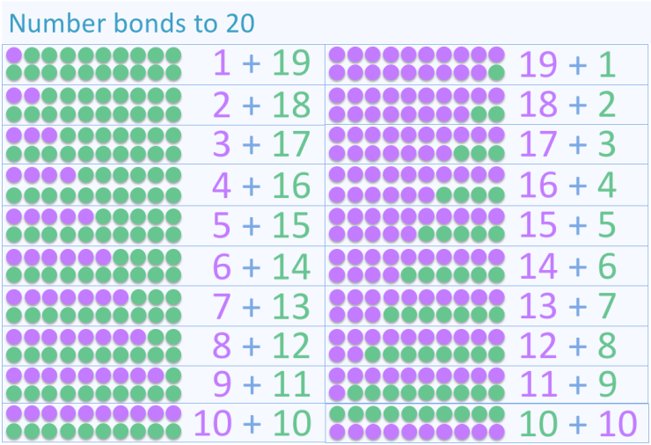
Working systematically

Slide 9

Plenary
Quick fire number bonds to 20!
True of false?
12 + 8 = 20
20 – 7 = 12

