Slide 1
Reception LO: add and subtract by counting on and back.
Must: order numbers to 20.
Should: count forwards on a number line to add.
Could: count back on a number line to subtract.
Year 1 LO: to use arrays to solve multiplication calculations.
Must: count rows and columns.
Should: draw arrays.
Could: solve multiplication word problems.

Slide 2
Name that symbol!
+
x
=
-

Slide 3
On your whiteboard, write the number sentence to match the array:
Is there more than one answer?

Slide 4
On your whiteboard, write the number sentence to match the array:
Is there more than one answer?

Slide 5
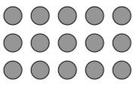
On your whiteboard, write the number sentence to match the array:
Is there more than one answer?

Slide 6

On your whiteboard, write the number sentence to match the array:
Is there more than one answer?

Slide 7
On your whiteboard, write the number sentence to match the array:
Is there more than one answer?

Slide 8
Draw the array for each number sentence:
3 x 2 =

Slide 9
Draw the array for each number sentence:
2 x 5 =

Slide 10
Draw the array for each number sentence:
6 x 2 =

Slide 11
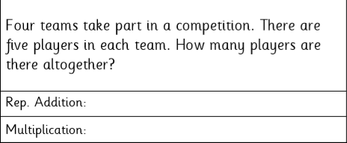
Word problems:
What is the question asking? Can you draw an array?
5 + 5 + 5 + 5 =
4 x 5 =

Slide 12
Your task:
Select your task sheet according to how confident you are feeling!
Can you record the multiplication calculation?
Can you draw the array to match the calculation?
Can you solve a multiplication word problem?

