Slide 1


LO: To add single and 2 digit numbers
Must: add single digit numbers using a number line.
Should: add 2 digit numbers by adding tens and ones.
Could: solve addition word problems.

Slide 2

Starter…
How quickly can you say the number of objects you can see?

Slide 3

How many?
1

Slide 4

How many?
3

Slide 5

How many?
4

Slide 6

How many?
2

Slide 7

How many?
5

Slide 8

How many?
Tip:
When the top row is full, you know that this is 5.
Strategy: Put 5 in your head and count on for the bottom row. It is quicker than starting to count from 1 again!
6

Slide 9

How many?
8

Slide 10

How many?
7

Slide 11

How many?
9

Slide 12

How many?
10

Slide 13
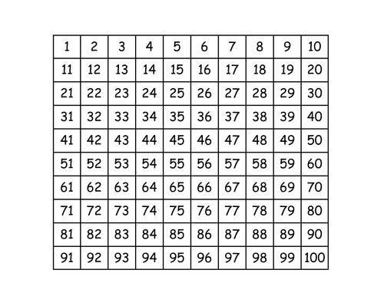
Recap! Count in tens from any number…
Can you count in tens from any number?
How many tens in 36? Can you add 1 more ten?
What is ten more than 68? 14? 31? etc

Slide 14
Addition- single digit
How can we solve these questions?
15 + 4 =
9 + 8 =
11 + 5 =
7 + 6 =
14 + 9 =

Slide 15



Addition- 2 digit
How can we add two 2-digit numbers quickly?
How many tens and how many ones?
14 + 12 =

Slide 16
Addition-2 digit
24 + 13 =

Slide 17
Your task:
1) Single digit addition worksheet. Use a numberline to count on.
2) 2-digit addition. Use a hundred square to add tens and ones.

