Slide 1
Reception LO: to create a wanted poster.
Must: verbally describe the wolf
Should: draw a picture of the wolf
Could: write some simple words to describe the wolf.
Year 1 LO: to write a character description
Must: write sentences which can be read back.
Should: use adjectives to describe.
Could: use conjunctions to extend my sentences.

Slide 2


Slide 3
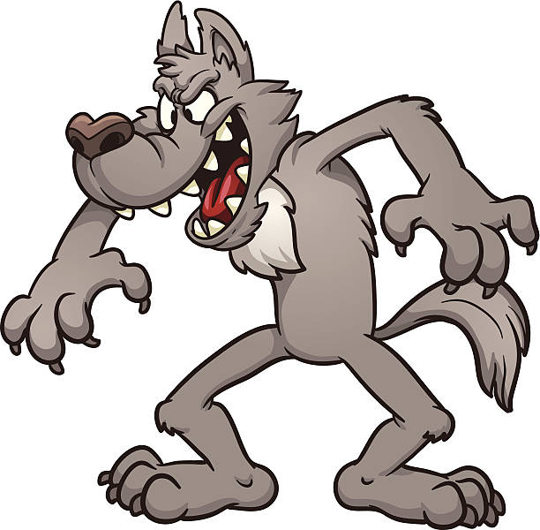
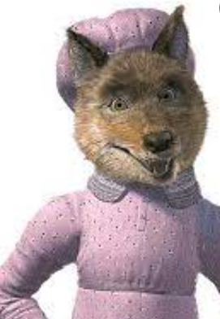
Wanted!
How can we describe the wolf?
What kind of words will we need to use?
What is an adjective?

Slide 4

Use your senses to help describe the wolf. What does he look like? Sound like? Feel like? Smell like?

Slide 5
Your task:
Write a character description/ make a wanted poster for the wolf.
Use adjectives to describe
Use your senses to help describe the wolf.
Check your writing makes sense!

