Slide 1
Reception LO: to listen carefully to initial sounds in words.
Must: listen carefully.
Should: recognise some initial sounds.
Could: group words with the same initial sound.
Year 1 LO: to plan my diary
Must: sequence key events.
Should: record key vocab
Could: record feeling words eg scared.

Slide 2
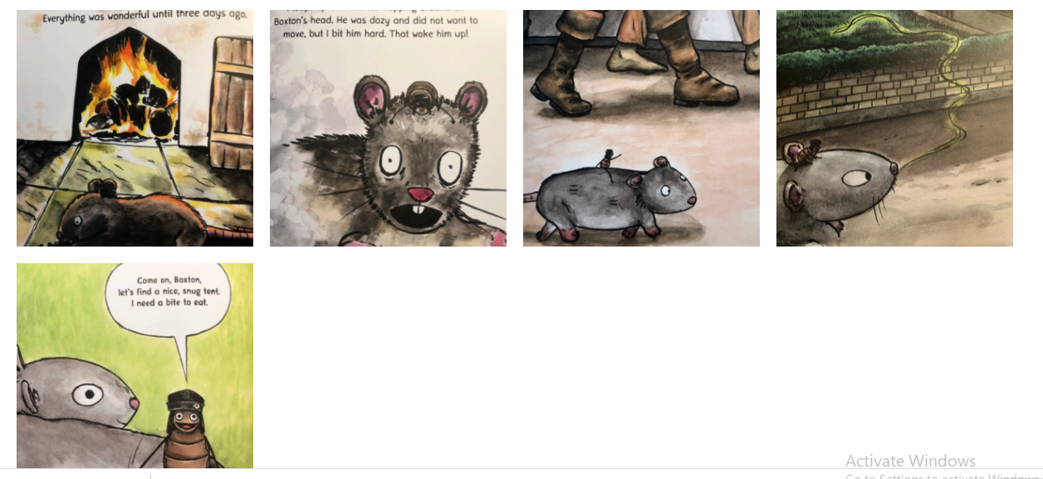
Sequence the events

Slide 3
What are the features of a diary?
Starts with ‘Dear Diary’
Has a date
Uses time connectives
Records the events in the order they happen
Explains how you are feeling
Finishes with your name
Click to reveal

Slide 4
Time connectives
Can you think of any time connectives?
After that
next
first
then
finally

Slide 5
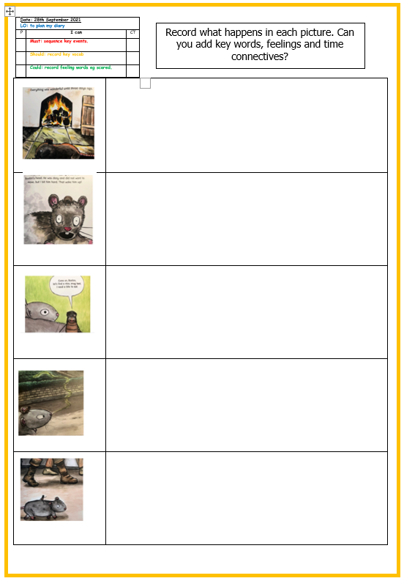
Your task
Add key words and time connectives for each main event on your planning sheet.
You can write in full sentences if you want to.
Challenge: Can you record how Vlad was feeling at each event?

Slide 6
Plenary
Share your plan with a partner. Talk through what you have written.

