Slide 1
LO: to identify imperative verbs.
Must: know what a verb is.
Should: identify imperative verbs in a sentence.
Could: write my own sentence using imperative verbs.

Slide 2
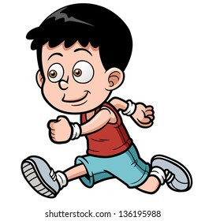
What is a verb?
A verb is a word that shows an action or state of being. Whatever you are doing can be expressed by a verb.
All sentences need a verb!
Eg
The boy is running.
The shops are closed.
Fairies can fly!
Carefully, the door creaked open.

Slide 3
Imperative Verbs
Imperative verbs are verbs that create an imperative sentence (i.e. a sentence that gives an order or command). When reading an imperative sentence, it will always sound like the speaker is bossing someone around. Imperative verbs don't leave room for questions or discussion, even if the sentence has a polite tone.
Simon says…..
Jump up and down!
Turn around!
Clean your room!
Do your homework.
Take the dog for a walk, please.
Don't touch that!
Do come to visit us whenever you're in town.

