Slide 1


Year 1/2 – Spring Block 1 – Multiplication and Division – Step 21
About This Resource:
This PowerPoint has been designed to support your teaching of this small step. It includes a starter activity and an example of each question from the Varied Fluency and Reasoning and Problem Solving resources also provided in this pack. You can choose to work through all examples provided or a selection of them depending on the needs of your class.
National Curriculum Objectives:
Mathematics Year 1: (1N1b) Count in multiples of twos, fives and tens
Mathematics Year 1: (1C8) Solve one-step problems involving multiplication and division, by calculating the answer using concrete objects, pictorial representations and arrays with the support of the teacher
Mathematics Year 2: (2C6) Recall and use multiplication and division facts for the 2, 5 and 10 multiplication tables, including recognising odd and even numbers
Mathematics Year 2: (2C7) Calculate mathematical statements for multiplication and division within the multiplication tables and write them using the multiplication (×), division (÷) and equals (=) signs
Mathematics Year 2: (2C8) Solve problems involving multiplication and division, using materials, arrays, repeated addition, mental methods, and multiplication and division facts, including problems in contexts
Mathematics Year 2: (2C9b) Show that multiplication of two numbers can be done in any order (commutative) and division of one number by another cannot
More Year 1 and Year 2 Multiplication and Division resources.
Did you like this resource? Don’t forget to review it on our website.
© Classroom Secrets Limited 2019

Slide 2
Year 1/2 – Spring Block 1 – Multiplication and Division
Step 21
Year 1: Make Equal Groups – Grouping
Year 2: Make Equal Groups – Grouping
© Classroom Secrets Limited 2019

Slide 3

Introduction
How many fish are there?
Can they be split into 2 equal groups?
Does it matter if the fish are different colours?
Y1

Slide 4

Introduction
How many fish are there? 11
Can they be split into 2 equal groups? No
Does it matter if the fish are different colours? No
There will be 1 tank of 5 fish and 1 tank of 6 fish.
Y1

Slide 5

Introduction
Sort the autumn treasure into three equal groups.
Each group needs the same number of each object.
Y2
© Classroom Secrets Limited 2019

Slide 6
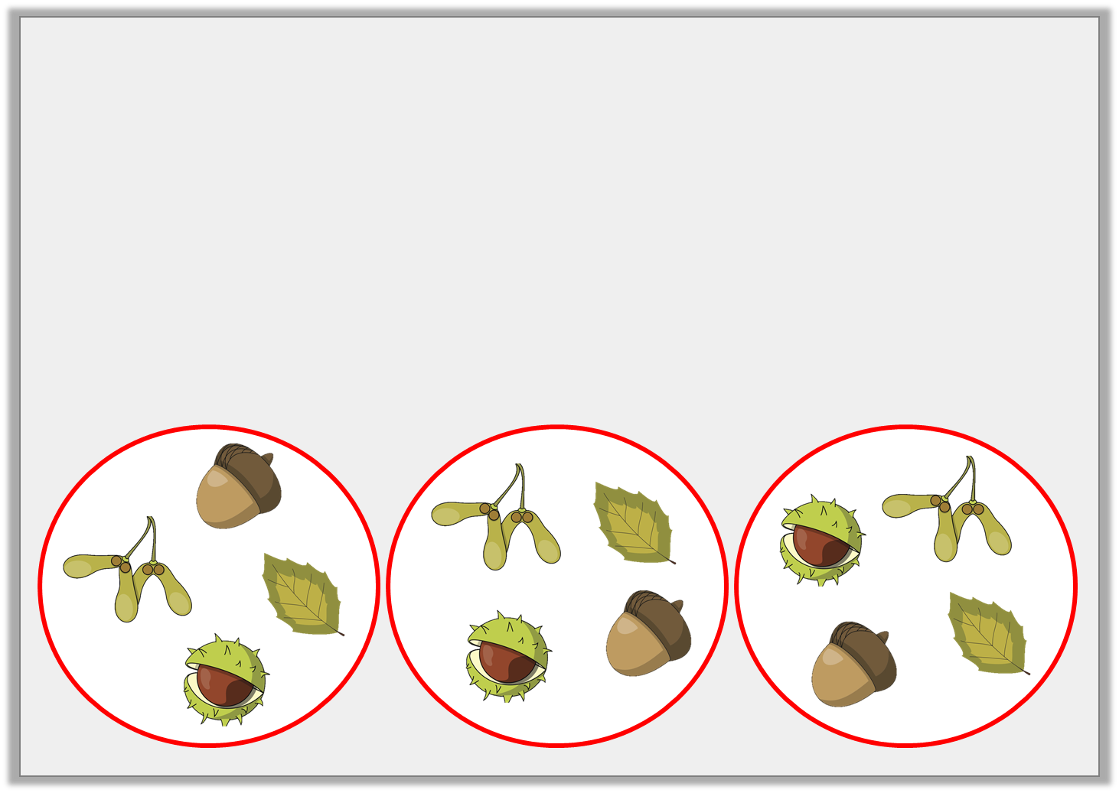
Introduction
Sort the autumn treasure into three equal groups.
Each group needs the same number of each object.
Y2
© Classroom Secrets Limited 2019

Slide 7
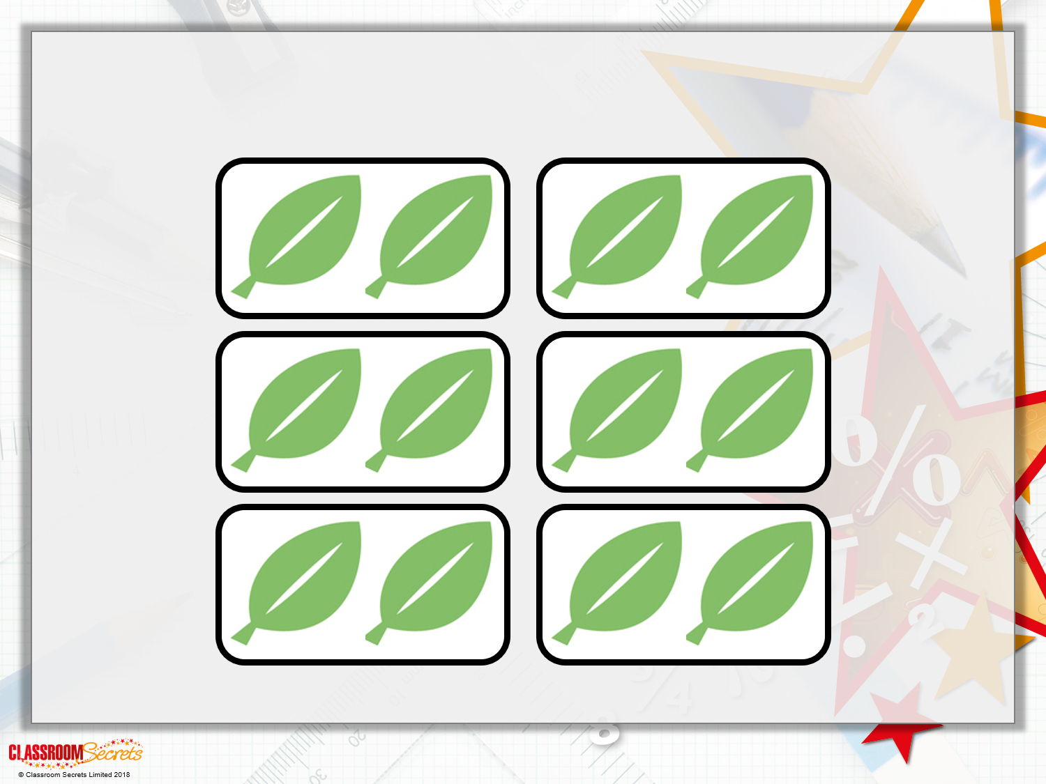
Varied Fluency 1
True or false? There are 6 equal groups of 2 leaves.
Y1

Slide 8
Varied Fluency 1
True or false? There are 6 equal groups of 2 leaves.
True
Y1

Slide 9
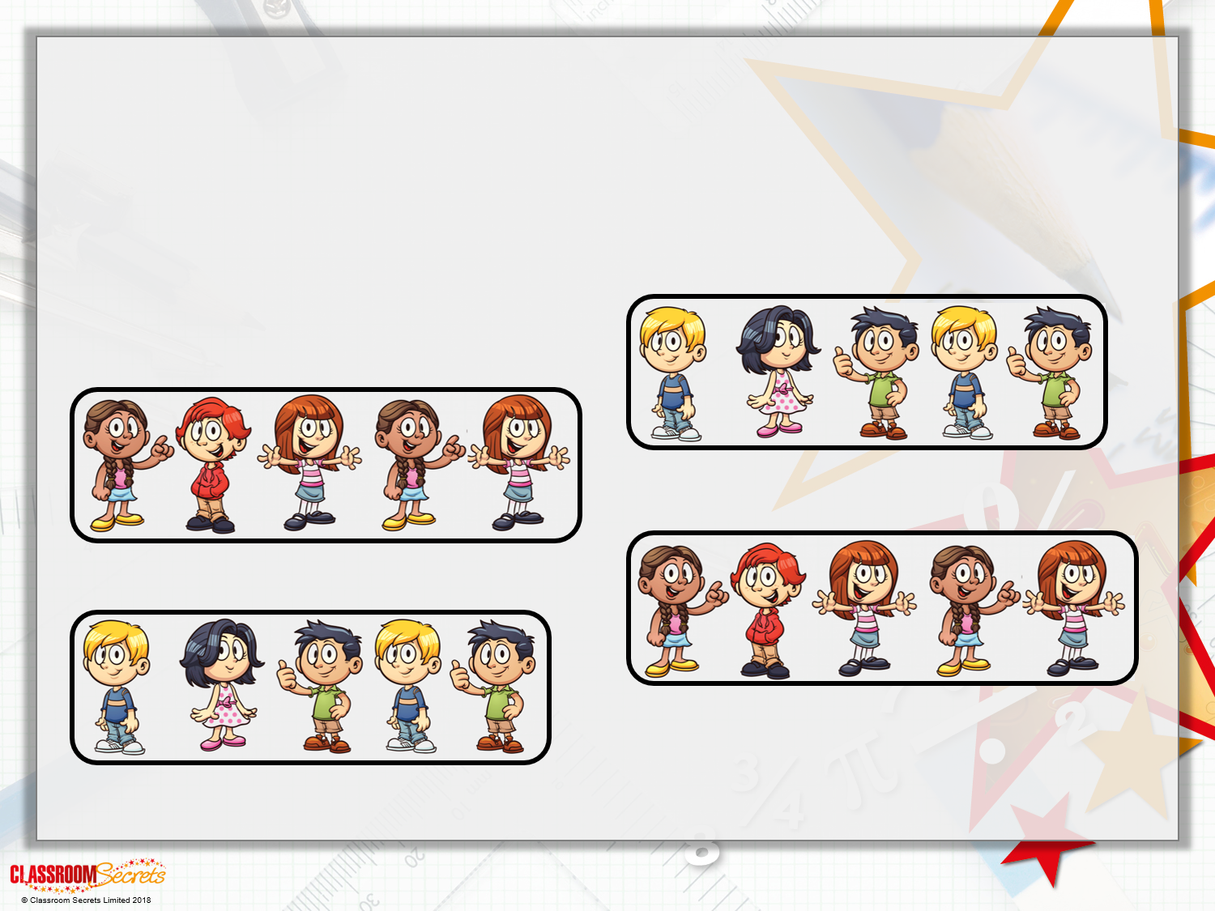
Varied Fluency 2
Fill in the blanks.
There are ______ equal groups of ______ children.
Y1

Slide 10
Varied Fluency 2
Fill in the blanks.
There are ______ equal groups of ______ children.
4
5
Y1

Slide 11
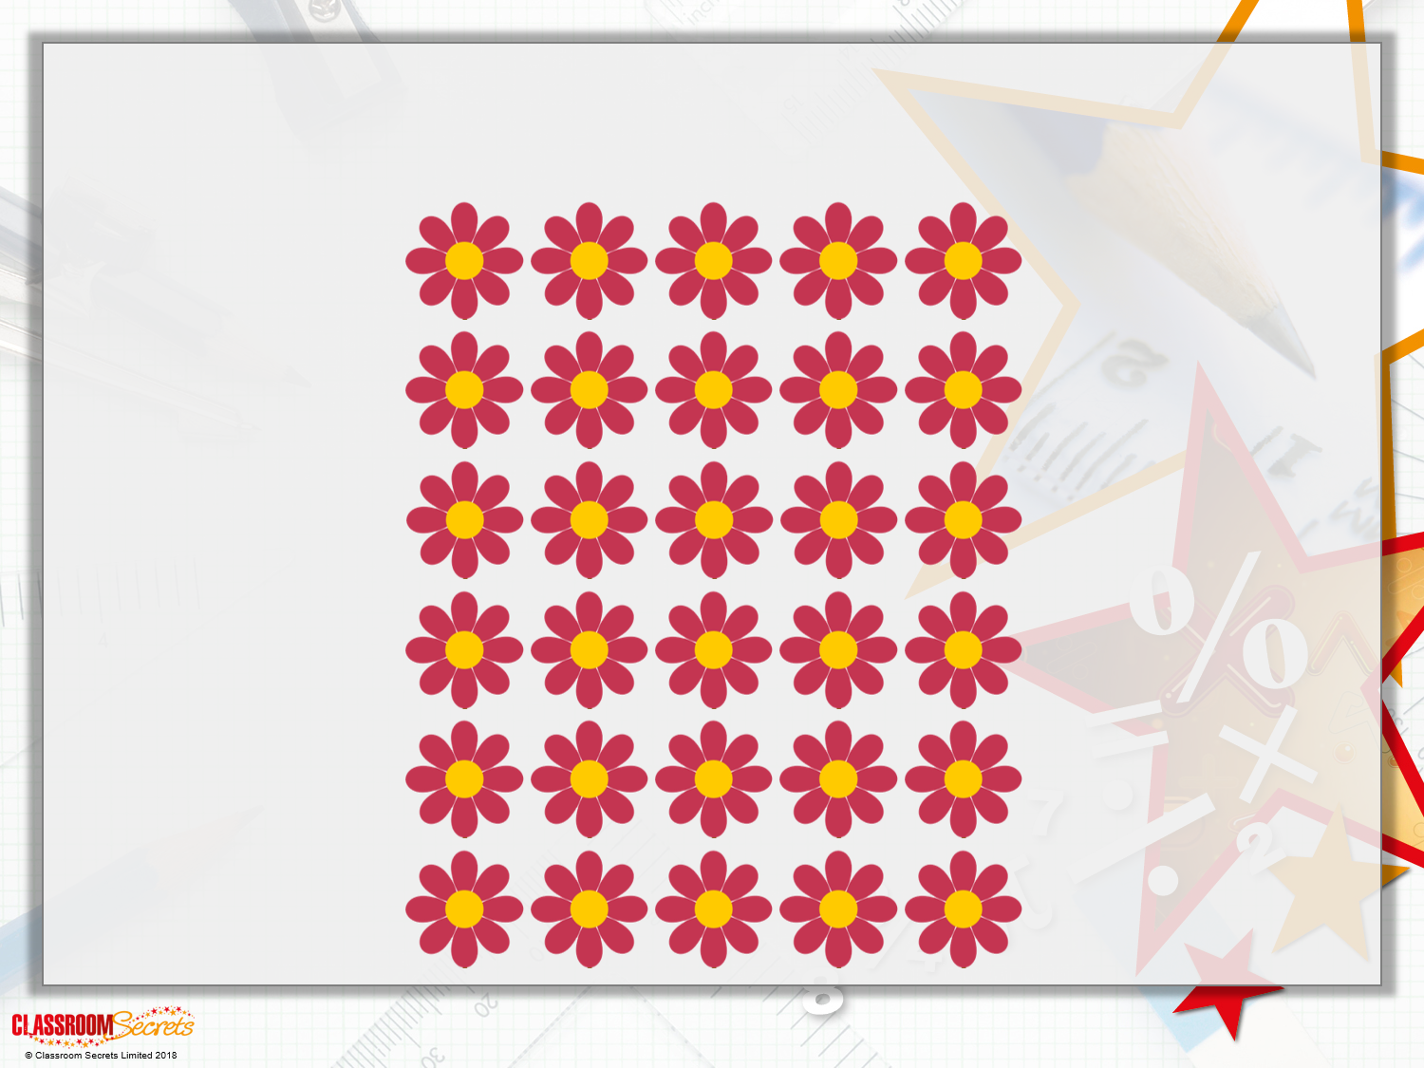
Varied Fluency 3
How many equal groups of 10 flowers can you make?
Y1

Slide 12
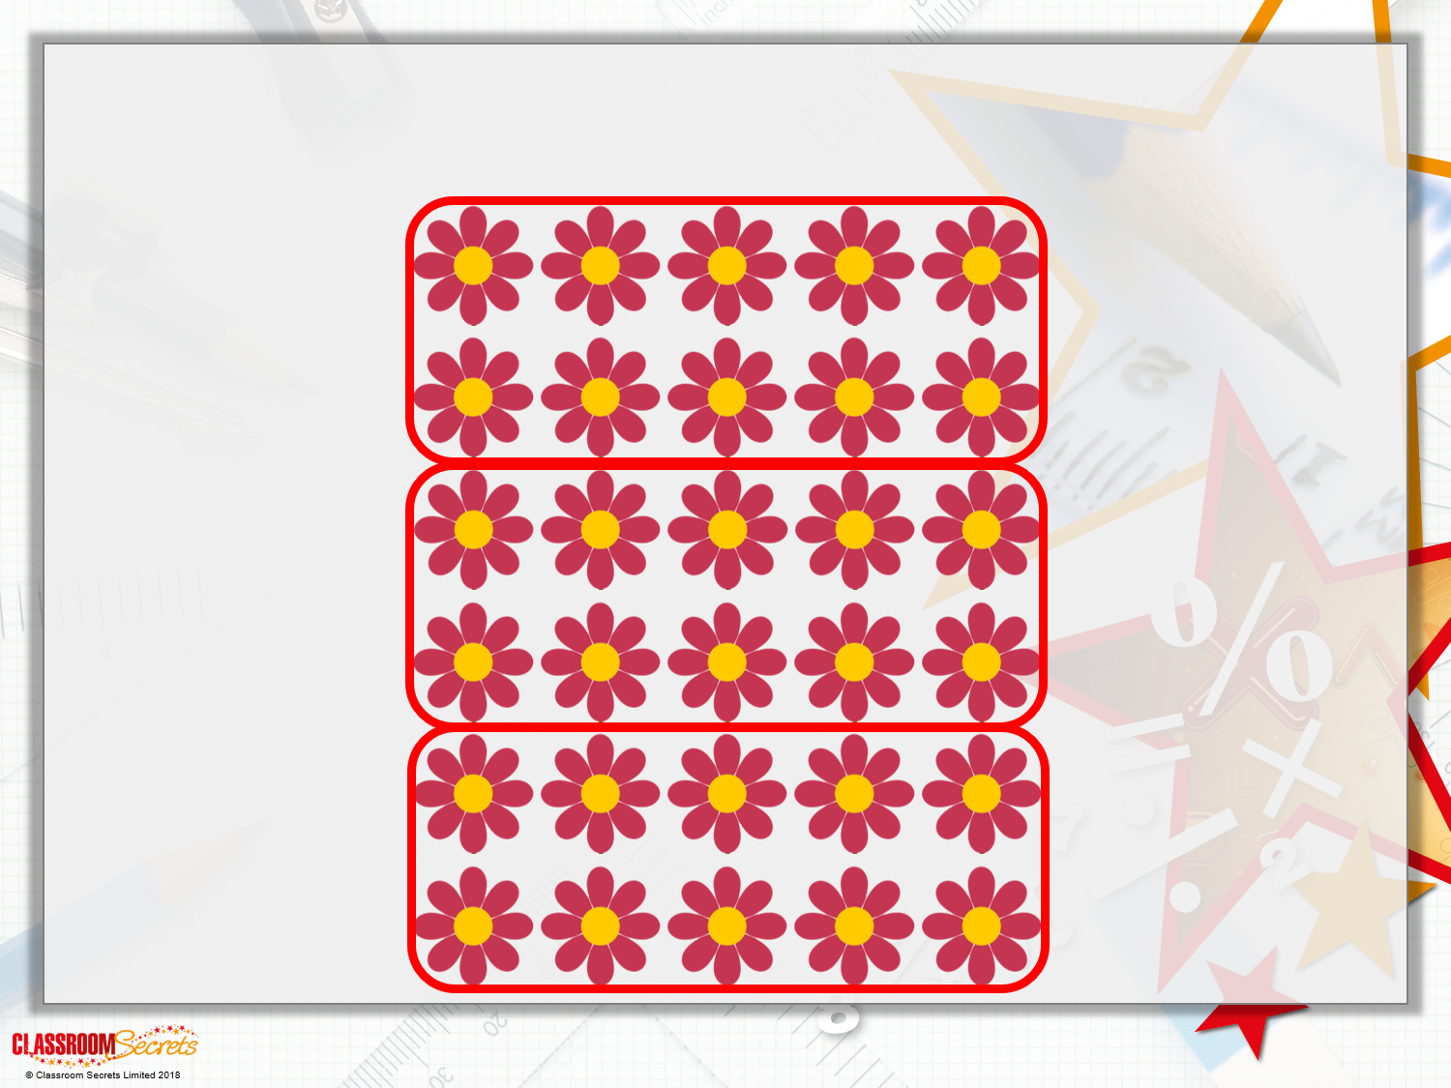
Varied Fluency 3
How many equal groups of 10 flowers can you make?
Y1

Slide 13
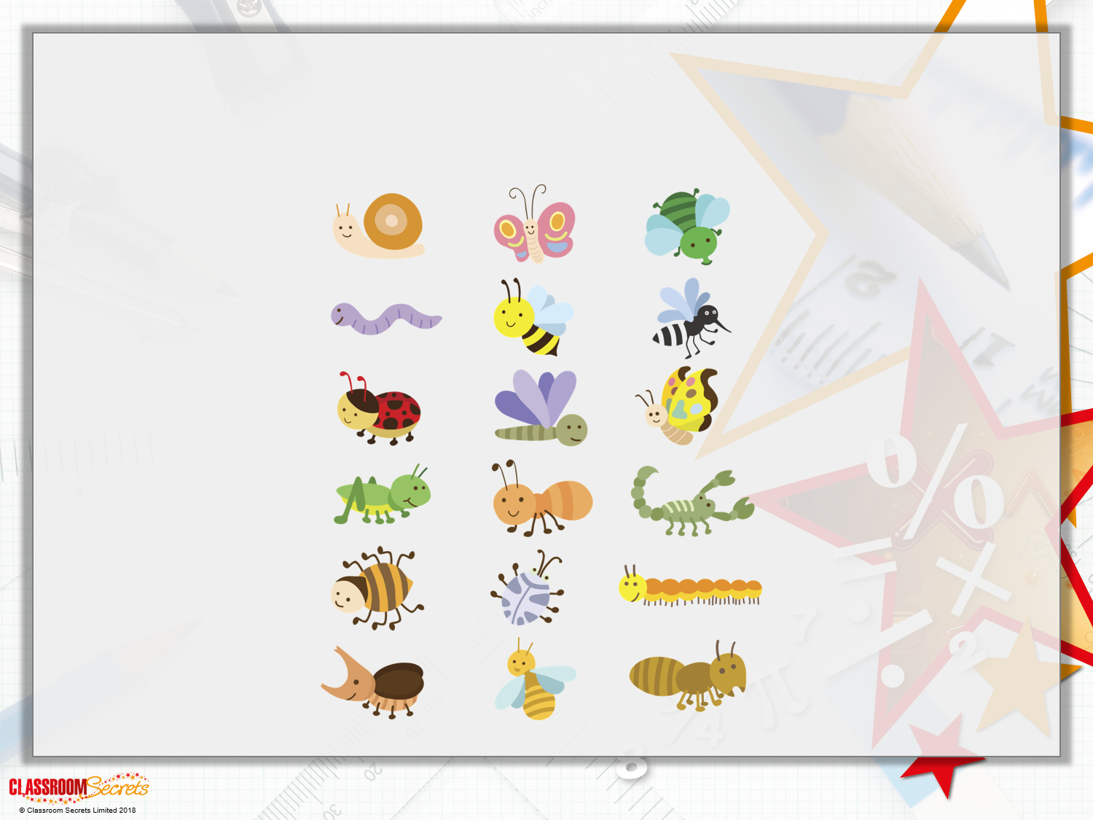
Varied Fluency 4
True or false? I can make 4 equal groups of 5 insects.
Y1

Slide 14
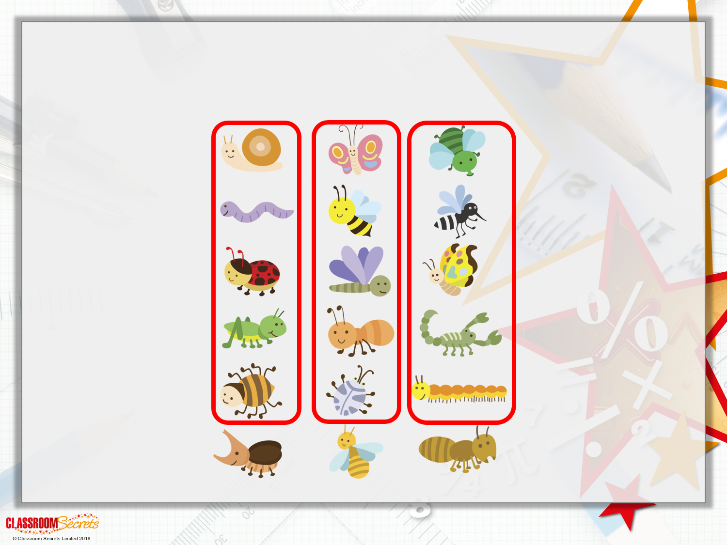
Varied Fluency 4
True or false? I can make 4 equal groups of 5 insects.
False – I do not have enough insects.
Y1

Slide 15

Varied Fluency 1
Sort 30 cubes into equal groups of 5.
How many cubes are there?
How many groups are there?
How many cubes are in each group?
Y2
© Classroom Secrets Limited 2019

Slide 16
Varied Fluency 1
Sort 30 cubes into equal groups of 5.
How many cubes are there?
There are 30 cubes.
How many groups are there?
There are 6 groups.
How many cubes are in each group?
There are 5 cubes in each group.
Y2
© Classroom Secrets Limited 2019

Slide 17
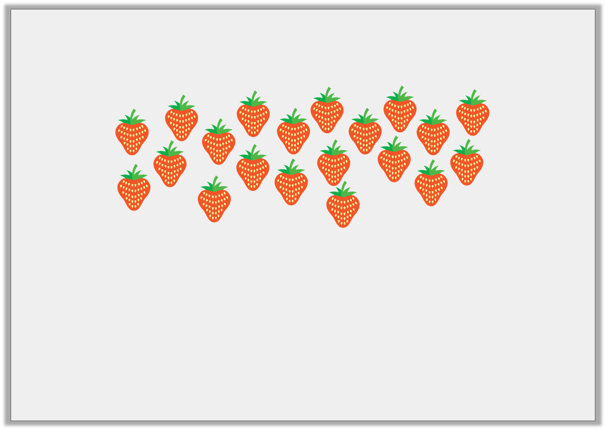
Varied Fluency 2
Group the strawberries into equal groups of two.
Using the groups complete the following calculations:
20 | ÷ | __ | = | 2
__ | x | 2 | = | 20
Y2
© Classroom Secrets Limited 2019

Slide 18
Varied Fluency 2
Group the strawberries into equal groups of two.
Using the groups complete the following calculations:
20 | ÷ | 10 | = | 2
10 | x | 2 | = | 20
Y2
© Classroom Secrets Limited 2019

Slide 19
Varied Fluency 3
Use the number line to help complete the calculation.
0 | 1 | 2 | 3 | 4 | 5 | 6 | 7 | 8 | 9 | 10 | 11 | 12
 | ÷ |  | =
Y2
© Classroom Secrets Limited 2019

Slide 20
Varied Fluency 3
Use the number line to help complete the calculation.
0 | 1 | 2 | 3 | 4 | 5 | 6 | 7 | 8 | 9 | 10 | 11 | 12
8 | ÷ | 4 | = | 2
Y2
© Classroom Secrets Limited 2019

Slide 21
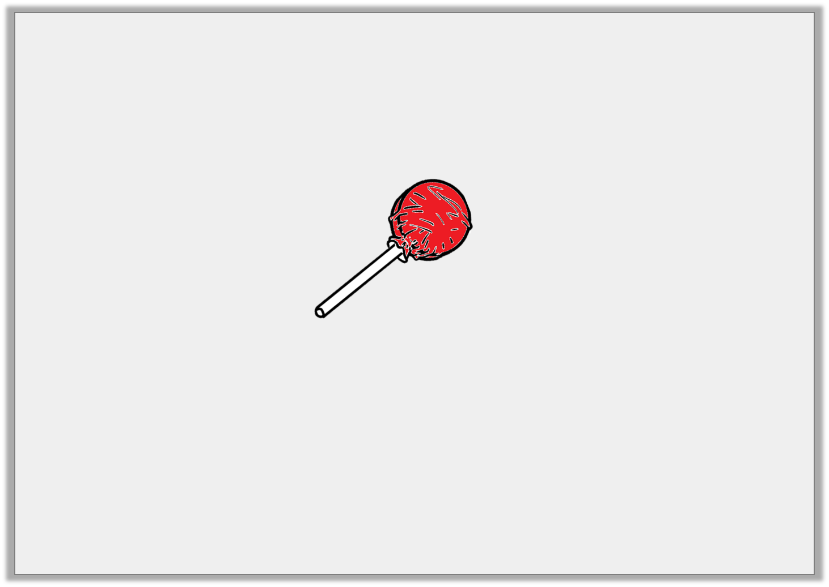
Varied Fluency 4
Mrs Greg buys a bag of 60 lollies.
Each group needs 10 lollies.
How many groups can have lollies?
Y2
© Classroom Secrets Limited 2019

Slide 22
Varied Fluency 4
Mrs Greg buys a bag of 60 lollies.
Each group needs 10 lollies.
How many groups can have lollies?
6 groups
Y2
© Classroom Secrets Limited 2019

Slide 23
Problem Solving 1
Kylie is thinking of a number.
She can describe her number using two number cards.
My number can make ______ equal groups of 5 or
______ equal groups of 10.
What number is she thinking of?
2
7
4
Y1
© Classroom Secrets Limited 2019

Slide 24
Problem Solving 1
Kylie is thinking of a number.
She can describe her number using two number cards.
My number can make ______ equal groups of 5 or
______ equal groups of 10.
What number is she thinking of? 20
2
7
4
4
2
Y1
© Classroom Secrets Limited 2019

Slide 25
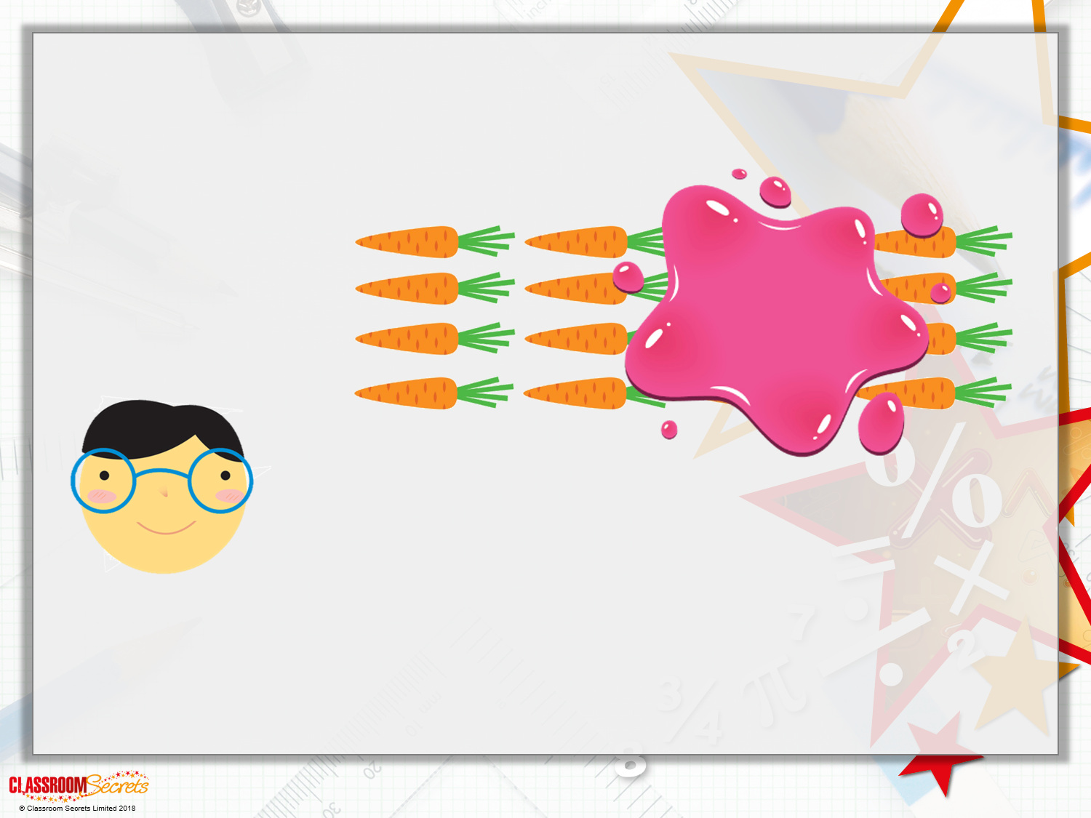
Problem Solving 2
Jaxon has fewer than 20 carrots. Some are hidden by the splat.
How many carrots could he have?
I can make equal groups of 2.
Y1

Slide 26
Problem Solving 2
Jaxon has fewer than 20 carrots. Some are hidden by the splat.
How many carrots could he have?
He could have 14, 16 or 18 carrots.
I can make equal groups of 2.
Y1

Slide 27
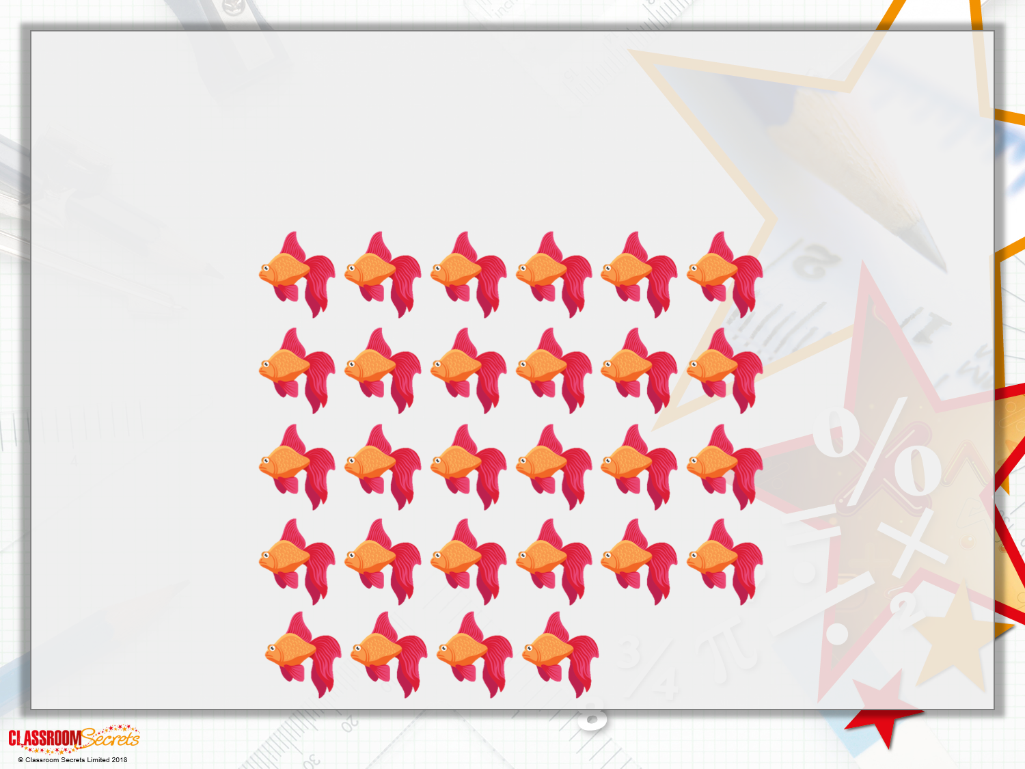
Reasoning 1
Charlie is grouping some fish to put into tanks.
He wants to make 6 equal groups of 5.
Does he have enough fish?
Y1

Slide 28
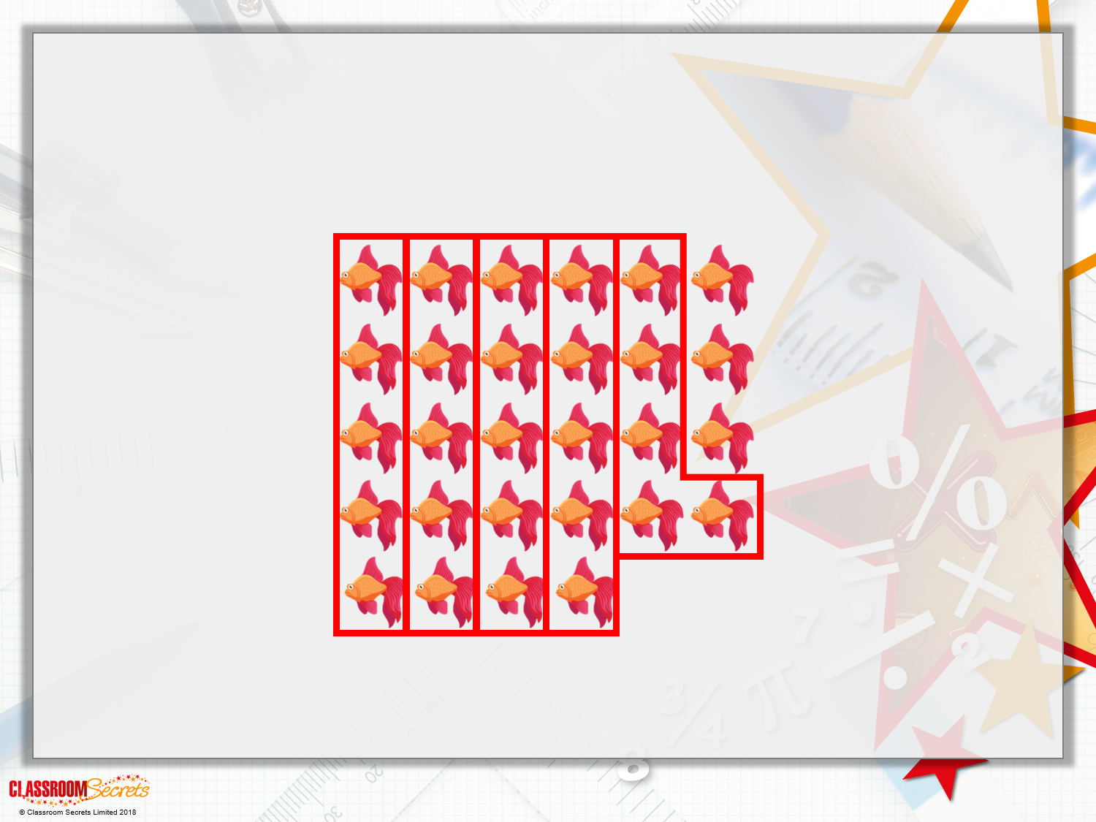
Reasoning 1
Charlie is grouping some fish to put into tanks.
He wants to make 6 equal groups of 5.
Does he have enough fish?
Charlie does not have enough fish to make 6 equal groups of 5. He can make 5 equal groups of 5 and he will have 3 leftover.
Y1

Slide 29
Problem Solving 1
Which of the following numbers can
be put into equal groups of 2?
What do you notice about the numbers?
16
23
Twelve
21
11
eight
twenty
Y2
© Classroom Secrets Limited 2019

Slide 30
Problem Solving 1
Which of the following numbers can
be put into equal groups of 2?
What do you notice about the numbers?
All the numbers are multiples of 2.
16
23
Twelve
21
11
eight
twenty
Y2
© Classroom Secrets Limited 2019

Slide 31
Problem Solving 2
Max is trying to calculate the number of
beanbags in a bag.
How many beanbags were in the bag at the start? Show your working.
Max knows the beanbags are put into equal groups of ten.
He knows there are four equal groups.
Y2
© Classroom Secrets Limited 2019

Slide 32
Problem Solving 2
Max is trying to calculate the number of
beanbags in a bag.
How many beanbags were in the bag at the start? Show your working.
Four equal groups of ten. 4 x 10 = 40 beanbags.
Max knows the beanbags are put into equal groups of ten.
He knows there are four equal groups.
Y2
© Classroom Secrets Limited 2019

Slide 33

Reasoning 1
Bahar, Ejaz and Lola are grouping counters.
They each have 18 counters.
Who is correct? Explain why.
Eighteen in equal groups of two equals 6 groups.
Bahar
Eighteen in equal groups of two equals nine groups.
Ejaz
Eighteen in equal groups of five equals three groups.
Lola
Y2
© Classroom Secrets Limited 2019

Slide 34
Reasoning 1
Bahar, Ejaz and Lola are grouping counters.
They each have 18 counters.
Who is correct? Explain why.
Ejaz is correct because…
Eighteen in equal groups of two equals 6 groups.
Bahar
Eighteen in equal groups of two equals nine groups.
Ejaz
Eighteen in equal groups of five equals three groups.
Lola
Y2
© Classroom Secrets Limited 2019

Slide 35
Reasoning 1
Bahar, Ejaz and Lola are grouping counters.
They each have 18 counters.
Who is correct? Explain why.
Ejaz is correct because 18 ÷ 9 = 2.
Eighteen in equal groups of two equals 6 groups.
Bahar
Eighteen in equal groups of two equals nine groups.
Ejaz
Eighteen in equal groups of five equals three groups.
Lola
Y2
© Classroom Secrets Limited 2019

