Slide 1
LO: To explore the features of good and bad characters.
Must: Sort characters from traditional tales into goodies or baddies
Should: Can name a quality of a good and bad character
Could: Explain why a character is good or bad using ‘because’
Starter:
What does it mean to be a good person?
When have you been good?
Did you do a nice thing?

Slide 2
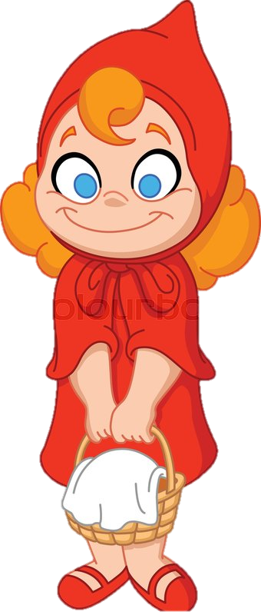
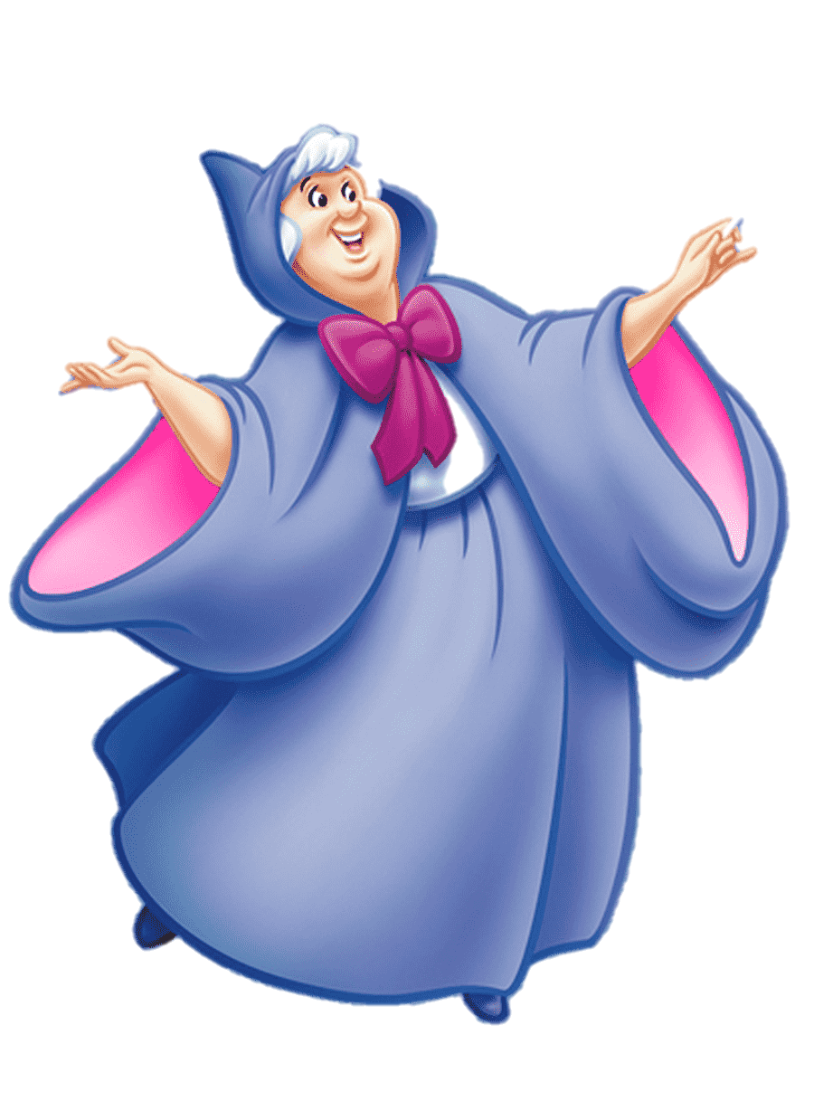
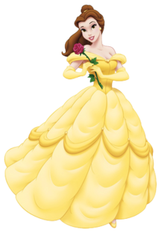
What is a good guy?
Can you think of a good guy in a story?
A nice person to the people in the story and who is often the hero.

Slide 3
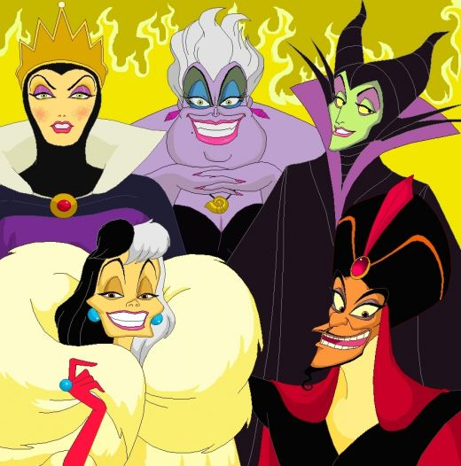
What is a bad guy?
Can you think of bad guy in a story?
A bad guy is the person who is fighting for the wrong side they are often called the villain.

Slide 4
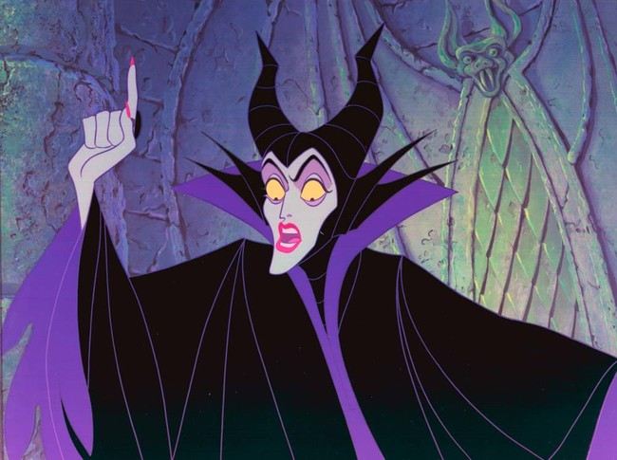
Characteristics of a good guy.
Characteristics of a bad guy.

Slide 5

Your Task:
Sort the characters into goodies and baddies.
What characteristics do they have? Record some words to describe their characteristics.
Challenge: write a sentence or 2 using ‘because’ to describe why your chosen character is good or bad.
What do you notice about the setting and the character?

