Slide 1

LO: to identify verbs

Slide 2
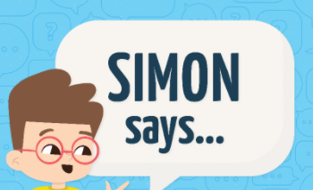
Verbs
Verbs describe an action.
For example: run, jump, sit, skip, pop, swish, creak.
You can add –ing to a verb too!
jumping
singing
hopping
crunching
ticking
jump
sing
hop
Notes:
Verbs describe an action. Some people call them doing words.
Pause here to play a game of Simon Says!
Explain that you can add –ing to a word to show that is a continuous action. Eg jumping, singing, hopping, crunching, ticking.

Slide 3
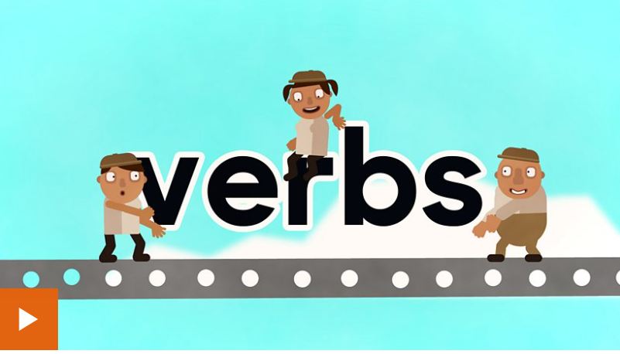
Verbs
https://www.bbc.co.uk/bitesize/topics/zrqqtfr/articles/zpxhdxs
Work through the video and activities on BBC Bitesize together.

Slide 4
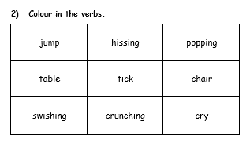

Colour all the verbs!
Remember a verb describes an action!
Notes:
Pause here and go and colour all the verbs on your worksheet. Can you find all of them? There are 6. Think carefully about if they are words that describe an action.
We will go through them together when you come back!

Slide 5

Your task:
Complete the verb worksheet. Can you identify all the verbs?
Can you underline the verbs in a sentence?
Can you write your own sentence and underline the verb?
Challenge: write 3 words on a whiteboard for a partner- 1 verb and 2 other types of words. Can your partner spot the verb?

