Slide 1
Reception LO: to subtract objects from a larger group and record using – and = symbols.
Must: touch count accurately.
Should: know a number gets smaller when you subtract.
Could: subtract using objects.
Year 1 LO: to subtract single and two digit numbers using a number line.
Must: read and write – and = symbols.
Should: count back accurately on a number line.
Could: solve subtraction word problems.

Slide 2
What do these symbols mean? Can you think of all the different words for these symbols?
+
-
=

Slide 3
What happens to a number when you subtract from it?
5 - 2 = 3
7 - 5 = 2
6 - 6 = 0
Notes:
The number gets bigger.
Model adding 5 children and then adding 2 more. What is the total?

Slide 4
When we subtract the amount gets smaller.
-
5 - 2 = 3
=

Slide 5
Try these using objects:
5 - 4 =
7 - 5 =
12 - 6 =
9- 6 =

Slide 6
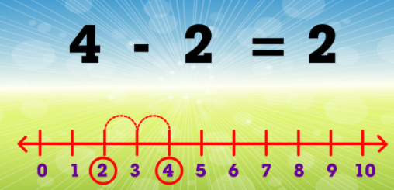
When you subtract using a number line you count back. Try these on your number line.
4 - 2 =
9 – 5 =
14 – 9 =
18 – 11 =

Slide 7
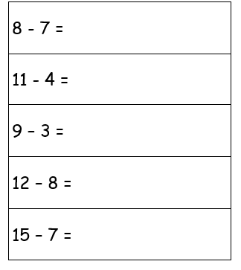
Your Task:
Reception: complete the something easier or something harder subtraction challenge sheet using counters to help you.

Slide 8
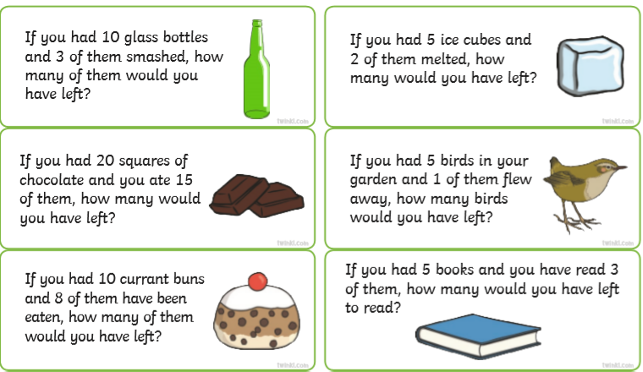
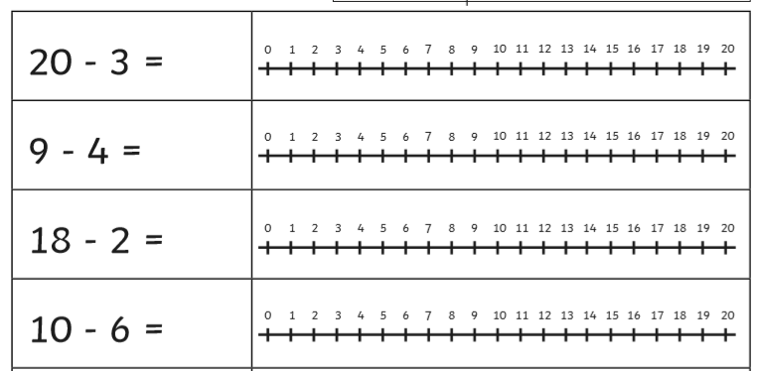
Your Task: year 1
Something easier: use counters to subtract and find out how many counters you have left.
Something harder: Complete some of the subtraction word problems. Show your working out.
Year 1: Use a number line to solve the subtraction number sentences. Show your working out. There are two levels of challenge to choose from.

