Slide 1
Year 1 LO: to add by making 10.
Must: make number bonds to 10 using a tens frame.
Should: Use number bonds to add numbers within 20.
Could: use a mental strategy.

Slide 2


Year 1 – Spring Block 1 – Addition and Subtraction
Step 3: Add by Making 10
© Classroom Secrets Limited 2018

Slide 3
Introduction
Match the numbers that bond to make 10.
10
5
1
2
7
6
0
9
8
5
3
4
© Classroom Secrets Limited 2018

Slide 4
Introduction
Match the numbers that bond to make 10.
0
10
1
9
2
8
3
7
4
6
5
5
© Classroom Secrets Limited 2018

Slide 5
Varied Fluency 1
Complete the calculation and ten frame below.
4 | + | 8 | =
© Classroom Secrets Limited 2018

Slide 6
Varied Fluency 1
Complete the calculation and ten frame below.
4 | + | 8 | = | 12
© Classroom Secrets Limited 2018

Slide 7
Varied Fluency 2
Use the part-whole model to solve this calculation.
7 | + | 6 | =
3
7 | +
10
© Classroom Secrets Limited 2018

Slide 8
Varied Fluency 2
Use the part-whole model to solve this calculation.
7 | + | 6 | = | 13
3
3
7 | +
10
© Classroom Secrets Limited 2018

Slide 9
Varied Fluency 3
Tick the calculation that matches the number track.
+ 2
+ 6
6 | 7 | 8 | 9 | 10 | 11 | 12 | 13 | 14 | 15 | 16
8 + 8 |  |  | 8 + 2
© Classroom Secrets Limited 2018

Slide 10
Varied Fluency 3
Tick the calculation that matches the number track.
+ 2
+ 6
6 | 7 | 8 | 9 | 10 | 11 | 12 | 13 | 14 | 15 | 16
8 + 8 | ✓ |  | 8 + 2
© Classroom Secrets Limited 2018

Slide 11
Varied Fluency 4
Complete the number line to show the calculation.
7 | + | 8 | =
+ 3
5 | 6 | 7 | 8 | 9 | 10 | 11 | 12 | 13 | 14 | 15
© Classroom Secrets Limited 2018

Slide 12
Varied Fluency 4
Complete the number line to show the calculation.
7 | + | 8 | = | 15
+ 3
+ 5
5 | 6 | 7 | 8 | 9 | 10 | 11 | 12 | 13 | 14 | 15
© Classroom Secrets Limited 2018

Slide 13
Problem Solving 1
Choose a digit card to complete the number sentence below.
5
3
7
2
5 | + |  | + | 2 | = | 12
8 | + |  | + | 7 | = | 17
© Classroom Secrets Limited 2018

Slide 14
Problem Solving 1
Choose a digit card to complete the number sentence below.
5
3
7
2
5 | + | 5 | + | 2 | = | 12
8 | + | 2 | + | 7 | = | 17
© Classroom Secrets Limited 2018

Slide 15
Reasoning 1
Craig is using the part-whole model to calculate 6 + 8 by making 10.
Is he correct? Explain why.
15
6
3
5
© Classroom Secrets Limited 2018

Slide 16
Reasoning 1
Craig is using the part-whole model to calculate 6 + 8 by making 10.
Is he correct? Explain why.
No, Craig is incorrect because…
15
6
3
5
© Classroom Secrets Limited 2018

Slide 17
Reasoning 1
Craig is using the part-whole model to calculate 6 + 8 by making 10.
Is he correct? Explain why.
No, Craig is incorrect because he has not partitioned 8 correctly to make 10. The correct number sentence is: 6 + 4 + 4 = 14.
15
6
3
5
© Classroom Secrets Limited 2018

Slide 18
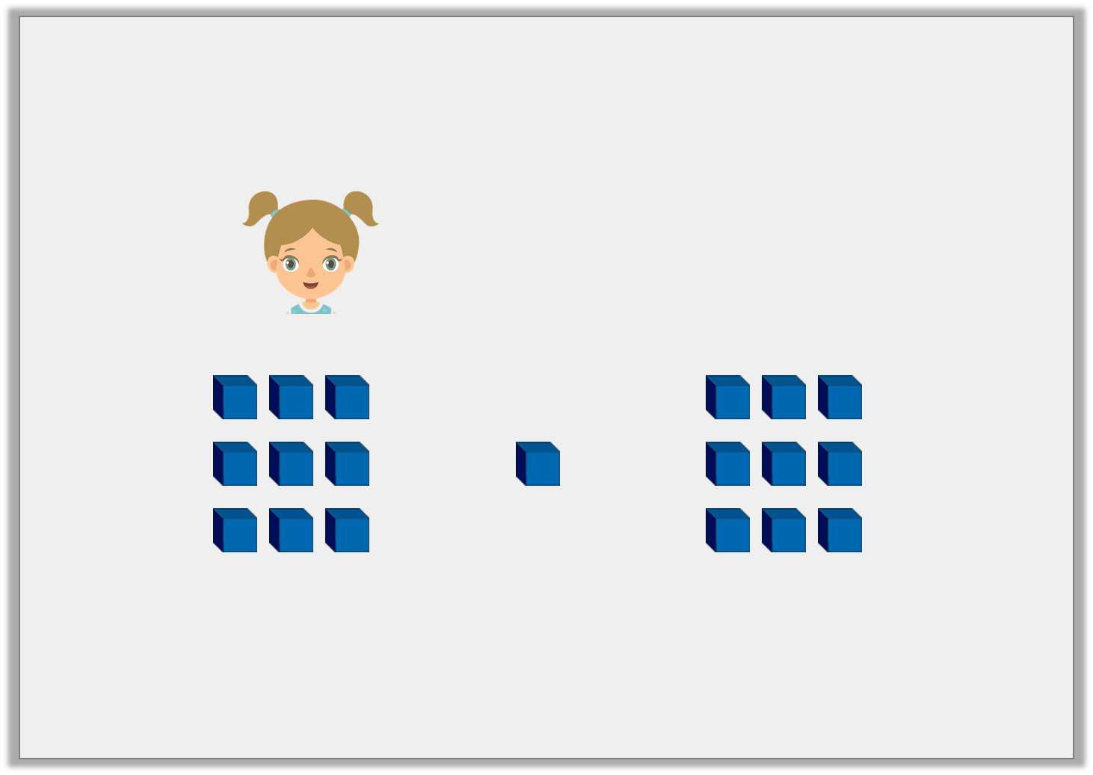
Reasoning 2
Rachael is solving 9 + 9.
Find and correct her errors. Explain your reasoning.
I need to add 1 to make 10 and then I add 9.
So 9 + 9 = 19.
+
+
© Classroom Secrets Limited 2018

Slide 19
Reasoning 2
Rachael is solving 9 + 9.
Find and correct her errors. Explain your reasoning.
Rachael has partitioned 9 incorrectly…
I need to add 1 to make 10 and then I add 9.
So 9 + 9 = 19.
+
+
© Classroom Secrets Limited 2018

Slide 20
Reasoning 2
Rachael is solving 9 + 9.
Find and correct her errors. Explain your reasoning.
Rachael has partitioned 9 incorrectly. The correct partitioning for 9 is: 1 and 8; 9 + 1 + 8 = 18
I need to add 1 to make 10 and then I add 9.
So 9 + 9 = 19.
+
+
© Classroom Secrets Limited 2018

