Slide 1
Reception LO: to blend sounds.
Must: listen carefully to sounds.
Should: match phonemes and graphemes.
Could: blend sounds to read simple words.
Year 1 LO: to write a diary entry.
Must: write about events in the correct sequence.
Should: use time connectives.
Could: record how the character is feeling.

Slide 2
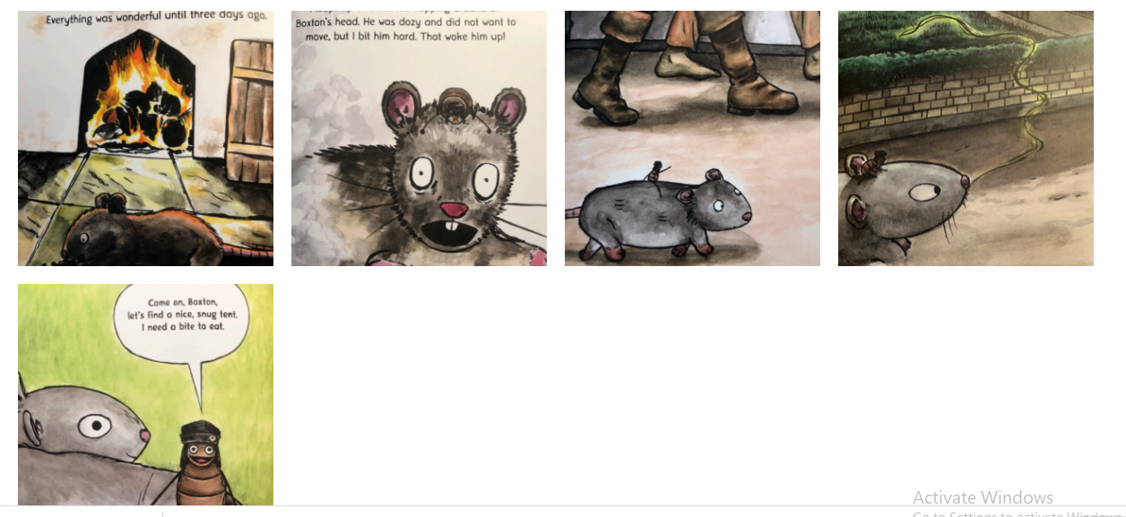
Sequence the events

Slide 3
What are the features of a diary?
Starts with ‘Dear Diary’
Has a date
Uses time connectives
Records the events in the order they happen
Explains how you are feeling
Finishes with your name
Click to reveal

Slide 4
Time connectives
Can you think of any time connectives?
After that
next
first
then
finally

Slide 5
Let’s write a diary entry together on sugar paper!
What makes a good diary?
Can we include time connectives?
How is Vlad feeling?
Can we write about the events in order?

Slide 6
Your task
3rd September 1666
Dear Diary,
Today there was a fire! It all started after we found a nice cosy spot to sleep in front of a fire in the bakery. Suddenly the room was filled with smoke so I bit Boxton hard to wake him up!
Next,
After that,
Finally,
Vlad
Use your plan to write a diary entry about Vlad and the Great Fire of London.

Slide 7
Plenary
Share your diary with a partner. Read it out loud. Does it make sense?

