Slide 1
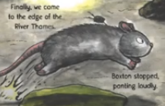
LO: to explore a character.
Must: describe what Vlad looks like.
Should: describe how Vlad might be feeling and his personality.
Could: complete a role on the wall.

Slide 2
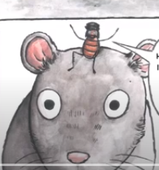
What do Vlad and Boxton look like? What animals are they?
What do you think Vlad’s personality is like? Is he brave/ shy? Is he adventurous?
Are there any similarities and differences between Vlad and Boxton?

Slide 3
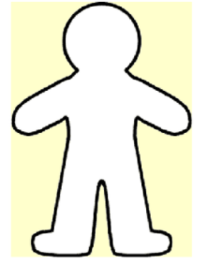
Role on the wall
Let’s complete a role on the wall together.
Remember, write about Vlad’s personality, likes and dislikes inside and what he looks like on the outside.

Slide 4
Your Task!
Complete the role on the wall sheet with a partner.
What is Vlad’s personality like? What are his likes/dislikes?
What does Vlad look like? What kind of animal is he?

Slide 5
Plenary
Share your role on the wall with a partner or another group. Can you add anything?

