Slide 1
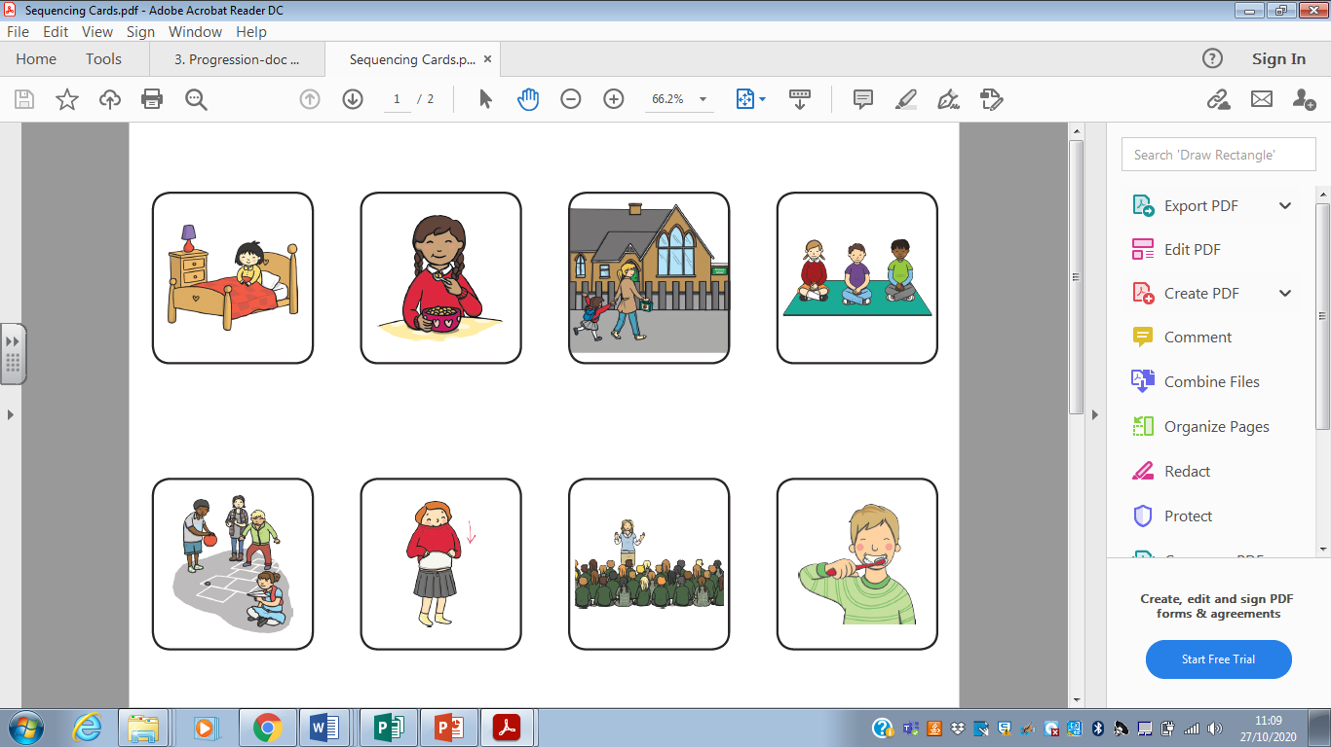
Starter:
Can you sequence my day using the words:
first, next, then, finally
L.O.: Can sequence the story of little red riding hood.
finally
then
first
next

Slide 2

We are going to read…
Little Red Riding Hood

Slide 3
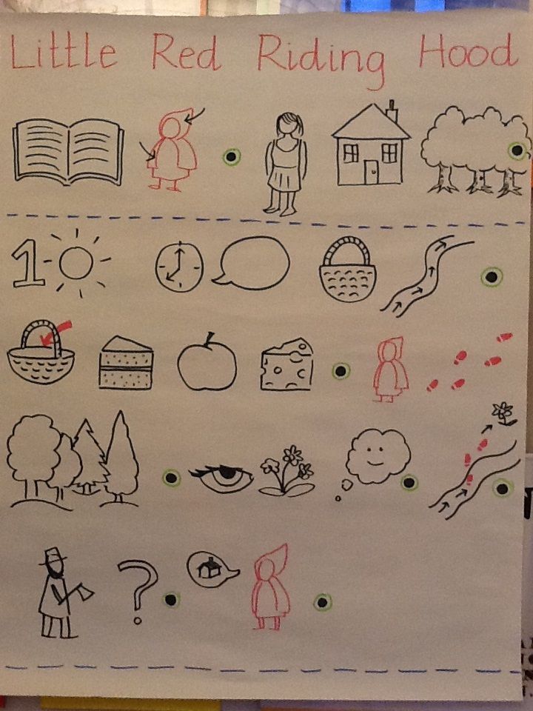
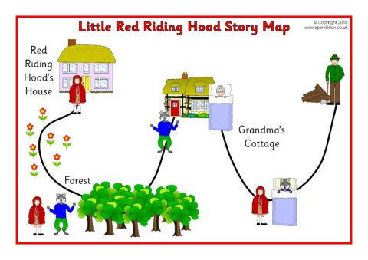
We are going to be making a story map as a class.
What words could we use to connect our map together?

Slide 4
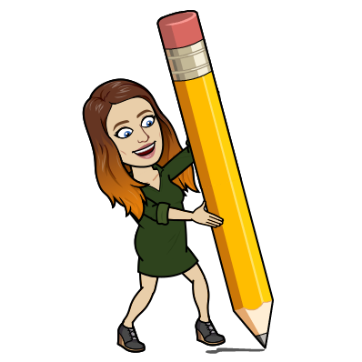
Your Task:
Can you put the pictures in the correct sequence?
Have a look at our class story map to help you put them in the right order.
When you have put the pictures in order can you challenge yourself sequence the captions too!
Extension:
Do you think Little Red Riding Hood is a good guy or bad guy?

