Slide 1
Reception LO: to understand that numbers can be combined to make bigger numbers.
Must: touch count accurately to 5.
Should: combine two groups of objects and find the total.
Could: record using jottings.
Year 1 LO: to compare number sentences within 20.
Must: add and subtract numbers within 20.
Should: use inequality symbols to compare number sentences.
Could: explore and explain why you might not have to solve the number sentences to compare them.

Slide 2
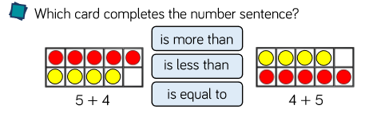

Slide 3
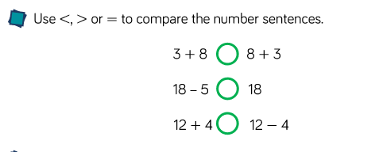

Slide 4
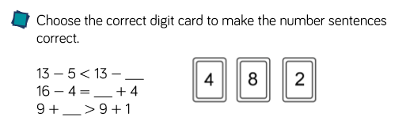

Slide 5
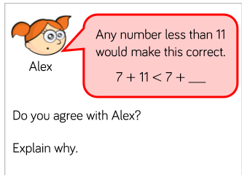

Slide 6
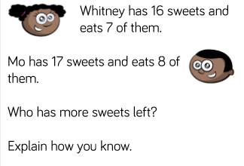

Slide 7
