Slide 1
LO: To use question marks in my writing.
Must: Explain when a question mark is used.
Should: Use a question mark in a sentence.
Could: Change how I read a sentence to show it is a question.

Slide 2


Perfect Punctuation: The Question Mark
A question mark ends a sentence which includes a question.
The sentence after a question mark always starts with a capital letter.
What are you doing after lunch?
Can you spot the capital letter and question mark in this sentence?

Slide 3





Perfect Punctuation: The Quiz
or
Listen to your teacher reading some sentences.
Hold up your or card to show which punctuation
mark is needed at the end of each sentence.
Hint: If you need to respond (give an answer) to the sentence, then it needs a question mark.

Slide 4


Perfect Punctuation: The Quiz
or
Cain is going to the fair

Slide 5


Perfect Punctuation: The Quiz
or
Can you help me find my pencil crayons

Slide 6

Perfect Punctuation: The Quiz
or
There is your brother

Slide 7
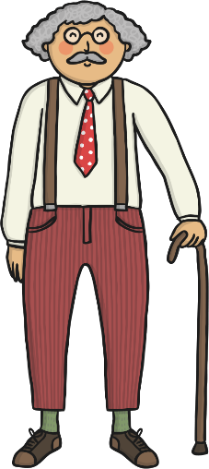
Perfect Punctuation: The Quiz
or
Is Grandpa coming to visit next week

Slide 8

Perfect Punctuation: The Quiz
or
Our class is going to the zoo

Slide 9

Perfect Punctuation: The Quiz
or
Where is my coat

Slide 10
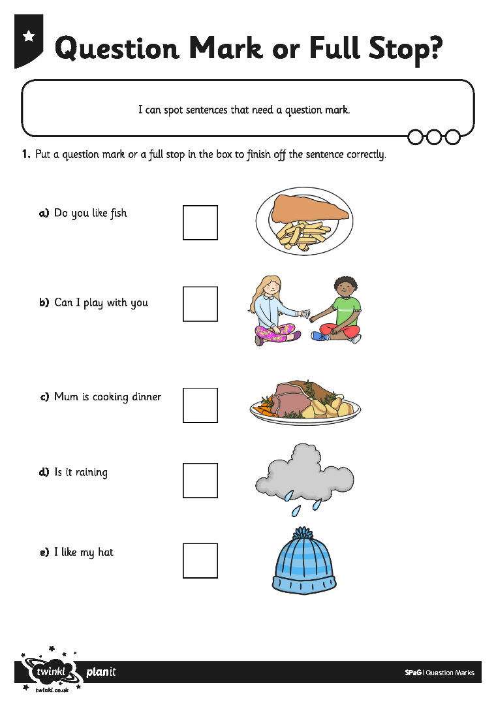
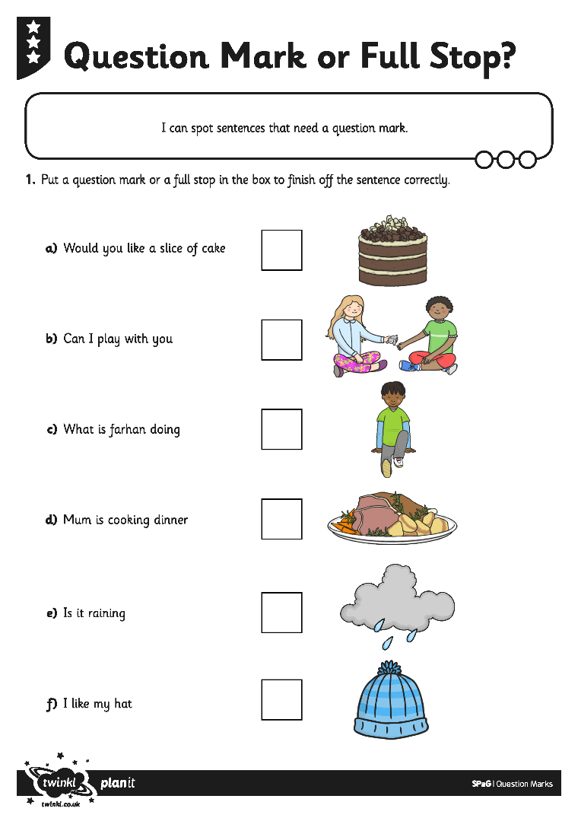
Your task:
You are going to work with a partner to add a question mark or a full stop to the sentences on your Question Mark or Full Stop Activity Sheet.
Read the sentences out loud to each other, to help you hear which punctuation mark you need.

