Slide 1

LO: to write sentences in the past tense.

Slide 2
Warm up- nouns and verbs!
Noun
Verb
Notes:
Recap nouns and verbs.
A noun is a person, place or thing.
A verb describes an action. Today we are going to practise writing some verbs in the past tense but first to remind ourselves of nouns and verbs lets play a quick game of Simon says.

Slide 3
Suffix
-ed

Slide 4

I play football.
Yesterday I played football.
Notes:
Which word is the action word? Let’s change it into the past tense by adding –ed.

Slide 5

I laugh at jokes.
Yesterday I laughed at some jokes.

Slide 6

I ask for help.
Yesterday I asked for help.

Slide 7

Ben can jump.
Yesterday Ben jumped.

Slide 8
Regular verbs (add –ed in past tense)
play
laugh
need
look
ask
call
played
laughed
needed
looked
asked
called

Slide 9
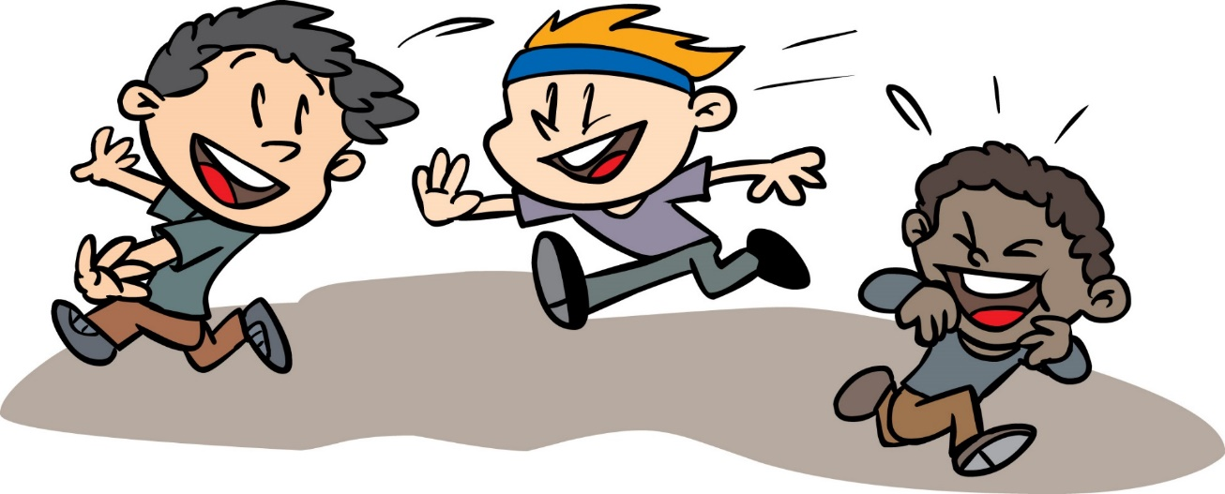
Sometimes I run around playing tag.
This morning I ran around playing tag.
Notes:
Some verbs are irregular and break the rules when being changed into the past tense! Let’s look at some examples.

Slide 10
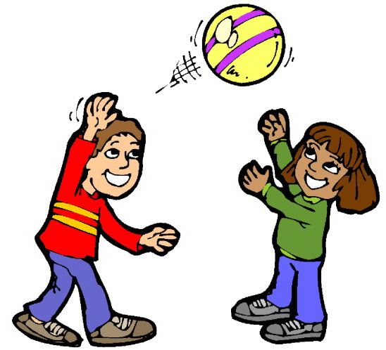
I throw the ball to my friend and she catches it.
I threw the ball to my friend and she caught it.

Slide 11

I say my name is Bill.
I said my name is Bill.

Slide 12
went
said
made
took
thought
was
Irregular verbs (They break the rules! You just have to learn them!)
go
say
make
take
think
is

Slide 13
Now try these:
It is sunny
We have Assembly today
We go swimming
I think P.E. is fun
My dad helps me with my homework
We need to tidy up the cloakroom
It was sunny
We had Assembly today
We went swimming
I thought P.E. was fun
My dad helped me with my homework
We needed to tidy up the cloakroom

Slide 14
Your task:
Year 1:
1- Complete task 1 worksheet. Convert each verb into the past tense and then use some in sentences.
Challenge: Some verbs in the paragraph are in the wrong tense. Can you correct them so they are all in the past tense?
Reception:
Complete the reception activity sheet. Convert the verbs into the past tense by adding –ed.
Challenge: choose a word from your sheet to write in a sentence.
Notes:
3 levels of challenge.

Slide 15
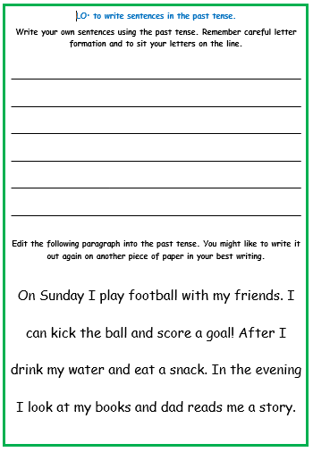
Challenge:

