Slide 1
Lesson 2
23.2.21
LO:To identify properties of 2D and 3D shapes.

Slide 2
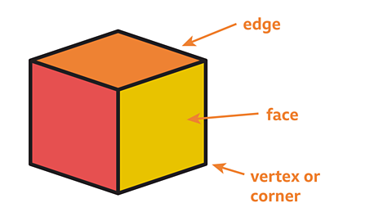
Faces - A face is a flat surface on a 3D shape. For example a cube has 6 faces.
Edges - An edge is where two faces meet. For example a cube has 12 edges.

Slide 3
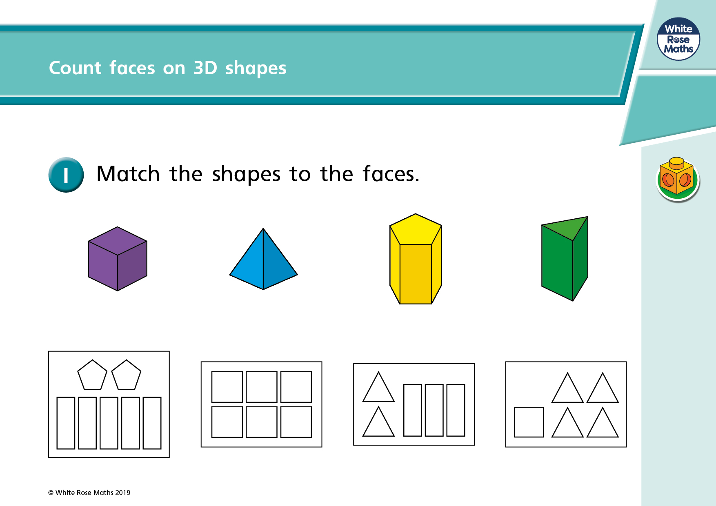

Slide 5
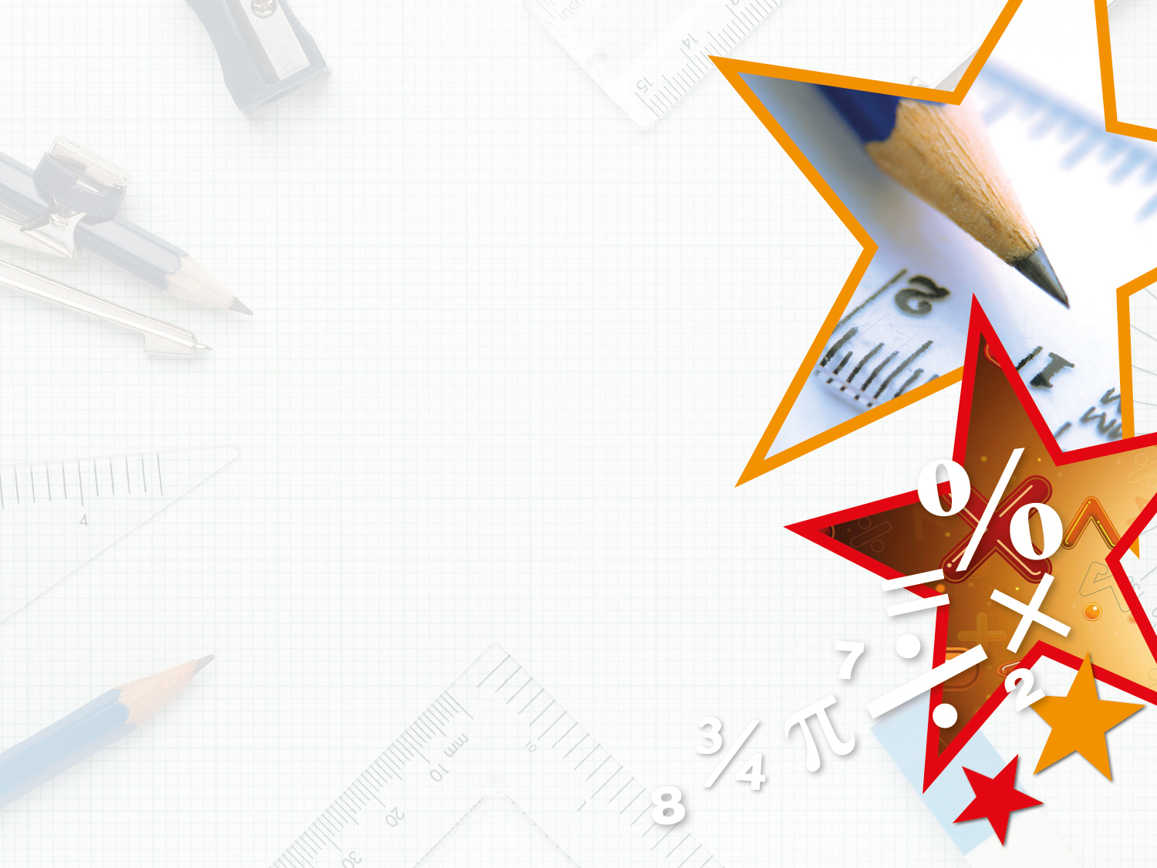
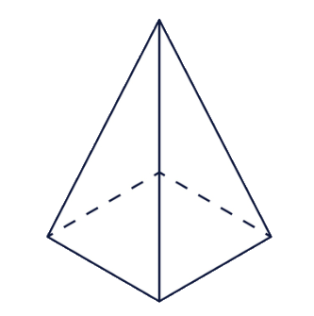

Varied Fluency 3
Complete the sentence below.
This shape has flat faces and curved surfaces.
© Classroom Secrets Limited 2018

Slide 6
Varied Fluency 3
Complete the sentence below.
This shape has flat faces and curved surfaces.
5
0
© Classroom Secrets Limited 2018

Slide 7
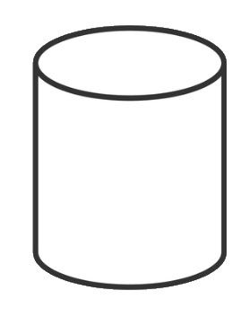
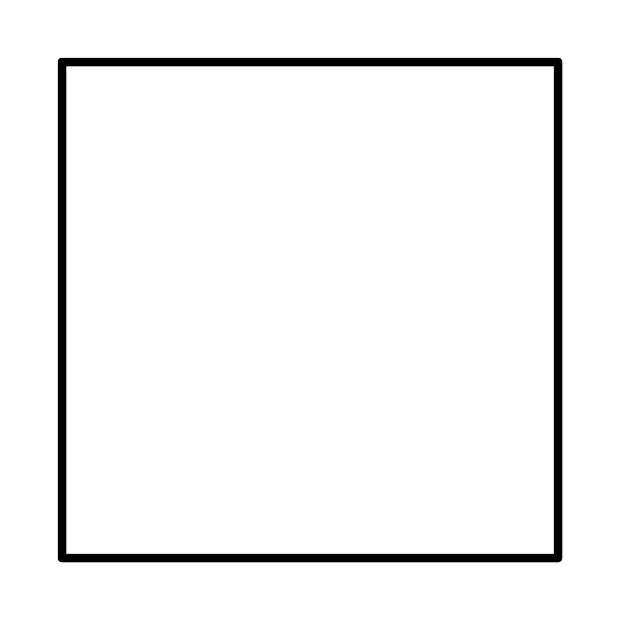
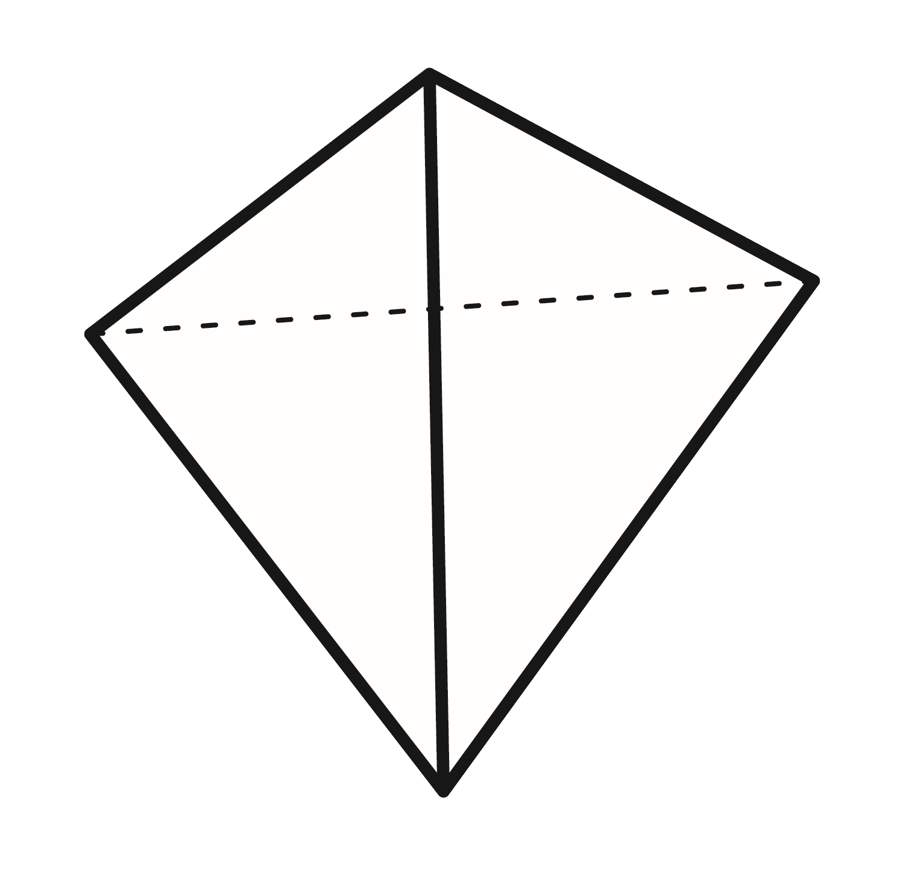
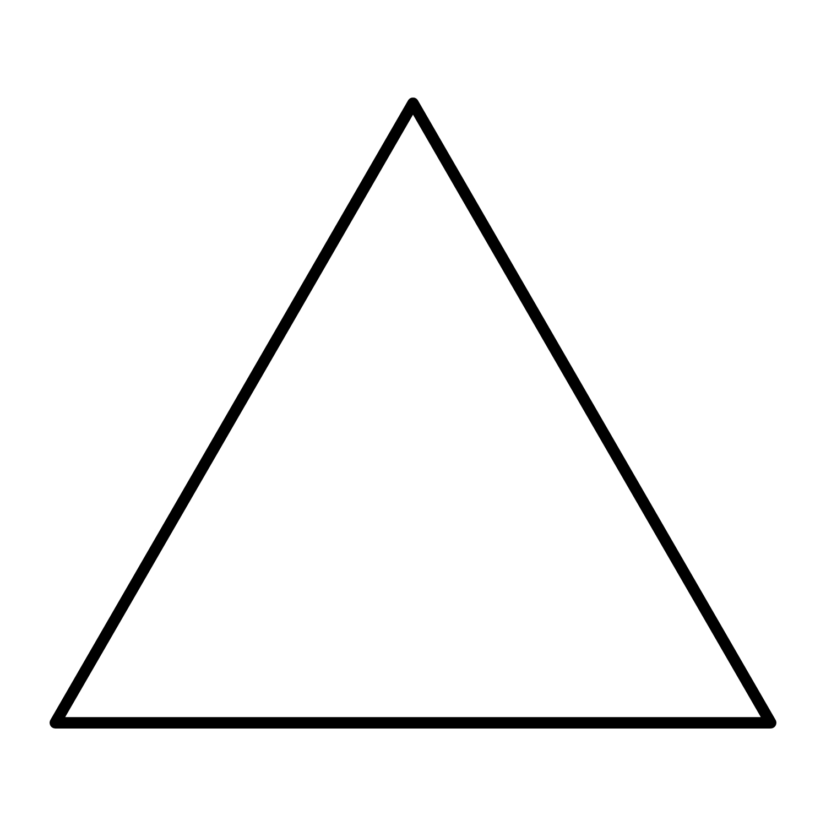
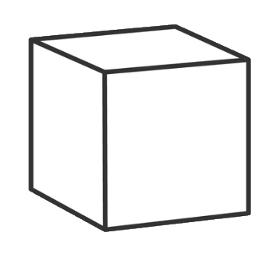
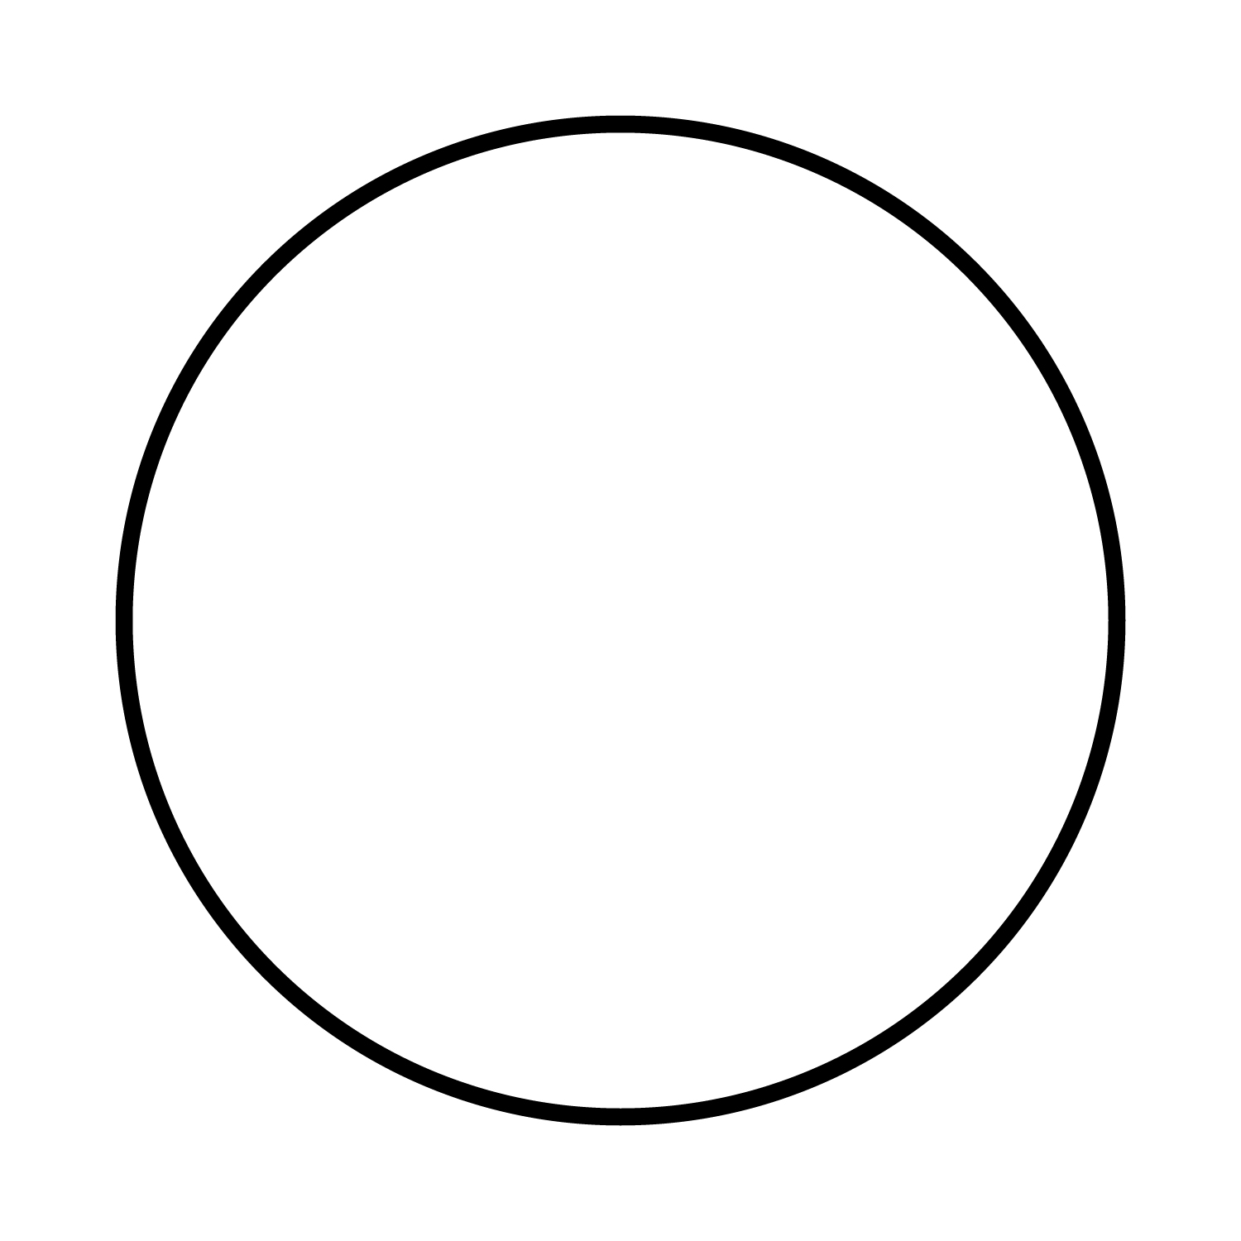
Varied Fluency 4
Which 2D shapes can you see on the flat faces of the 3D shapes?
A. |  | 1.
B. |  | 2.
C. |  | 3.
© Classroom Secrets Limited 2018

Slide 8
Varied Fluency 4
Which 2D shapes can you see on the flat faces of the 3D shapes?
A = circle; B = triangle; C = square
A. |  | 1.
B. |  | 2.
C. |  | 3.
© Classroom Secrets Limited 2018

Slide 9
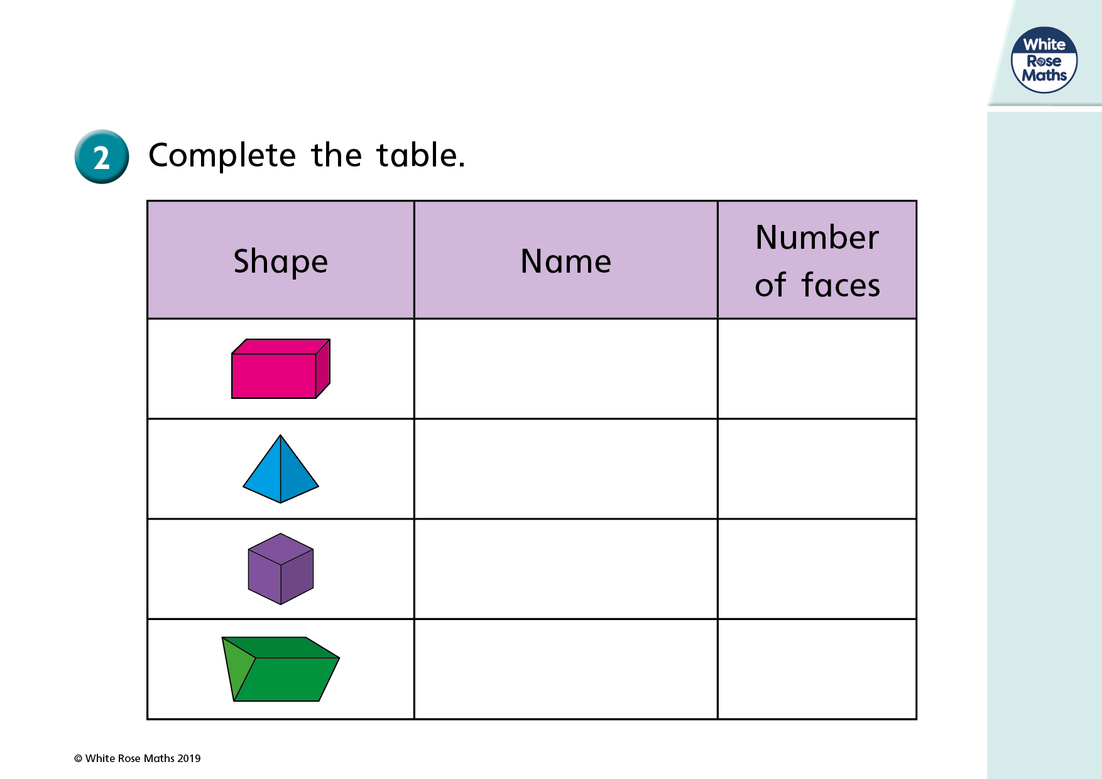

Slide 10
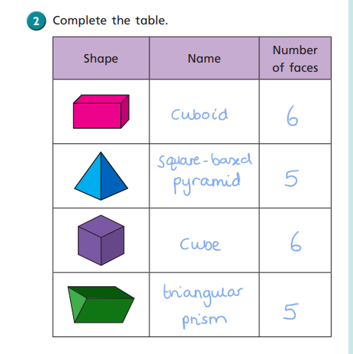

Slide 11
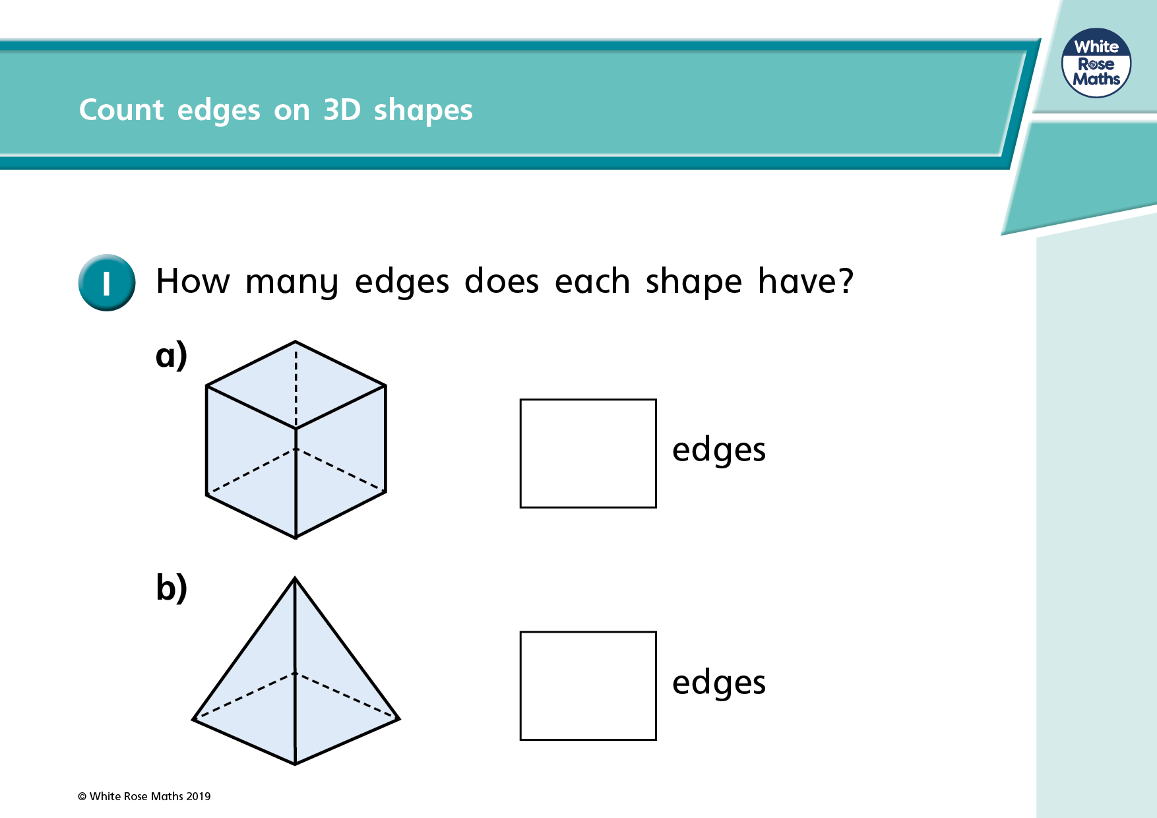

Slide 12
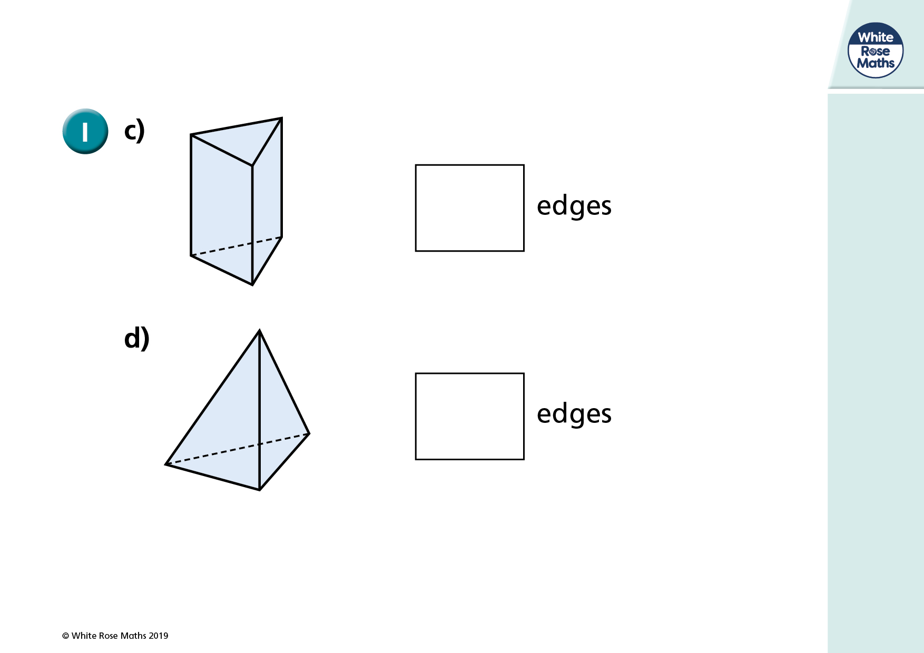

Slide 13
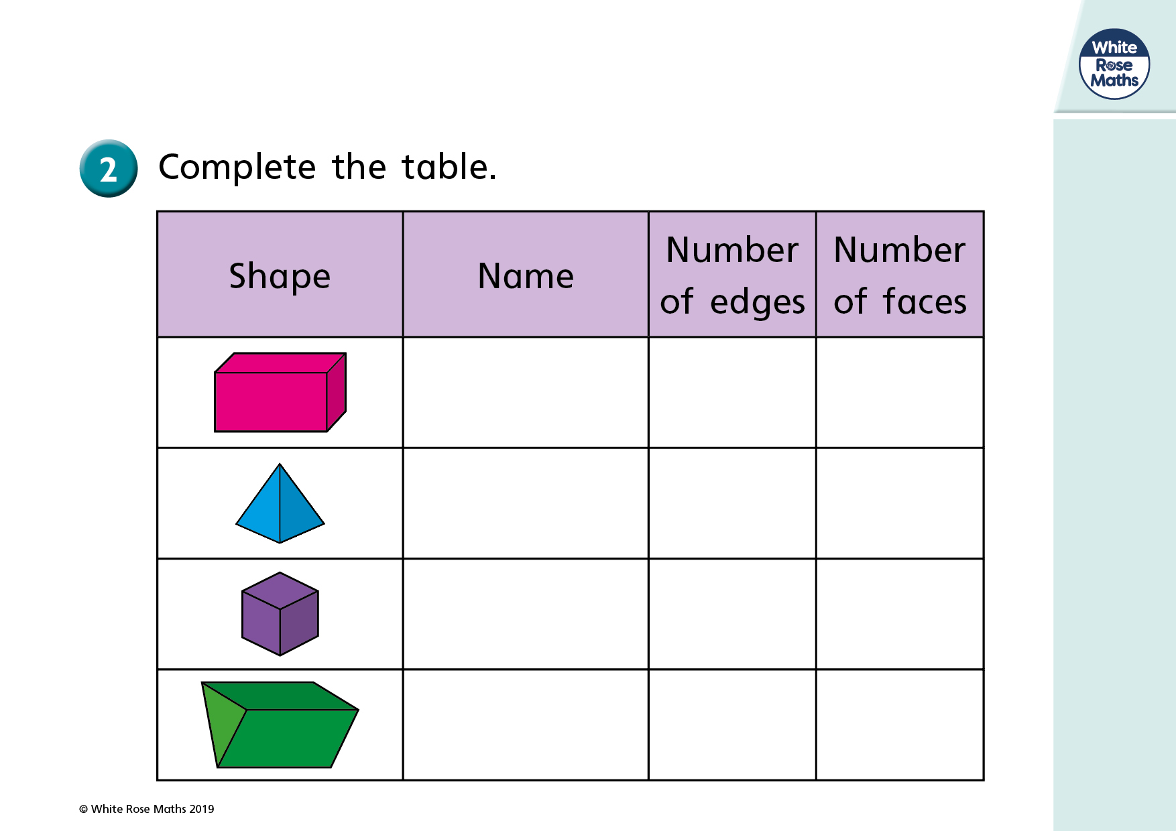

Slide 14
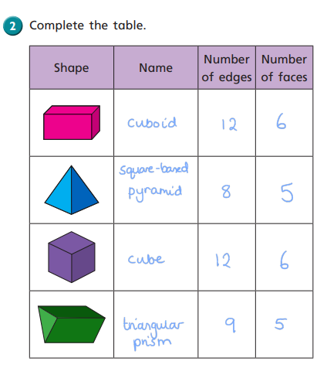

Slide 15
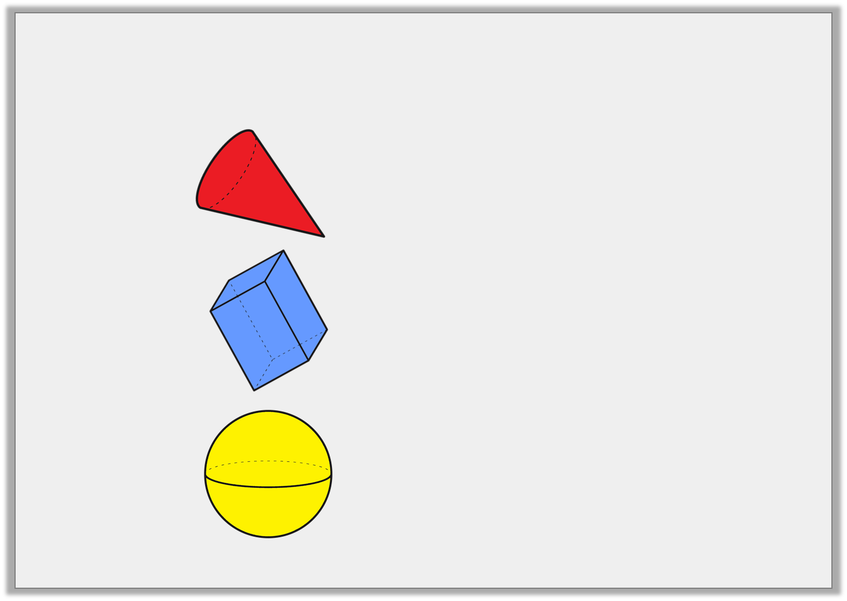
Varied Fluency 1
Match the 3D shapes to the correct number of edges.
A.
0 edges
6 edges
B.
1 edge
12 edges
C.
© Classroom Secrets Limited 2018

Slide 16
Varied Fluency 1
Match the 3D shapes to the correct number of edges.
A.
0 edges
6 edges
B.
1 edge
12 edges
C.
© Classroom Secrets Limited 2018

Slide 17
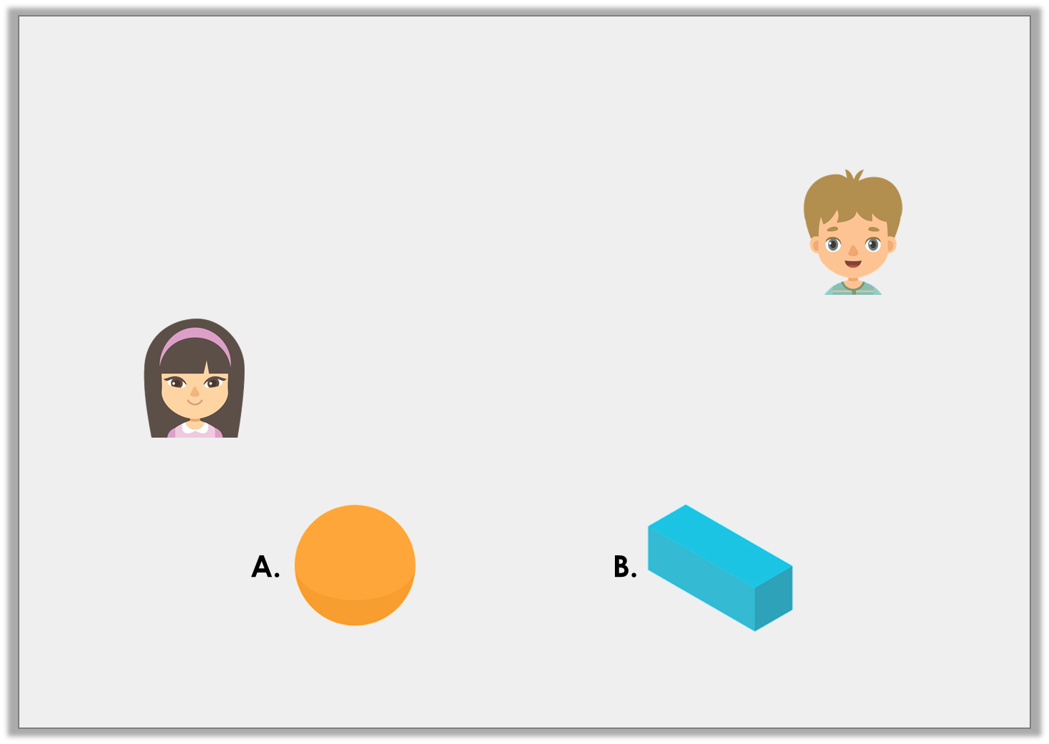
Problem Solving 1
Match each child to the shape they are describing.
My shape has 0 edges.
Thomas
My shape has 12 edges.
Molly
© Classroom Secrets Limited 2018

Slide 18
Problem Solving 1
Match each child to the shape they are describing.
Thomas = A; Molly = B
My shape has 0 edges.
Thomas
My shape has 12 edges.
Molly
© Classroom Secrets Limited 2018

Slide 19
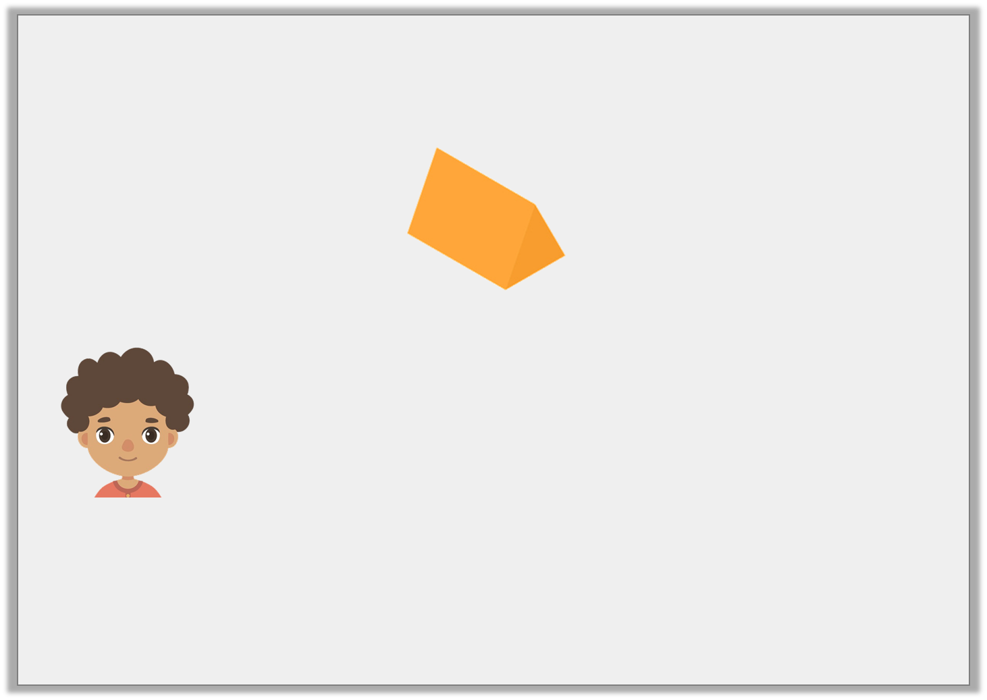
Reasoning 1
Caleb is describing the shape below.
He says,
Do you agree? Explain your answer.
The triangular prism has 6 edges.
© Classroom Secrets Limited 2018

Slide 20
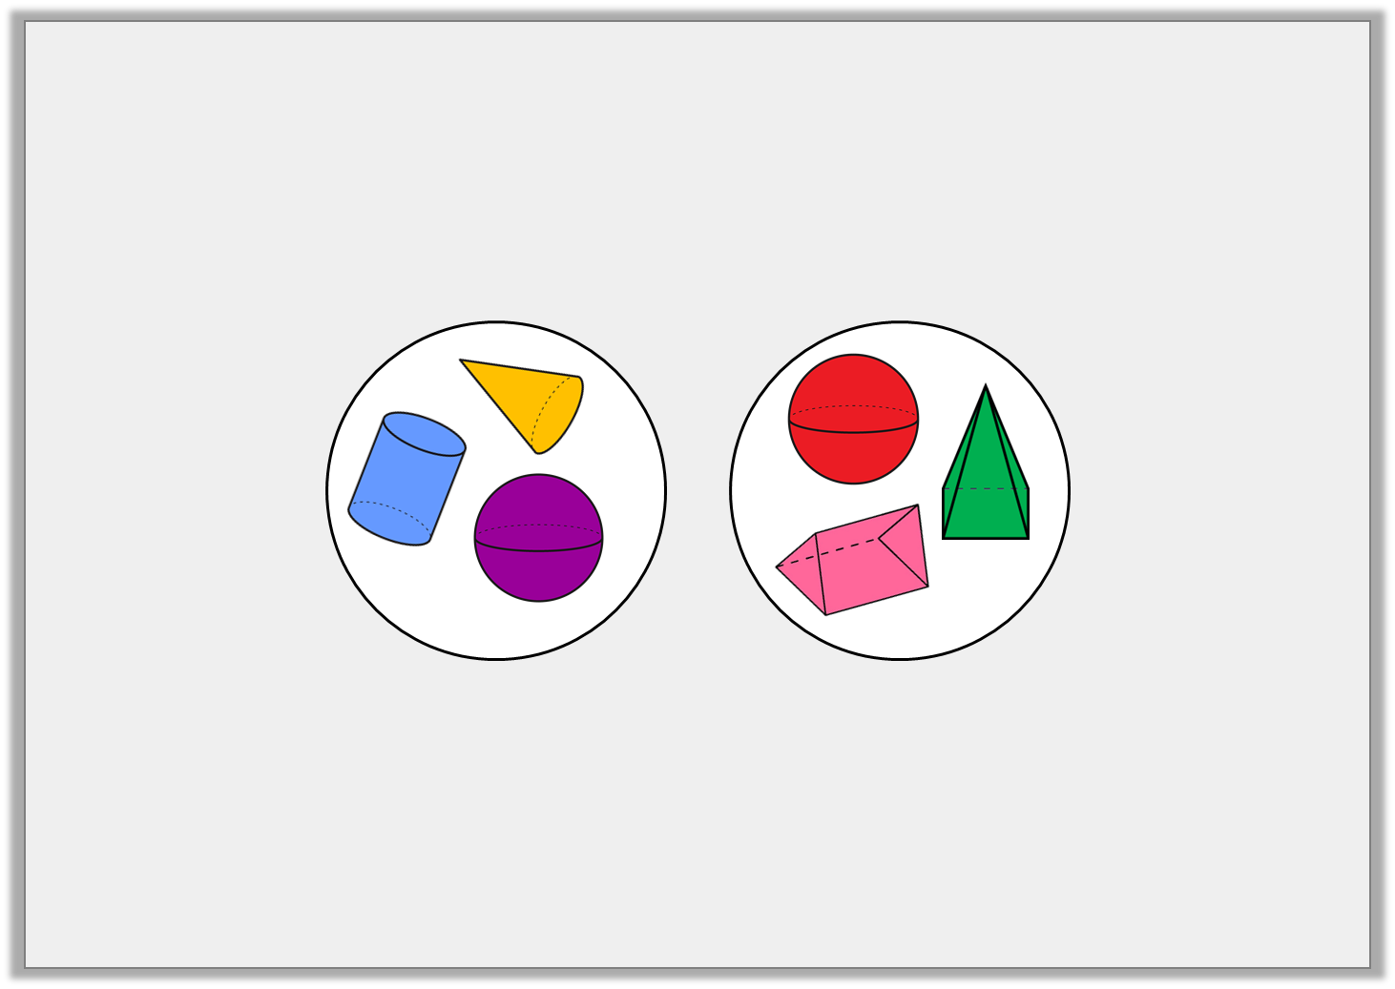
Reasoning 2
Ted has made a mistake when sorting 3D shapes.
What has he done wrong?
Fewer than
3 edges
More than
3 edges
© Classroom Secrets Limited 2018

Slide 21
Reasoning 2
Ted has made a mistake when sorting 3D shapes.
What has he done wrong?
Ted has but the sphere in the wrong group because…
Fewer than
3 edges
More than
3 edges
© Classroom Secrets Limited 2018

Slide 22
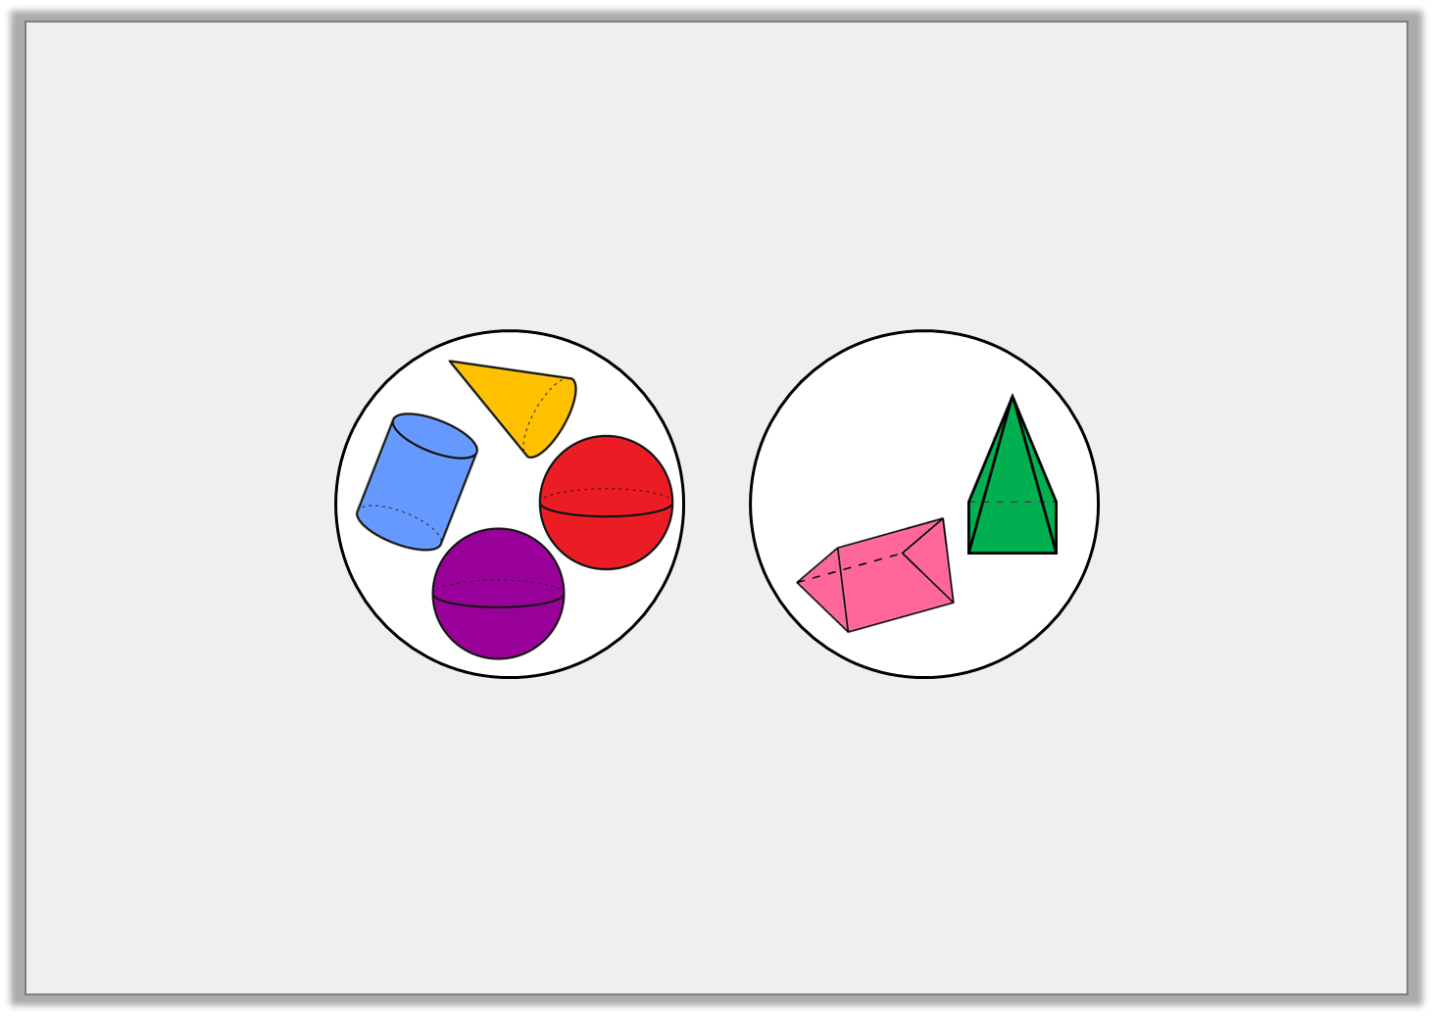
Reasoning 2
Ted has made a mistake when sorting 3D shapes.
What has he done wrong?
Ted has but the sphere in the wrong group because a sphere has 0 edges which is fewer than 3. Both spheres should be in the same group.
Fewer than
3 edges
More than
3 edges
© Classroom Secrets Limited 2018

