Slide 1
Lesson 1 22.2.21
LO: To be able to recognise and describe 2-D and 3-D shapes.

Slide 2
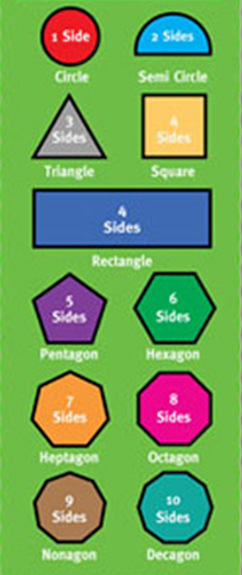
2D Shapes.
2D shapes are everywhere! For example, windows are
shaped like rectangles and clocks are shaped like circles.
2D shapes are flat.
They all have different properties. A property is
a quality that a shape has.
Number of sides
Number of angles (corners)
length of sides
types of angles (acute, obtuse, right-angle)
perpendicular and parallel lines

Slide 3


Slide 4
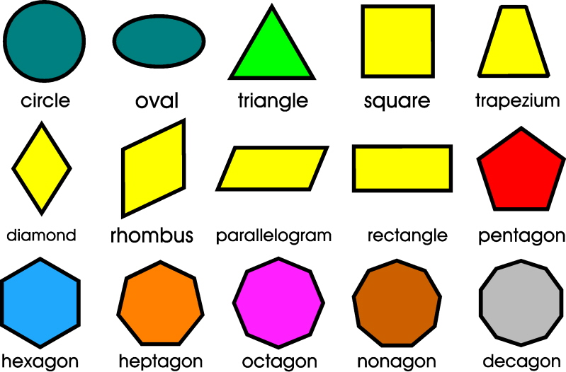

Slide 5
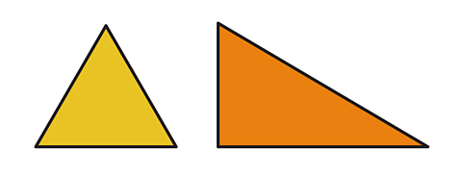
Triangles
All triangles have 3 sides and 3 angles.
However, different triangles have different properties, depending on how they are drawn. You have to look very carefully to see what is different.
For example, compare these two triangles:
Like all triangles, both have 3 sides and 3 angles.
However, the yellow triangle’s sides are all the same length and the angles are all the same size.
The green triangle has a right-angle and all the sides are a different length.

Slide 6
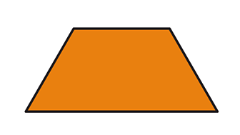
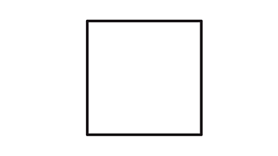


Quadrilaterals
A quadrilateral is a shape with 4 sides and 4 angles.
Trapezium
1 pair of parallel lines.
2 sets of equal angles.
2 lines equal length and 2 that aren’t.
Kite
2 pairs of equal sides.
1 pair of equal angles.
No parallel lines.
Square
Sides all equal length.
Angles all right-angles (perpendicular lines).
2 pairs of parallel lines.
Rectangle
2 sides longer than the others.
Angles all right-angles (perpendicular lines).
2 pairs of parallel lines.

Slide 7
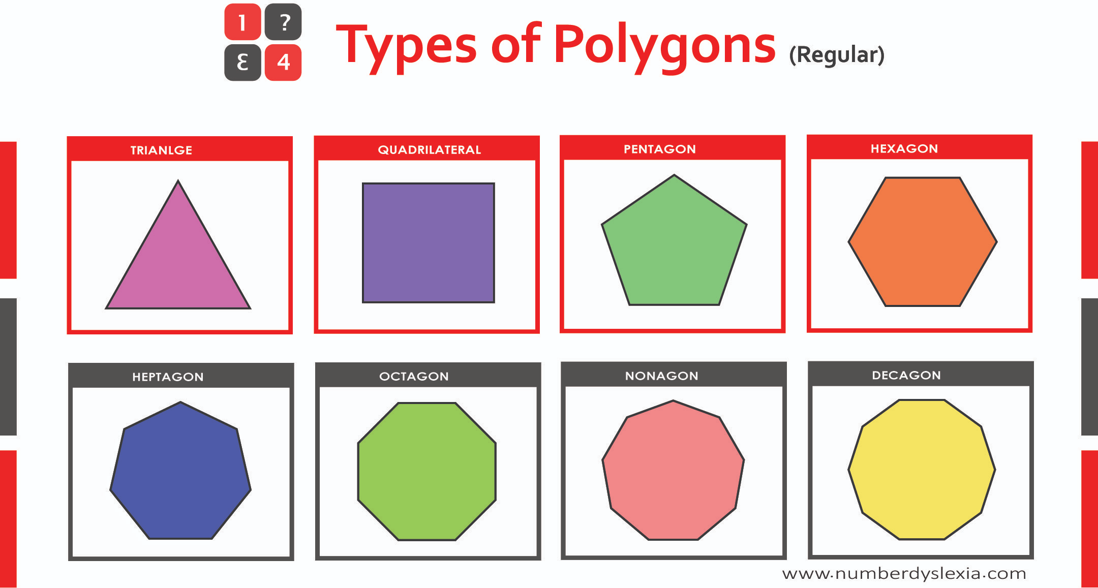
Regular polygons
These are shapes that have all equal sides and equal angles.
Pentagon | 5 equal sides and angles.
Hexagon | 6 equal sides and angles. 3 pairs of parallel lines.
Heptagon | 7 equal sides and angles
Octagon | 8 equal sides and angles. 4 pairs of parallel lines.
Irregular polygons.
These are shapes that have sides and angles of different sizes.

Slide 8


Introduction
How many squares can you see?
© Classroom Secrets Limited 2018

Slide 9
Introduction
How many squares can you see?
4
© Classroom Secrets Limited 2018

Slide 10
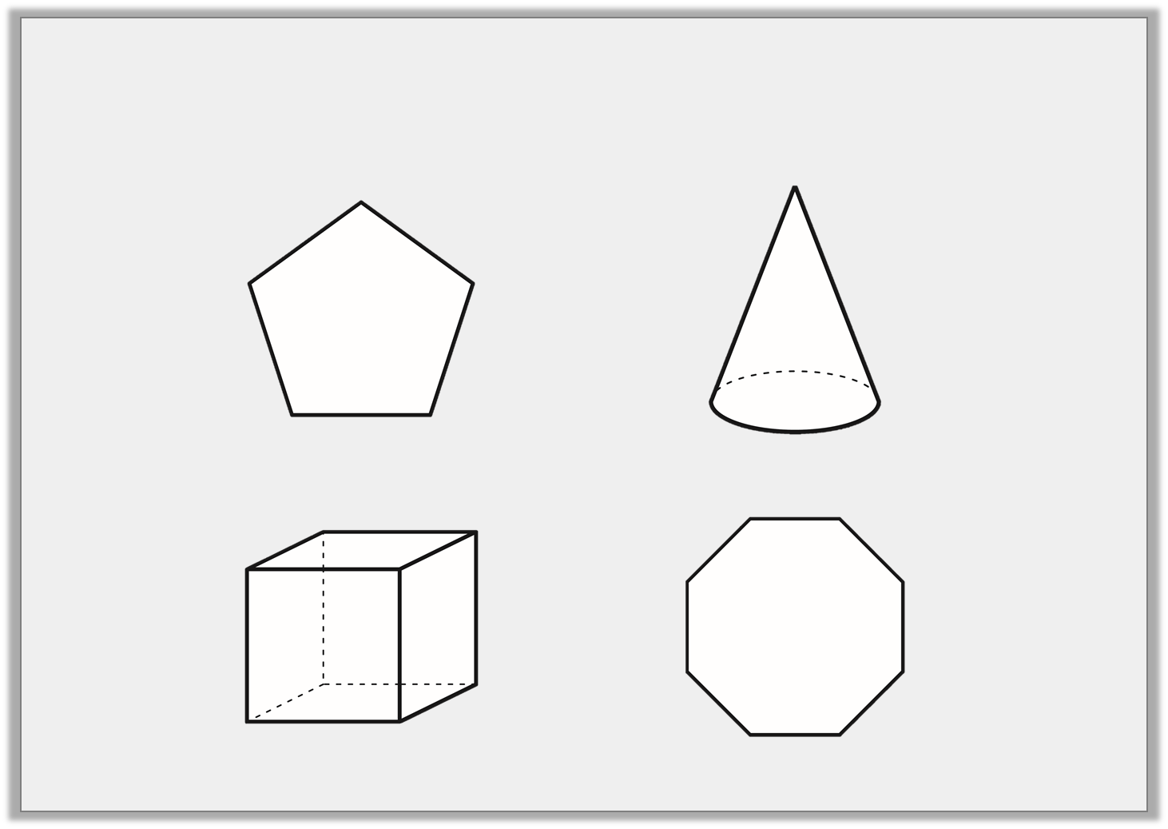
Varied Fluency 1
Which of the following shapes is an octagon?
A.
B.
C.
D.
© Classroom Secrets Limited 2018

Slide 11
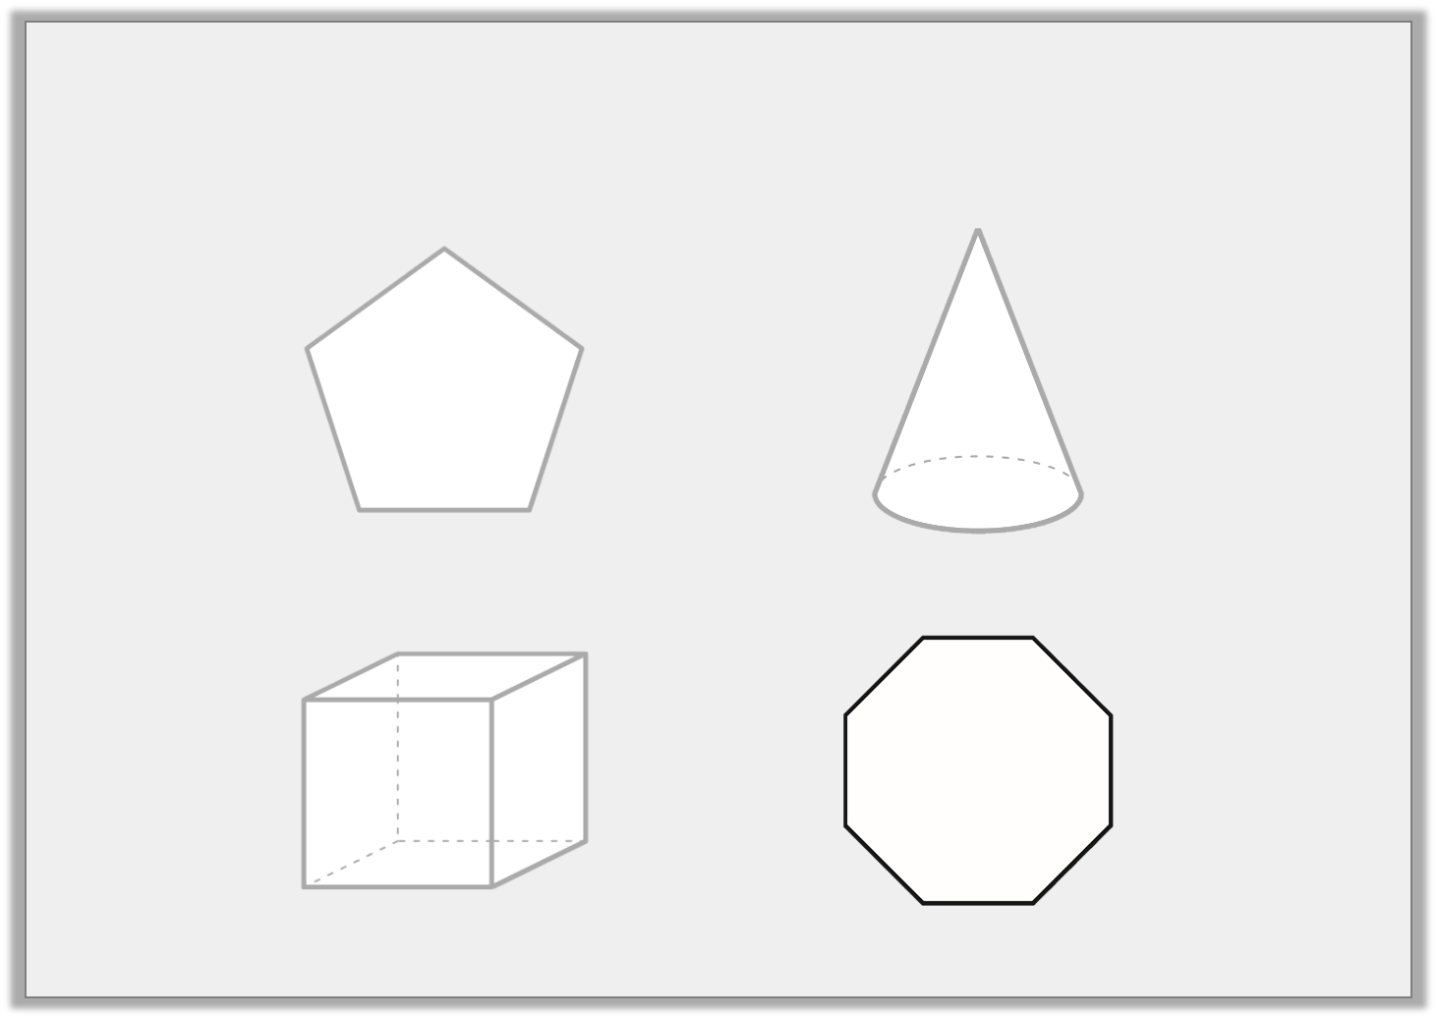
Varied Fluency 1
Which of the following shapes is an octagon?
A.
B.
C.
D.
© Classroom Secrets Limited 2018

Slide 12
Varied Fluency 3
Circle the name of the shape below.
octagon |  | sphere
cylinder |  | hexagon
© Classroom Secrets Limited 2018

Slide 13
Varied Fluency 3
Circle the name of the shape below.
octagon |  | sphere
cylinder |  | hexagon
© Classroom Secrets Limited 2018

Slide 14
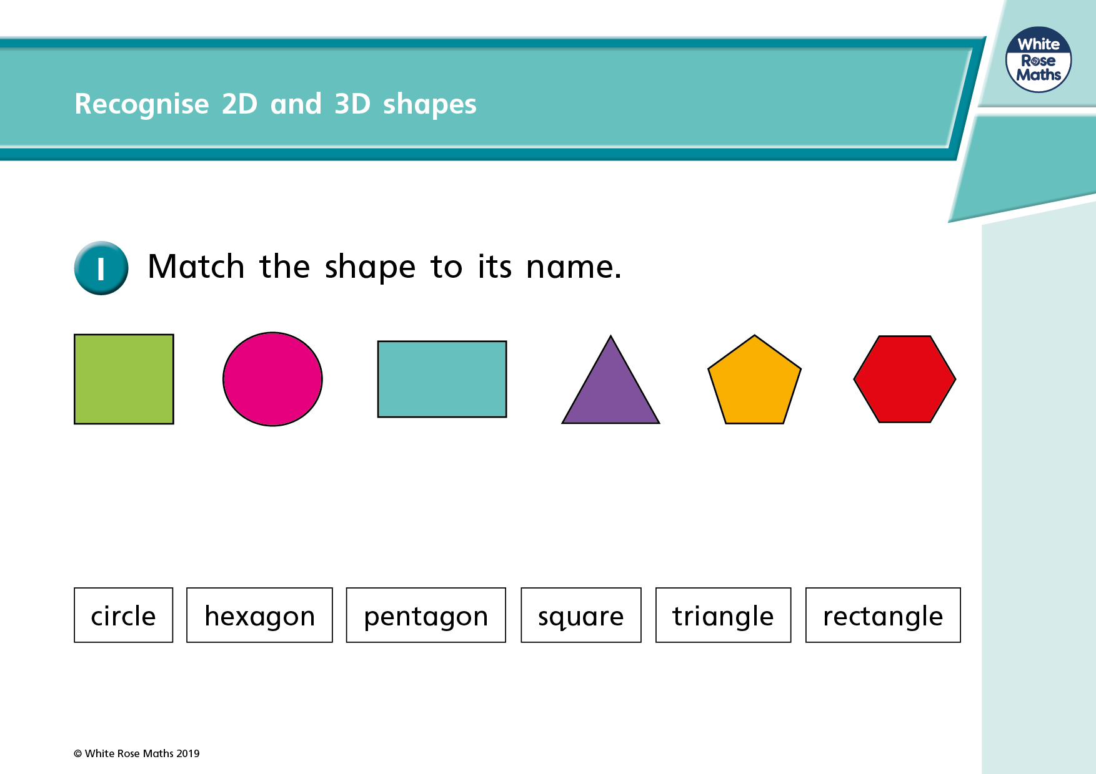

Slide 15

3D Shapes
These shapes have 3 dimensions.
They are called solid shapes.
They can be picked up.

Slide 16
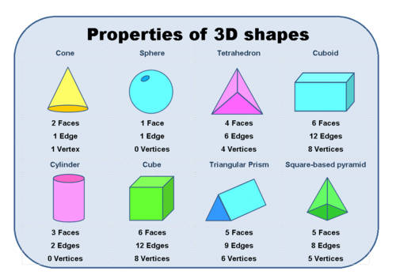

Slide 17
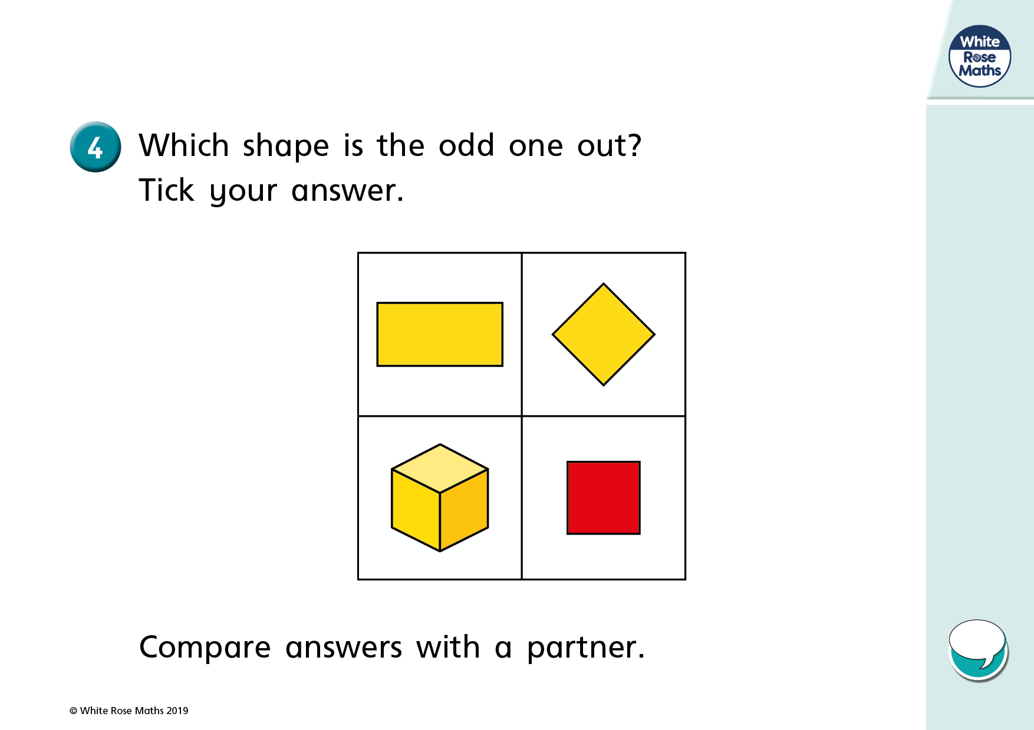

Slide 18
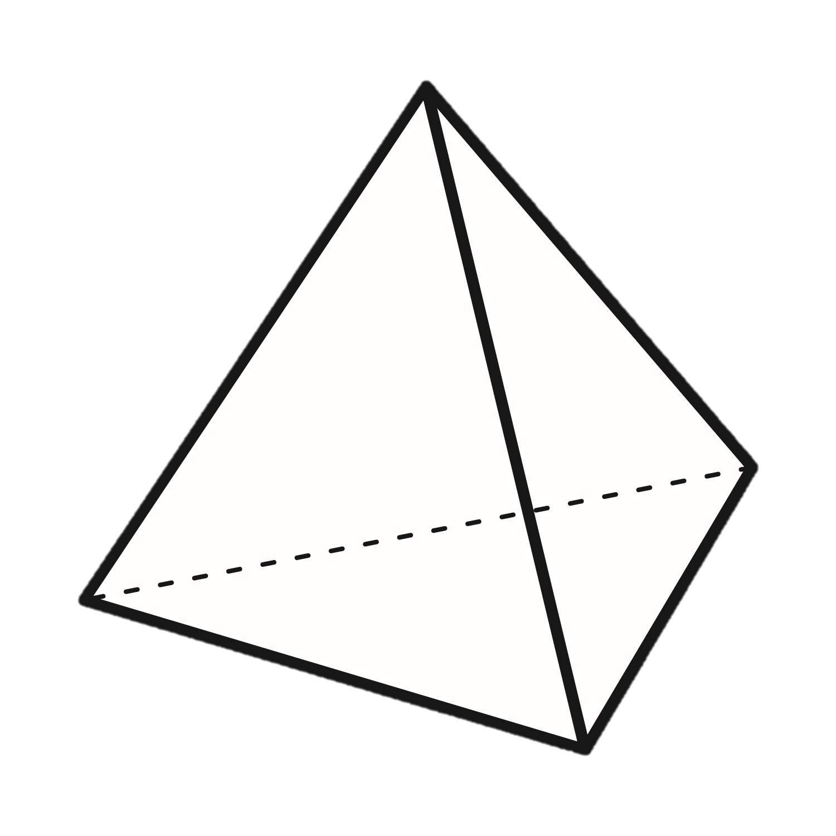
Varied Fluency 2
Tick the correct sentence.
A. This shape is a square-based pyramid.
B. This shape is a triangular-based pyramid.
© Classroom Secrets Limited 2018

Slide 19
Varied Fluency 2
Tick the correct sentence.
A. This shape is a square-based pyramid.
B. This shape is a triangular-based pyramid.
P
© Classroom Secrets Limited 2018

Slide 20
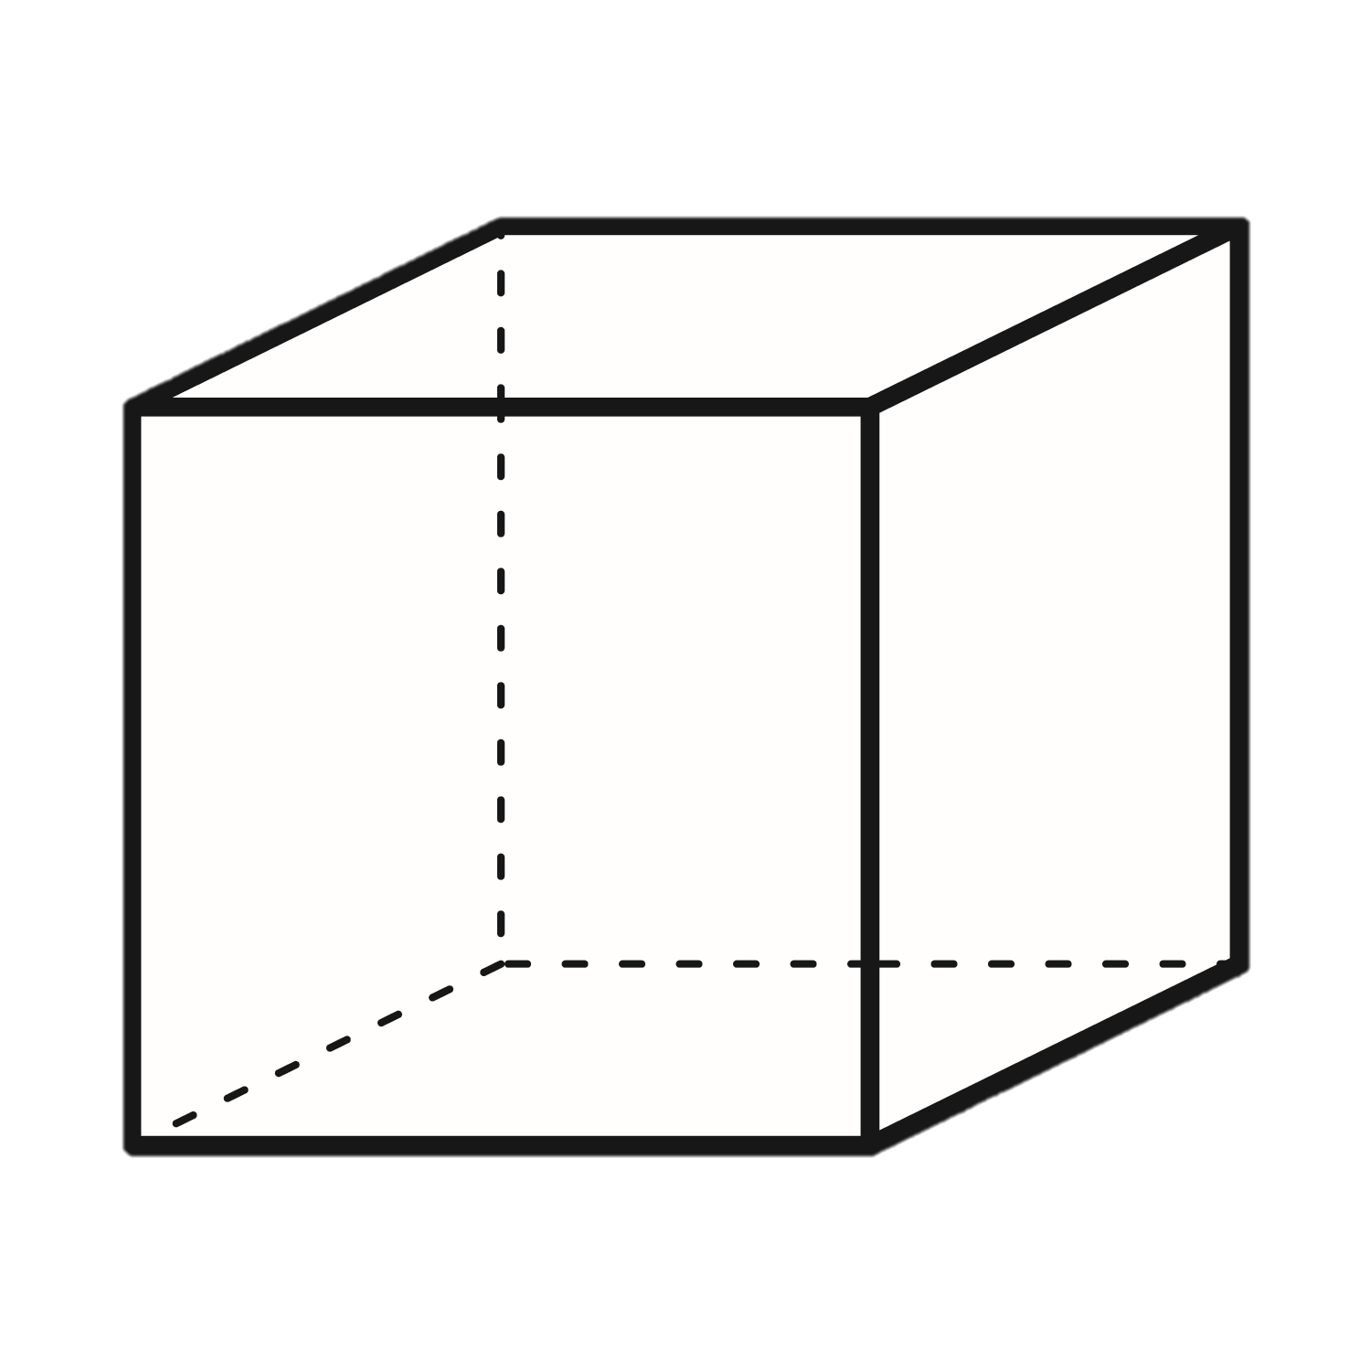
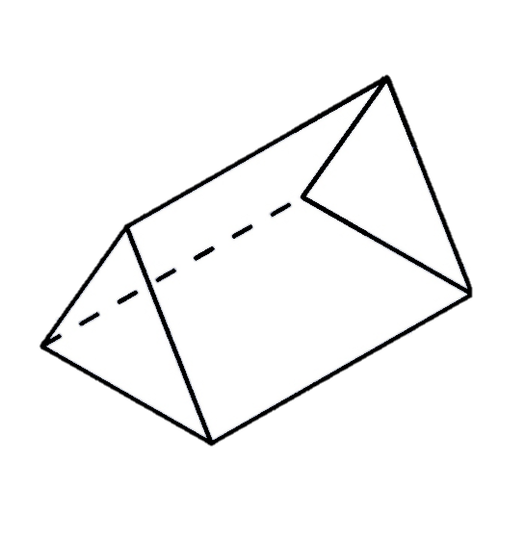
Varied Fluency 4
Label the shapes using the word bank.
circle |  | prism |  | cube |  | pentagon
A. | B.
C. | D.
© Classroom Secrets Limited 2018

Slide 21
Varied Fluency 4
Label the shapes using the word bank.
circle |  | prism |  | cube |  | pentagon
A. | B.
C. | D.
cube
circle
pentagon
prism
© Classroom Secrets Limited 2018

Slide 22
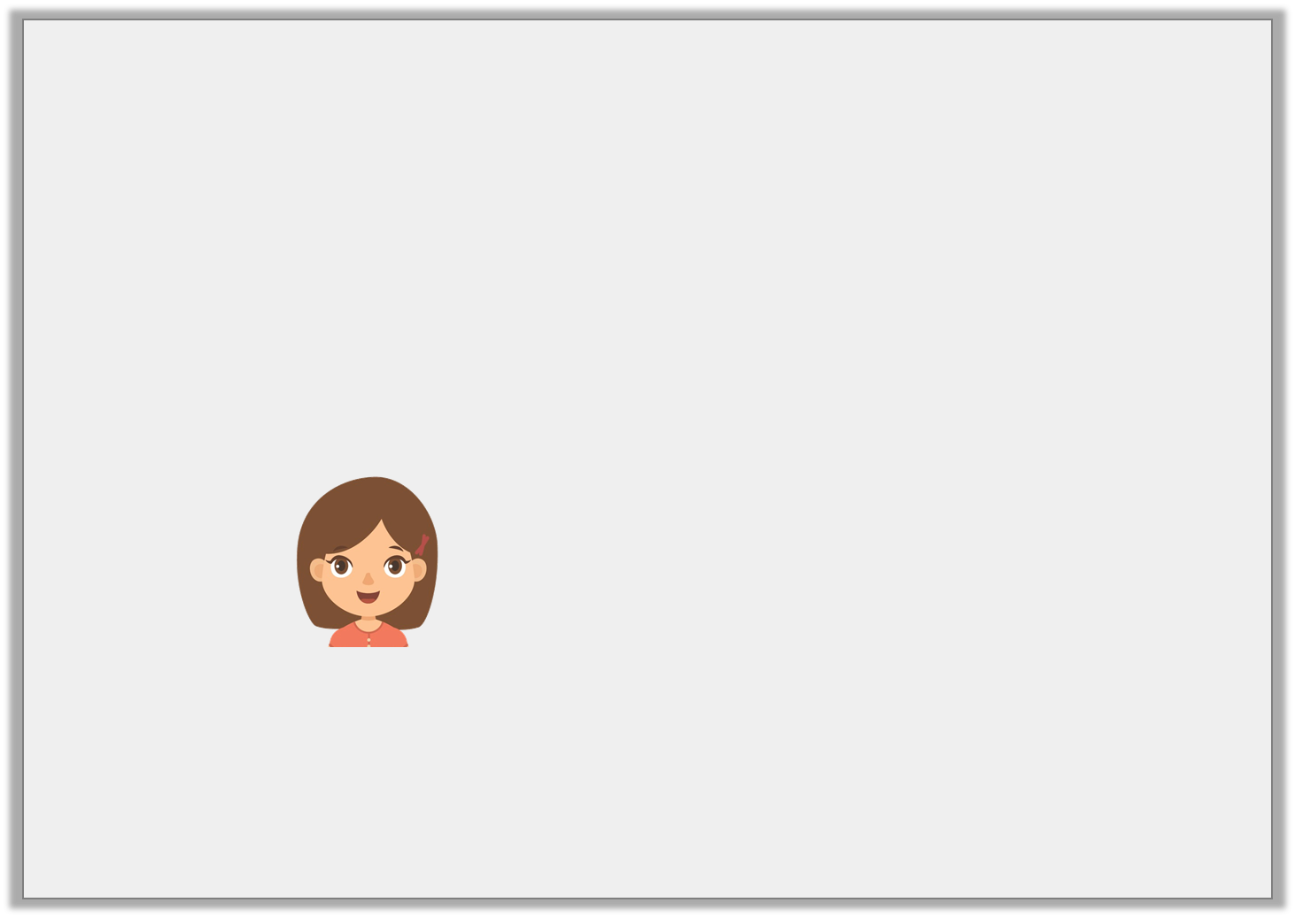

Reasoning 1
True or false?
Sara says,
Explain your answer.
All of these shapes
are pyramids.
© Classroom Secrets Limited 2018

Slide 23
Reasoning 1
True or false?
Sara says,
Explain your answer.
False because…
All of these shapes
are pyramids.
© Classroom Secrets Limited 2018

Slide 24
Reasoning 1
True or false?
Sara says,
Explain your answer.
False because these shapes are all 2D triangles.
All of these shapes
are pyramids.
© Classroom Secrets Limited 2018

Slide 25
Your Task
Complete the worksheet.
There is also a problem solving sheet with three different levels. Please choose the level you feel most comfortable with.
Extension: Complete a shape scavenger hunt. How many different shapes can you find around your house? Can you present your findings?

