Slide 1
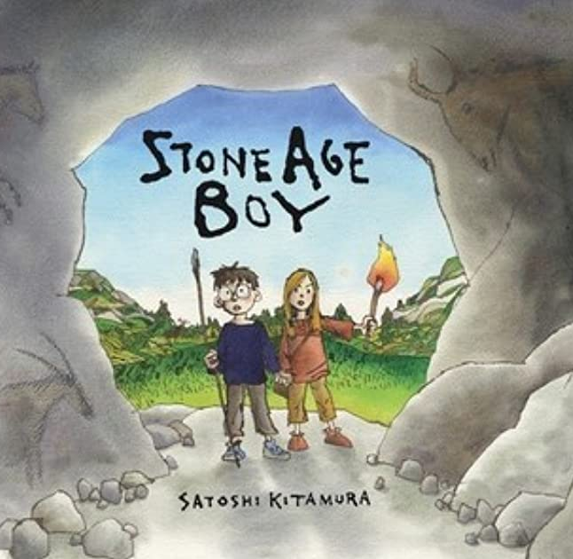
Stone Age Boy
Lesson 2

Slide 2
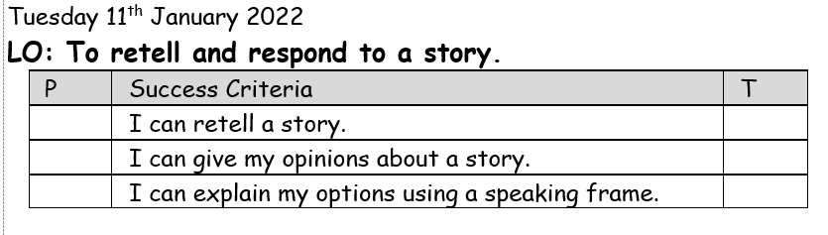

Slide 3
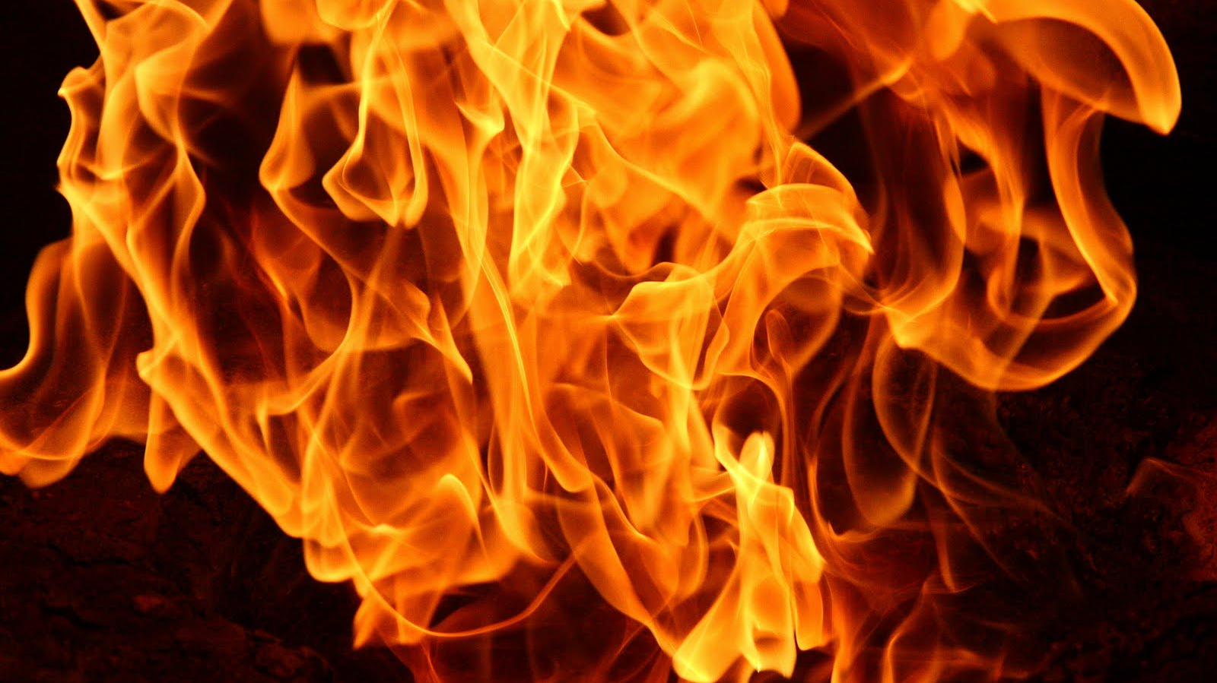
Starter: Word association
Notes:
How does it make you feel? What does it sound like? What word types have we used? On your whiteboard, how many words can you think of to describe fire.

Slide 4
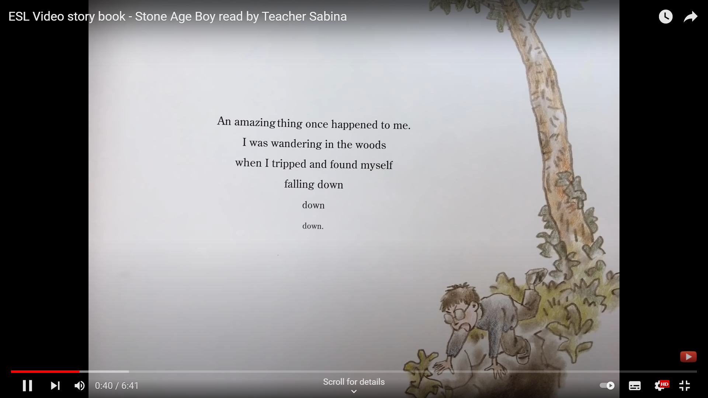
Notes:
ESL Video story book - Stone Age Boy read by Teacher Sabina - YouTube. Starts at 0:28

Slide 5
What did we notice about the story?
Written in first person narrator. Why?
How is he telling his story?
Which tense is it in? How do we know?
Were any of our predictions correct?

Slide 6
Your task:
Can you order the pictures to retell the story. Use the writing and key phrases to help you.
Notes:
Chn to order the events chronologically and orally retell the story using a bank of words and phrases.
LA – Provide chn with pictures and attached writing to order chronologically.
MA – Provide chn with images from the story and word bank of key phrases in chronological order.
HA – Provide chn with images from the story and word bank of key words and phrases from the story. Provide chn with time connectives also.

Slide 7

Plenary:
What did you like and dislike about the story? What did they learn about the stone age? Speaking frame given:
In my opinion I like/dislike the story because…

