Slide 1
Symmetry
LO: To understand symmetry.
LO: To be able to draw the whole.

Slide 2
We can describe lines as horizontal or vertical.
A horizontal line runs across, from left to right (or right to left):
A vertical line runs up and down:

Slide 3

What is Symmetry?
An object, shape or design can be said to be symmetrical if a line can be drawn through the middle, such that the two halves are mirror images of each other.
For example, a butterfly has symmetry. If you drew a line down the middle of the butterfly, both sides would be the same.
Lines of symmetry can be horizontal, vertical or diagonal.

Slide 4
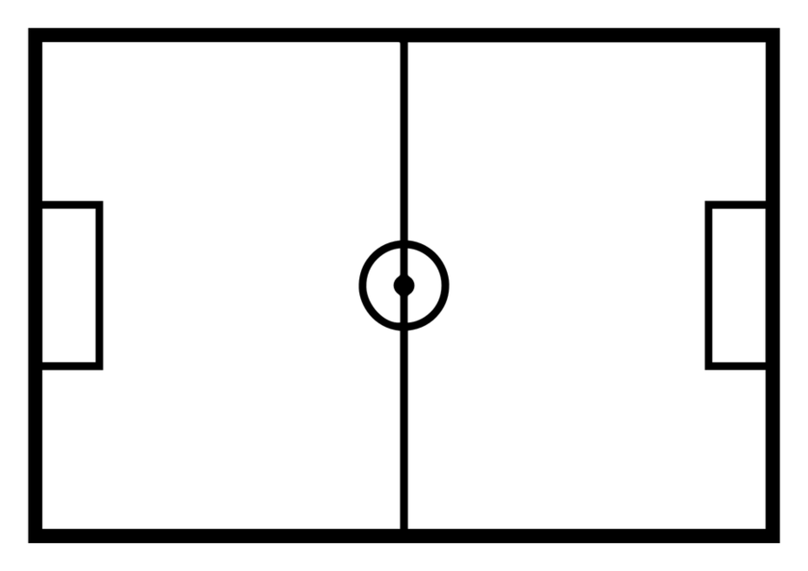
What is a vertical line of symmetry?

Slide 6

What is a horizontal line of symmetry?

Slide 7
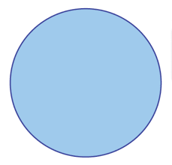

Slide 8
Shapes can have more then one line of symmetry.

Slide 9
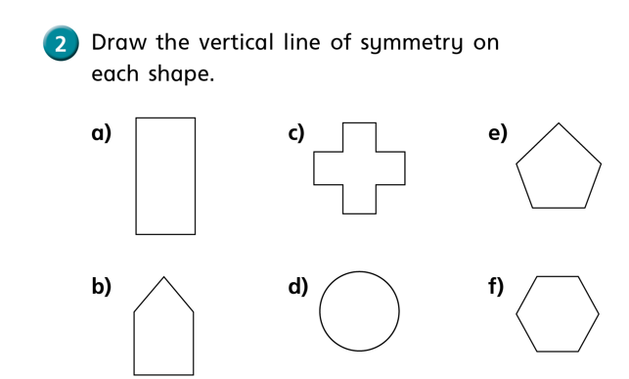

Slide 10



Complete the shape
Have a think

Slide 11


Slide 13
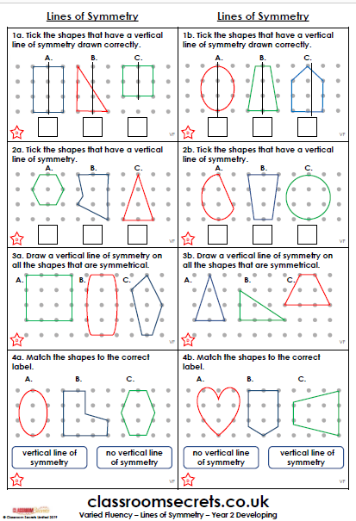
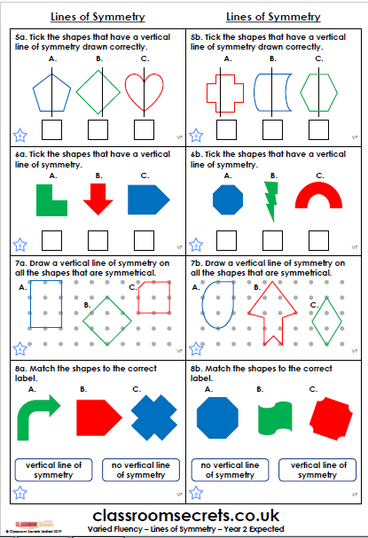
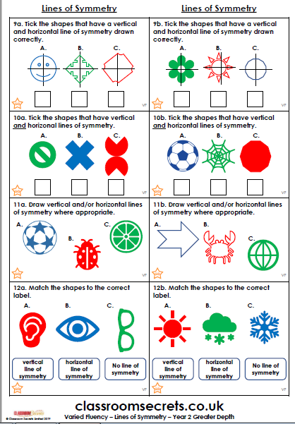
Your Task:
Activity one: Complete the classroom secret worksheet. There are three levels of difficulties, choose the one you are most comfortable with.

Slide 14
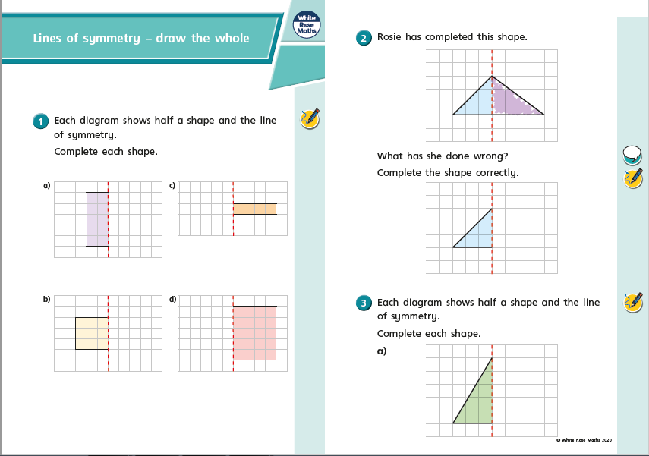
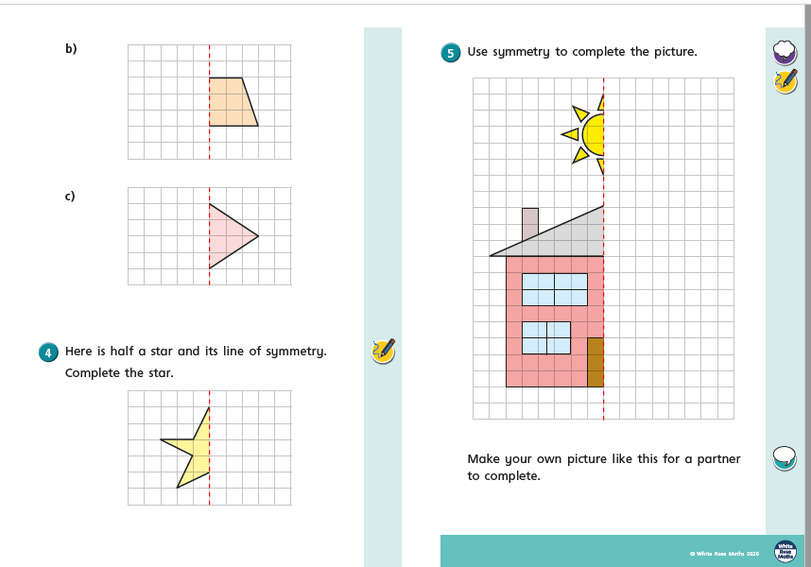
Activity two: Then complete the drawing the whole worksheet.
Extension: Can you find any symmetrical items in your home? Record your findings.

