Slide 1
Lesson 3
24.2.21
LO: To identify properties of 2D and 3D shapes.

Slide 2
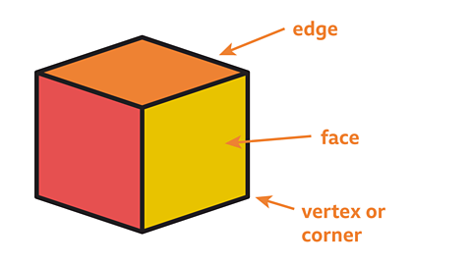
What are vertices?
A vertex is a corner where edges meet.
The plural is vertices.
For example a cube has 8 vertices.

Slide 3
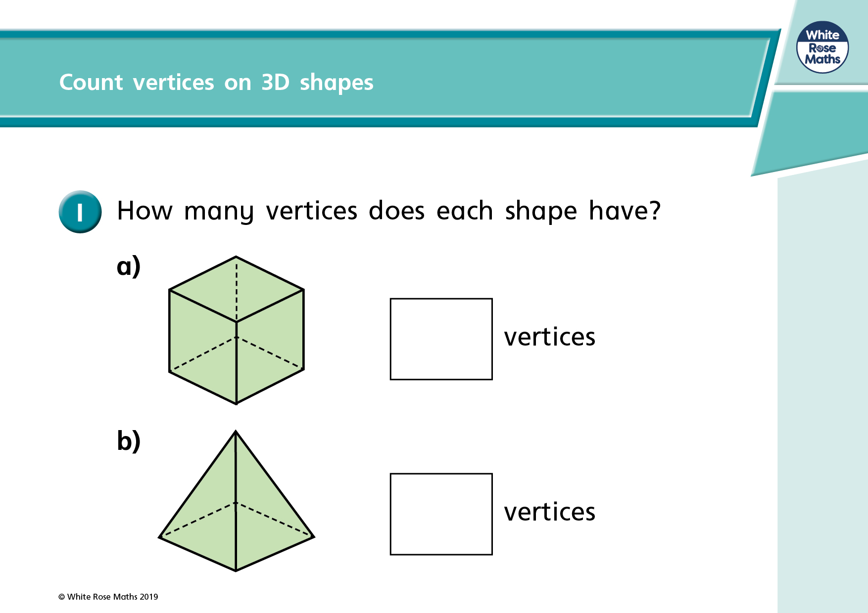

Slide 4
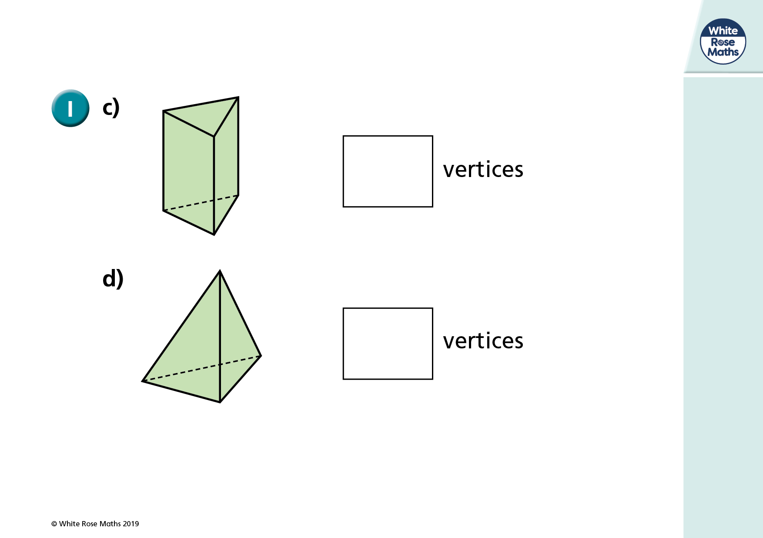

Slide 5
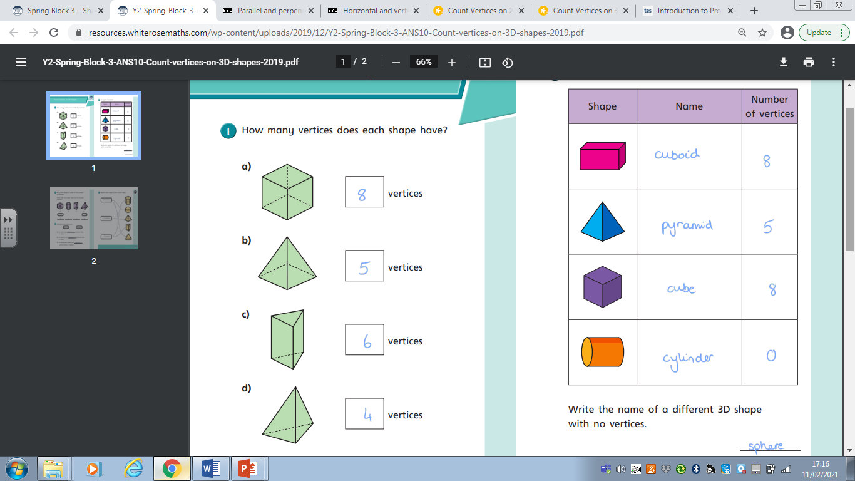

Slide 6
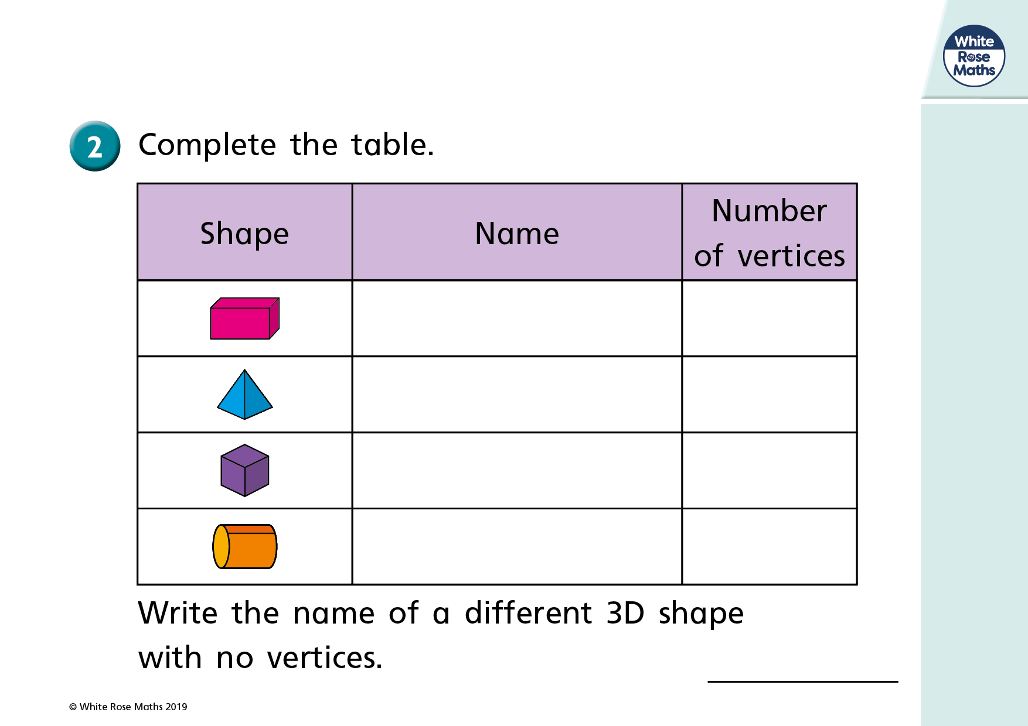

Slide 8
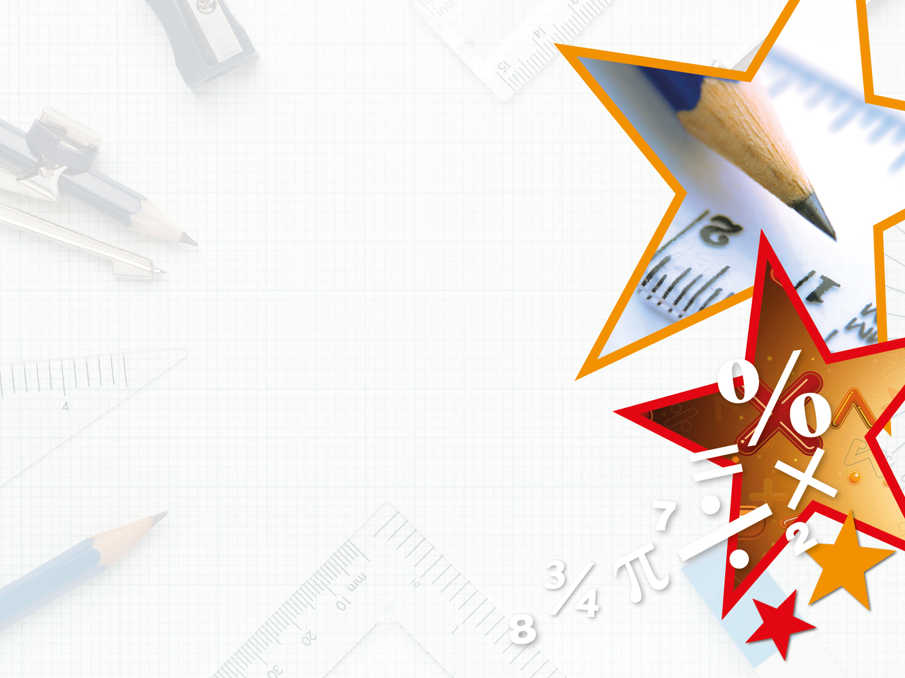
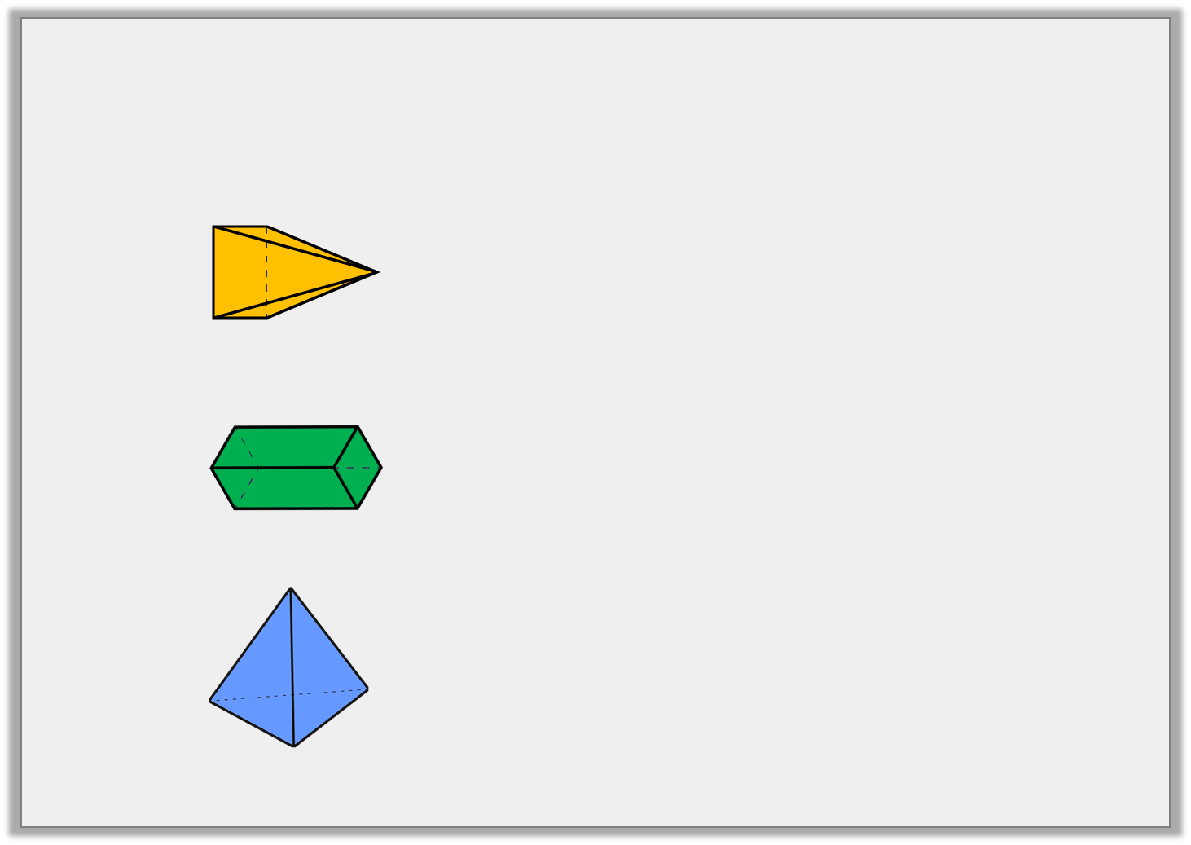

Varied Fluency 3
Match the shape to the number of vertices.
4
8
5
© Classroom Secrets Limited 2018

Slide 9
Varied Fluency 3
Match the shape to the number of vertices.
4
8
5
© Classroom Secrets Limited 2018

