Slide 1
L.O: To be able to write a diary entry.

Slide 2
Can we remember the key features of a diary before we write our own?

Slide 3
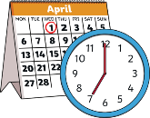



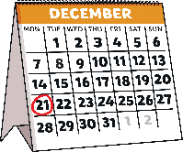




Diary Writing Checklist
Can you remember all the things you need to do to write a fantastic diary entry?
Diary writing must...
include the date and/or time;
be written in the past tense
use the words ‘I’, ‘my’, ‘we’ and ‘our’;
write as if I was there;
write about the most important events in order;
describe feelings;
use time linking words, e.g. ‘next’, ‘first’ and ‘then’;
talk about where events happened.

Slide 4
Now it’s time to use what you have learnt through the week to write your own diary entry.
Write a diary entry about a visit to an Indian street market, or visiting the image you had described in yesterday’s lesson.
Remember to use the diary writing checklist to help you remember what to include!
Year 2s: Try and include expanded noun phrases.
Year 3s: Include expanded noun phrase and try and include time adverbials.

Slide 5
When you have finished your diary entry, remember to send it to the office so your teacher can have a look!
We can’t wait to see all your hard work! ☺

