Slide 1
Haiku
LO: To explore a variety of poems.
LO: To understand the structure and meaning of a Haiku poem.

Slide 2
Poetry:
Limerick- these are funny and have rhyming words.
Haiku- this is a Japanese poetic form that consists of three lines, with five syllables in the first line, seven in the second, and five in the third. These are short poems, usually about nature.
Acrostic- the first letter of each line spells out what the poem is about.
Free verse- these have no rhyming words. Lines can be full sentences or even just one word.
Kennings- this is a way of describing something using clues rather than just saying what it is. Each line is two words long.
Shape poems- the words of the poem form the shape of the object, person or animal being described.

Slide 3
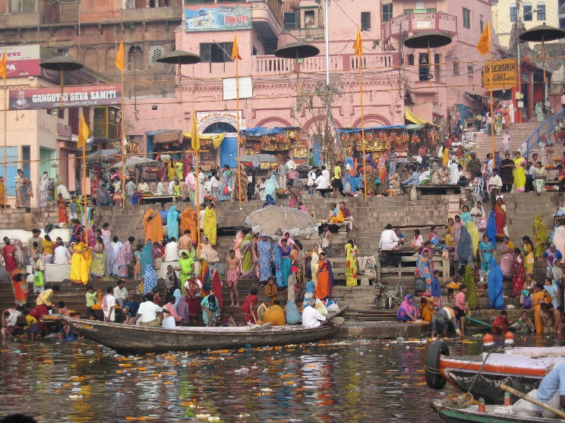
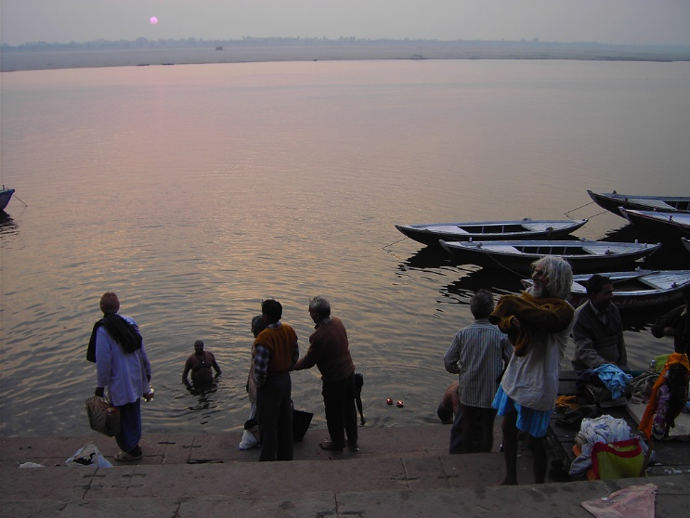
River Ganges Kennings Poem
Life-giver
Mountain-drinker
Glacier-melter
Soil-carrier
Festival-dancer
Nation-visitor
Flower-transporter
Food-accepter
Candle-protector
Mile-eater

Slide 4
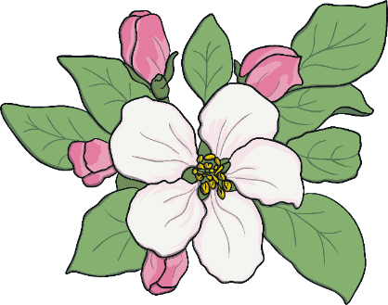
What is a Haiku?
Haiku poems are a traditional Japanese art form.
Each haiku has only three lines.
The lines follow a pattern of syllables:
5-7-5
Haiku are often written about nature or the seasons, but they don’t have to be!

Slide 5

What is a Haiku?
Winter is coming.
Snow will be arriving soon.
We should rake the leaves.
My two plum trees are
So gracious. See, they flower.
One now, one later.

Slide 6
What is a Haiku?
What did you notice about the poems?
Think about:
the poem’s theme;
how many lines are in each poem;
how many syllables in each line.
Three lines in each poem.
My two plum trees are
So gracious. See, they flower.
One now, one later.
Winter is coming.
Snow will be arriving soon.
We should rake the leaves.
5 syllables in first line
7 syllables in middle line
5 syllables in final line
Final line is a comment or observation on the theme.
natural
theme

Slide 7
Let’s have a go!
How can we write a haiku?
First, we need to choose a theme. It doesn’t have to be about seasons or nature, but let’s be traditional.
Summer
hot
sunshine
flowers
holiday
beach
ice-cream
games
sea
swimming
fun
warm
sand

Slide 8
Let’s have a go!
How can we write a haiku?
Next, we choose two or three ideas which will flow together.
Summer
hot
sunshine
flowers
holiday
beach
ice-cream
games
sea
swimming
fun
warm
sand

Slide 9
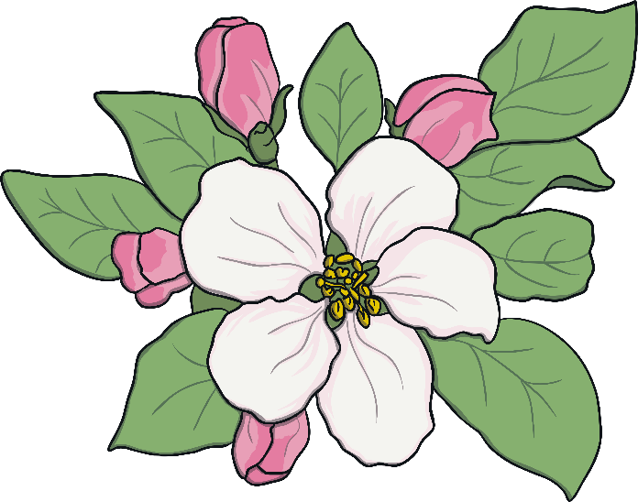
Now we have our ideas, let’s try to fit them into the 5-7-5 syllable format.
You might have to alter words or phrases slightly fit the pattern.
Summer
Holidays are coming
We can go to the beach
Hot sand is next to and the cool sea
Summer
Holidays are coming
We can go to the beach
Hot sand is next to and the cool sea
here
sea side
and

Slide 10
Now we have our ideas, let’s try to fit them into the 5-7-5 syllable format.
You might have to alter words or phrases slightly fit the pattern.
Summer
Holidays are here.
We can go to the sea side.
Hot sand and cool sea.

Slide 11
Your task:
Your activity today is to look at a variety of Haiku poems. Can you discuss or write down what you notice in these poems?
Can you tell me which poem is your favourite and why?

