Slide 1
Turns and Angles
LO: To have an understanding of turns and angles.
LO: To be able to compare angles.

Slide 2
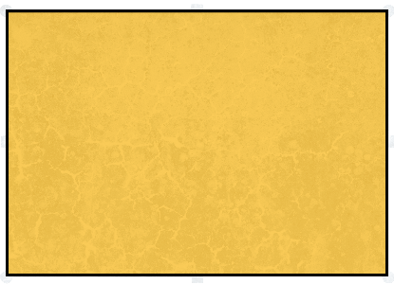
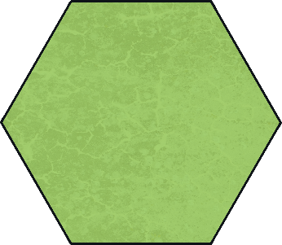
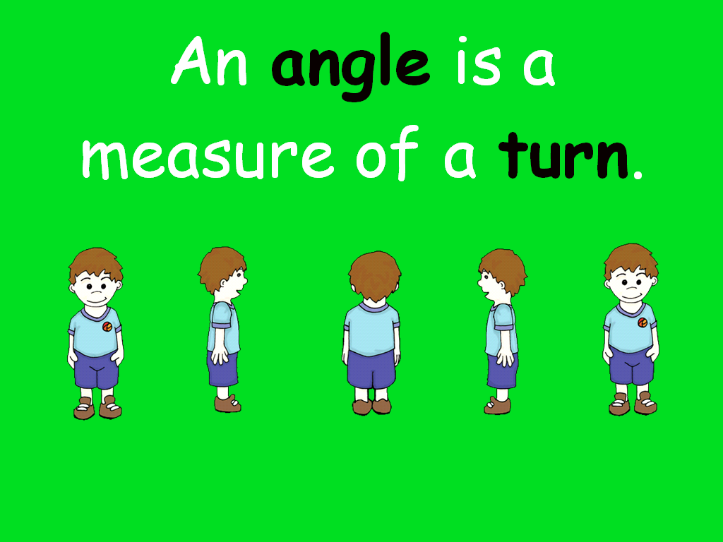
What are they?
Each of these pictures shows one or more angles.
An angle is made when two straight lines meet.
An angle is the measure of a turn:

Slide 3
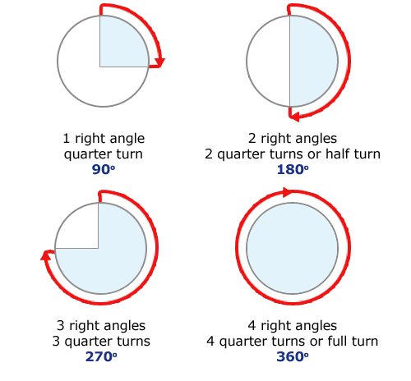
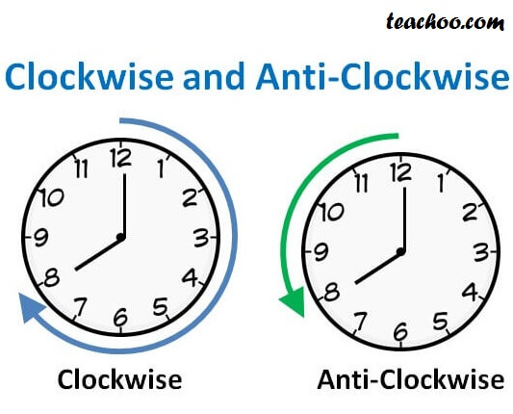
Turn

Slide 4
Angles
Less than 90 degrees right angle.
Also known as an acute angle.
90 degrees.
Also known as a right angle.
More than 90 degrees right angle.
Also known as an obtuse angle.

Slide 5
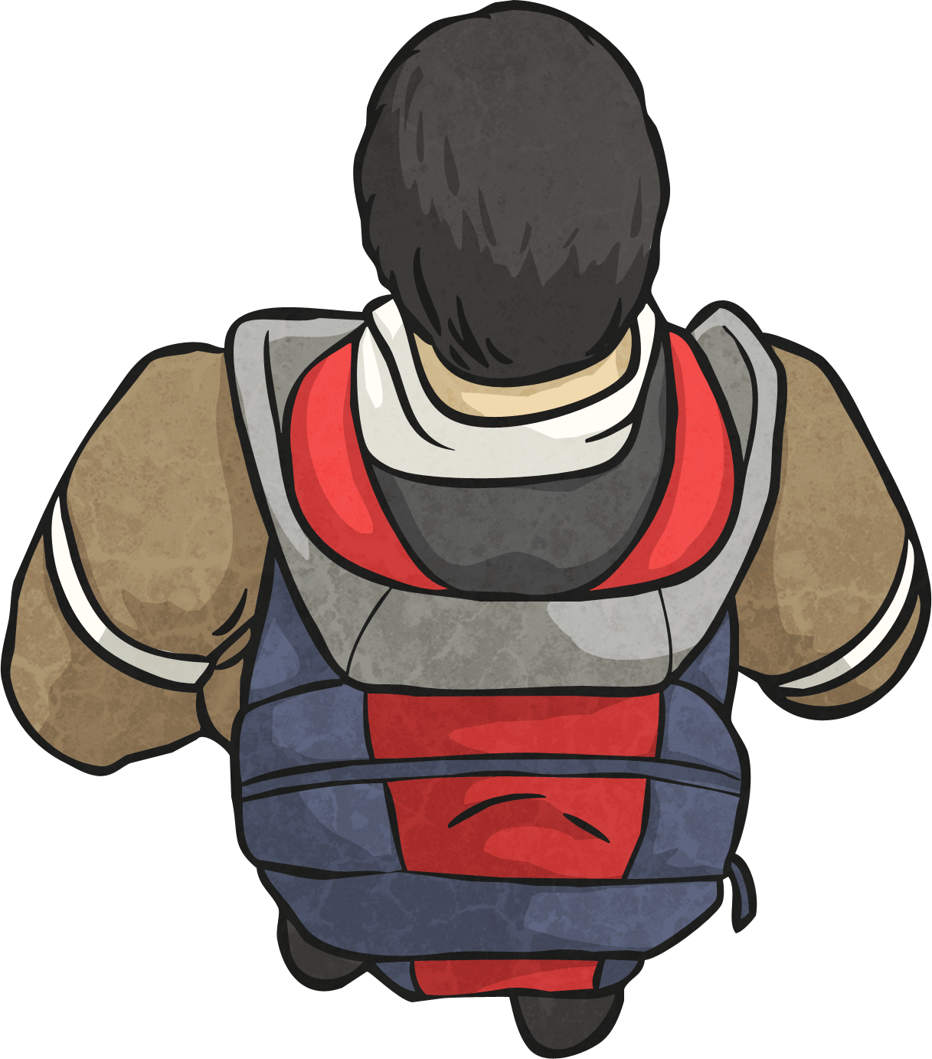
A right angle is made when two lines meet like this:
A quarter turn looks like this:
When something makes a quarter turn, it turns 90°.
The size of a right angle is 90°.

Slide 6
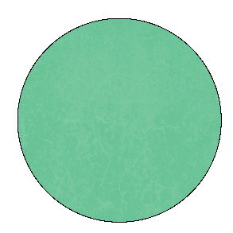
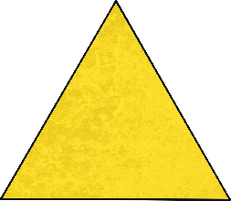

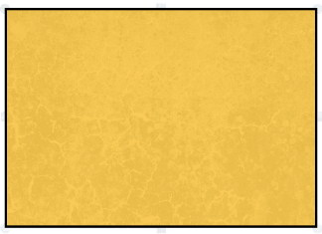
The child is facing the circle. If they make a quarter turn clockwise, which shape will they be facing?

Slide 7
The child is facing the rectangle. If they make a three-quarter turn anticlockwise, which shape will they be facing?

Slide 8
The child makes a quarter turn clockwise to face the circle.
Is there another way he could have turned to end up in the same position?

Slide 9
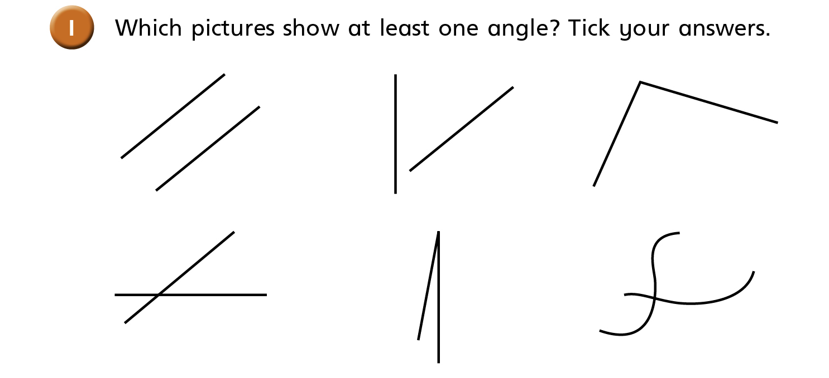

Slide 10
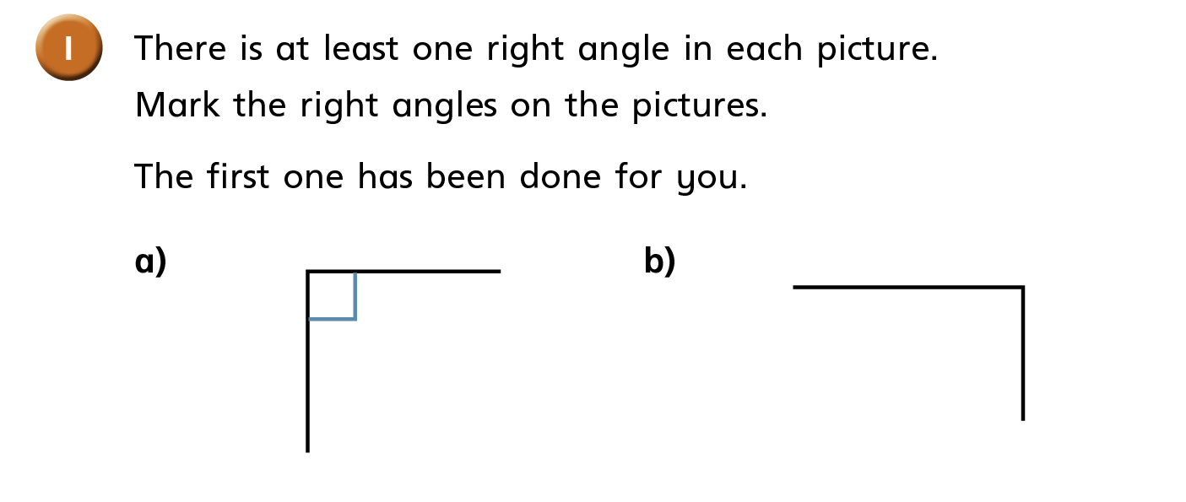
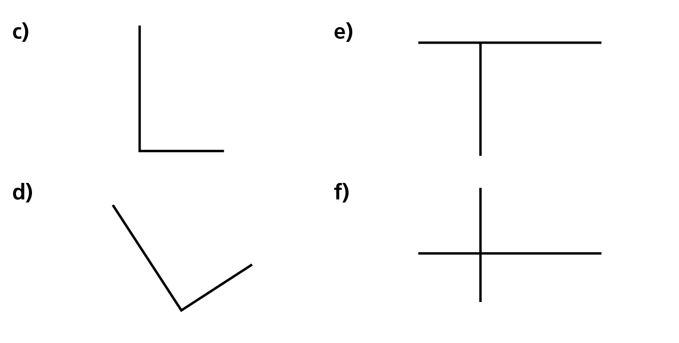

Slide 11
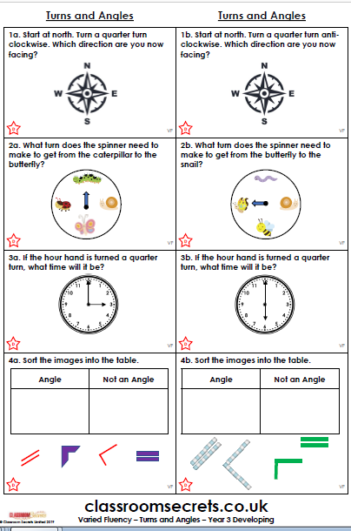
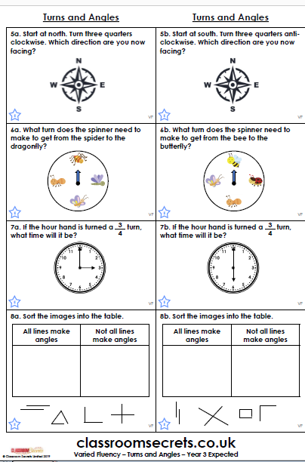
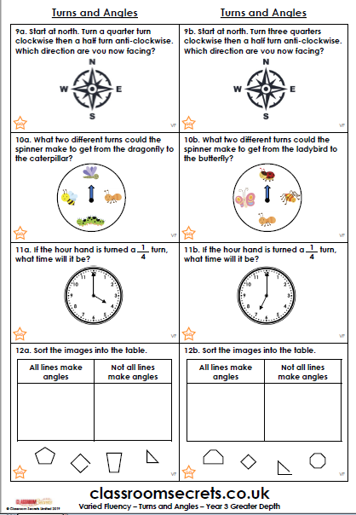
Your Task:
Activity one: complete the worksheet. There are three levels, please choose the level you are most comfortable with.

Slide 12
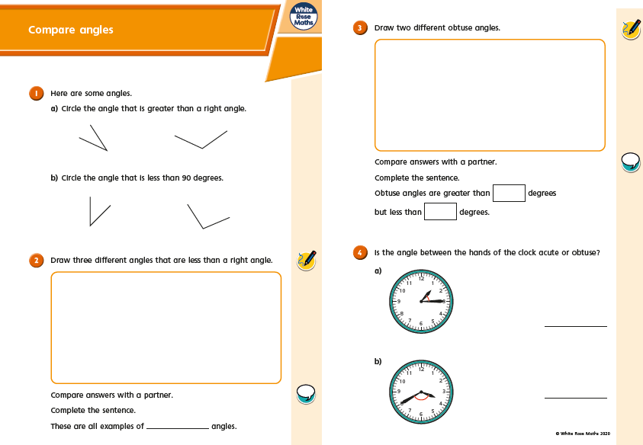
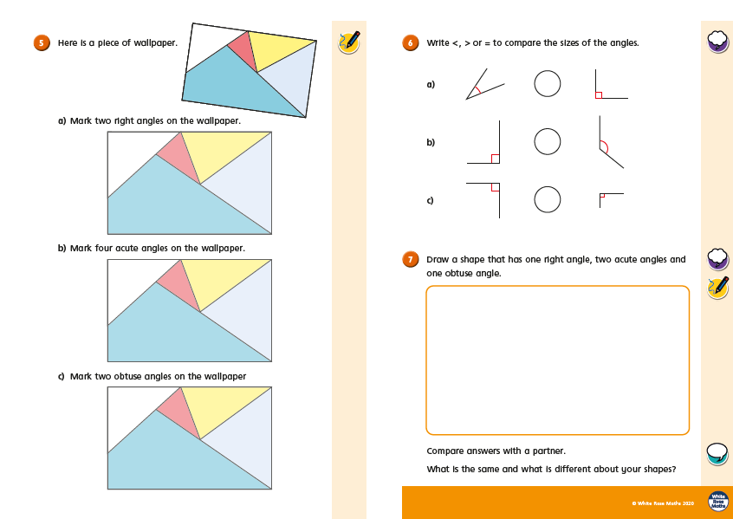
Activity two: Watch the White Rose video. Then complete the worksheet linked to comparing angles.

Slide 13
Challenge: Choose a selection of shapes, draw then and identify the angles the shapes have.
Challenge 2: Draw/ or use the printed shapes and rotate your shape. What will it look like after it’s been rotated?

