Slide 1
Lesson 2
23.2.21
LO: To recognise horizontal and vertical lines.

Slide 2
We can describe lines as horizontal or vertical.
A horizontal line runs across, from left to right (or right to left):
A vertical line runs up and down:

Slide 3
Look at this shape.
Where are the horizontal lines?

Slide 4
Where are the vertical lines?
Remember that some lines may not be either vertical or horizontal.

Slide 5

We can also talk about horizontal and vertical lines when thinking about symmetry.

Slide 6
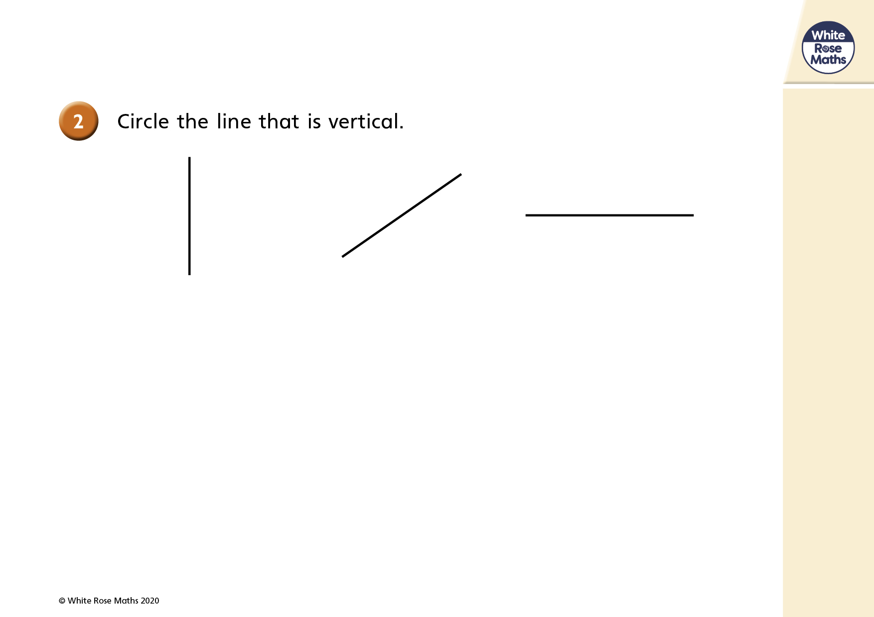

Slide 8
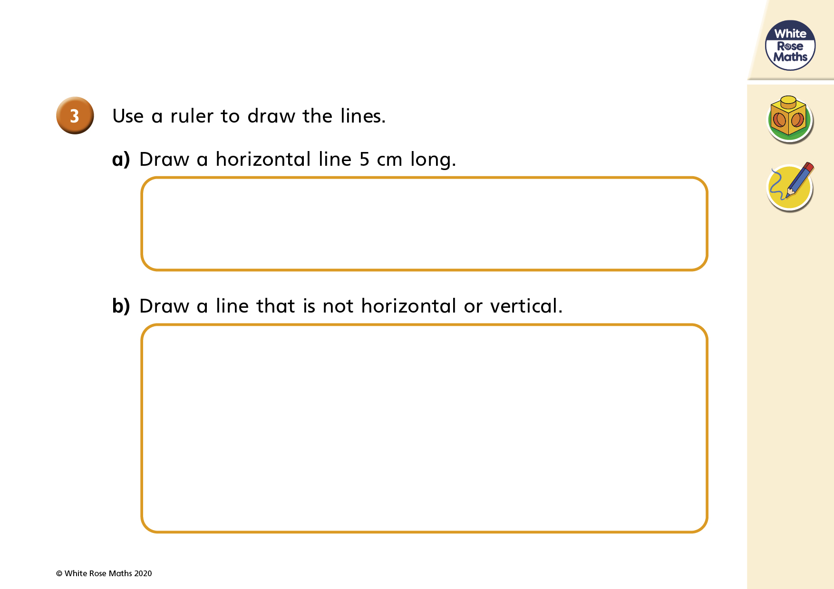

Slide 10
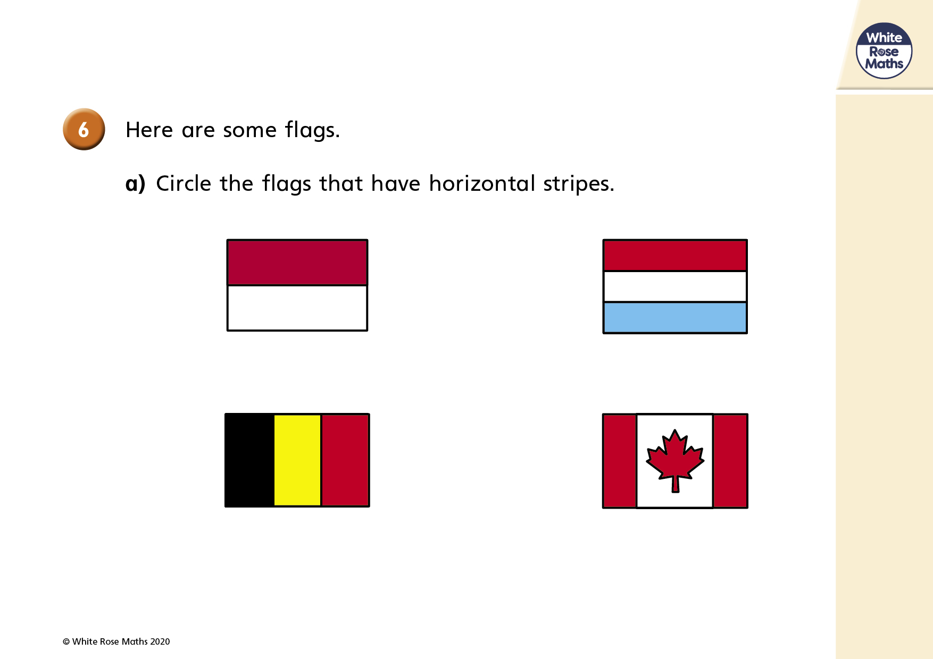

Slide 12


Varied Fluency 2
What types of lines are the shapes made up of?
Horizontal, vertical or both.
Object | Type of lines – horizontal, vertical or both?
© Classroom Secrets Limited 2018

Slide 13
Varied Fluency 2
What types of lines are the shapes made up of?
Horizontal, vertical or both.
Object | Type of lines –horizontal, vertical or both?
 | both
 | vertical
 | horizontal
 | both
© Classroom Secrets Limited 2018

Slide 14

Reasoning 1
Ruby is looking for horizontal and vertical lines. The time is now:
Is she correct? Explain how you know.
In 10 minutes, one hand will be horizontal and one hand will be vertical.
© Classroom Secrets Limited 2018

Slide 15
Reasoning 1
Ruby is looking for horizontal and vertical lines. The time is now:
Is she correct? Explain how you know.
Ruby is correct because…
In 10 minutes, one hand will be horizontal and one hand will be vertical.
© Classroom Secrets Limited 2018

Slide 16

Reasoning 1
Ruby is looking for horizontal and vertical lines. The time is now:
Is she correct? Explain how you know.
Ruby is correct because at 3 o’clock the hour hand will be pointing to 3 so it will be horizontal and the minute hand will be pointing at 12 so it will be vertical.
In 10 minutes, one hand will be horizontal and one hand will be vertical.
© Classroom Secrets Limited 2018

Slide 17
Your Task:
Complete the question sheet. There are three levels of difficulty, please choose the level you feel comfortable with.
Extension: Can you find examples of vertical and horizontal lines around the house or on your daily walk? Can you record when you find examples, and how many. E.g. outside gate, there are 8 vertical lines.

