Slide 1
Patterns
LO: To create patterns with 2D and 3D shapes.

Slide 2
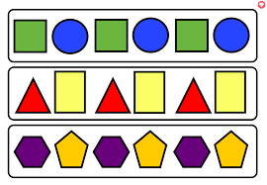
What is a pattern?
A pattern is when there are things that are arranged following a rule or rules.
A pattern can be made from objects, colours, shapes and numbers and sounds.
Patterns are often repeating.

Slide 3
Repeating patterns
Patterns repeat if we find the rule and look back at what has happened previously in the pattern we can work out what comes next.

Slide 4
What colour circle is going to be next in this repeating pattern?
What is the rule for this repeating pattern?

Slide 5
What comes next?

Slide 6


Slide 7
What comes next?

Slide 8
Make your own pattern

Slide 10
Make your own pattern

Slide 11
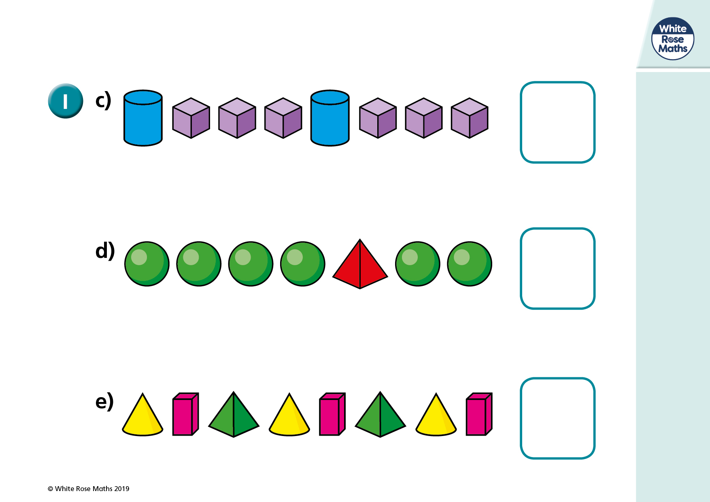
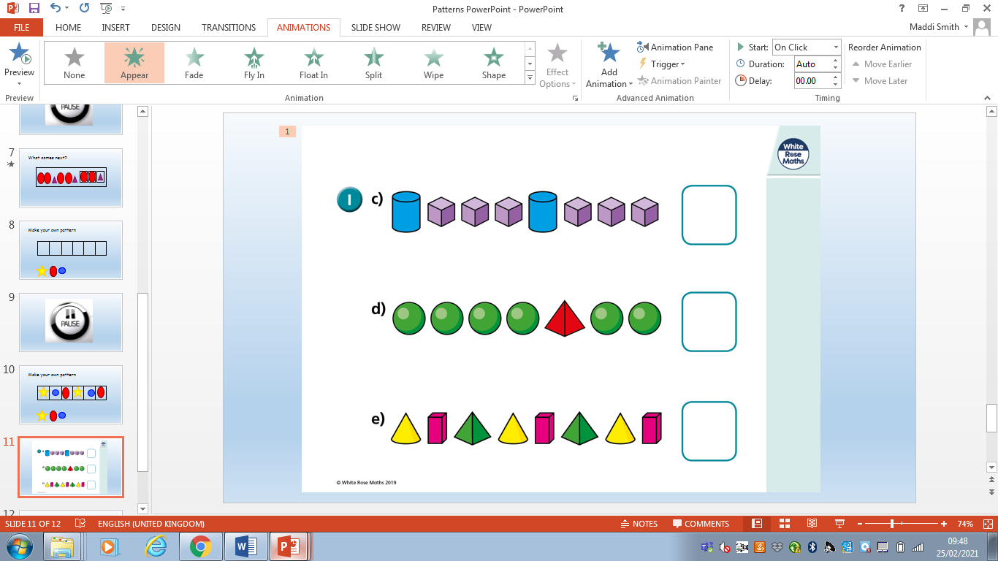

Slide 12
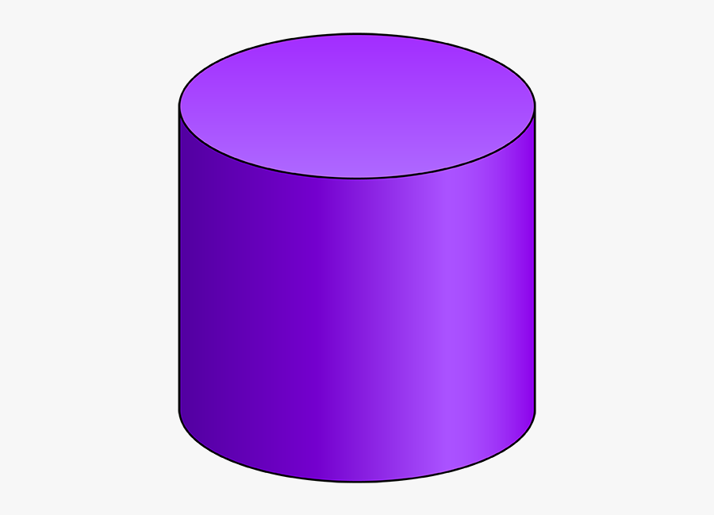


Can you draw my pattern?
My pattern is cylinder, cube, cube, cylinder.
Can you make it a repeating pattern?

Slide 13
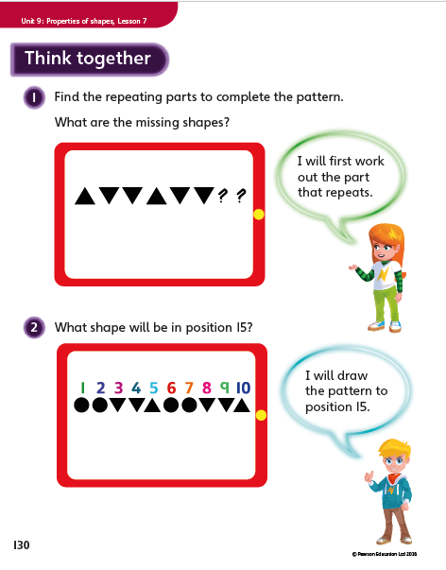
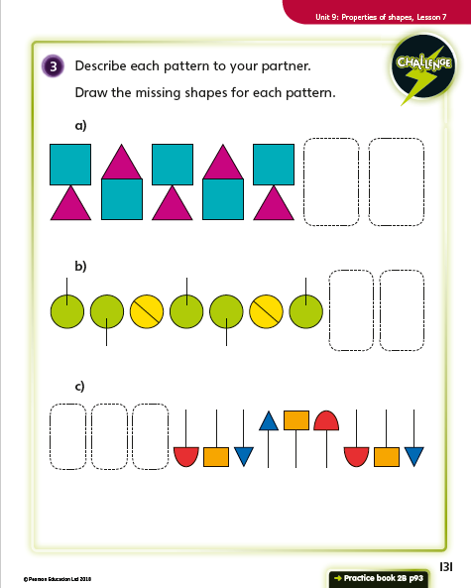
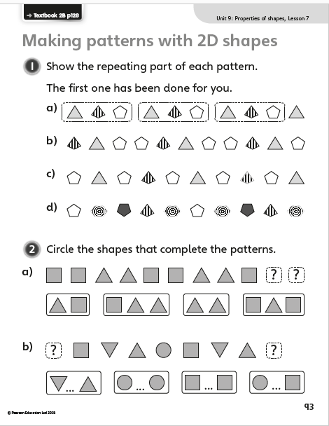
Your task:
Draw, or use the shapes on the website, to create five of your own patterns using a mixture of 2D and 3D shapes. Can you name the shapes you have used in your patterns?
Then complete the worksheets attached.

Slide 14
Extension: Using household items could you create your own repeating patterns?

