Slide 1


Year 4 – Statistics
Interpret Charts
FLUENCY
© Classroom Secrets Limited 2019

Slide 2
Introduction
What is each increment worth on these scales?
0 |  |  |  |  | 10 |  |  |  |  | 20
0 |  |  |  |  |  |  |  |  |  | 100
0 |  |  |  |  | 25 |  |  |  |  | 50
0 |  |  |  |  | 20 |  |  |  |  | 40
© Classroom Secrets Limited 2019

Slide 3
Introduction
What is each increment worth on these scales?
0 | 2 | 4 | 6 | 8 | 10 | 12 | 14 | 16 | 18 | 20
0 | 10 | 20 | 30 | 40 | 50 | 60 | 70 | 80 | 90 | 100
0 | 5 | 10 | 15 | 20 | 25 | 30 | 35 | 40 | 45 | 50
0 | 4 | 8 | 12 | 16 | 20 | 24 | 28 | 32 | 36 | 40
© Classroom Secrets Limited 2019

Slide 4
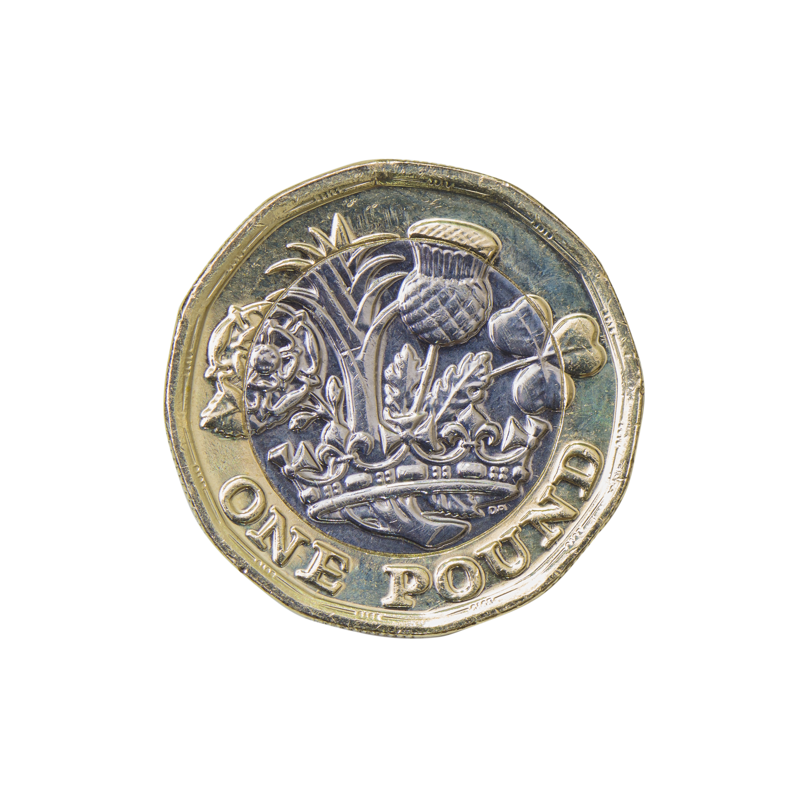
Varied Fluency 1
Look at this pictogram.
Fill in the blanks in the table.
Pocket Money
< £5 | £6 - £10 | £11 - £15 | £16 - £20
each image = 5 children
< £5 | £6 – £10 | £11 – £15 | £16 – £20
 |  | 10
© Classroom Secrets Limited 2019

Slide 5
Varied Fluency 1
Look at this pictogram.
Fill in the blanks in the table.
Pocket Money
< £5 | £6 - £10 | £11 - £15 | £16 - £20
each image = 5 children
< £5 | £6 – £10 | £11 – £15 | £16 – £20
15 | 15 | 10 | 5
© Classroom Secrets Limited 2019

Slide 6
Varied Fluency 2
Think of one question to ask about the information in this tally chart:
Holiday Destinations
UK
Europe
Rest of the World
© Classroom Secrets Limited 2019

Slide 7
Varied Fluency 2
Think of one question to ask about the information in this tally chart:
Various answers, for example:
How many people stayed in the UK for their holiday?
Which is the least popular destination?
How many people were asked in total?
How many more people stayed in the UK than travelled to Europe?
Holiday Destinations
UK
Europe
Rest of the World
© Classroom Secrets Limited 2019

Slide 8
Varied Fluency 3
Use the information in the table to create a bar chart.
Colour of Cars Passing the School
Silver | 35
Red | 40
Blue | 55
 | Silver |  | Red |  | Blue
© Classroom Secrets Limited 2019

Slide 9
Varied Fluency 3
Use the information in the table to create a bar chart.
Colour of Cars Passing the School
Silver | 35
Red | 40
Blue | 55
 | Silver |  | Red |  | Blue
Discuss which scale to use: 1s, 2s, 5s, 10s, 20s
How will you
show 35? 55?
© Classroom Secrets Limited 2019

Slide 10
Varied Fluency 3
Use the information in the table to create a bar chart.
Silver | 35
Red | 40
Blue | 55
Colour of Cars Passing the School
60
40
20
0
 | Silver |  | Red |  | Blue
Number of Cars
Colour
© Classroom Secrets Limited 2019

Slide 11
Varied Fluency 4
Use the bar chart to answer the questions.
60
45
30
15
0
Cake Sales
How many cakes were sold on Monday?
What is the most cakes sold in one day?
On which day were the least amount of cakes sold?
Mon | Tues | Wed | Thurs | Fri
© Classroom Secrets Limited 2019

Slide 12
Varied Fluency 4
Use the bar chart to answer the questions.
60
45
30
15
0
Cake Sales
How many cakes were sold on Monday? 45
What is the most cakes sold in one day? 60 on Wednesday
On which day were the least amount of cakes sold? Tuesday and Thursday
Mon | Tues | Wed | Thurs | Fri
© Classroom Secrets Limited 2019

