Slide 1


Year 4 – Spring Block 3 – Fractions
Step 1: What is a Fraction?
© Classroom Secrets Limited 2019

Slide 2

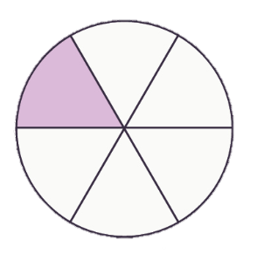



Introduction
Circle the images which represent .
1
6
© Classroom Secrets Limited 2019

Slide 3
Introduction
Circle the images which represent .
1
6
© Classroom Secrets Limited 2019

Slide 4


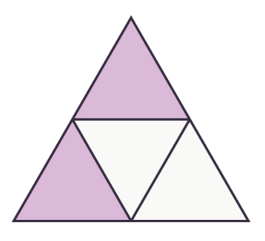
Varied Fluency 1
Circle the unit fractions.
© Classroom Secrets Limited 2019

Slide 5
Varied Fluency 1
Circle the unit fractions.
© Classroom Secrets Limited 2019

Slide 6



Varied Fluency 2
Match the fraction to the correct representation.
1
5
3
4
4
7
2
4
A.
B.
C.
D.
© Classroom Secrets Limited 2019

Slide 7
Varied Fluency 2
Match the fraction to the correct representation.
1
5
3
4
4
7
2
4
A.
B.
C.
D.
© Classroom Secrets Limited 2019

Slide 8
Varied Fluency 3
Place the following fractions on the number line below.
4 |  |  | 11 |  |  | 2 |  |  | 6
12 |  |  | 12 |  |  | 12 |  |  | 12
0 |  |  |  |  |  |  |  |  |  |  |  | 1
© Classroom Secrets Limited 2019

Slide 9
Varied Fluency 3
Place the following fractions on the number line below.
4 |  |  | 11 |  |  | 2 |  |  | 6
12 |  |  | 12 |  |  | 12 |  |  | 12
2
12
0 |  |  |  |  |  |  |  |  |  |  |  | 1
4
12
6
12
11
12
© Classroom Secrets Limited 2019

Slide 10
Varied Fluency 4
Write a fraction represented below
© Classroom Secrets Limited 2019

Slide 11
Varied Fluency 4
Write a fraction represented below
or
3
9
6
9
© Classroom Secrets Limited 2019

Slide 12
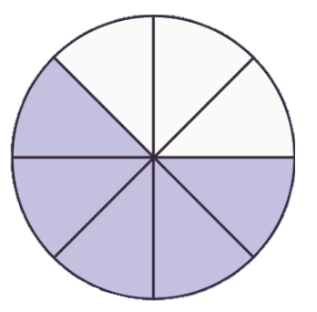
Problem Solving 1
Which image is the odd one out?
Redraw the image to show the correct fraction.
A.
B.
C.
D.
5
8
0 |  |  |  |  |  |  |  | 1
© Classroom Secrets Limited 2019

Slide 13
Problem Solving 1
Which image is the odd one out?
Redraw the image to show the correct fraction.
Various possible answers, for example:
A.
B.
C.
D.
5
8
0 |  |  |  |  |  |  |  | 1
© Classroom Secrets Limited 2019

Slide 14
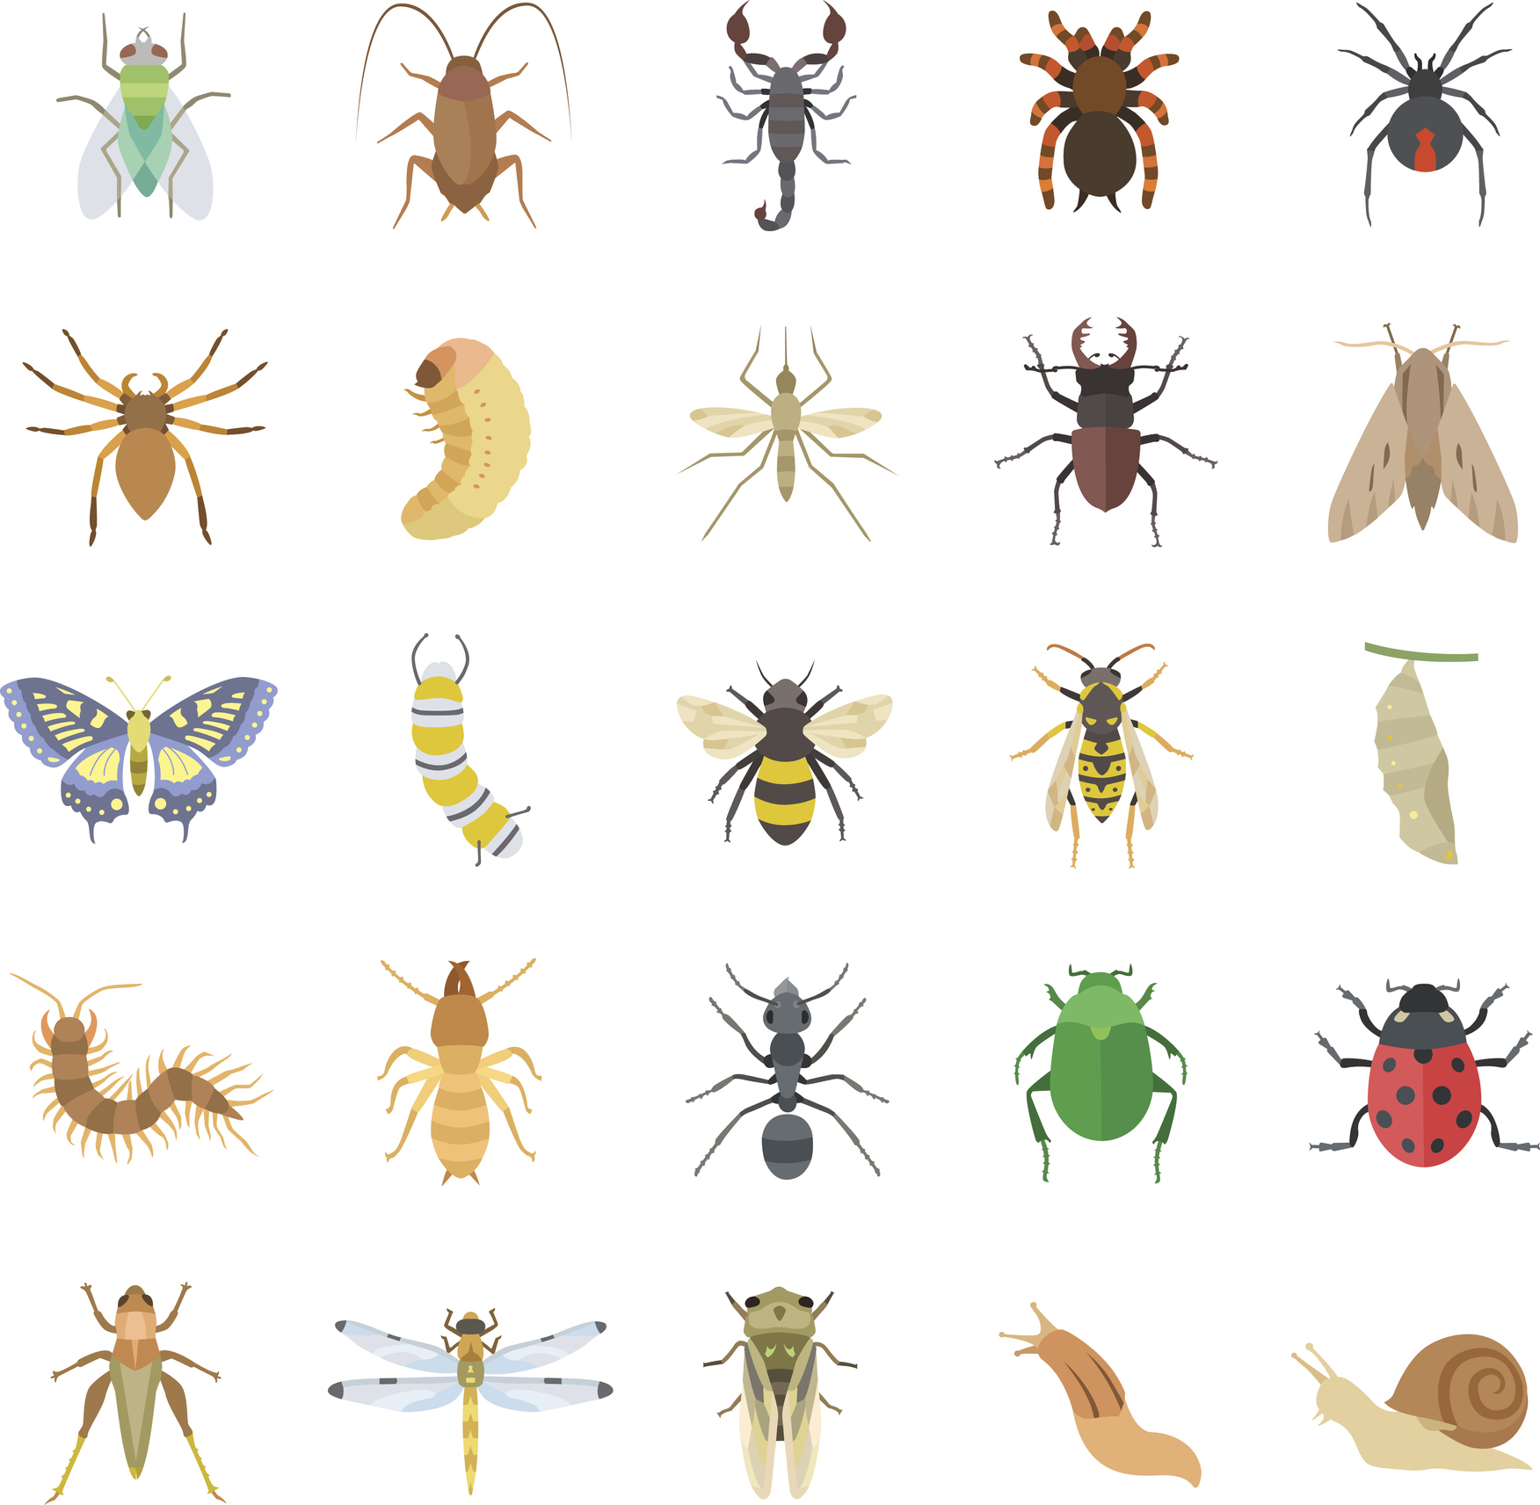
Reasoning 1
Josh thinks one of the fractions being represented below is .
Is he correct? Prove it.
4
5
© Classroom Secrets Limited 2019

Slide 15
Reasoning 1
Josh thinks one of the fractions being represented below is .
Is he correct? Prove it.
Josh is incorrect because…
4
5
© Classroom Secrets Limited 2019

Slide 16
Reasoning 1
Josh thinks one of the fractions being represented below is .
Is he correct? Prove it.
Josh is incorrect because the whole is 9.
The fraction should be or .
4
5
5
9
4
9
© Classroom Secrets Limited 2019

Slide 17
Reasoning 2
Tara has placed a fraction on the number line.
Is she correct? Explain how you know.
3
12
0 |  |  |  |  |  |  |  |  |  |  |  | 1
© Classroom Secrets Limited 2019

Slide 18
Reasoning 2
Tara has placed a fraction on the number line.
Is she correct? Explain how you know.
Tara is incorrect because...
3
12
0 |  |  |  |  |  |  |  |  |  |  |  | 1
© Classroom Secrets Limited 2019

Slide 19
Reasoning 2
Tara has placed a fraction on the number line.
Is she correct? Explain how you know.
Tara is incorrect because she has placed the fraction in the middle of the number line which would be .
3
12
0 |  |  |  |  |  |  |  |  |  |  |  | 1
6
12
© Classroom Secrets Limited 2019

