Slide 1
English 01.03.21
Explanation Texts Monday 1st March, 2021

Slide 2
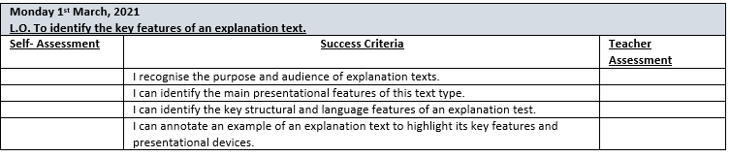

Slide 3
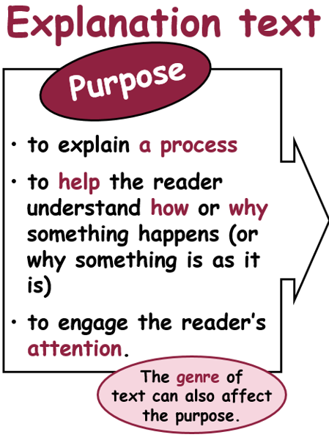
Where might we find examples of this text type?
From ‘The Explanation Book’by Sue Palmer

Slide 4
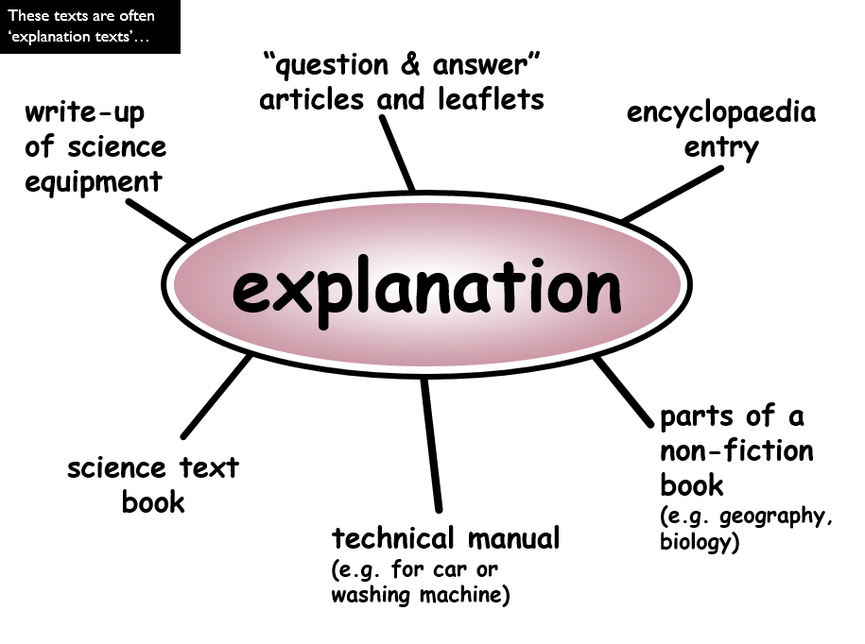

Slide 5

Purpose – to explain how the time/space travel machine and its various components that we have designed works.

Slide 6
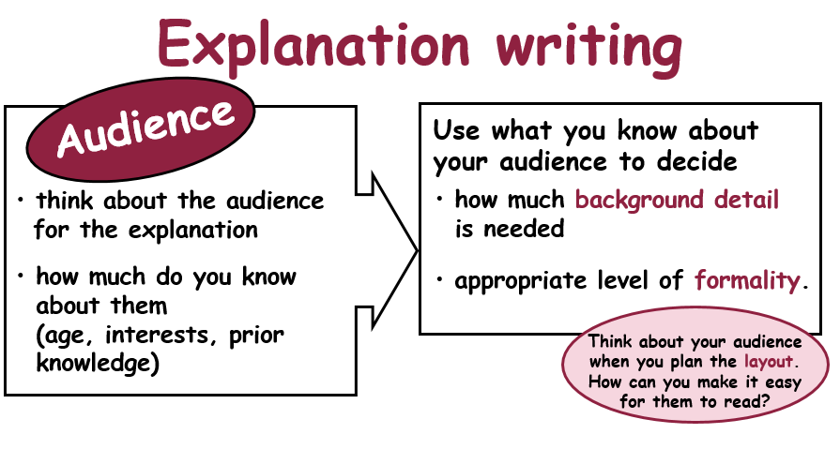

Slide 7
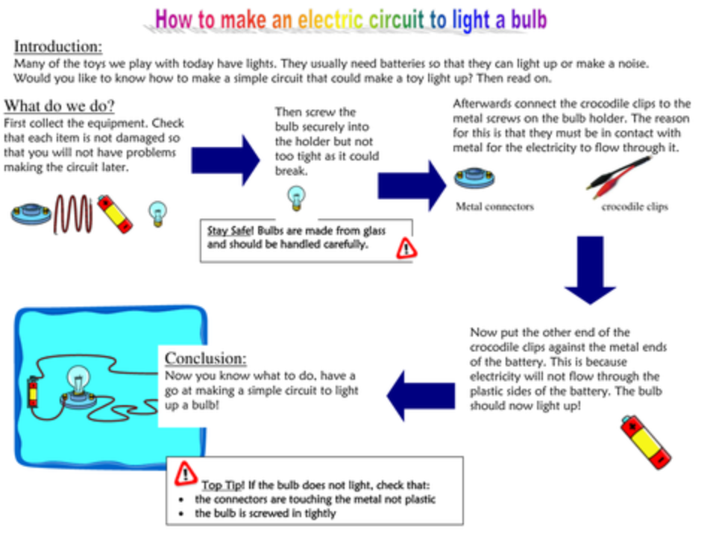
What are the key features of this test type?
How is the text presented?
How is the text structured or organised?
What sort of language is used?

Slide 8
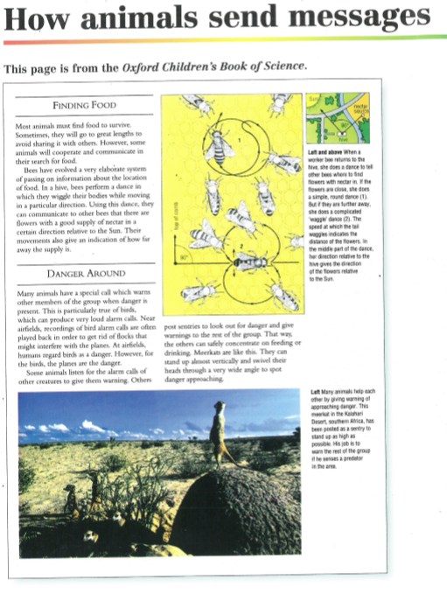
Independent Work: Year 4: Work through text provided, highlighting key structure, language and presentational features. Create a mind map or list of key features identified. Year 5: As above using a selection of texts. Also, make a note of any conjunctions found. Year 6: In addition to above, pupils to use examples from the text to justify their comments about the effectiveness of the texts read e.g. how well does this text explain the process.

Slide 9
Plenary: Use this link to find out more. http://www.bbc.co.uk/bitesize/ks2/english/writing/explanation/play/ Note any additional information in your book.

