Slide 1
English 04.03.21
Explanation Texts 4th March, 2021

Slide 2
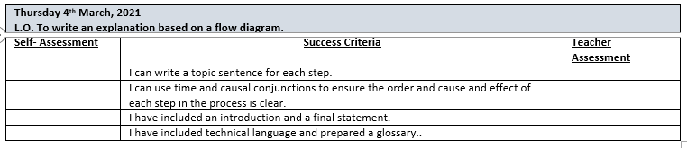

Slide 3
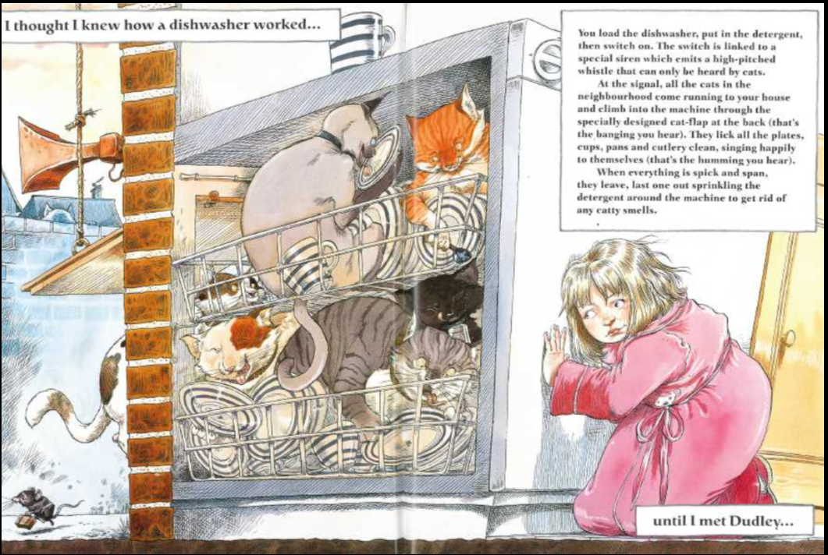

Slide 4
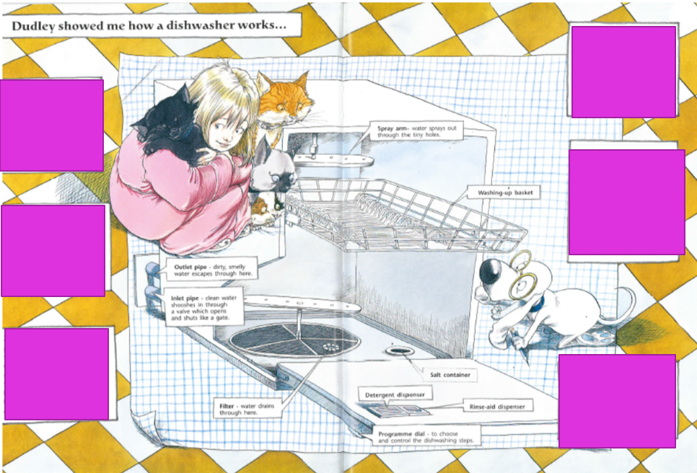
How does a dishwasher work?
What do you need to do to begin the process? At the end?
What do you think the steps are?
See the flow diagram.

Slide 5
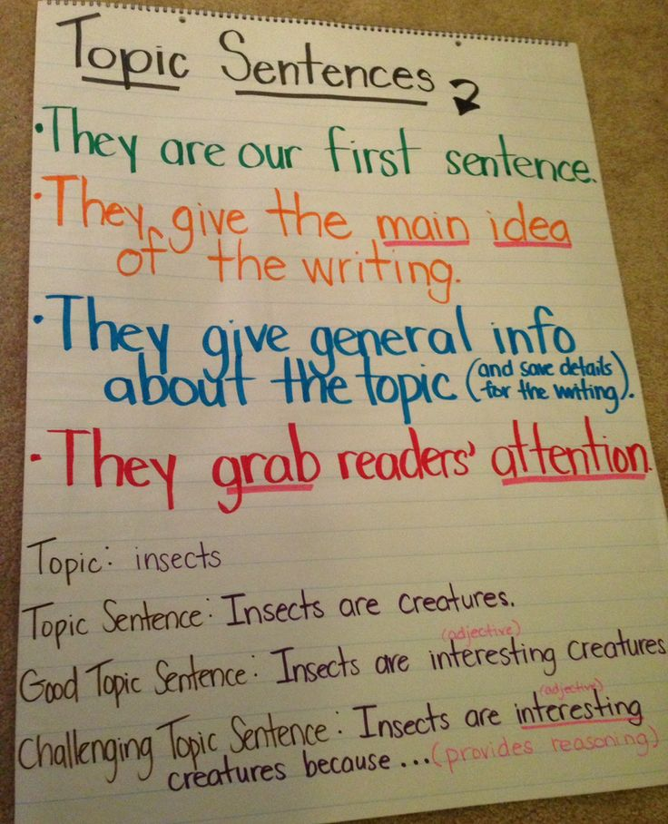
Each step (paragraph) must begin with a topic sentence. Remember…
e.g. Before you press ‘start’ to switch the dishwasher on, add detergent.
Add liquid dishwasher detergent, powder, tablets or capsules to the correct compartment and close the door. Then use the knob on the front of the machine to select the programme that you wish to use.

Slide 6
Independent work:
Year 4: Using the Y4 flow diagram, write an explanation of how dishwashers work. Remember to include time conjunctions in your writing.
Year 5: As above using Y5 flow diagram, complete the explanation of how dishwashers work. Include time and causal conjunctions in your explanations and technical language. You also need to include an introduction and a final statement.
Year 6: Include all of the above and using the Y6 copy of the flow diagram for reference, pupils to write an explanation of how dishwashers work in their books. Text to be written in formal, impersonal style.
Challenge: To include a passive sentence.

