Slide 1
English Day 10
English day 10 – Monday 25th January

Slide 2

How many different synonyms for ‘said’ can you think of?

Slide 3
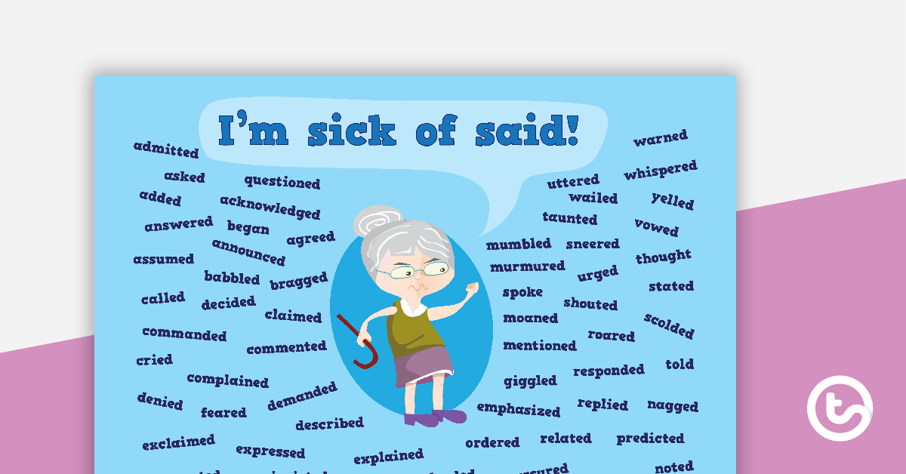

Slide 4

Listen carefully to what happens next in the story…

Slide 5
How do we know when words are spoken when they are written down?
We'll live in one of these places, Nick told Mercy.
But we've not been invited! said Mercy. And my face is dirty. Mother wouldn't...
We won't go in through a front door, nor even through the servant's entrance, said Nick. No-one will see if we are dirty or clean. We'll set up home in secret. Here. Nick dodged down an alley-way that ran beside one big house.

Slide 6
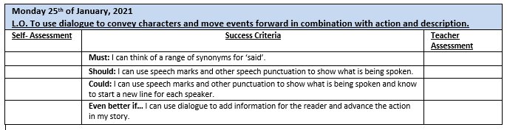

Slide 7
"We'll live in one of these places," Nick told Mercy.
"But we've not been invited!" said Mercy. "And my face is dirty. Mother wouldn't...“
"We won't go in through a front door, nor even through the servant's entrance," said Nick. "No-one will see if we are dirty or clean. We'll set up home in secret. Here." Nick dodged down an alley-way that ran beside one big house.

Slide 8
Why is dialogue useful in stories?
To give the reader extra information e.g. “Look Father, the fire is burning from Pudding Lane all the way west to Fleet Street!” gasped Will.
To advance the action e.g. “Quick!” shouted his father. “We must go home and save our possessions.”

Slide 9
Your task today: write a conversation between…
Y4 - William and his father at the top of Tower Hill
Y5 - Conversation between William and his Mother as she asks him to take his siblings to their grandparent’s house
Y6 - Conversation between William and his siblings: Thomas, Sarah, who were leading their younger sister Bessie, and the baby Samuel
Don’t forget to use speech marks and a new line for each speaker

Slide 10
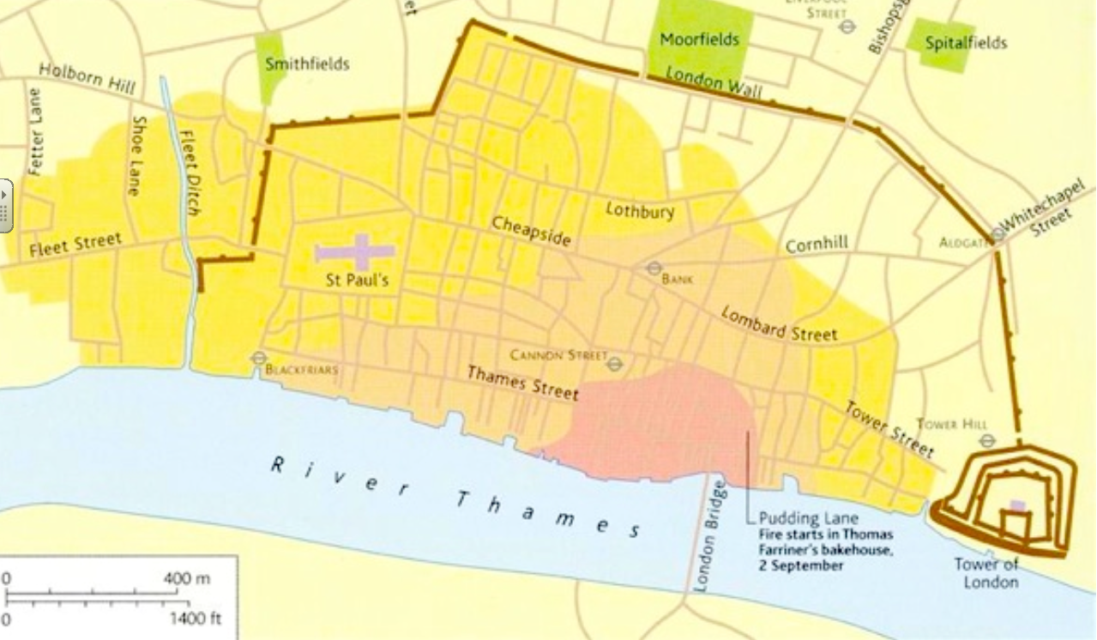
http://www.fireoflondon.org.uk/story/streets-and-buildings/

Slide 11
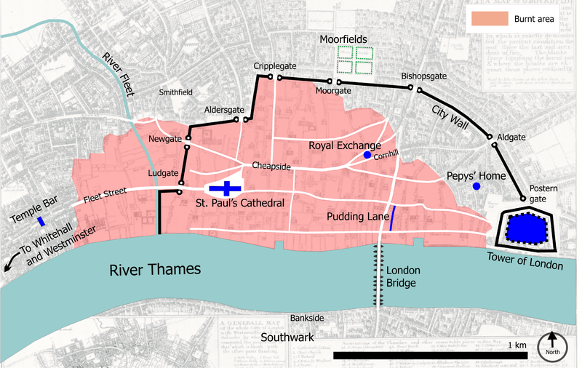
Don’t forget:
Historical details
Archaic language
Street names
Speech punctuation

