Slide 1
English Day 11
English day 11 – Tuesday 26th January

Slide 2
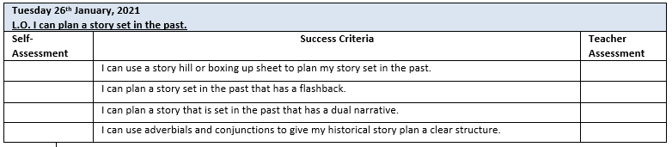

Slide 3
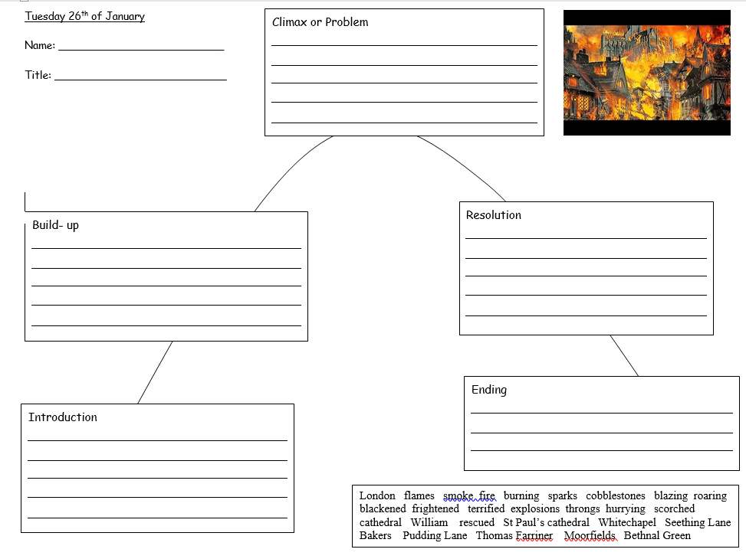
Story Hill Planning sheet
See the next slide for what to include under each heading.

Slide 4
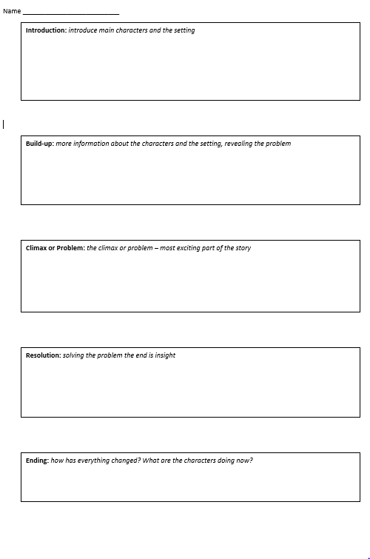
Boxing-up Planning Sheet
Introduction: introduce characters and the setting – use your 5 senses; what are your character(s) and the setting like
Build-up: tell me more about the characters and the setting, suggest what the problem is
Climax/Problem: the most exciting part of the story – fast paced action
Resolution: how will your character(s) solve the problem?
Ending: what happens in the end? Can you link the back to the beginning?

Slide 5
Today’s Task: To plan a story set in the past
with the following narrative structure:
Y4: Children to plan their story using the structure on the story hill
Y5: Children to plan using the boxing-up sheet or same subheadings
Challenge (Y5): children to include a ‘flashback’
Y6: Children to plan their story using the boxing-up sheet or using the same subheadings in their book – their story must contain a flashback
Challenge (Y6): Children to try to write a parallel narrative – telling two linked stories at the same time – using conjunctions to help switch between them

Slide 6
Story with a flashback: an interruption in the present story to jump back in time. For example…
A grandma putting her grandchildren to bed… children want a story… she says she’ll tell them a story that her grandma told her…
She tells them a story…
A story set at the time of the Great Fire of London – tell the story about the fire.
After the story ends, the grandchildren tell her it was a lovely story. She tells them that it’s a true story, a very old story… that the main character was a distant relative (e.g. her great, great grandfather, whose name was Will) and that it has been passed down through the generations.

Slide 7
Flashbacks might be caused by…
Memory – triggered by an object e.g. a photo
Special object – could be an old letter or a piece of jewellery such as a locket
Historical place – an old house, church or old road

Slide 8
Structure:
Story before the flashback
Main story – e.g. during The Great Fire Of London
Story after the flashback

Slide 9
Writing a dual narrative – two interlinked stories – different locations
e.g. Story 1: Will’s mum sends Will off with his siblings to their grandparent’s house – focus on Will’s story to his grandparent’s, what they did when they got there… Will talking to grandparents.
Story 2: Meanwhile Will’s parents watch with horror as the fire engulfs the Dolphin Tavern two streets away. Fire will reach Tower Hill soon. Mother quickly gather’s sentimental keepsakes – Father selects important paperwork. Buries valuables under the tree in the garden. As they leave the house, loud explosions….
Story !: As he left his grandparent’s house, Will heard huge explosions and the ground shook. Looking skywards, he realised that the flames must be close to Tower Hill, his home. I must find Mother and Father he thought as he started to run towards the blaze. Blackened by smoke, the narrow streets became difficult to navigate. Losing his way, he began to choke…

Slide 10
Structure:
Story 1
Story 1
Story 1
Story 2
Story 2
Important that conjuctions and opening sentences in paragraphs make clear which story is being told

Slide 11
Checklist:
Interesting paragraph and sentence openers
Used adverbials or conjunctions to link sentences and paragraphs and show passage of time
Clear who pronouns refer to
Shifts of time and place are clear – prepositional language

