Slide 1
English Day 12
English day 12 – Wednesday 27th January, 2021

Slide 2
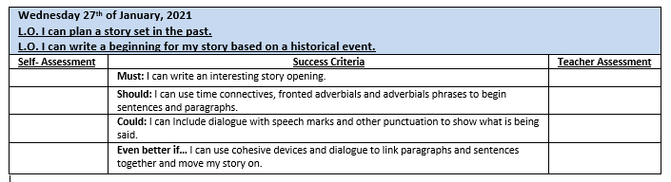

Slide 3
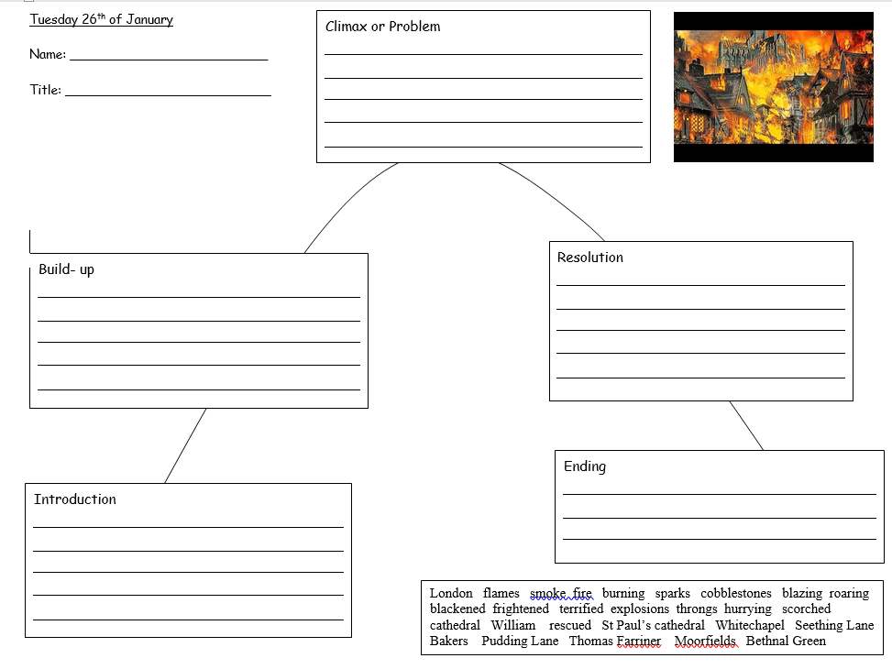
Story Hill Planning sheet
See the next slide for what to include under each heading.

Slide 4
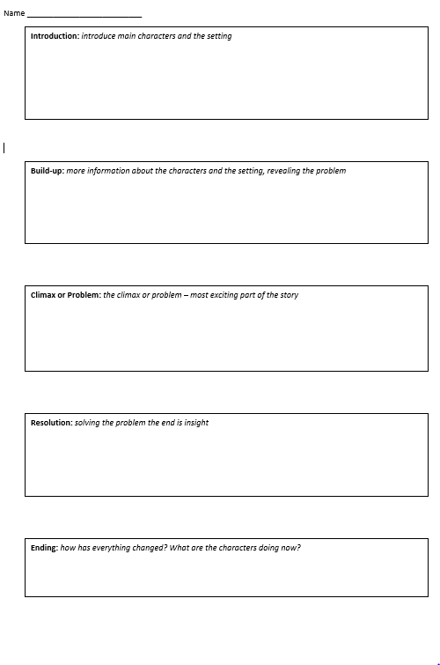
Boxing-up Planning Sheet
Introduction: introduce characters and the setting – use your 5 senses; what are your character(s) and the setting like
Build-up: tell me more about the characters and the setting, suggest what the problem is
Climax/Problem: the most exciting part of the story – fast paced action
Resolution: how will your character(s) solve the problem?
Ending: what happens in the end? Can you link the back to the beginning?

Slide 5
Structure: story with a flashback
Story before the flashback
Main story – e.g. during The Great Fire Of London
Story after the flashback

Slide 6
Structure:
Story 1
Story 1
Story 1
Story 2
Story 2
Important that conjuctions and opening sentences in paragraphs make clear which story is being told

Slide 7
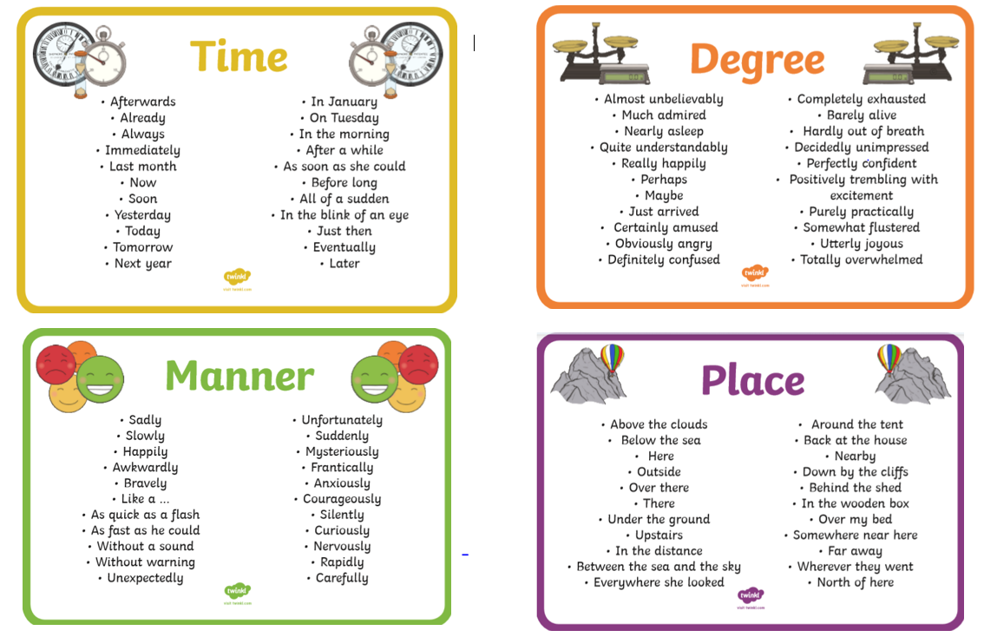

Slide 8
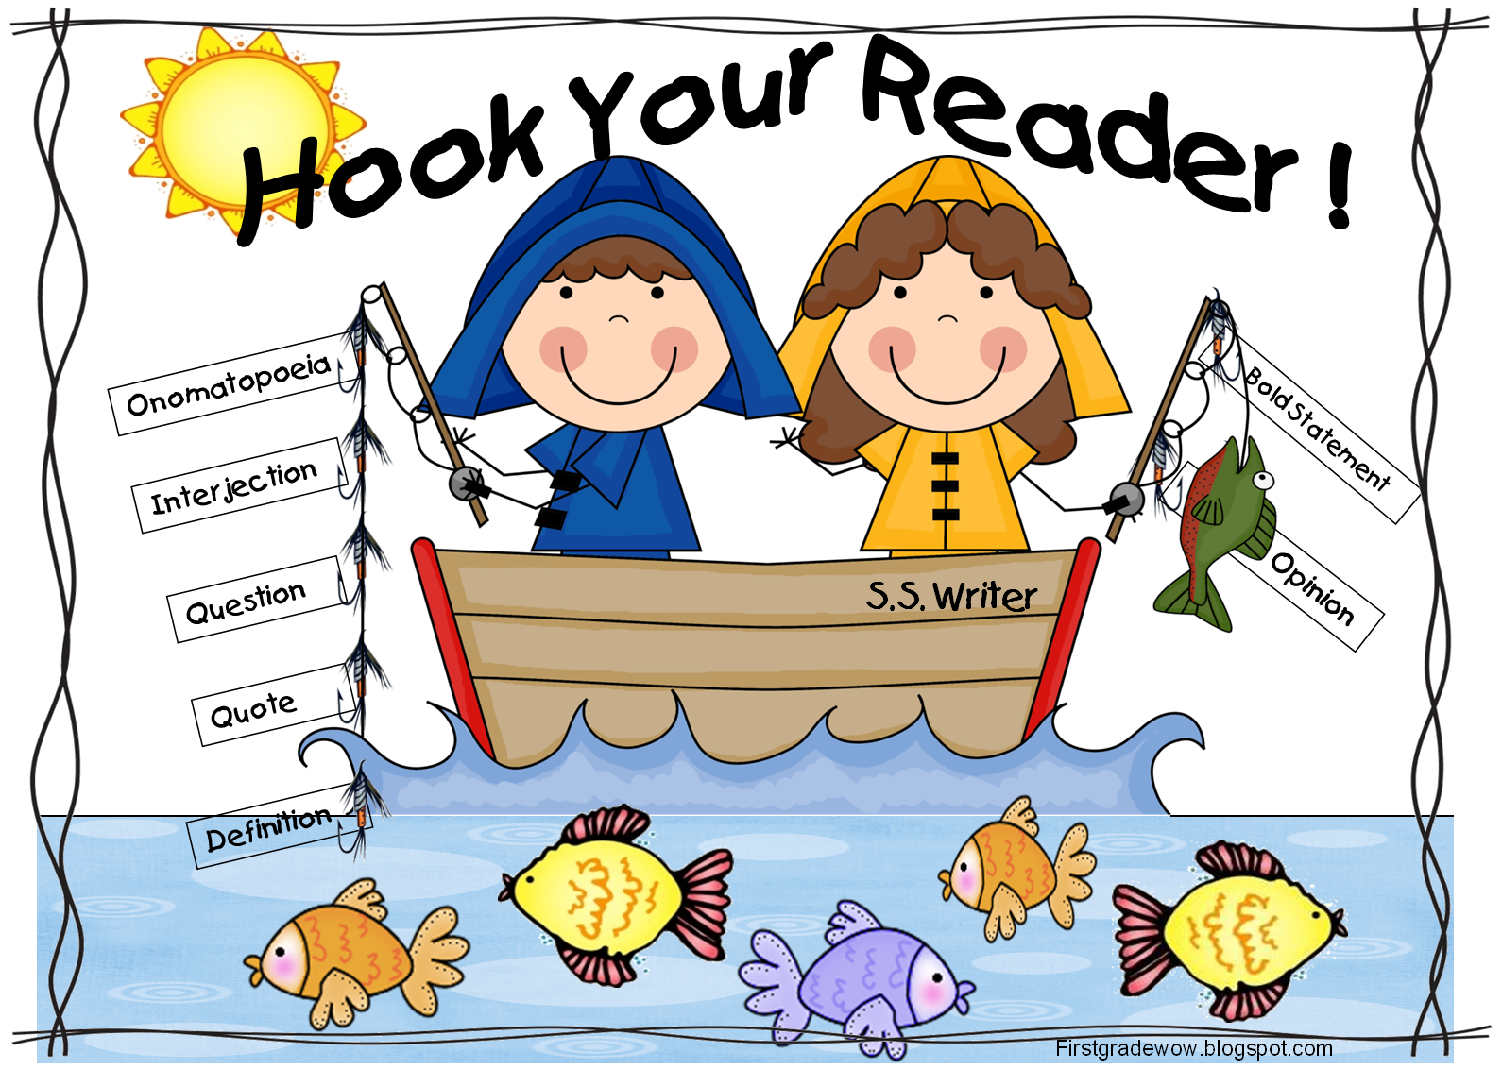

Slide 9
“Fire! Fire! Henry, rise quickly, the whole street is ablaze!” yelled his mother, Mistress Farthing. At once, Henry leapt off the shelf and pulled on his britches and rough, filthy shirt. He was by his anxious mother’s side in moments. “Haste,” she cried pushing a bundle of hastily gathered possessions towards him. “We must away, the baker’s and the rest of Pudding Lane is on fire! Thomas Farrynor has done for us this time…”

Slide 10
Begin writing your story according to your plan. Include:
An exciting story opener
Information about your characters and setting
Adverbials of time/place to sequence your story
Dialogue
Historical details
Archaic language
A range of sentence structures and punctuation

