Slide 1
English Day 13
English day 13 – Thursday 28th January

Slide 2
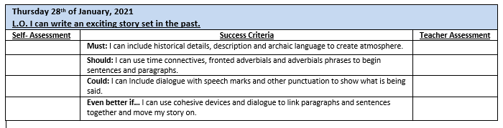

Slide 3
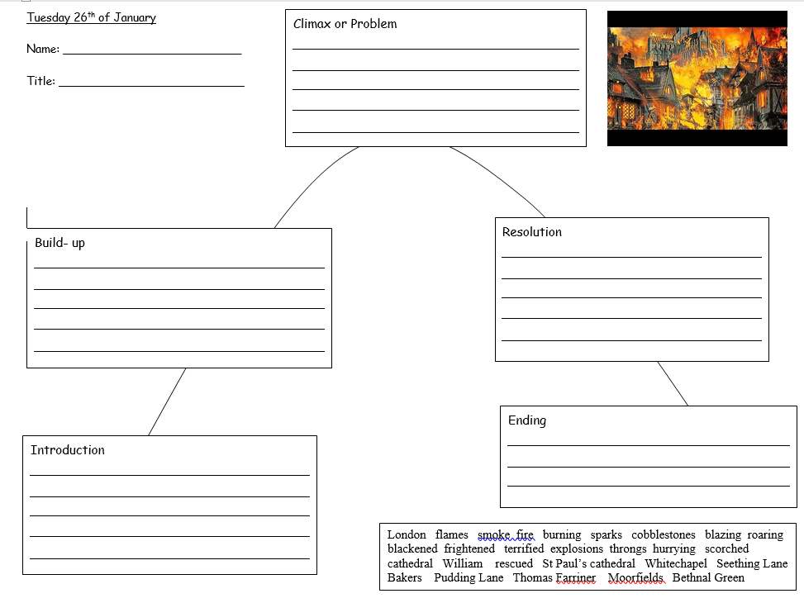

Slide 4
Build-up
Choking, Henry took his Mother’s arm and led her through the smoke-filled streets. Looking back, he could see the Pudding Lane and the surrounding streets were completely ablaze. Flames shot upwards into the dark night sky and sparks flew out in every direction. “Henry,” gasped his Mother. “I can go no further, I cannot catch my breath.”
“It is not far now Mother, we will be at the river soon. Come, let me take your bundle.” With that Henry thrust his Mother’s motley collection of rags and pans onto his shoulder and took her arm. Suddenly , she seemed old and frail…

Slide 5
Climax/problem
Immediately, William's father snatched his coat from the wooden peg and grabbed William's arm. Together they hastened towards the River Thames. Within moments, they stood upon the bank gazing in horror at the scene of destruction: the smouldering buildings; ash-darkened sky and the terrified people jumping into the Thames to flee the fire.
As quickly as he was able, Mr Turner launched his small wooden boat into the river and clambered down. William leapt after him. Rowing rapidly, they soon reached the other side of the Thames; to where the distraught people were waiting. At once, the boat was swamped, desperate hands grabbing on to what they could. “Help me!”, cried one woman, “please save the little ones.”

Slide 6
Continue to the end of your story…
Tell the reader what happens to the main characters and what’s changed.
Try to link the ending back to the beginning.

Slide 7
Continue with your story according to your plan. Include:
More information about your characters and setting – use your 5 senses
Adverbials of time/place to sequence your story
Dialogue
Historical details
Archaic language
A range of sentence structures and punctuation
Pace and action

