Slide 1
English 05.03.21
Exciting Writing Friday 5th of March, 2021

Slide 2
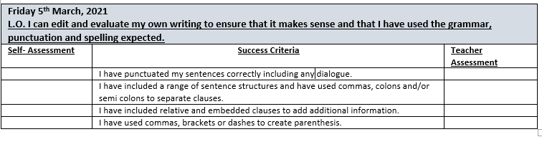

Slide 3
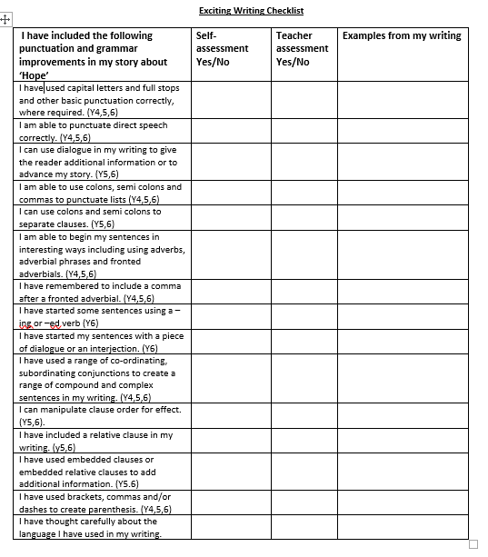
Checklist:
Use the checklist opposite to edit your story about ‘Hope’.
Hopefully you have tried to include the punctuation and grammar improvements that we’ve worked on.
Include examples from your writing.
Is there anything that you’ve forgotten to include?

Slide 4
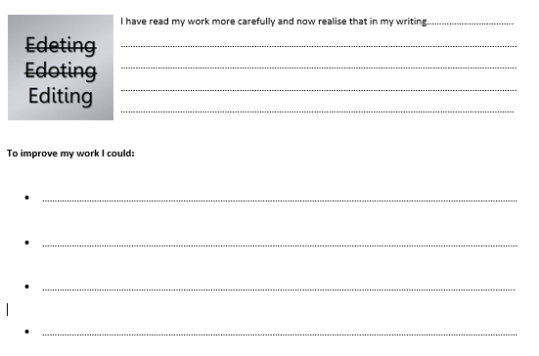
How could your writing be improved?
Complete the editing slip
suggesting ways in which your writing could be improved.
Edit your work to make the improvements you have suggested.
Edit as neatly as possible. Use an editing flap if needed.

